Slide 1

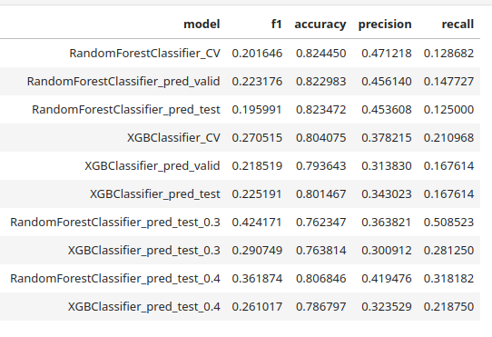
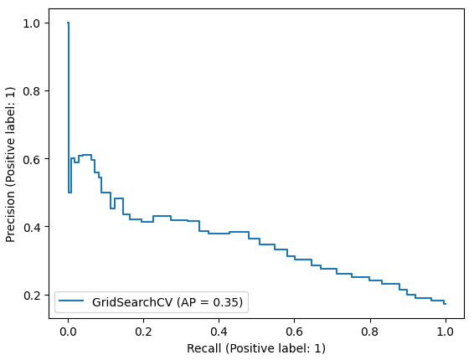
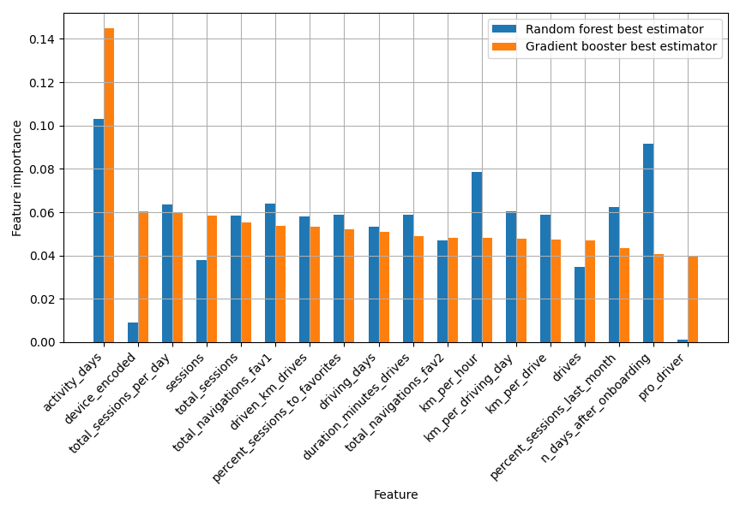
User Churn Project | Device Dependency: Hypothesis Testing
After modeling churning with a logistic regression (LG) algorithm, here we explore tree based models with aggregation: random forest (RF) and gradient boost machine (GBM).
Methodology
All features were used for modeling. New features were derived. The models were developed with sets: 60/20/20 for train/validation/test.
Models observations
Both models bring similar poor churn-prediction power: e.g 59 matches out of 352 for GBM
It is good at predicting retention: 1580 out of 1693
Models are not well explainable, specially GBM.
Most influential feature is activity_days for both models. This was also the case for LG. Further feature importances are discrepant between models.
Further tuning with probability threshold set to 0.4 improves FN effects notably for RF. RF also has a better precision-recall curve than GBM
Next Steps
Get more data: long term, new features: geolocation, etc.
Clarify meaning of some features: session vs. navigation: no clear definition
Perform PCA for feature selection

