Slide 1
Analyse Growth and Present Insights to the Telangana Government
Objectives:
Explore Stamp Registration, Transportation and Ts-Ipass Datasets.
Understand their attributes, categories and time period.
Analyze trends and patterns within each department.
Identify growth opportunities and areas needing attention.

Slide 2
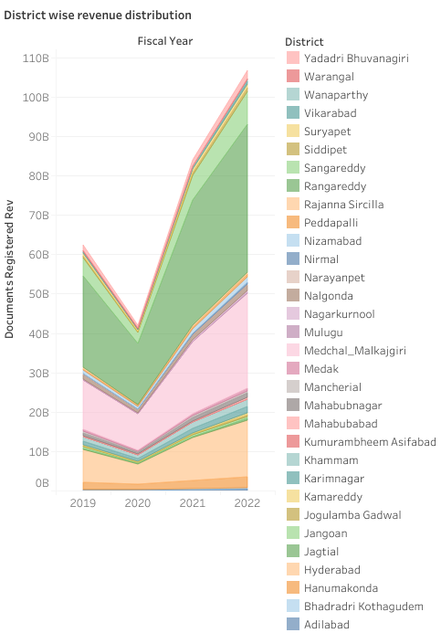
How does the revenue generated from document registration vary across districts in Telangana?

Slide 3
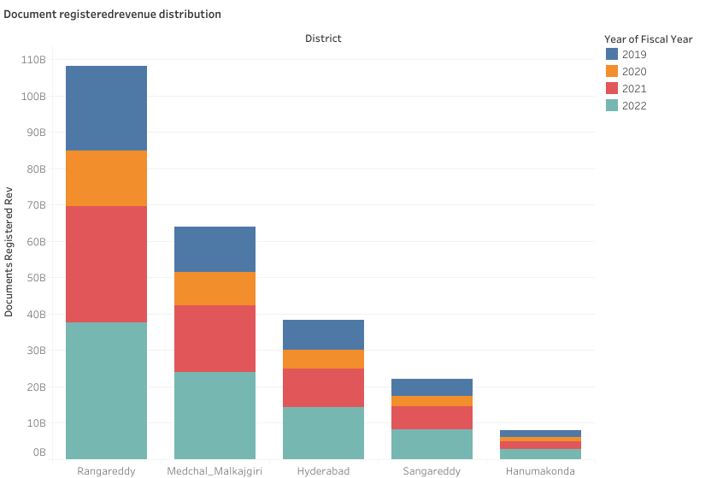
List down the top 5 districts that showed the highest document registration revenue growth between FY 2019 and 2022.?

Slide 4
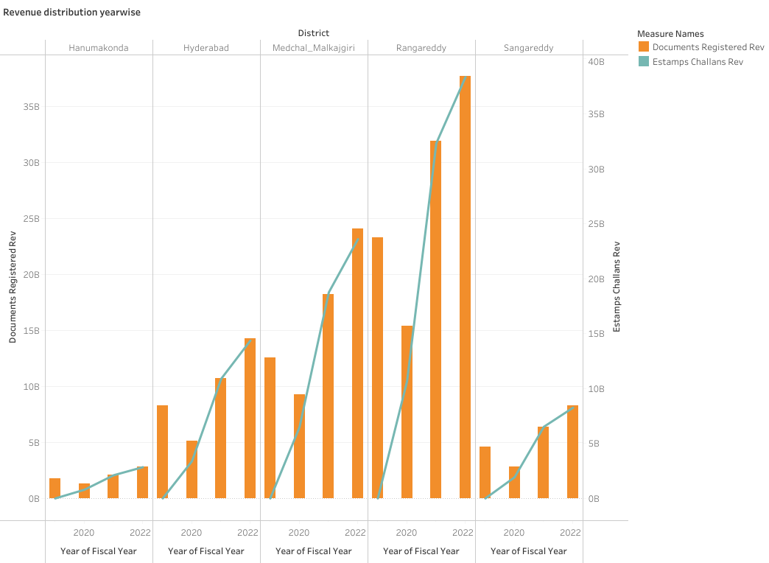
Revenue Distribution

Slide 5
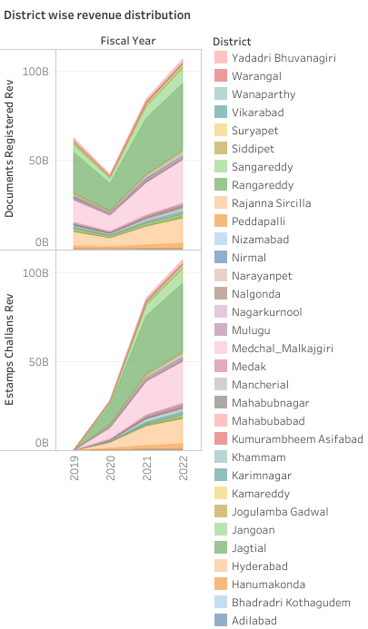
How does the revenue generated from document registration compare to the revenue generated from e-stamp challans across districts? List down the top 5 districts where e-stamps revenue contributes significantly more to the revenue than the documents in FY 2022?

Slide 6
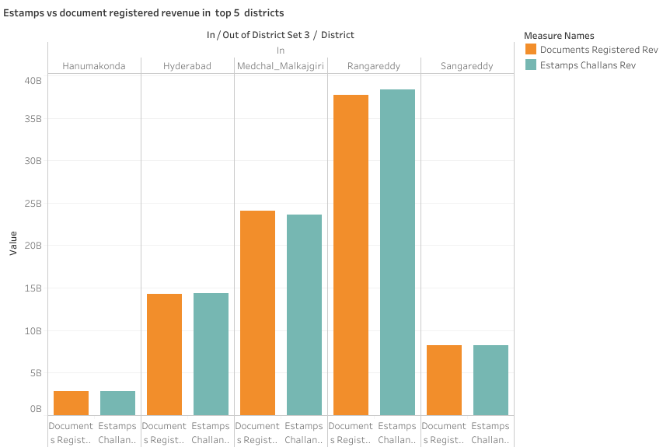

Slide 7
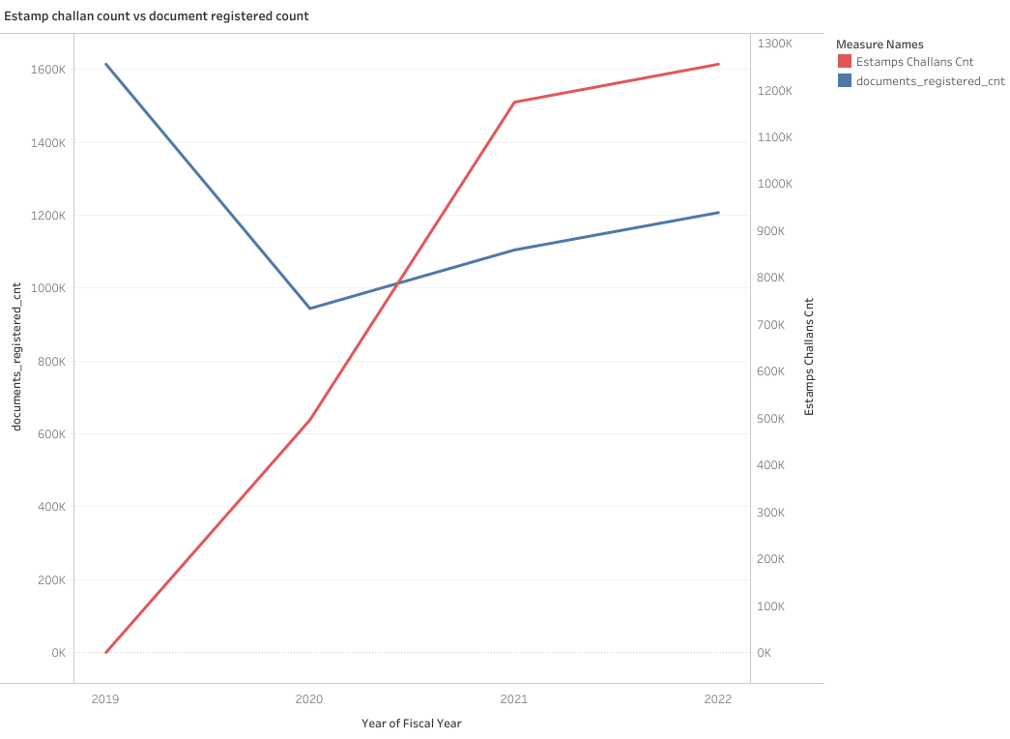
Is there any alteration of e-Stamp challan count and document registration count pattern since the implementation of e-Stamp challan?

Slide 8
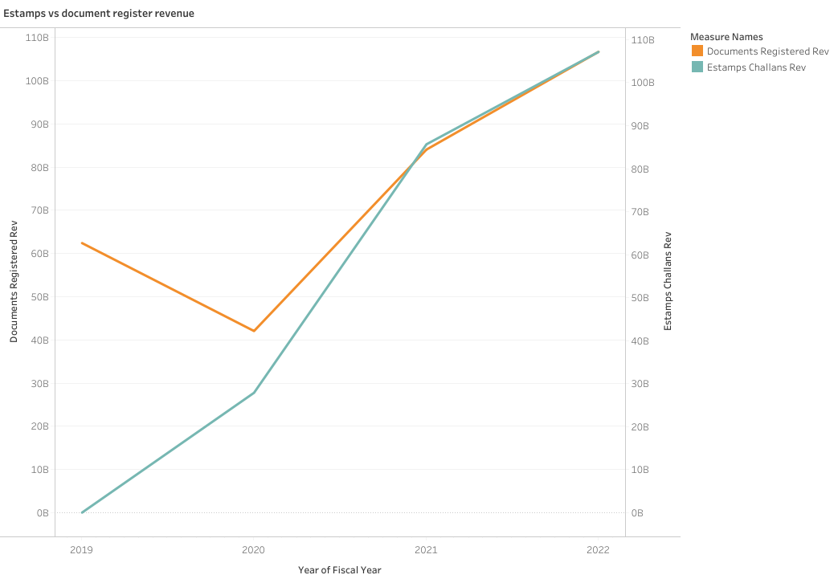

Slide 9
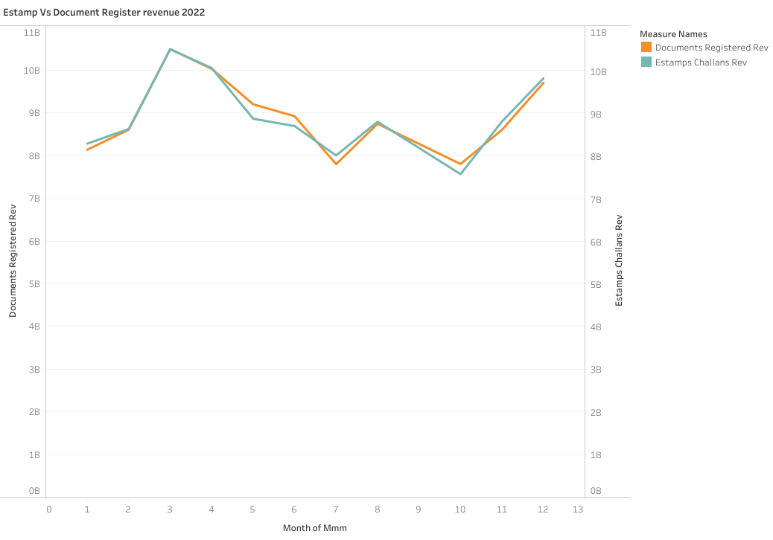

Slide 10
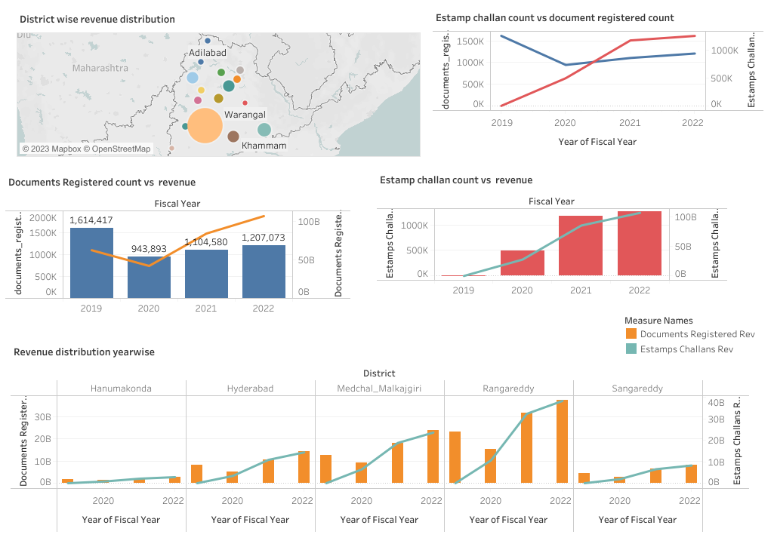

Slide 11
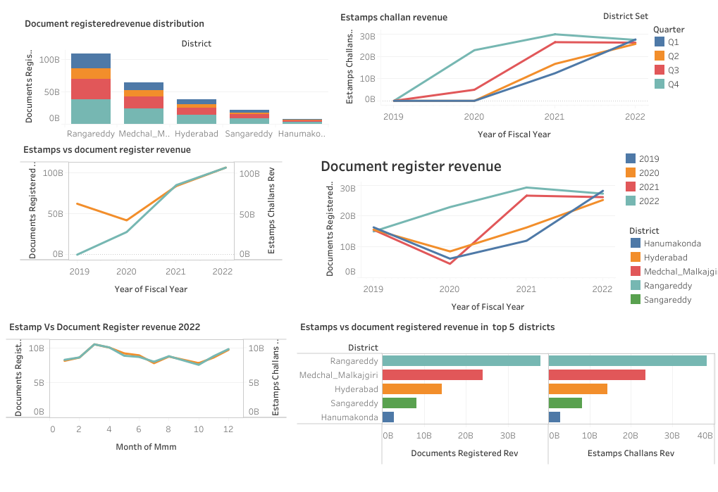

Slide 12
Insights(Revenue)
Ranga Reddy, Medchal Malkajgiri, Hyderabad, Sangareddy,
Hanamkonda have maximum revenue(document registered).
Estamps registration has increased from year 2019 to 2022.
Decrease in counts of document registered challan has been seen in graph from 2019 to 2022 but it has not affected revenue collection.
The graph showing revenue collected by estamp and document registered is almost equal.
Though document registered counts have been decreased but there is increase in document registered revenue.

Slide 13
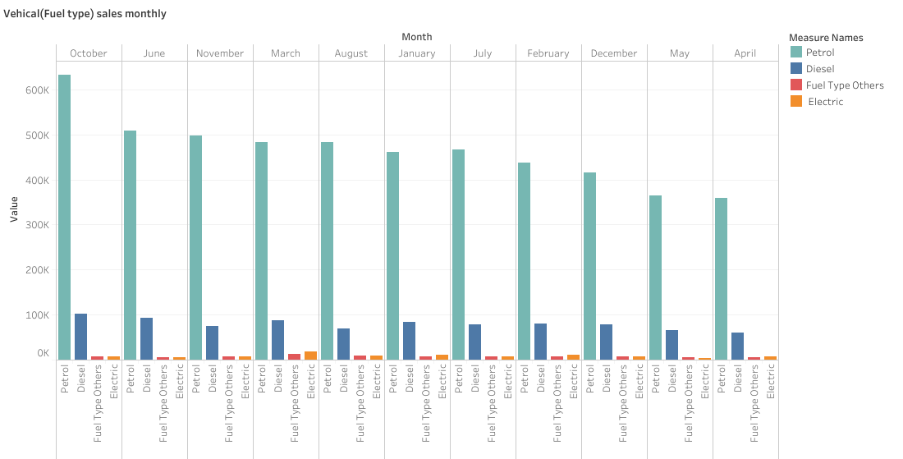
Investigate whether there is any correlation between vehicle sales and specific months or seasons in different districts. Are there any months or seasons that consistently show higher or lower sales rate, and if yes, what could be the driving factors? (Consider Fuel-Type category only)

Slide 14
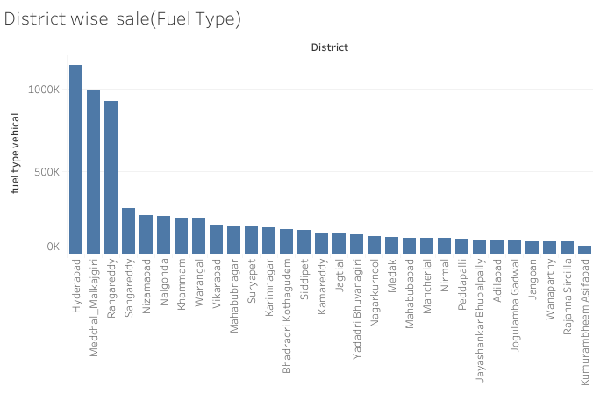

Slide 15
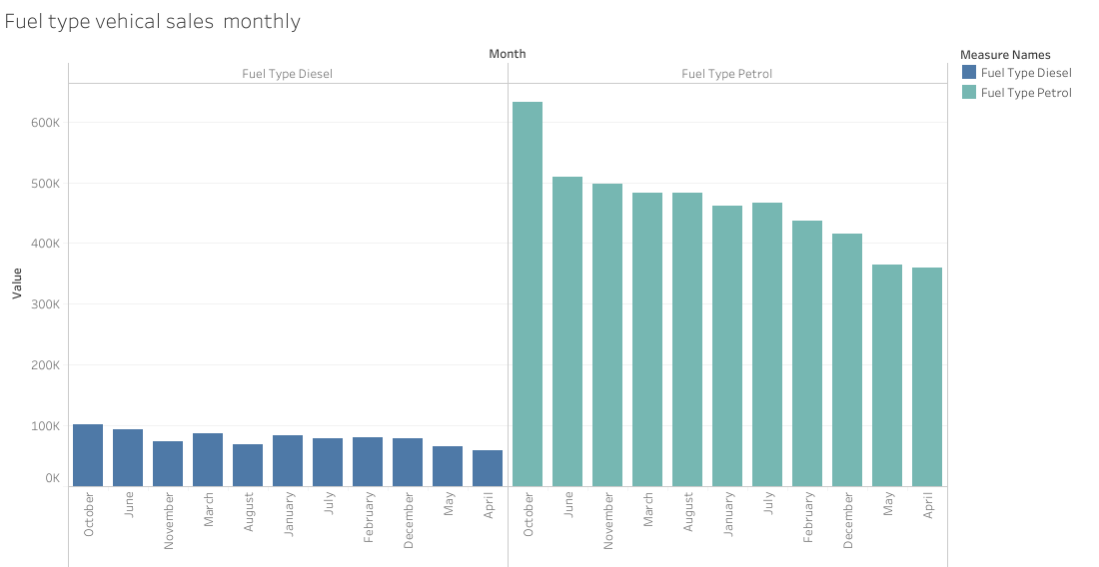

Slide 16
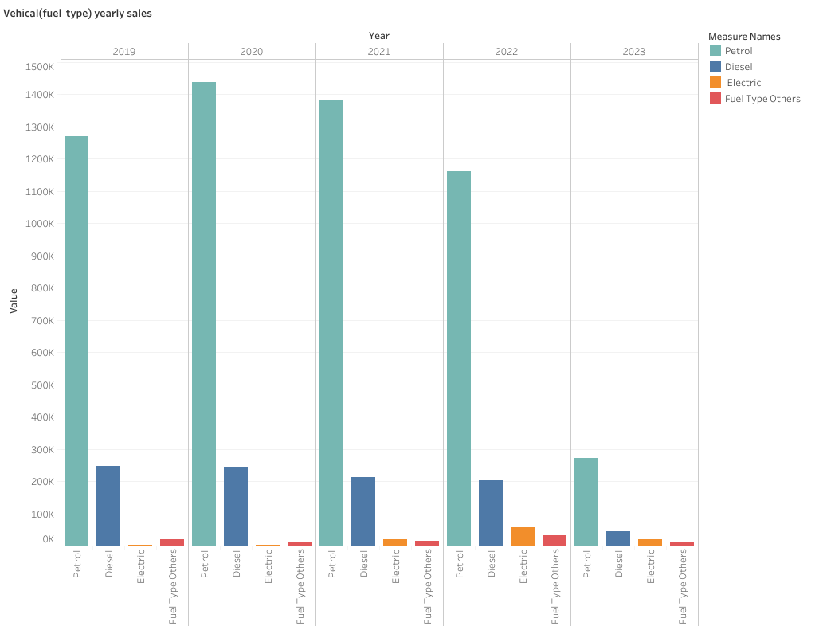

Slide 17
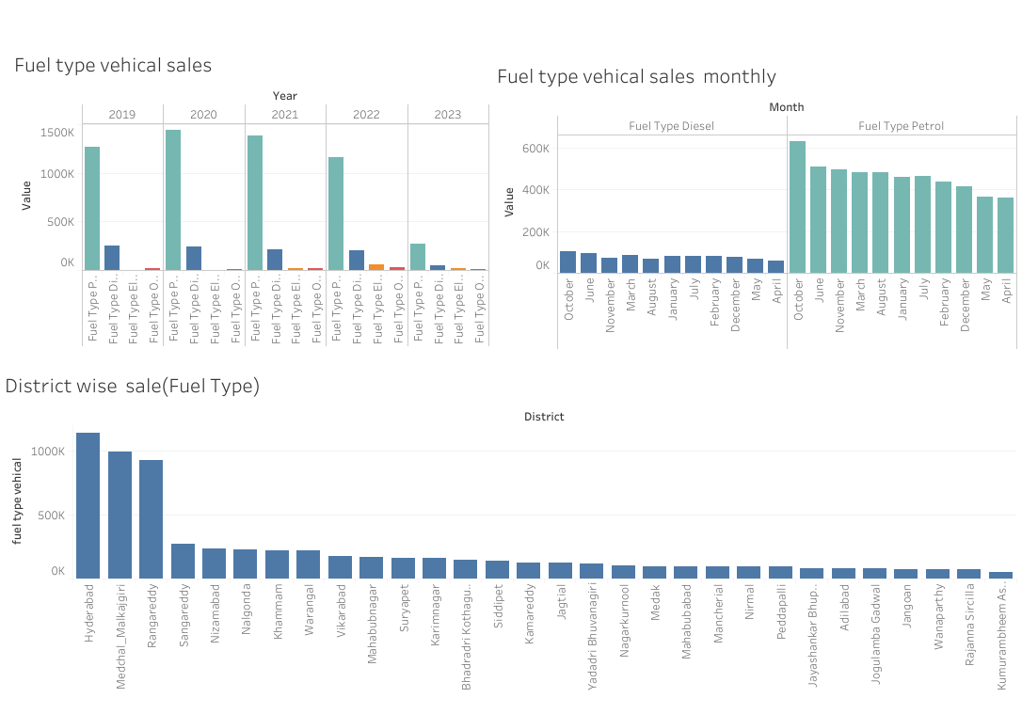

Slide 18
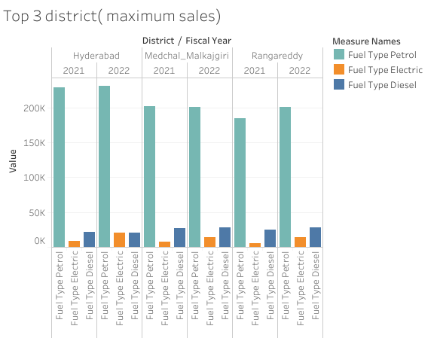
List down the top 3 and bottom 3 districts that have shown the highest and lowest vehicle sales growth during FY 2022 compared to FY 2021? (Consider and compare categories: Petrol, Diesel and Electric)

Slide 19
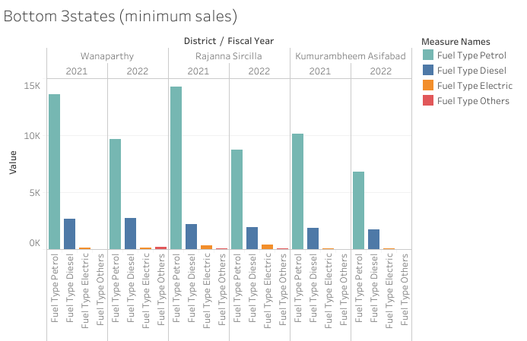

Slide 20
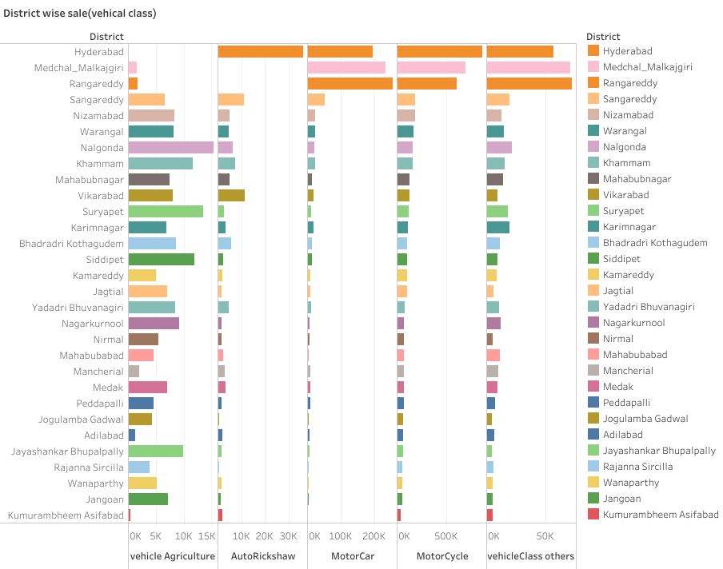
How does the distribution of vehicles vary by vehicle class (MotorCycle, MotorCar, AutoRickshaw, Agriculture) across different districts? Are there any districts with a preference for a specific vehicle class? Consider FY 2022 for analysis.

Slide 21
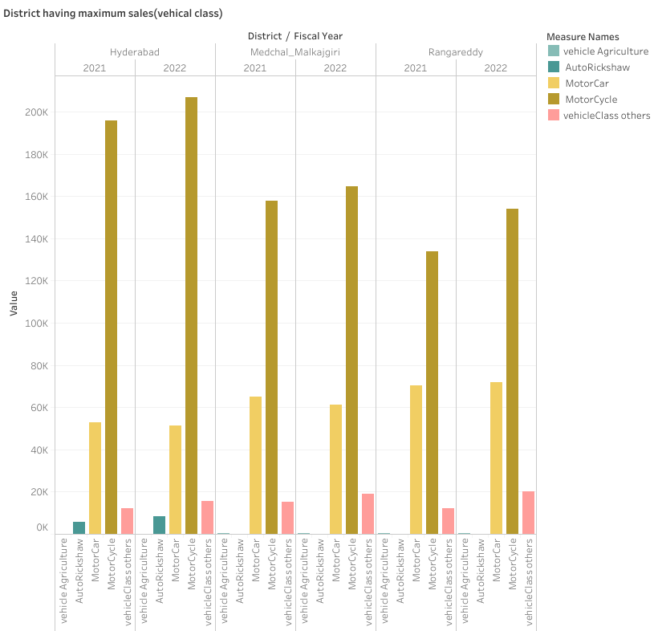

Slide 22
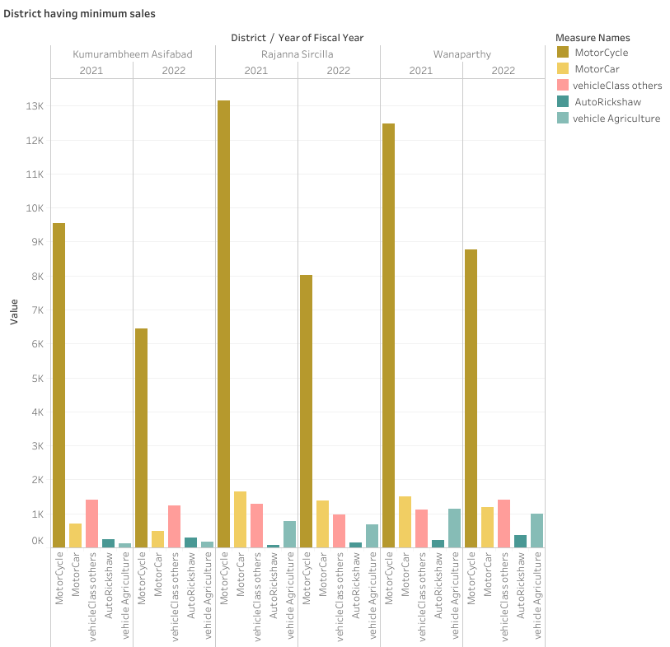

Slide 23
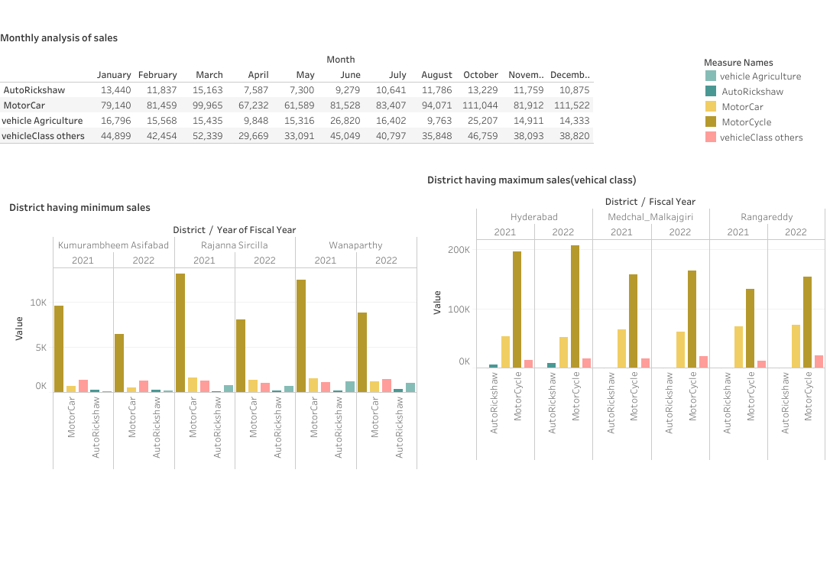

Slide 24
Insights(transport)
Petrol and diesel vehicle are sold most.
October,June, November ,March have maximum sales .
Hyderabad, Medchal Malkajgiri, Rangareddy, Sangareddy ,Nizamabaad are the districts where maximum sales happened.
Wanaparthy, Rajanna Sircilla , Komaram Bheem Asifabad has minimum sales.
Motor cycles and motor car are maximum sold vehicles.
Auto Riksha, motor car, motor cycles are sold maximum in Hyderabad.
Vehicle(agriculture )are sold maximum in Nalgonda.

Slide 25
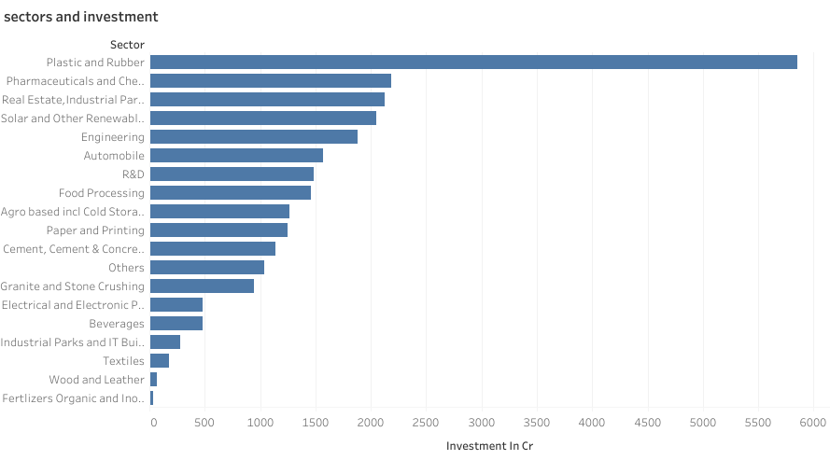
List down the top 5 sectors that have witnessed the most significant investments in FY 2022.

Slide 26
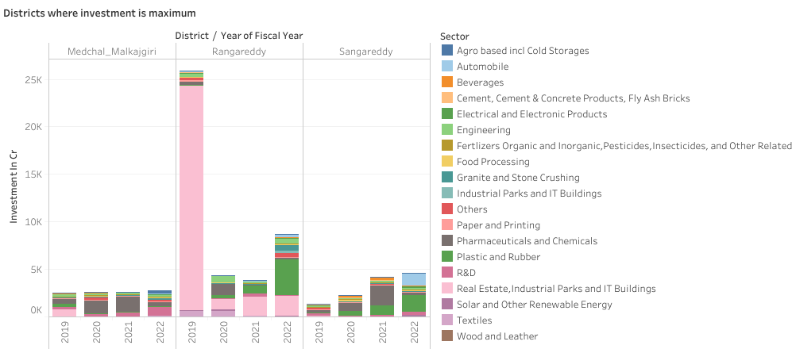
List down the top 3 districts that have attracted the most significant sector investments during FY 2019 to 2022? What factors could have led to the substantial investments in these particular districts?

Slide 27
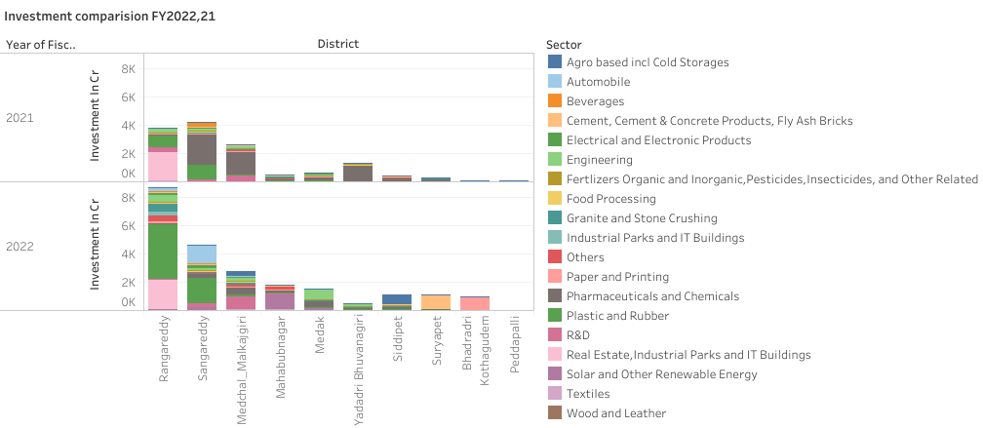
Are there any particular sectors that have shown substantial investment in multiple districts between FY 2021 and 2022?

Slide 28
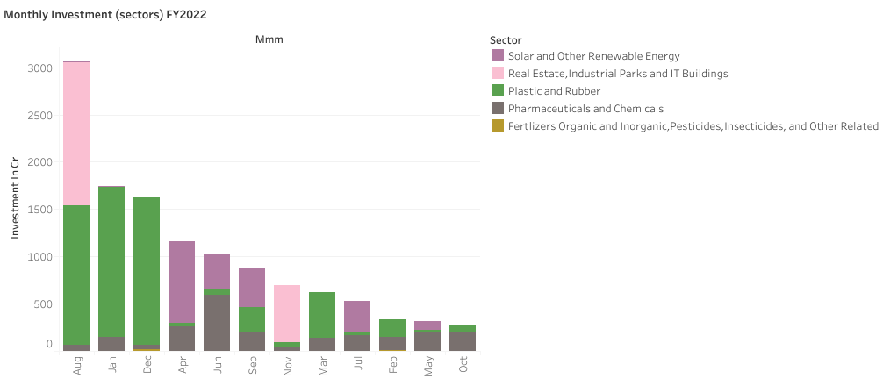
Can we identify any seasonal patterns or cyclicality in the investment trends for specific sectors?Do certain sectors experience higher investments during particular months?

Slide 29
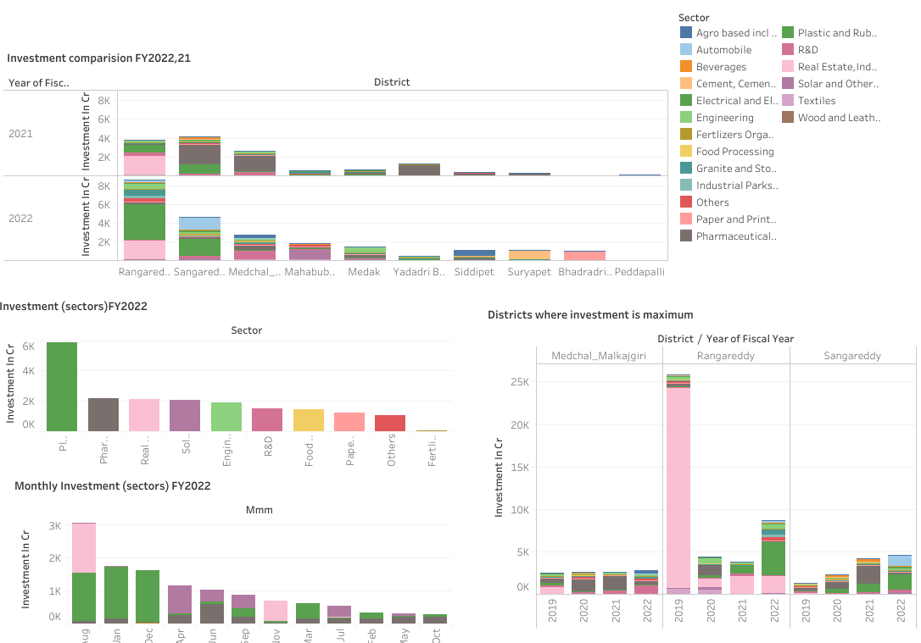

Slide 30
Insights (Investment)
Real estates and plastics are major sectors for investment in FY2022
In Rangareddy FY2019 real estates sector were maximum, but in 2022 plastics has made its place.
Rangareddy,Sangareddy, Medchal Malkajgiri are major district for investment where main sectors are real estates, plastics and pharmaceuticals
In August and November real estate sector ,plastics sectors are at maximum in January and December , April and June solar and other renewable energy sector are at boom.
In some districts automobile sector has been developed in FY2022.

