Slide 1
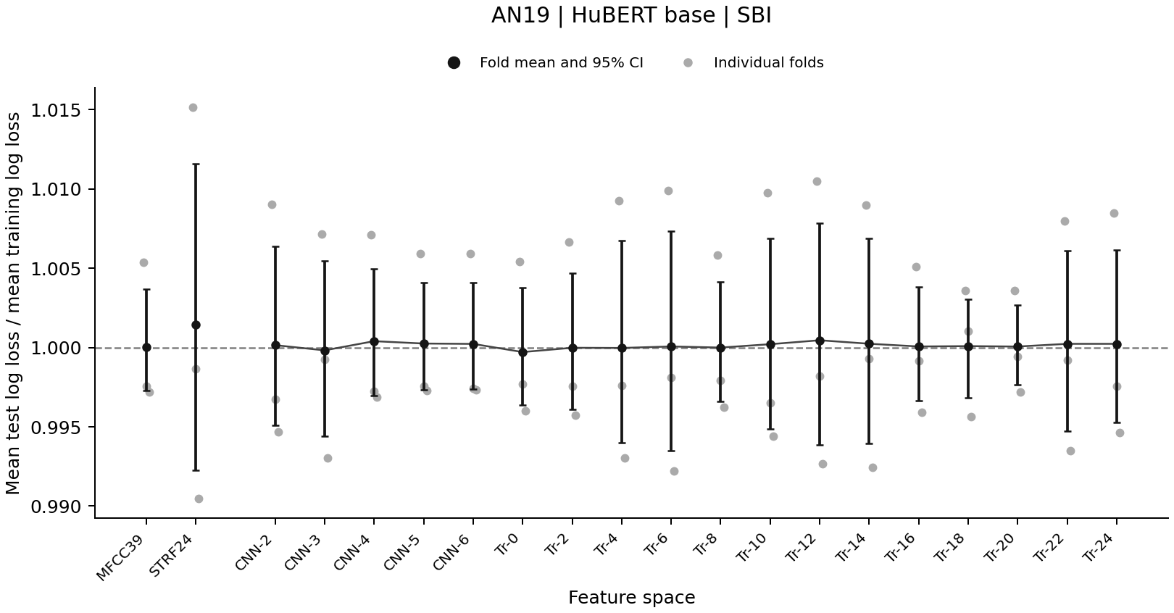
Notes:
Source: cross_talker_generalization/analysis_update_2026-09-17/si_diagnostics/figures/AN19_SBI_base_similarity_all_participants_test_train_ratio.png
Each point shows a participant-held-out fold. Black markers show three-fold means with descriptive 95% fold-bootstrap intervals. The horizontal line marks equal training and test mean log loss. Scores use the same training-fitted model and frozen scaling with random effects set to zero. These plots use the existing fixed-distance predictor. A near-one mean does not establish absence of overfitting.
Interpretation: cross_talker_generalization/analysis_update_2026-09-18/sbi_diagnostic_review/README.md

Slide 2
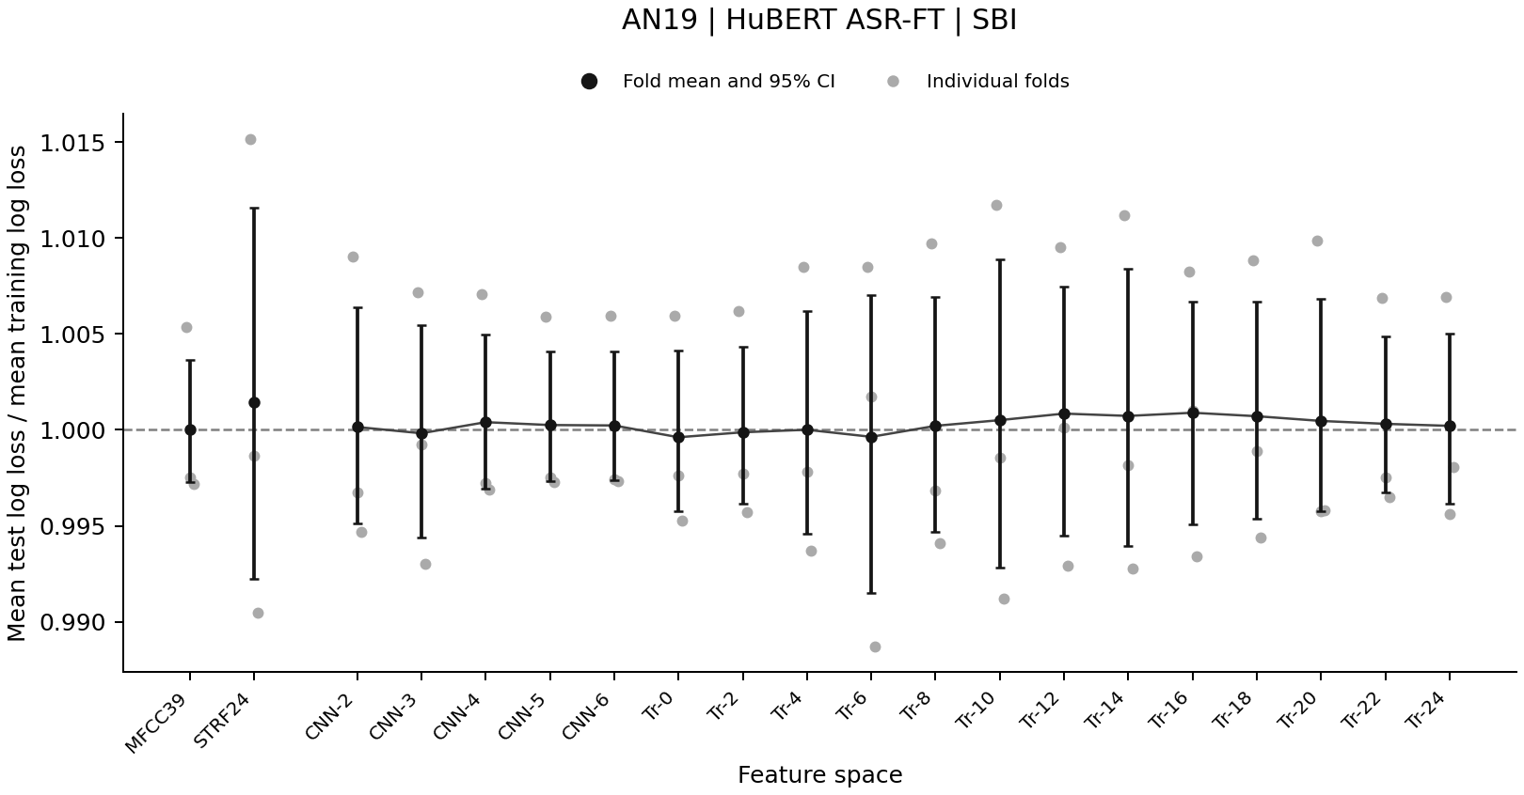
Notes:
Source: cross_talker_generalization/analysis_update_2026-09-17/si_diagnostics/figures/AN19_SBI_ft_similarity_all_participants_test_train_ratio.png
Each point shows a participant-held-out fold. Black markers show three-fold means with descriptive 95% fold-bootstrap intervals. The horizontal line marks equal training and test mean log loss. Scores use the same training-fitted model and frozen scaling with random effects set to zero. These plots use the existing fixed-distance predictor. A near-one mean does not establish absence of overfitting.
Interpretation: cross_talker_generalization/analysis_update_2026-09-18/sbi_diagnostic_review/README.md

Slide 3
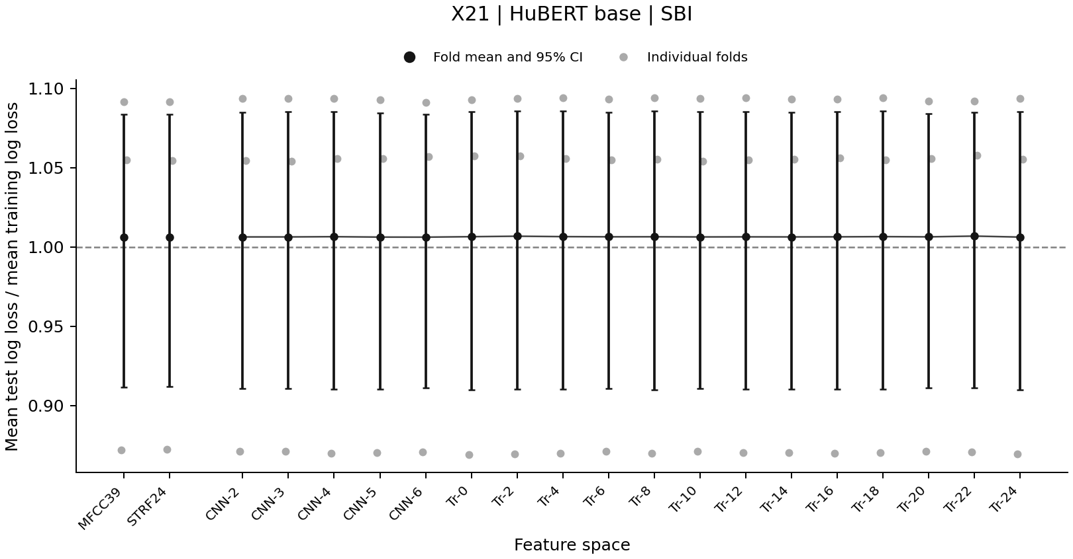
Notes:
Source: cross_talker_generalization/analysis_update_2026-09-17/si_diagnostics/figures/X21_SBI_base_similarity_all_participants_test_train_ratio.png
Each point shows a participant-held-out fold. Black markers show three-fold means with descriptive 95% fold-bootstrap intervals. The horizontal line marks equal training and test mean log loss. Scores use the same training-fitted model and frozen scaling with random effects set to zero. These plots use the existing fixed-distance predictor. A near-one mean does not establish absence of overfitting.
Interpretation: cross_talker_generalization/analysis_update_2026-09-18/sbi_diagnostic_review/README.md

Slide 4
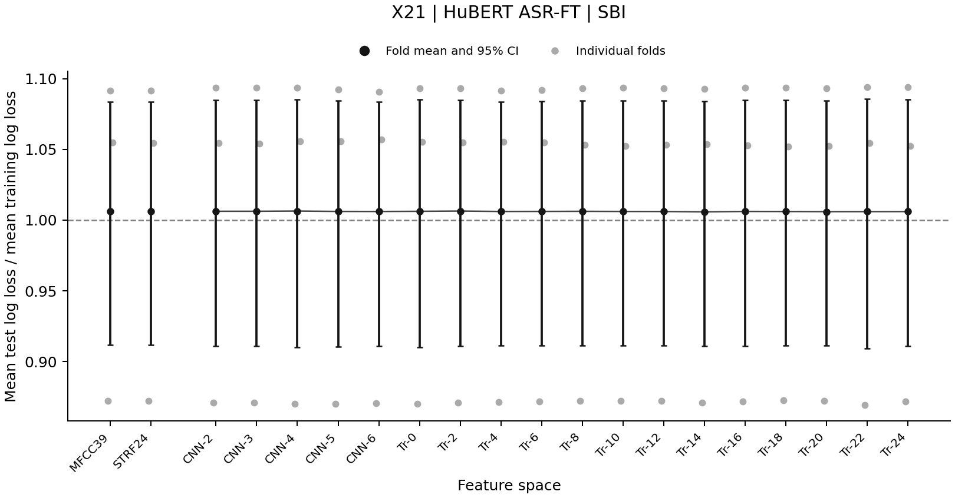
Notes:
Source: cross_talker_generalization/analysis_update_2026-09-17/si_diagnostics/figures/X21_SBI_ft_similarity_all_participants_test_train_ratio.png
Each point shows a participant-held-out fold. Black markers show three-fold means with descriptive 95% fold-bootstrap intervals. The horizontal line marks equal training and test mean log loss. Scores use the same training-fitted model and frozen scaling with random effects set to zero. These plots use the existing fixed-distance predictor. A near-one mean does not establish absence of overfitting.
Interpretation: cross_talker_generalization/analysis_update_2026-09-18/sbi_diagnostic_review/README.md

Slide 5
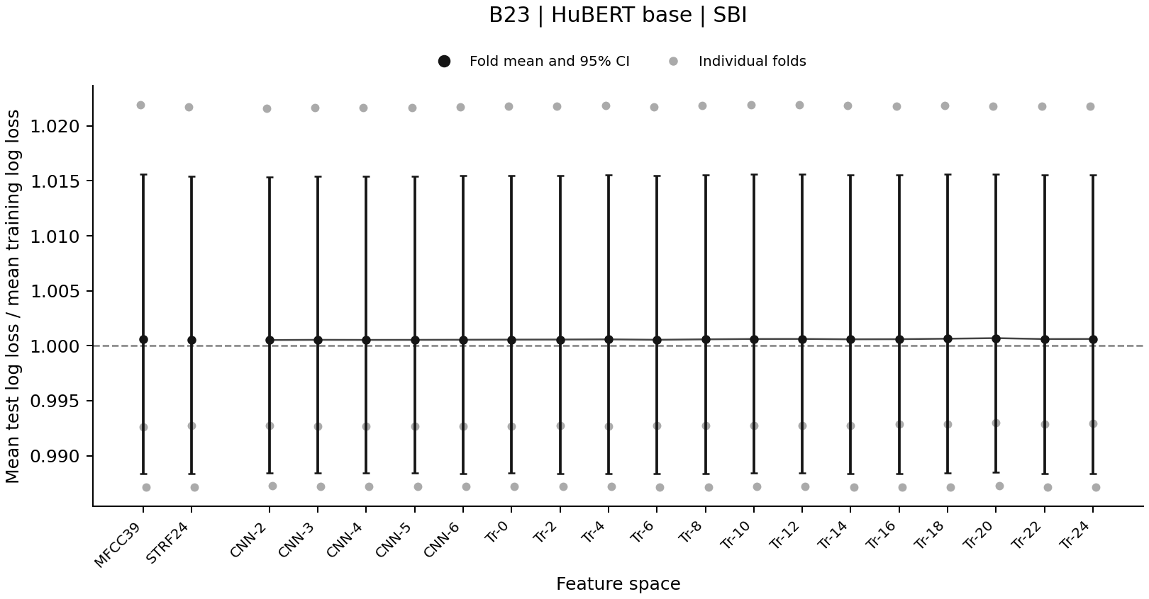
Notes:
Source: cross_talker_generalization/analysis_update_2026-09-17/si_diagnostics/figures/B23_SBI_base_similarity_all_participants_test_train_ratio.png
Each point shows a participant-held-out fold. Black markers show three-fold means with descriptive 95% fold-bootstrap intervals. The horizontal line marks equal training and test mean log loss. Scores use the same training-fitted model and frozen scaling with random effects set to zero. These plots use the existing fixed-distance predictor. A near-one mean does not establish absence of overfitting.
Interpretation: cross_talker_generalization/analysis_update_2026-09-18/sbi_diagnostic_review/README.md

Slide 6
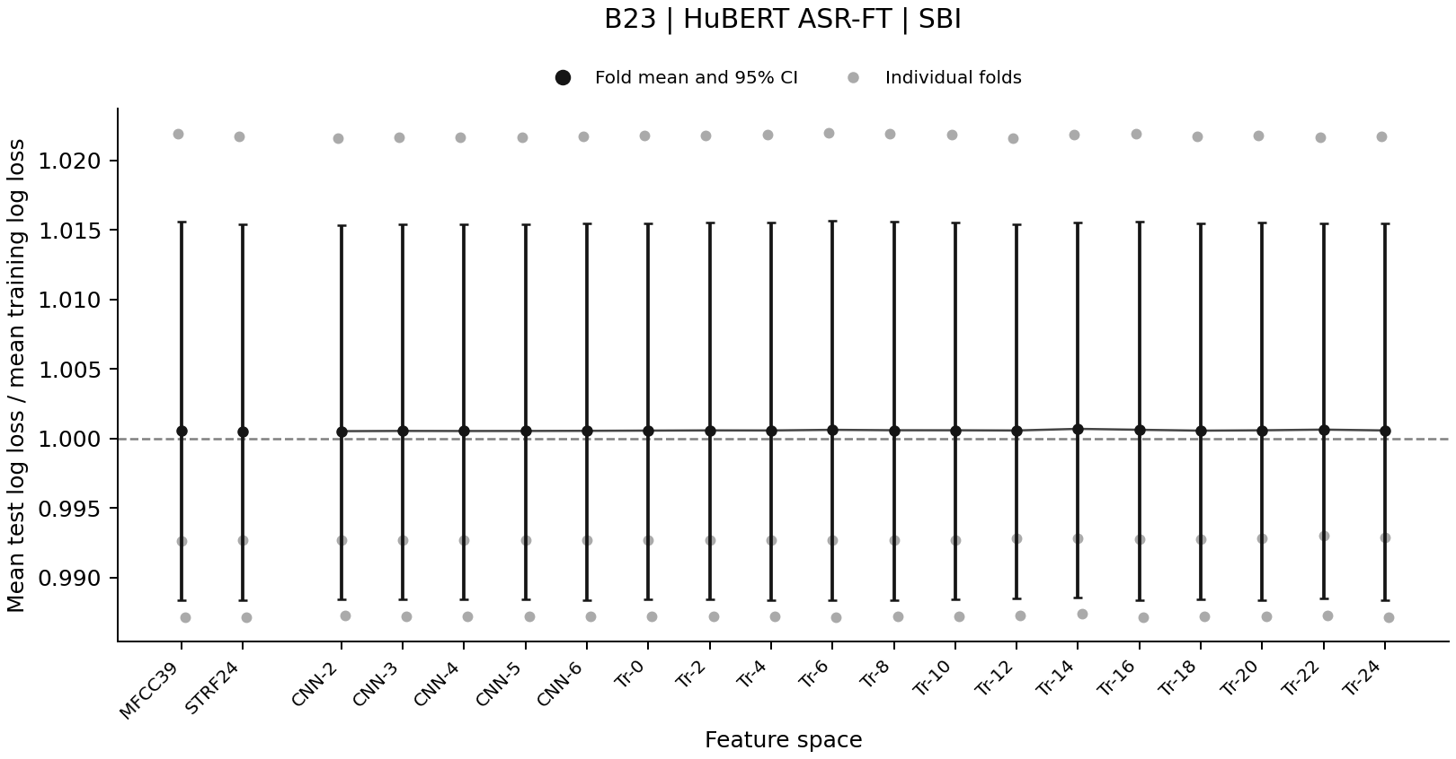
Notes:
Source: cross_talker_generalization/analysis_update_2026-09-17/si_diagnostics/figures/B23_SBI_ft_similarity_all_participants_test_train_ratio.png
Each point shows a participant-held-out fold. Black markers show three-fold means with descriptive 95% fold-bootstrap intervals. The horizontal line marks equal training and test mean log loss. Scores use the same training-fitted model and frozen scaling with random effects set to zero. These plots use the existing fixed-distance predictor. A near-one mean does not establish absence of overfitting.
Interpretation: cross_talker_generalization/analysis_update_2026-09-18/sbi_diagnostic_review/README.md

