Slide 1
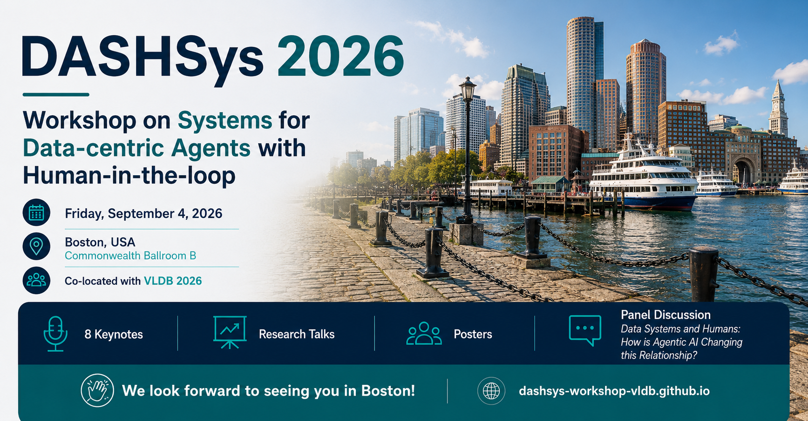

Slide 2
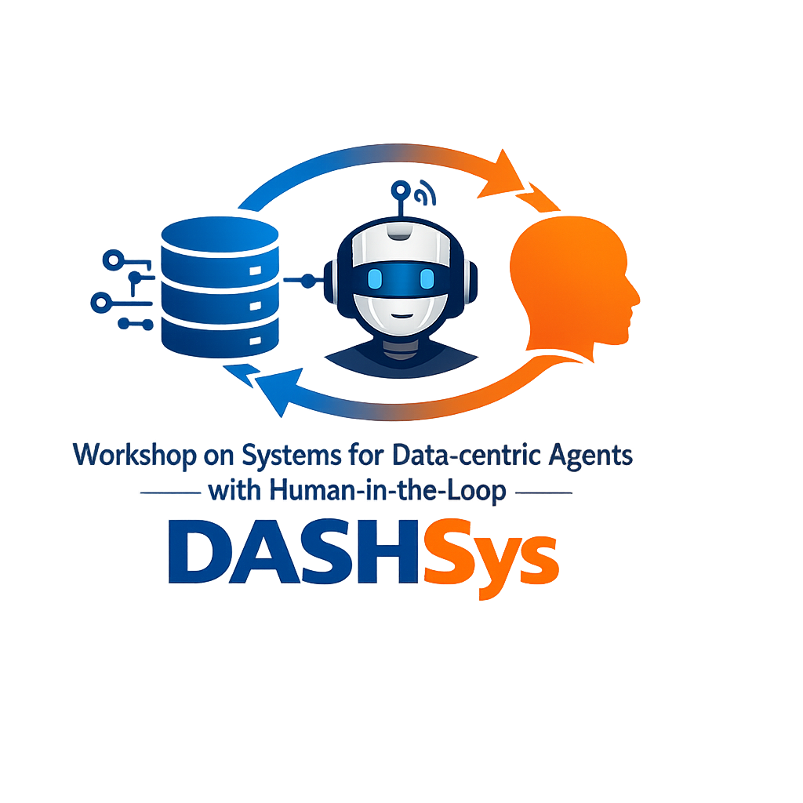

DASHSys: First Edition
DAIS - Data and AI Systems (2nd Edition)
DAAS - Data Management for Agentic AI Systems
DASH - Data Systems with Human-in-the-loop AI (7th Edition)
Sponsored by:

Slide 3

Organizers

Slide 4
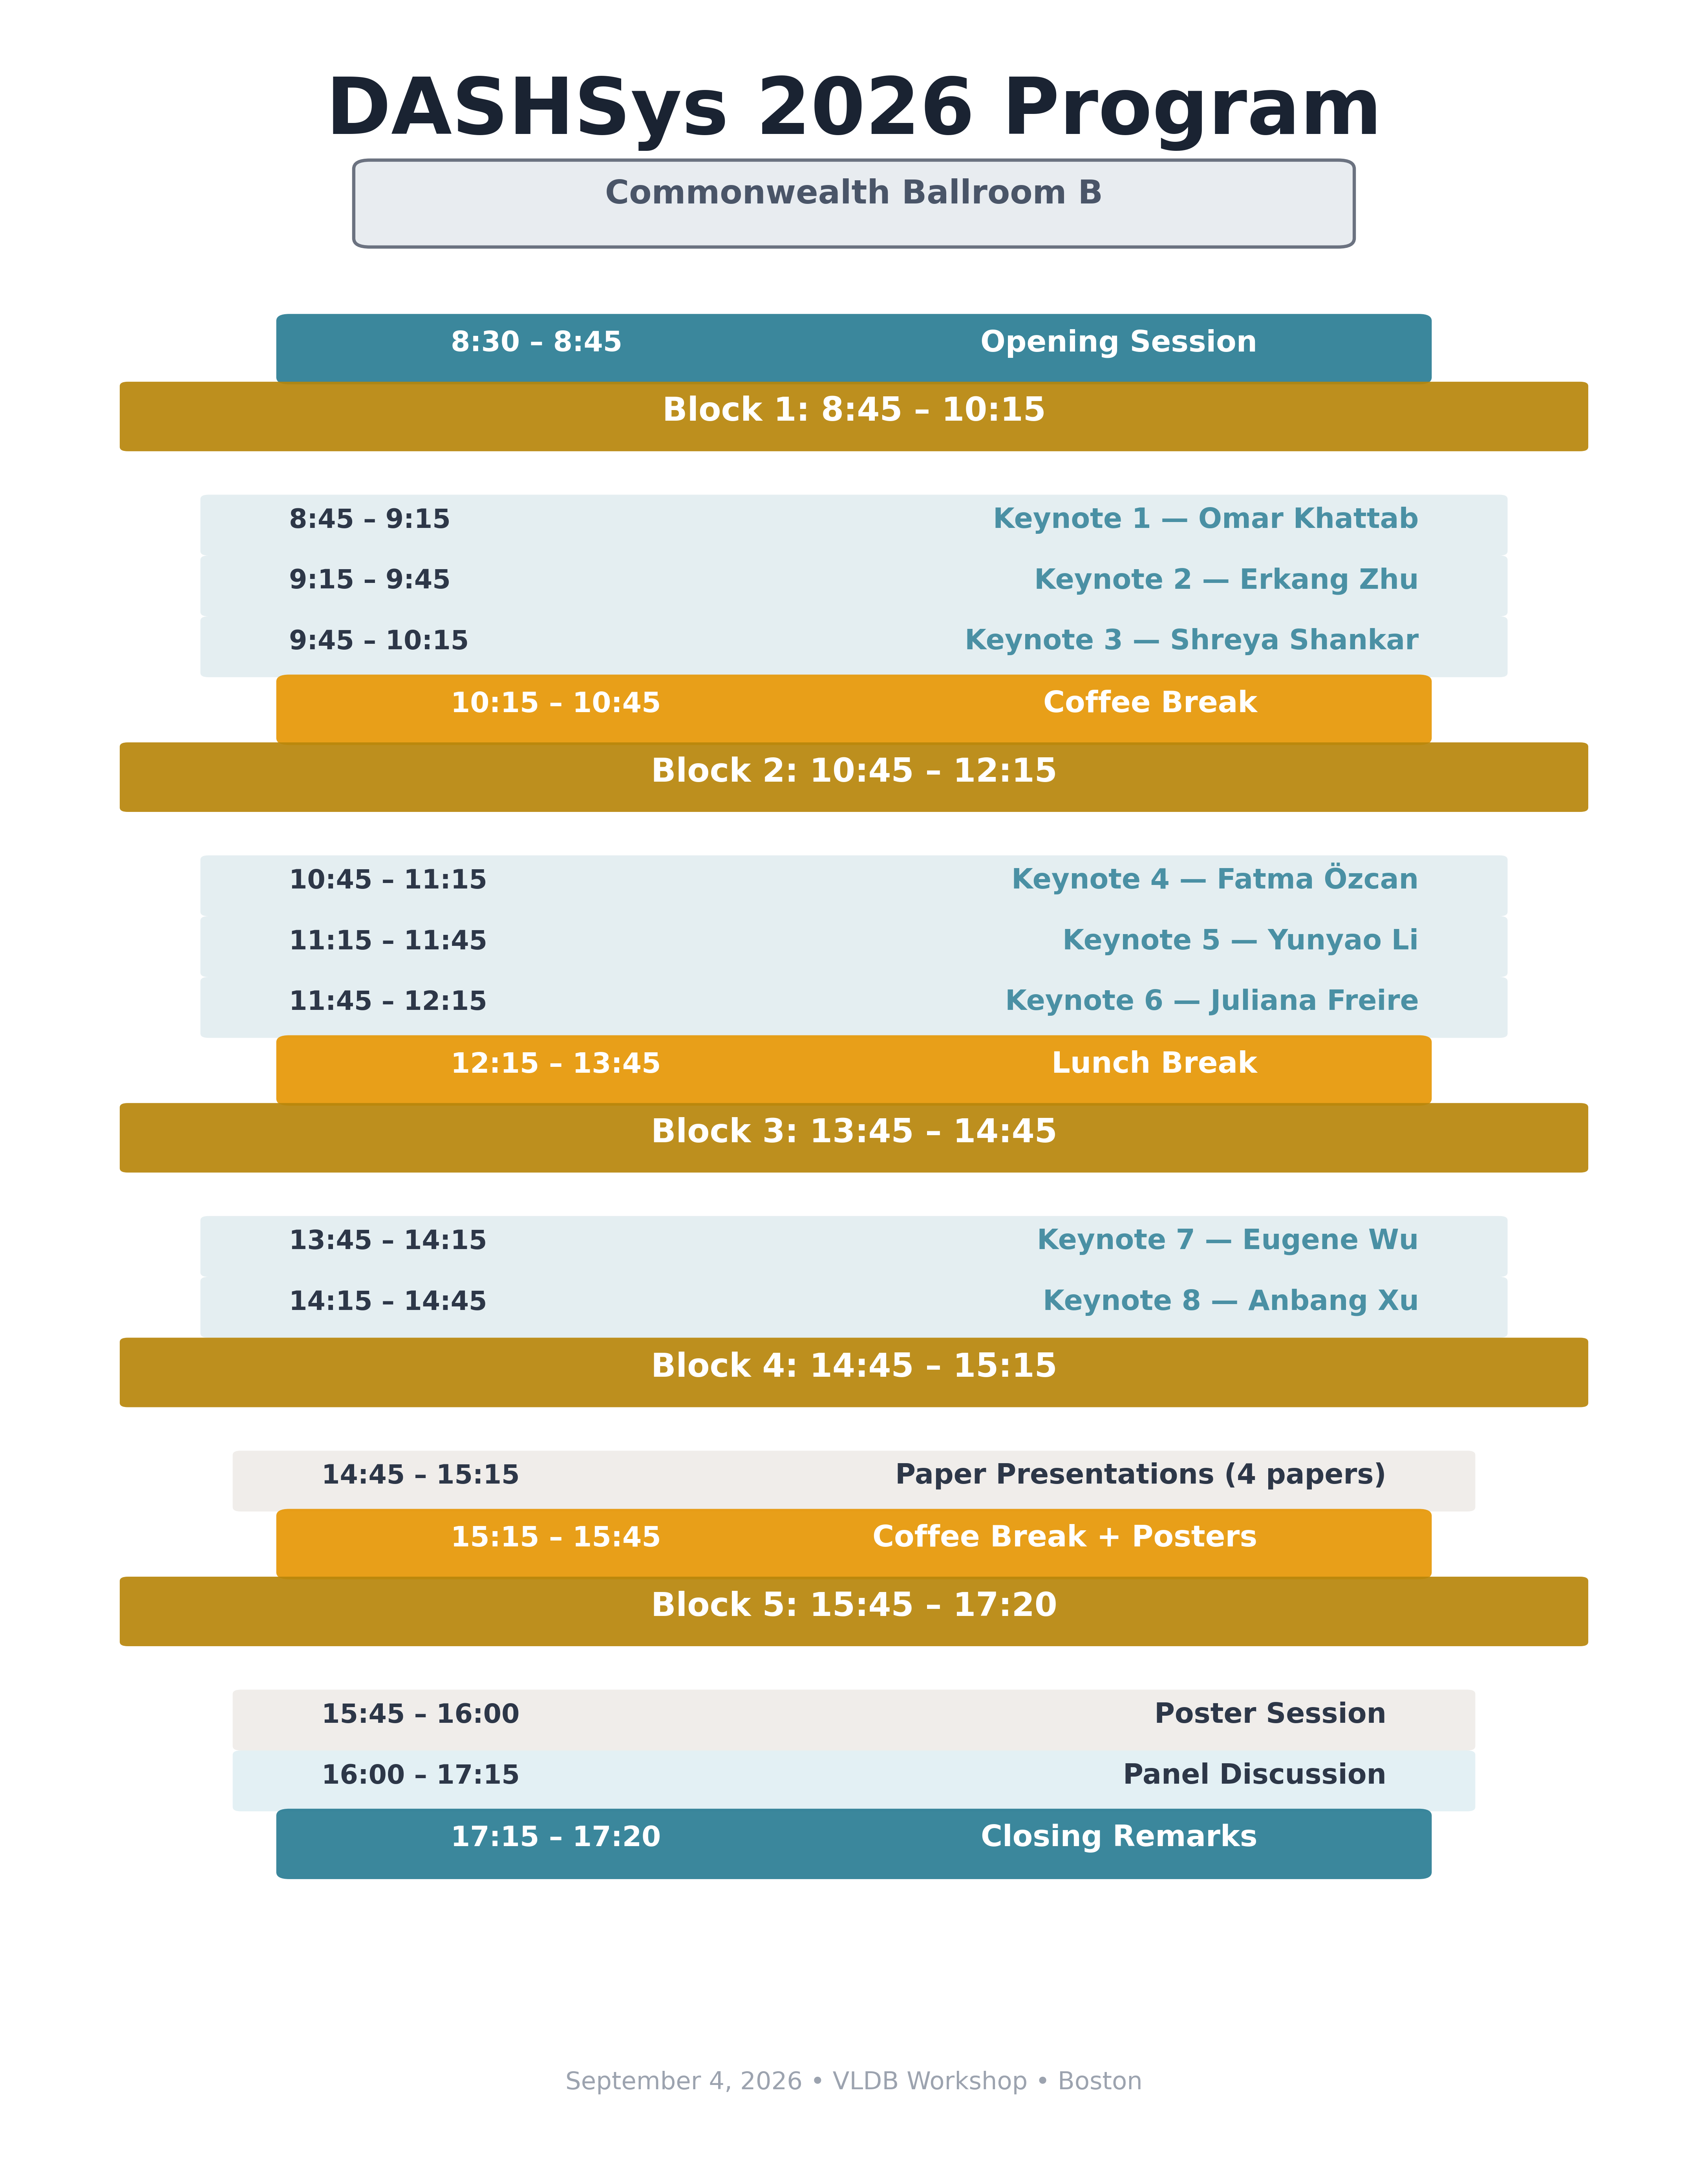

Slide 5
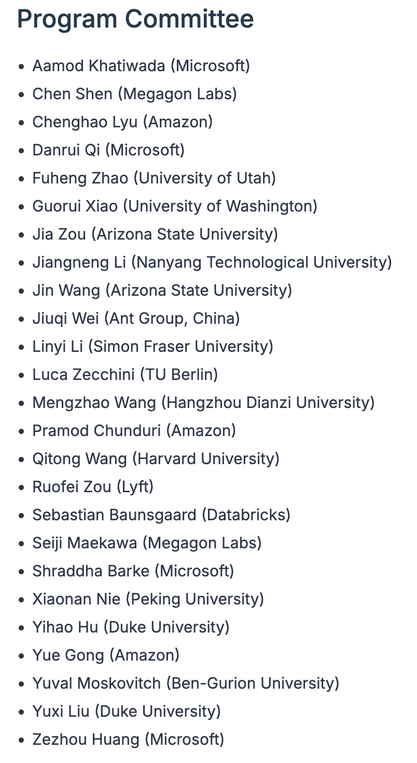
DASHSys By the Numbers
35 Total submission
Regular Track: 23 papers
4 long papers, 8 posters
System Track: 12 agents
1st Place: IBM Research Zurich
2nd Place: Princeton University

Slide 6
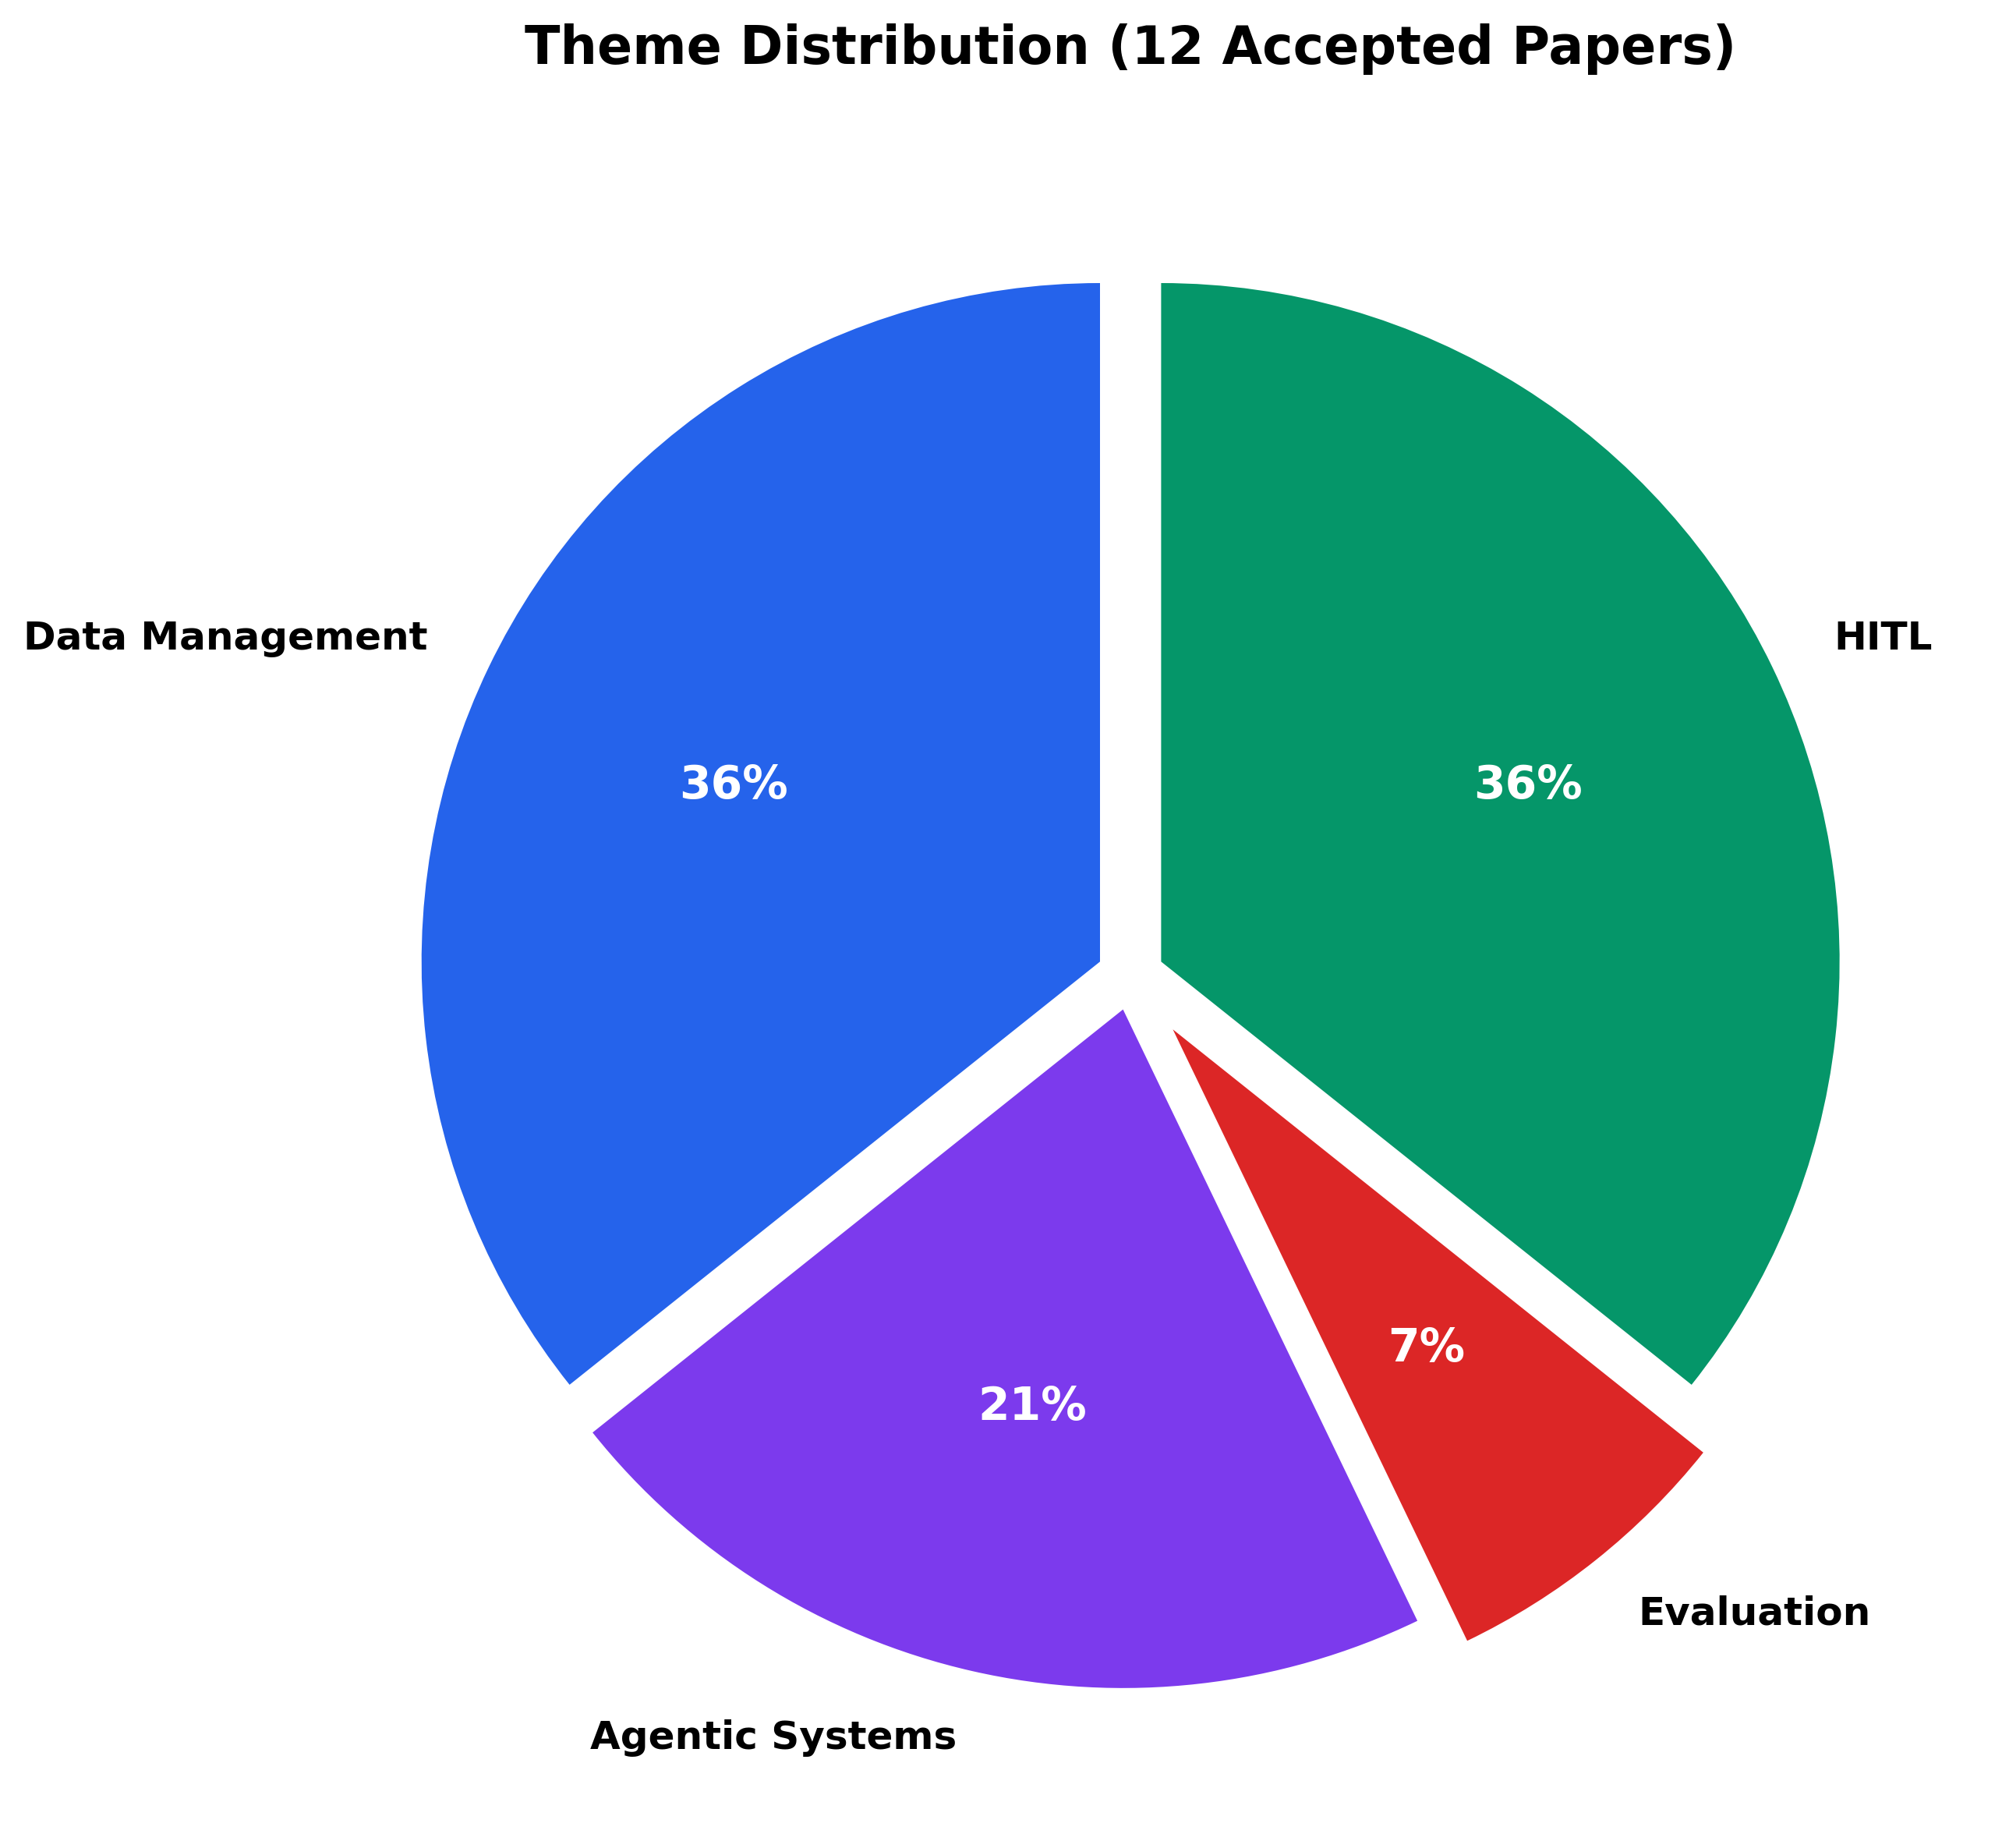
Four Core Themes
Data Management for Agentic Systems
Agentic Systems for Data Management
Human-in-the-Loop Agentic Systems
Evaluation, Reliability, and Learning

Slide 7

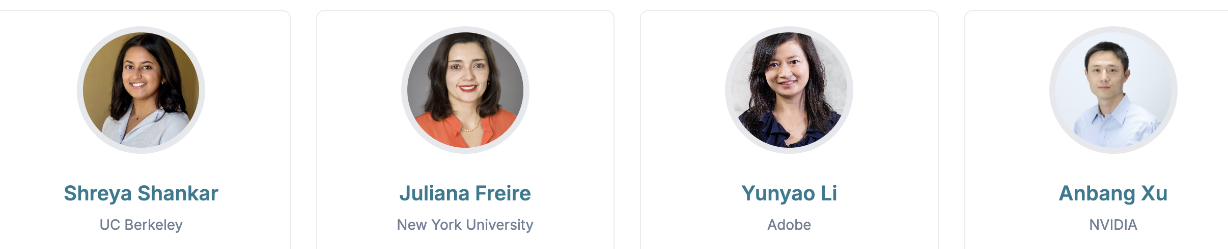
Keynote Talks

Slide 8
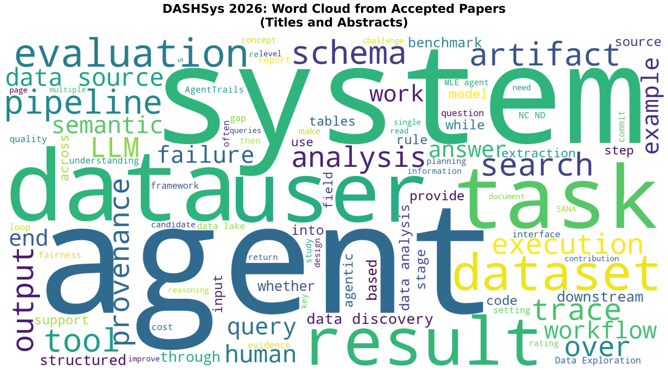
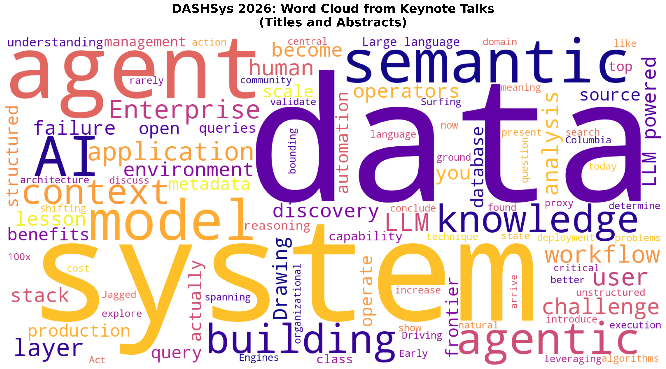

Slide 9
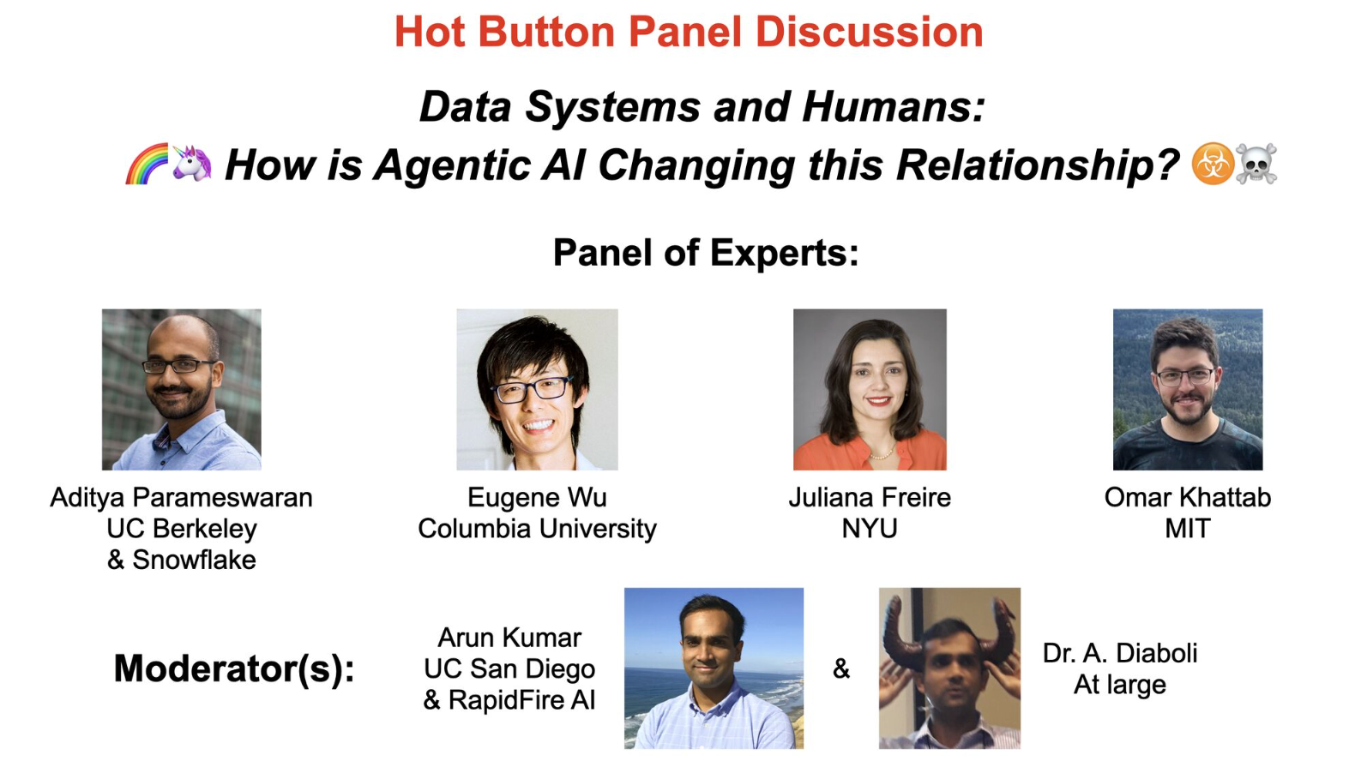

Slide 10
Thank You!
Let’s reimagine the future of data-AI systems together!
#DASHSys2026
https://dashsys-workshop-vldb.github.io/index.html#program

