Slide 1
DASHSys Systems Track Agent
Progress and Optimization Report
SQL-first/API-verification agent for data-centric question answering
To open local code links during slideshow, click the blue file buttons exactly; normal slide clicks advance the deck.
Qinyang Tan · May 1, 2026
Notes:
Open with the project framing: this is a SQL-first/API-verification agent for the DASHSys Systems Track, and the deck explains the evolution from prototype to optimized submission system. To open local code links during slideshow, click the blue file buttons exactly; normal slide clicks advance the deck.

Slide 2
DASHSys Systems Track
Project goal and evaluation criteria
Speaking cue
The workshop asks the agent to answer questions using only SQL and API calls. The system must be accurate without wasting tool calls or tokens.
The system has to decide when to check the local database, when to call Adobe APIs, and how to explain the answer.
Allowed tools
Correctness score
Efficiency score
execute_sql(sql)
call_api(method, url, params, headers)
SQL correctness
API correctness
Answer correctness
Tool calls
Tokens
Runtime and preprocessing time
Required output
For each query: metadata.json, filled_system_prompt.txt, and trajectory.json. Overall: source_code.zip-ready project.
DASHSys progress report | 02
Notes:
The workshop asks the agent to answer questions using only two tools: SQL and API calls. So the system has to decide when to check the local database, when to call Adobe APIs, and how to explain the answer. The score depends on both correctness and efficiency, so the system needs to be accurate without wasting tool calls or tokens.

Slide 3
DASHSys Systems Track
Initial prototype: useful skeleton, weak precision
Speaking cue
The first version was useful, but still rough. It could load data, prepare API calls, route questions, and save logs, but SQL was too simple and answers were not always shaped to the question.
Database layer
API client
Planner
Trajectory
DuckDB loader
Parquet views
Read-only SQL guard
Env credentials
Dry-run mode
Redacted logging
Simple routing
Mostly single-table SQL
Generic API params
Tool calls
Validation
Final answer
Analogy: it was like a student who knows where the textbook is, but not yet which chapter to use.
DASHSys progress report | 03
Notes:
The first version was a useful skeleton. It could load the database, prepare API calls, route the question, and save logs. But it was still rough: SQL was often too simple, API calls were too generic, and answers were not always shaped to the question. It was like a student who knows where the textbook is, but not yet which chapter to use.

Slide 4
DASHSys Systems Track
Iteration timeline: from skeleton to verified answers
Speaking cue
The project improved step by step. Each pass fixed one clear weakness: planning, debugging, efficiency, query understanding, or answer checking.
Skeleton
Templates
Failure analysis
Efficiency controls
Architecture pass
NLP pass
Answer layer
DuckDB, API client, router, simple planner
>
Schema-guided SQL and endpoint-constrained API params
>
Ranked public-example failures drove targeted fixes
>
API policy, call budget, compact metadata
>
EvidenceBus, QueryAnalysis, optimizer, cache
>
Normalization, tokens, relevance, one-plan selection
>
Slots, claims, verifier, reranker, diagnostics
The architecture stayed stable; the improvements were targeted and measurable.
DASHSys progress report | 04
Notes:
The project improved step by step. First I built the basic pipeline. Then I added templates so SQL and API calls became more reliable. Then I used failure analysis to fix the weakest examples. After that I added efficiency controls, architecture-inspired optimizations, NLP-style query understanding, and finally answer verification. Each pass fixed one clear weakness.

Slide 5
DASHSys Systems Track
Optimization Techniques Used Across Iterations
Speaking cue
This table shows what each added module does in simple terms. Some decide what to do, some run tools efficiently, and some check the final answer.
Mechanism
Technique Used
Why It Helps
Mechanism
Technique Used
Why It Helps
SQL/API templates
Schema-guided planning — safe SQL/API patterns.
Gives the system safe SQL/API patterns instead of letting it guess.
query_normalizer
Query cleaning — make wording easier to match.
Cleans the wording of the question.
failure_analysis
Benchmark-guided debugging — fix weakest examples first.
Shows which examples failed and what to fix next.
query_tokens
Entity extraction — pull out names, IDs, dates, metrics.
Pulls out names, IDs, dates, metrics, and statuses.
answer_templates
Structured generation — use the right answer format.
Uses the right answer format for count, list, status, and detail questions.
relevance_scorer
Relevance ranking — focus on useful tables/APIs.
Ranks which tables/APIs are most likely useful.
evidence_policy
Conditional execution — decide if API is needed.
Decides whether an API call is needed or can be skipped.
plan_ensemble
Plan reranking — compare plans and run one.
Compares possible plans and runs only the best one.
call_budget
Tool-call budget — limit SQL/API spending.
Limits how many SQL/API calls the system can make.
answer_slots
Evidence slots — turn raw results into clean facts.
Turns raw results into clean facts.
EvidenceBus
Operand forwarding — pass exact results forward.
Carries useful facts from SQL/API results to later steps.
answer_intent
Answer intent — choose count/list/date/status shape.
Decides whether the answer should be a count, list, date, or status.
QueryAnalysis
Shared query understanding — decide once and reuse.
Understands the question once and shares that decision.
LookupPathPredictor
Lookup-path prediction — like using a map for tables/APIs.
Acts like a map for finding the right tables and APIs.
answer_claims
Claim splitting — break answer into checkable facts.
Breaks the answer into facts that can be checked.
PlanOptimizer
Plan cleanup — remove duplicate or unsafe calls.
Cleans the plan before running it.
answer_verifier
Answer fact-checking — verify claims against evidence.
Checks that the answer is supported by evidence.
cache.py
Multi-level cache — reuse saved schema/API notes.
Reuses saved schema/API information.
answer_reranker
Safe answer selection — choose the best supported answer.
Chooses the best safe answer.
context_cards
Context packing — give only relevant context.
Gives only the relevant context, not the whole database.
answer_diagnostics
Answer diagnostics — log why answers pass or fail.
Logs why an answer passed or failed.
DASHSys progress report | 05
Notes:
This is the technique map. It connects project modules to known systems, compiler, NLP, and verification ideas so the professor can see the research framing.

Slide 6
DASHSys Systems Track
Schema-guided planning: SQL/API templates
Speaking cue
Templates are safe forms for SQL and API calls; they keep the system from inventing random joins, columns, or endpoints.
Technique used: Schema-guided planning — safe SQL/API patterns.
Dataflow / contract diagram
Step-by-step workflow
1
Read the question type.
3
Fill in known table, column, endpoint, and parameter names.
5
Send a safe structured plan forward.
2
Pick the matching SQL/API template.
4
Validate the SQL/API call.
Mechanism
Technique used
Modules
Benefit
SQL/API templates
Schema-guided planning — safe SQL/API patterns.
Open sql_templates.py
Open api_templates.py
Gives the system safe SQL/API patterns instead of letting it guess.
Open planner.py
DASHSys progress report | 06
Notes:
Schema-guided planning: SQL/API templates. Simple explanation: Templates are safe forms for SQL and API calls; they keep the system from inventing random joins, columns, or endpoints. Step-by-step workflow: Read the question type. Pick the matching SQL/API template. Fill in known table, column, endpoint, and parameter names. Validate the SQL/API call. Send a safe structured plan forward. Mechanism: SQL/API templates. Technique used: Schema-guided planning — safe SQL/API patterns.. Modules: sql_templates.py, api_templates.py, planner.py. Benefit: Gives the system safe SQL/API patterns instead of letting it guess..

Slide 7
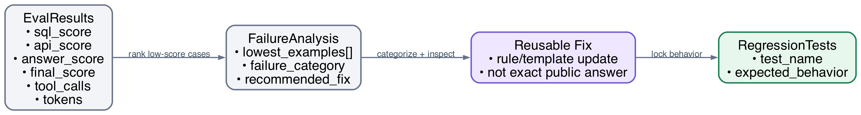
DASHSys Systems Track
Error-driven optimization: failure_analysis
Speaking cue
Failure analysis is the debugging loop: find the lowest-scoring examples and fix those reusable patterns first.
Technique used: Benchmark-guided debugging — fix weakest examples first.
Dataflow / contract diagram
Step-by-step workflow
1
Run evaluation.
3
Label the failure type.
5
Add a test so the same failure does not come back.
2
Find low-scoring examples.
4
Fix the reusable rule or template.
Mechanism
Technique used
Modules
Benefit
failure_analysis
Benchmark-guided debugging — fix weakest examples first.
Open failure_analysis.py
Shows which examples failed and what to fix next.
Open generate_failure_analysis.py
DASHSys progress report | 07
Notes:
Error-driven optimization: failure_analysis. Simple explanation: Failure analysis is the debugging loop: find the lowest-scoring examples and fix those reusable patterns first. Step-by-step workflow: Run evaluation. Find low-scoring examples. Label the failure type. Fix the reusable rule or template. Add a test so the same failure does not come back. Mechanism: failure_analysis. Technique used: Benchmark-guided debugging — fix weakest examples first.. Modules: failure_analysis.py, generate_failure_analysis.py. Benefit: Shows which examples failed and what to fix next..

Slide 8
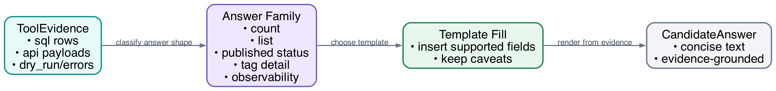
DASHSys Systems Track
Structured generation: answer_templates
Speaking cue
Answer templates make responses less vague by matching the answer format to the question.
Technique used: Structured generation — use the right answer format.
Dataflow / contract diagram
Step-by-step workflow
1
Collect SQL/API evidence.
3
Choose the matching answer format.
5
Return a concise response.
2
Identify the answer type.
4
Fill the answer with evidence.
Mechanism
Technique used
Modules
Benefit
answer_templates
Structured generation — use the right answer format.
Open answer_templates.py
Uses the right answer format for count, list, status, and detail questions.
DASHSys progress report | 08
Notes:
Structured generation: answer_templates. Simple explanation: Answer templates make responses less vague by matching the answer format to the question. Step-by-step workflow: Collect SQL/API evidence. Identify the answer type. Choose the matching answer format. Fill the answer with evidence. Return a concise response. Mechanism: answer_templates. Technique used: Structured generation — use the right answer format.. Modules: answer_templates.py. Benefit: Uses the right answer format for count, list, status, and detail questions..

Slide 9
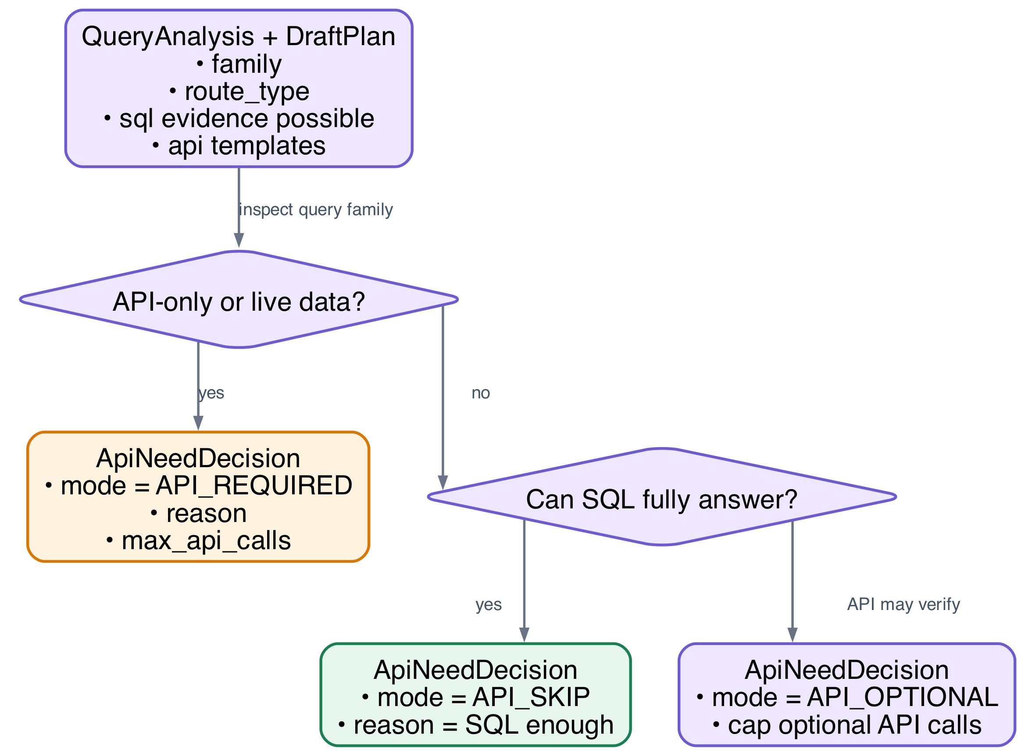
DASHSys Systems Track
Conditional execution: evidence_policy
Speaking cue
evidence_policy decides whether the system should call the API or whether SQL evidence is already enough.
Technique used: Conditional execution — decide if API is needed.
Dataflow / contract diagram
Step-by-step workflow
1
Check the query type.
3
Keep required API calls.
5
Remove API calls that are not needed.
2
Decide API_REQUIRED, API_OPTIONAL, or API_SKIP.
4
Limit optional API calls.
Mechanism
Technique used
Modules
Benefit
evidence_policy
Conditional execution — decide if API is needed.
Open evidence_policy.py
Decides whether an API call is needed or can be skipped.
DASHSys progress report | 09
Notes:
Conditional execution: evidence_policy. Simple explanation: evidence_policy decides whether the system should call the API or whether SQL evidence is already enough. Step-by-step workflow: Check the query type. Decide API_REQUIRED, API_OPTIONAL, or API_SKIP. Keep required API calls. Limit optional API calls. Remove API calls that are not needed. Mechanism: evidence_policy. Technique used: Conditional execution — decide if API is needed.. Modules: evidence_policy.py. Benefit: Decides whether an API call is needed or can be skipped..

Slide 10
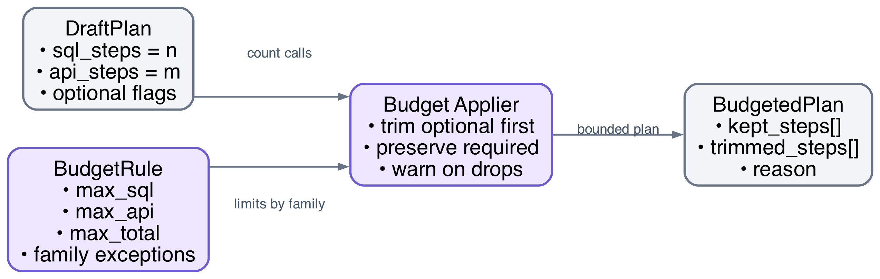
DASHSys Systems Track
Resource scheduling: call_budget
Speaking cue
call_budget is a spending limit for tool calls, so the agent cannot keep calling SQL/API tools unnecessarily.
Technique used: Tool-call budget — limit SQL/API spending.
Dataflow / contract diagram
Step-by-step workflow
1
Look at the draft plan.
3
Apply the tool-call limit.
5
Send a bounded plan forward.
2
Count SQL and API calls.
4
Remove optional extra calls.
Mechanism
Technique used
Modules
Benefit
call_budget
Tool-call budget — limit SQL/API spending.
Open call_budget.py
Limits how many SQL/API calls the system can make.
DASHSys progress report | 10
Notes:
Resource scheduling: call_budget. Simple explanation: call_budget is a spending limit for tool calls, so the agent cannot keep calling SQL/API tools unnecessarily. Step-by-step workflow: Look at the draft plan. Count SQL and API calls. Apply the tool-call limit. Remove optional extra calls. Send a bounded plan forward. Mechanism: call_budget. Technique used: Tool-call budget — limit SQL/API spending.. Modules: call_budget.py. Benefit: Limits how many SQL/API calls the system can make..

Slide 11
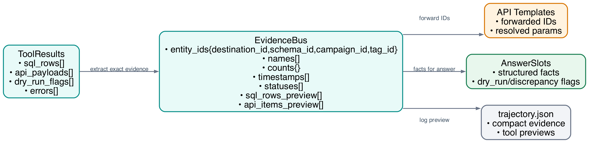
DASHSys Systems Track
Operand forwarding: EvidenceBus
Speaking cue
EvidenceBus passes exact results, such as IDs and counts, directly to later steps.
Technique used: Operand forwarding — pass exact results forward.
Dataflow / contract diagram
Step-by-step workflow
1
Read SQL/API results.
3
Store them as structured facts.
5
Avoid re-reading messy text.
2
Extract names, IDs, counts, dates, and statuses.
4
Pass them to API templates or answer slots.
Mechanism
Technique used
Modules
Benefit
EvidenceBus
Operand forwarding — pass exact results forward.
Open evidence_bus.py
Carries useful facts from SQL/API results to later steps.
Open executor.py
DASHSys progress report | 11
Notes:
Operand forwarding: EvidenceBus. Simple explanation: EvidenceBus passes exact results, such as IDs and counts, directly to later steps. Step-by-step workflow: Read SQL/API results. Extract names, IDs, counts, dates, and statuses. Store them as structured facts. Pass them to API templates or answer slots. Avoid re-reading messy text. Mechanism: EvidenceBus. Technique used: Operand forwarding — pass exact results forward.. Modules: evidence_bus.py, executor.py. Benefit: Carries useful facts from SQL/API results to later steps..

Slide 12
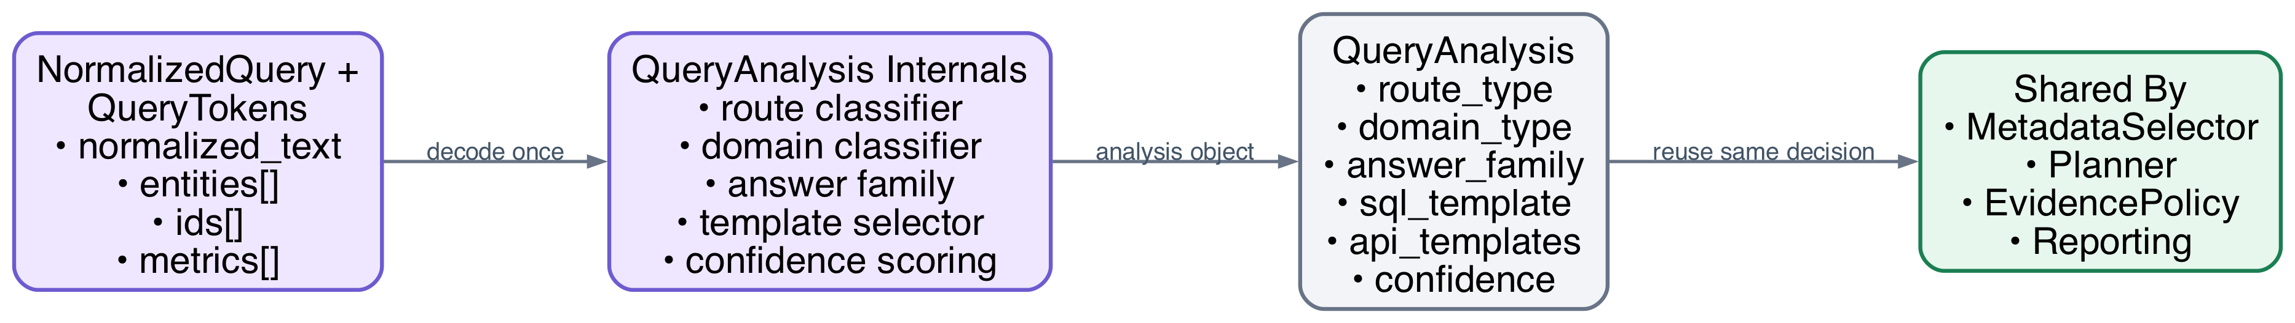
DASHSys Systems Track
Shared decode: QueryAnalysis
Speaking cue
QueryAnalysis is the first serious understanding step: it decides what kind of question this is.
Technique used: Shared query understanding — decide once and reuse.
Dataflow / contract diagram
Step-by-step workflow
1
Read the cleaned query and extracted tokens.
3
Pick likely SQL/API templates.
5
Share this analysis with planning and reporting.
2
Decide the domain and route type.
4
Estimate confidence.
Mechanism
Technique used
Modules
Benefit
QueryAnalysis
Shared query understanding — decide once and reuse.
Open query_analysis.py
Understands the question once and shares that decision.
DASHSys progress report | 12
Notes:
Shared decode: QueryAnalysis. Simple explanation: QueryAnalysis is the first serious understanding step: it decides what kind of question this is. Step-by-step workflow: Read the cleaned query and extracted tokens. Decide the domain and route type. Pick likely SQL/API templates. Estimate confidence. Share this analysis with planning and reporting. Mechanism: QueryAnalysis. Technique used: Shared query understanding — decide once and reuse.. Modules: query_analysis.py. Benefit: Understands the question once and shares that decision..

Slide 13
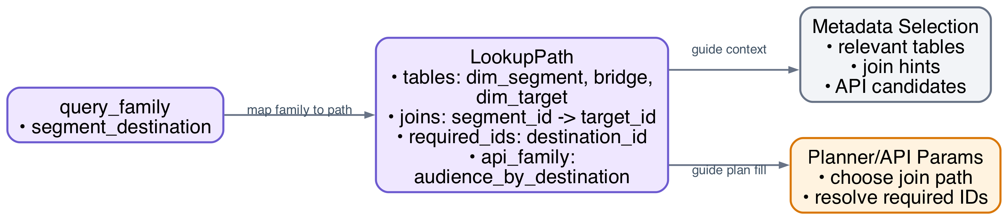
DASHSys Systems Track
Lookup-path prediction: LookupPathPredictor
Speaking cue
LookupPathPredictor is a map for the database and API, especially for relationship questions.
Technique used: Lookup-path prediction — like using a map for tables/APIs.
Dataflow / contract diagram
Step-by-step workflow
1
Identify the query family.
3
List needed tables, joins, APIs, and IDs.
5
Avoid unrelated tables and endpoints.
2
Pick the matching lookup path.
4
Guide metadata selection.
Mechanism
Technique used
Modules
Benefit
LookupPathPredictor
Lookup-path prediction — like using a map for tables/APIs.
Open lookup_paths.py
Acts like a map for finding the right tables and APIs.
DASHSys progress report | 13
Notes:
Lookup-path prediction: LookupPathPredictor. Simple explanation: LookupPathPredictor is a map for the database and API, especially for relationship questions. Step-by-step workflow: Identify the query family. Pick the matching lookup path. List needed tables, joins, APIs, and IDs. Guide metadata selection. Avoid unrelated tables and endpoints. Mechanism: LookupPathPredictor. Technique used: Lookup-path prediction — like using a map for tables/APIs.. Modules: lookup_paths.py. Benefit: Acts like a map for finding the right tables and APIs..

Slide 14
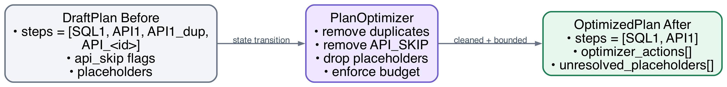
DASHSys Systems Track
Compiler optimization: PlanOptimizer
Speaking cue
PlanOptimizer cleans the to-do list before execution.
Technique used: Plan cleanup — remove duplicate or unsafe calls.
Dataflow / contract diagram
Step-by-step workflow
1
Receive the draft plan.
3
Remove API calls marked as skippable.
5
Enforce the call budget.
2
Remove duplicate calls.
4
Drop unresolved placeholders.
6
Output the cleaned plan.
Mechanism
Technique used
Modules
Benefit
PlanOptimizer
Plan cleanup — remove duplicate or unsafe calls.
Open plan_optimizer.py
Cleans the plan before running it.
DASHSys progress report | 14
Notes:
Compiler optimization: PlanOptimizer. Simple explanation: PlanOptimizer cleans the to-do list before execution. Step-by-step workflow: Receive the draft plan. Remove duplicate calls. Remove API calls marked as skippable. Drop unresolved placeholders. Enforce the call budget. Output the cleaned plan. Mechanism: PlanOptimizer. Technique used: Plan cleanup — remove duplicate or unsafe calls.. Modules: plan_optimizer.py. Benefit: Cleans the plan before running it..

Slide 15
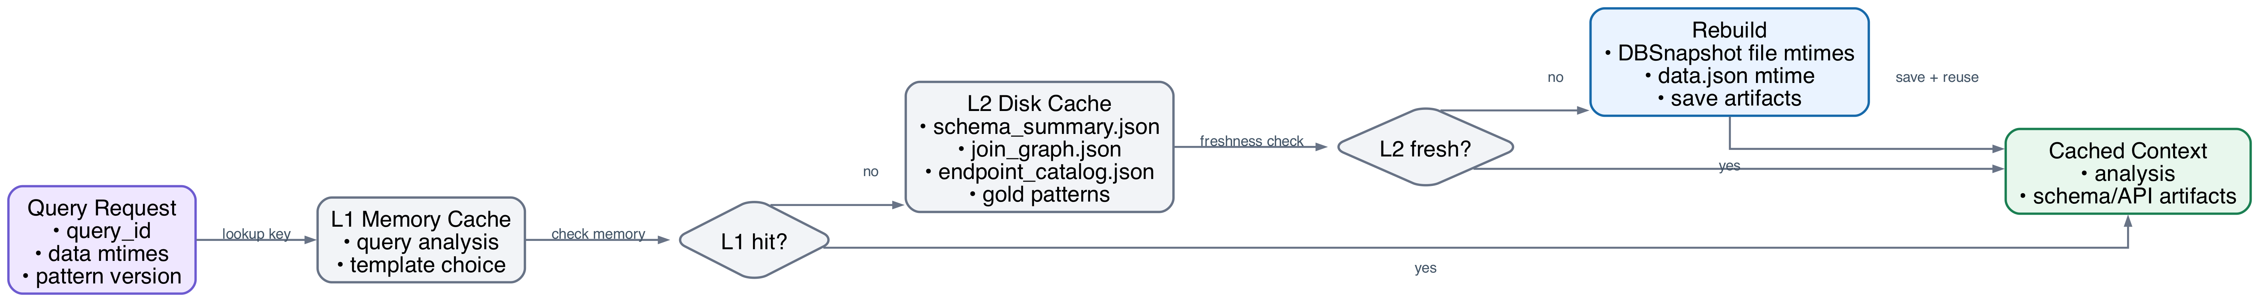
DASHSys Systems Track
Multi-level caching: cache.py
Speaking cue
cache.py saves schema and API information the system already learned.
Technique used: Multi-level cache — reuse saved schema/API notes.
Dataflow / contract diagram
Step-by-step workflow
1
Check memory cache.
3
Reuse fresh schema/API artifacts.
5
Save time during query processing.
2
Check disk cache.
4
Rebuild only if stale.
Mechanism
Technique used
Modules
Benefit
cache.py
Multi-level cache — reuse saved schema/API notes.
Open cache.py
Reuses saved schema/API information.
DASHSys progress report | 15
Notes:
Multi-level caching: cache.py. Simple explanation: cache.py saves schema and API information the system already learned. Step-by-step workflow: Check memory cache. Check disk cache. Reuse fresh schema/API artifacts. Rebuild only if stale. Save time during query processing. Mechanism: cache.py. Technique used: Multi-level cache — reuse saved schema/API notes.. Modules: cache.py. Benefit: Reuses saved schema/API information..

Slide 16
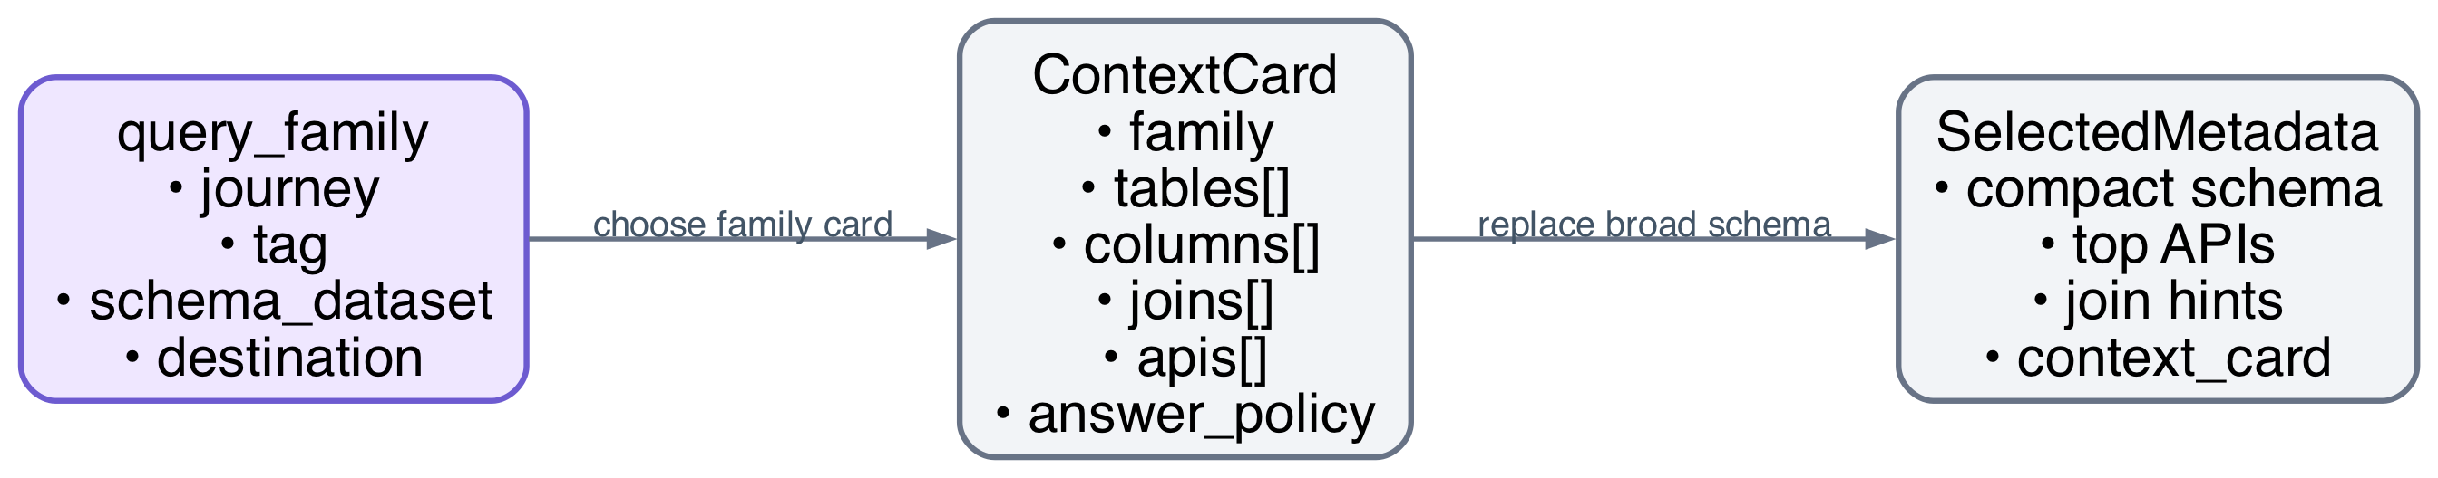
DASHSys Systems Track
Context packing: context_cards
Speaking cue
context_cards give the system only the information needed for this question family.
Technique used: Context packing — give only relevant context.
Dataflow / contract diagram
Step-by-step workflow
1
Identify the query family.
3
Include only relevant tables, columns, APIs, and rules.
5
Reduce prompt size.
2
Pick the matching context card.
4
Build compact metadata.
Mechanism
Technique used
Modules
Benefit
context_cards
Context packing — give only relevant context.
Open context_cards.py
Gives only the relevant context, not the whole database.
Open metadata_selector.py
DASHSys progress report | 16
Notes:
Context packing: context_cards. Simple explanation: context_cards give the system only the information needed for this question family. Step-by-step workflow: Identify the query family. Pick the matching context card. Include only relevant tables, columns, APIs, and rules. Build compact metadata. Reduce prompt size. Mechanism: context_cards. Technique used: Context packing — give only relevant context.. Modules: context_cards.py, metadata_selector.py. Benefit: Gives only the relevant context, not the whole database..

Slide 17
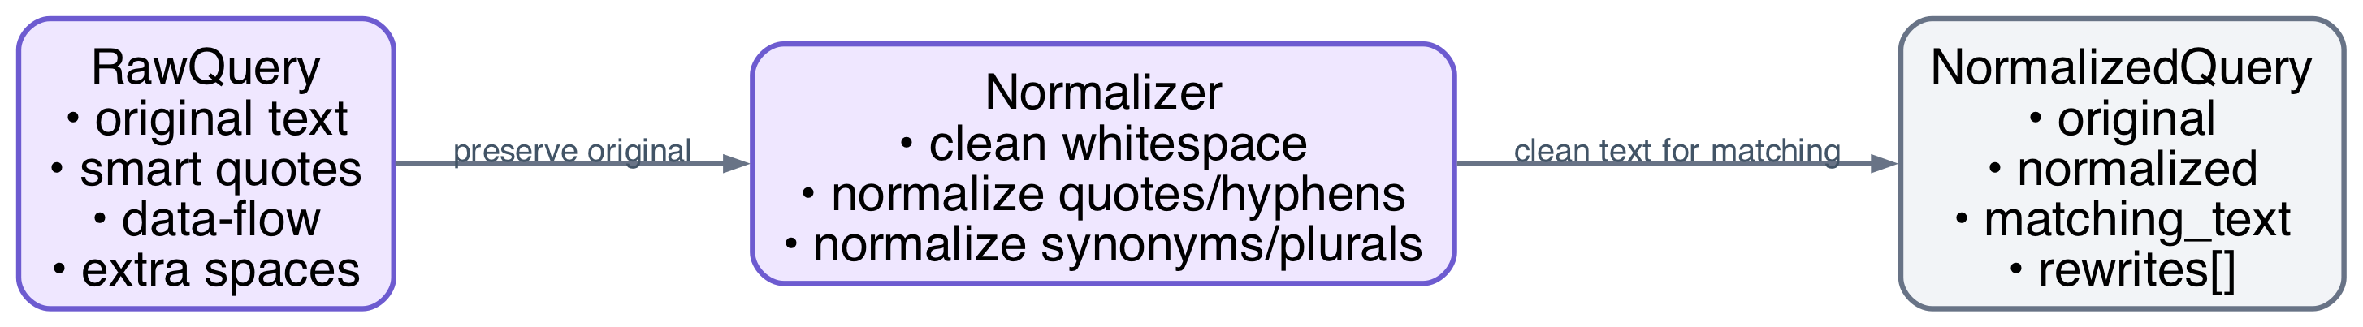
DASHSys Systems Track
Data cleaning: query_normalizer
Speaking cue
query_normalizer cleans the question text while keeping the original query for outputs.
Technique used: Query cleaning — make wording easier to match.
Dataflow / contract diagram
Step-by-step workflow
1
Keep the original query.
3
Normalize spaces, quotes, hyphens, plurals, and synonyms.
5
Improve robustness to wording differences.
2
Make a cleaned copy.
4
Use the cleaned version for matching.
Mechanism
Technique used
Modules
Benefit
query_normalizer
Query cleaning — make wording easier to match.
Open query_normalizer.py
Cleans the wording of the question.
DASHSys progress report | 17
Notes:
Data cleaning: query_normalizer. Simple explanation: query_normalizer cleans the question text while keeping the original query for outputs. Step-by-step workflow: Keep the original query. Make a cleaned copy. Normalize spaces, quotes, hyphens, plurals, and synonyms. Use the cleaned version for matching. Improve robustness to wording differences. Mechanism: query_normalizer. Technique used: Query cleaning — make wording easier to match.. Modules: query_normalizer.py. Benefit: Cleans the wording of the question..

Slide 18
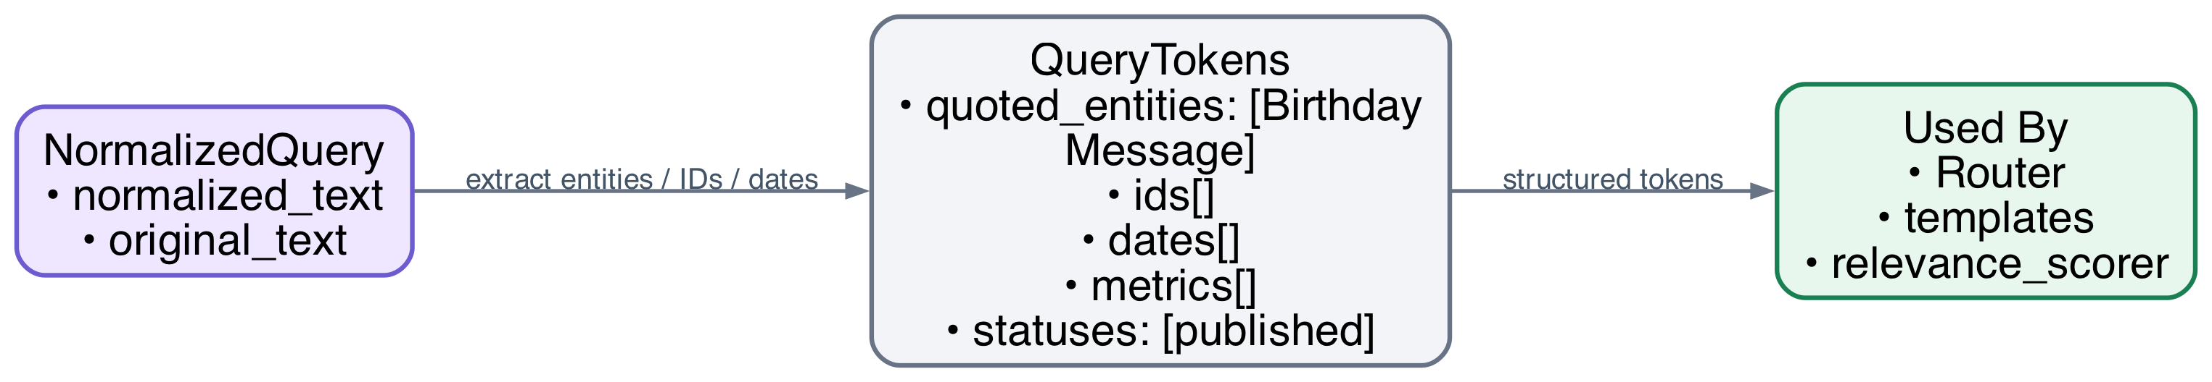
DASHSys Systems Track
Tokenization and entity extraction: query_tokens
Speaking cue
query_tokens highlights the important names, IDs, dates, metrics, and statuses in the question.
Technique used: Entity extraction — pull out names, IDs, dates, metrics.
Dataflow / contract diagram
Step-by-step workflow
1
Read the cleaned query.
3
Extract IDs, dates, metrics, fields, and status words.
5
Fill plans more accurately.
2
Extract entity names.
4
Send tokens to routing and templates.
Mechanism
Technique used
Modules
Benefit
query_tokens
Entity extraction — pull out names, IDs, dates, metrics.
Open query_tokens.py
Pulls out names, IDs, dates, metrics, and statuses.
DASHSys progress report | 18
Notes:
Tokenization and entity extraction: query_tokens. Simple explanation: query_tokens highlights the important names, IDs, dates, metrics, and statuses in the question. Step-by-step workflow: Read the cleaned query. Extract entity names. Extract IDs, dates, metrics, fields, and status words. Send tokens to routing and templates. Fill plans more accurately. Mechanism: query_tokens. Technique used: Entity extraction — pull out names, IDs, dates, metrics.. Modules: query_tokens.py. Benefit: Pulls out names, IDs, dates, metrics, and statuses..

Slide 19
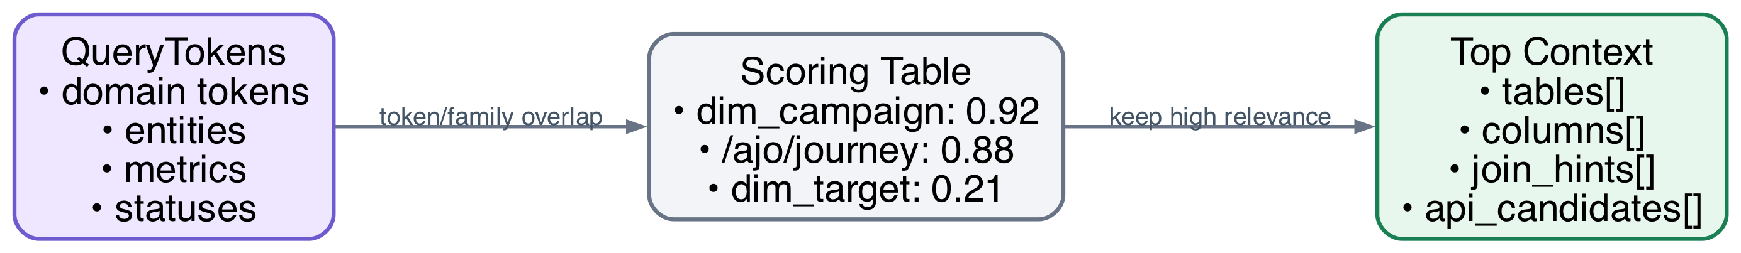
DASHSys Systems Track
Attention-style selection: relevance_scorer
Speaking cue
relevance_scorer helps the system focus on the most useful tables, columns, joins, and APIs.
Technique used: Relevance ranking — focus on useful tables/APIs.
Dataflow / contract diagram
Step-by-step workflow
1
Compare query tokens with schema/API candidates.
3
Keep the highest-ranked context.
5
Reduce noise and tokens.
2
Score each candidate.
4
Drop low-relevance context.
Mechanism
Technique used
Modules
Benefit
relevance_scorer
Relevance ranking — focus on useful tables/APIs.
Open relevance_scorer.py
Ranks which tables/APIs are most likely useful.
DASHSys progress report | 19
Notes:
Attention-style selection: relevance_scorer. Simple explanation: relevance_scorer helps the system focus on the most useful tables, columns, joins, and APIs. Step-by-step workflow: Compare query tokens with schema/API candidates. Score each candidate. Keep the highest-ranked context. Drop low-relevance context. Reduce noise and tokens. Mechanism: relevance_scorer. Technique used: Relevance ranking — focus on useful tables/APIs.. Modules: relevance_scorer.py. Benefit: Ranks which tables/APIs are most likely useful..

Slide 20
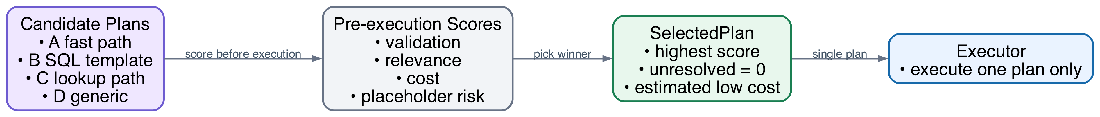
DASHSys Systems Track
Ensemble selection: plan_ensemble
Speaking cue
plan_ensemble checks a few possible routes, then runs only the best one.
Technique used: Plan reranking — compare plans and run one.
Dataflow / contract diagram
Step-by-step workflow
1
Generate cheap candidate plans.
3
Prefer valid, relevant, low-cost plans.
5
Execute only that plan.
2
Score them before execution.
4
Pick one plan.
Mechanism
Technique used
Modules
Benefit
plan_ensemble
Plan reranking — compare plans and run one.
Open plan_ensemble.py
Compares possible plans and runs only the best one.
DASHSys progress report | 20
Notes:
Ensemble selection: plan_ensemble. Simple explanation: plan_ensemble checks a few possible routes, then runs only the best one. Step-by-step workflow: Generate cheap candidate plans. Score them before execution. Prefer valid, relevant, low-cost plans. Pick one plan. Execute only that plan. Mechanism: plan_ensemble. Technique used: Plan reranking — compare plans and run one.. Modules: plan_ensemble.py. Benefit: Compares possible plans and runs only the best one..

Slide 21
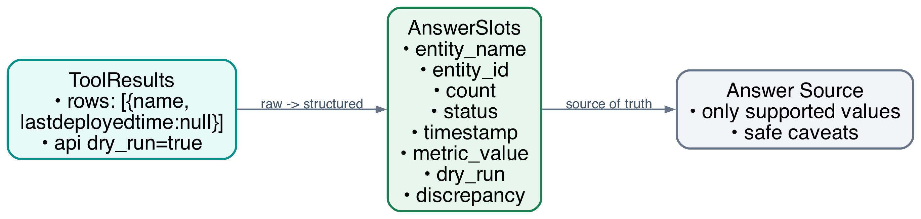
DASHSys Systems Track
Evidence slot extraction: answer_slots
Speaking cue
answer_slots turn raw SQL/API results into clean facts before writing the answer.
Technique used: Evidence slots — turn raw results into clean facts.
Dataflow / contract diagram
Step-by-step workflow
1
Read tool results.
3
Record dry-run and discrepancy flags.
5
Avoid unsupported values.
2
Extract clean facts: name, ID, count, status, time, metric.
4
Use these facts as the answer source.
Mechanism
Technique used
Modules
Benefit
answer_slots
Evidence slots — turn raw results into clean facts.
Open answer_slots.py
Turns raw results into clean facts.
DASHSys progress report | 21
Notes:
Evidence slot extraction: answer_slots. Simple explanation: answer_slots turn raw SQL/API results into clean facts before writing the answer. Step-by-step workflow: Read tool results. Extract clean facts: name, ID, count, status, time, metric. Record dry-run and discrepancy flags. Use these facts as the answer source. Avoid unsupported values. Mechanism: answer_slots. Technique used: Evidence slots — turn raw results into clean facts.. Modules: answer_slots.py. Benefit: Turns raw results into clean facts..

Slide 22
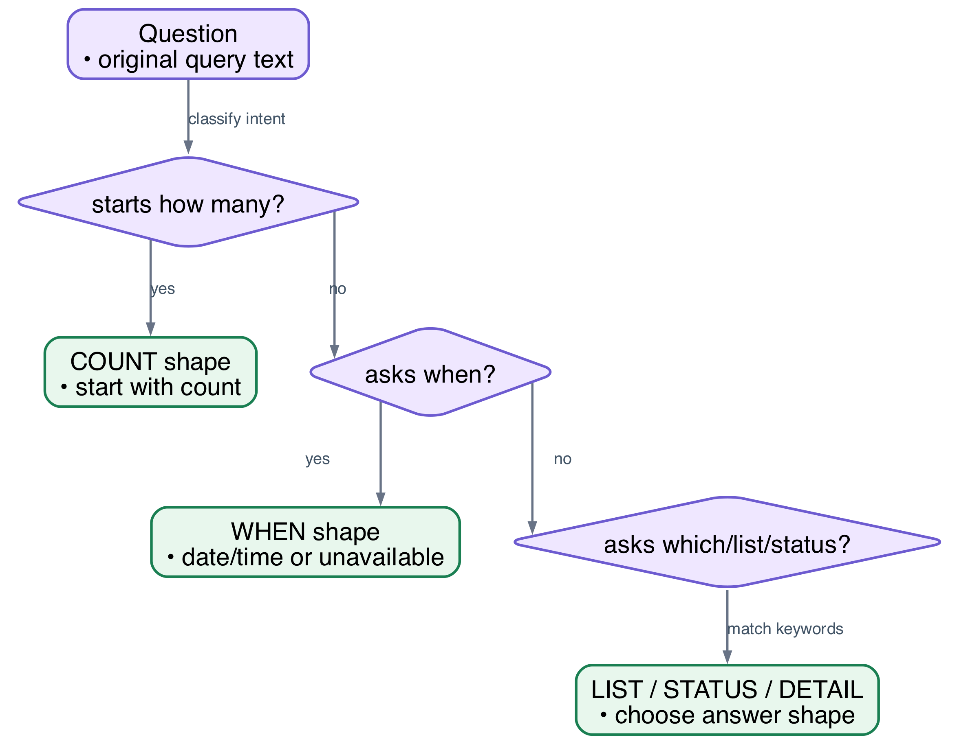
DASHSys Systems Track
Intent-aware response shaping: answer_intent
Speaking cue
answer_intent decides whether the answer should be a number, list, date, status, or details.
Technique used: Answer intent — choose count/list/date/status shape.
Dataflow / contract diagram
Step-by-step workflow
1
Read the question.
3
Choose the answer shape.
5
Make date questions start with dates or unavailable statements.
2
Classify the expected answer type.
4
Make count questions start with counts.
Mechanism
Technique used
Modules
Benefit
answer_intent
Answer intent — choose count/list/date/status shape.
Open answer_intent.py
Decides whether the answer should be a count, list, date, or status.
DASHSys progress report | 22
Notes:
Intent-aware response shaping: answer_intent. Simple explanation: answer_intent decides whether the answer should be a number, list, date, status, or details. Step-by-step workflow: Read the question. Classify the expected answer type. Choose the answer shape. Make count questions start with counts. Make date questions start with dates or unavailable statements. Mechanism: answer_intent. Technique used: Answer intent — choose count/list/date/status shape.. Modules: answer_intent.py. Benefit: Decides whether the answer should be a count, list, date, or status..

Slide 23
DASHSys Systems Track
Claim decomposition: answer_claims
Speaking cue
answer_claims split an answer into small facts so each one can be checked.
Technique used: Claim splitting — break answer into checkable facts.
Dataflow / contract diagram
Step-by-step workflow
1
Read a candidate answer.
3
Mark number, name, date, status, and API-confirmation claims.
5
Make the answer auditable.
2
Break it into factual claims.
4
Send these claims to the verifier.
Mechanism
Technique used
Modules
Benefit
answer_claims
Claim splitting — break answer into checkable facts.
Open answer_claims.py
Breaks the answer into facts that can be checked.
DASHSys progress report | 23
Notes:
Claim decomposition: answer_claims. Simple explanation: answer_claims split an answer into small facts so each one can be checked. Step-by-step workflow: Read a candidate answer. Break it into factual claims. Mark number, name, date, status, and API-confirmation claims. Send these claims to the verifier. Make the answer auditable. Mechanism: answer_claims. Technique used: Claim splitting — break answer into checkable facts.. Modules: answer_claims.py. Benefit: Breaks the answer into facts that can be checked..

Slide 24
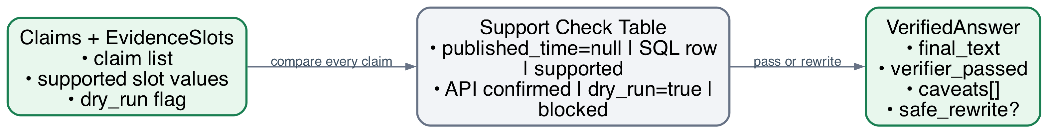
DASHSys Systems Track
Groundedness checking: answer_verifier
Speaking cue
answer_verifier is the fact-checker for the final answer.
Technique used: Answer fact-checking — verify claims against evidence.
Dataflow / contract diagram
Step-by-step workflow
1
Compare claims with evidence slots.
3
If API was dry-run, require a caveat.
5
Rewrite unsafe answers.
2
Reject unsupported names, numbers, dates, and statuses.
4
If SQL and API disagree, mention the conflict.
Mechanism
Technique used
Modules
Benefit
answer_verifier
Answer fact-checking — verify claims against evidence.
Open answer_verifier.py
Checks that the answer is supported by evidence.
DASHSys progress report | 24
Notes:
Groundedness checking: answer_verifier. Simple explanation: answer_verifier is the fact-checker for the final answer. Step-by-step workflow: Compare claims with evidence slots. Reject unsupported names, numbers, dates, and statuses. If API was dry-run, require a caveat. If SQL and API disagree, mention the conflict. Rewrite unsafe answers. Mechanism: answer_verifier. Technique used: Answer fact-checking — verify claims against evidence.. Modules: answer_verifier.py. Benefit: Checks that the answer is supported by evidence..

Slide 25
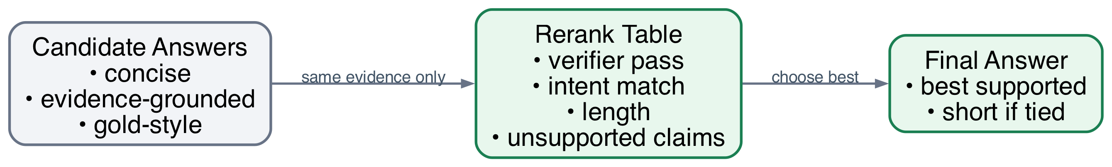
DASHSys Systems Track
Deterministic reranking: answer_reranker
Speaking cue
answer_reranker chooses the best answer from safe options without calling more tools.
Technique used: Safe answer selection — choose the best supported answer.
Dataflow / contract diagram
Step-by-step workflow
1
Create a few candidate answers from the same evidence.
3
Score support, intent match, style, and brevity.
5
Return one final answer.
2
Verify each one.
4
Pick the best verifier-passing answer.
Mechanism
Technique used
Modules
Benefit
answer_reranker
Safe answer selection — choose the best supported answer.
Open answer_reranker.py
Chooses the best safe answer.
DASHSys progress report | 25
Notes:
Deterministic reranking: answer_reranker. Simple explanation: answer_reranker chooses the best answer from safe options without calling more tools. Step-by-step workflow: Create a few candidate answers from the same evidence. Verify each one. Score support, intent match, style, and brevity. Pick the best verifier-passing answer. Return one final answer. Mechanism: answer_reranker. Technique used: Safe answer selection — choose the best supported answer.. Modules: answer_reranker.py. Benefit: Chooses the best safe answer..

Slide 26
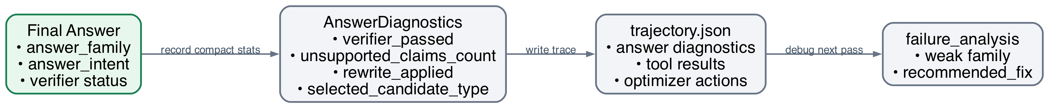
DASHSys Systems Track
Error observability: answer_diagnostics
Speaking cue
answer_diagnostics are debugging notes that explain why an answer passed or failed.
Technique used: Answer diagnostics — log why answers pass or fail.
Dataflow / contract diagram
Step-by-step workflow
1
Record answer family and intent.
3
Record unsupported claim count.
5
Use this later for failure analysis.
2
Record whether verification passed.
4
Save diagnostics in trajectory.json.
Mechanism
Technique used
Modules
Benefit
answer_diagnostics
Answer diagnostics — log why answers pass or fail.
Open answer_diagnostics.py
Logs why an answer passed or failed.
Open trajectory.py
DASHSys progress report | 26
Notes:
Error observability: answer_diagnostics. Simple explanation: answer_diagnostics are debugging notes that explain why an answer passed or failed. Step-by-step workflow: Record answer family and intent. Record whether verification passed. Record unsupported claim count. Save diagnostics in trajectory.json. Use this later for failure analysis. Mechanism: answer_diagnostics. Technique used: Answer diagnostics — log why answers pass or fail.. Modules: answer_diagnostics.py, trajectory.py. Benefit: Logs why an answer passed or failed..

Slide 27
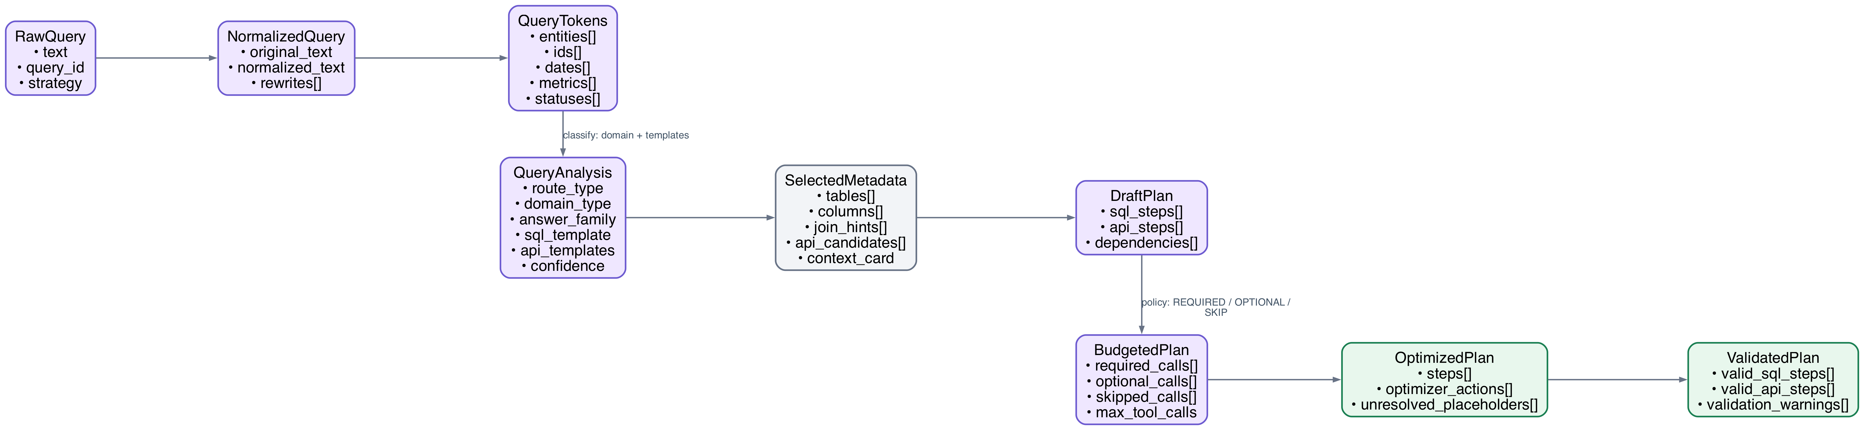
DASHSys Systems Track
Whole project workflow: planning dataflow
Speaking cue
Part A shows how the question becomes a validated plan. Each block shows the object fields being carried forward, and each arrow names the transformation.
Object transformations: RawQuery to ValidatedPlan
Transition summary
1
User asks a question.
3
System extracts names, IDs, dates, metrics, and statuses.
5
System selects relevant tables and APIs.
7
System removes unnecessary or unsafe calls.
2
System cleans the wording.
4
System decides the query type.
6
System creates a SQL/API plan.
8
System validates the plan.
DASHSys progress report | 27
Notes:
Whole project workflow Part A. It shows object transformations from RawQuery to ValidatedPlan. Steps: User asks a question. System cleans the wording. System extracts names, IDs, dates, metrics, and statuses. System decides the query type. System selects relevant tables and APIs. System creates a SQL/API plan. System removes unnecessary or unsafe calls. System validates the plan.

Slide 28
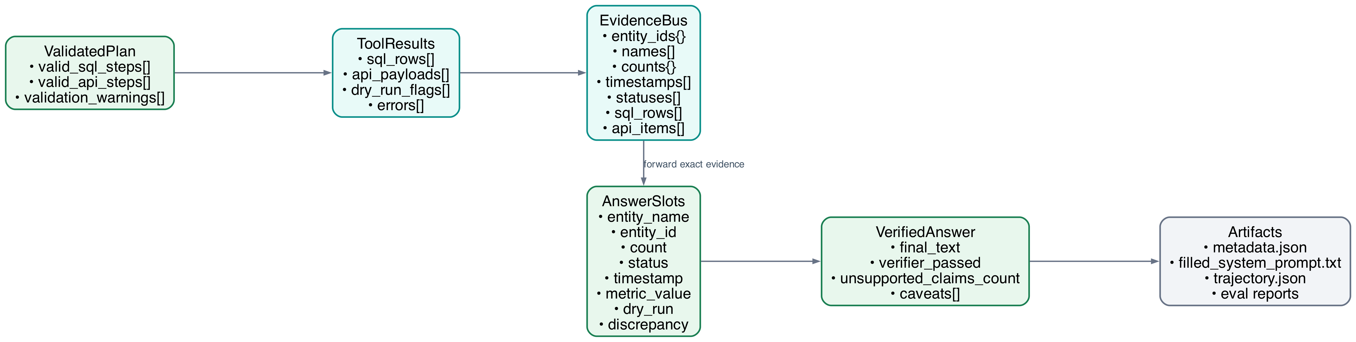
DASHSys Systems Track
Whole project workflow: evidence and answer dataflow
Speaking cue
Part B shows how validated tool calls become evidence, verified answer slots, and reproducible artifacts.
Object transformations: ValidatedPlan to Artifacts
Transition summary
1
System runs SQL and dry-run/live API.
3
System verifies the answer.
5
Evaluation checks correctness and efficiency.
2
System collects evidence.
4
System writes metadata.json, filled_system_prompt.txt, and trajectory.json.
DASHSys progress report | 28
Notes:
Whole project workflow Part B. It shows execution, evidence forwarding, answer verification, and artifacts. Steps: System runs SQL and dry-run/live API. System collects evidence. System verifies the answer. System writes metadata.json, filled_system_prompt.txt, and trajectory.json. Evaluation checks correctness and efficiency.

Slide 29
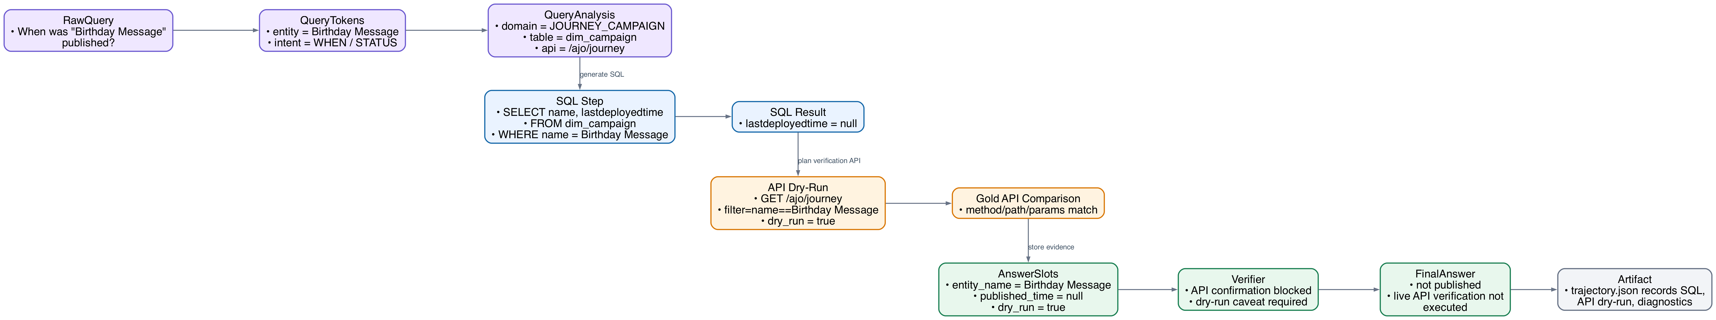
DASHSys Systems Track
Concrete dry-run example: Birthday Message
Speaking cue
This example shows dry-run API evaluation. Without credentials, the system checks whether the planned API call is correct instead of claiming a live API result.
Detailed trace: fields, payloads, and dry-run condition
Step-by-step dry-run trace
1
Question asks when Birthday Message was published.
4
SQL finds lastdeployedtime is null.
7
The planned method, endpoint, and params are compared with public gold API.
2
System extracts Birthday Message as the journey name.
5
System plans API call: GET /ajo/journey?filter=name==Birthday Message.
8
Answer verifier prevents saying that live API confirmed anything.
3
System checks local database table dim_campaign.
6
Because credentials are unavailable, API call is dry-run only.
9
Final answer says Birthday Message has not been published, and live API verification was not executed.
DASHSys progress report | 29
Notes:
Talk through the Birthday Message trace. Question asks when Birthday Message was published. System extracts Birthday Message as the journey name. System checks local database table dim_campaign. SQL finds lastdeployedtime is null. System plans API call: GET /ajo/journey?filter=name==Birthday Message. Because credentials are unavailable, API call is dry-run only. The planned method, endpoint, and params are compared with public gold API. Answer verifier prevents saying that live API confirmed anything. Final answer says Birthday Message has not been published, and live API verification was not executed.

Slide 30
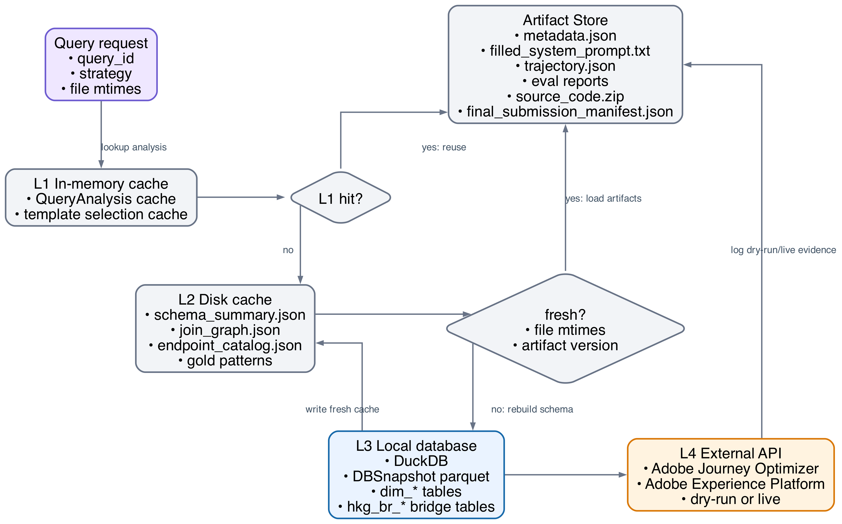
DASHSys Systems Track
Memory and cache hierarchy
Speaking cue
The cache hierarchy is like using notes before searching everywhere. It checks memory, saved files, the local database, and then Adobe API when needed.
Cache hierarchy with hit/miss and freshness transitions
How the cache hierarchy supports reproducibility
1
L1 cache stores recent query analysis and template choices.
3
L3 local database stores DuckDB/parquet evidence.
5
Artifact store saves metadata, prompt, trajectory, reports, and submission files.
2
L2 disk cache stores schema, join graph, endpoint catalog, and patterns.
4
L4 Adobe API is the external live source.
6
This reduces repeated work while keeping the system reproducible.
Cache boundary
Live API response caching is disabled for final live mode unless explicitly enabled; dry-run/dev artifacts stay reproducible.
DASHSys progress report | 30
Notes:
Present this as the memory hierarchy analogy. L1 cache stores recent query analysis and template choices. L2 disk cache stores schema, join graph, endpoint catalog, and patterns. L3 local database stores DuckDB/parquet evidence. L4 Adobe API is the external live source. Artifact store saves metadata, prompt, trajectory, reports, and submission files. This reduces repeated work while keeping the system reproducible.

Slide 31
DASHSys Systems Track
Current metrics: compact and submission-ready
Speaking cue
The current best strategy is SQL_FIRST_API_VERIFY. It gives the best balance between correctness and efficiency.
Correctness
Answer correctness
Final score
Tool calls
Tokens
Tests
0.8407
0.5208
0.8154
1.4571
851.6
46 passed
combined SQL/API/answer
weakest dimension
efficiency-adjusted
avg per query
estimated avg
readiness passed
Strategy
Correctness
Final score
Notes
SQL_FIRST_API_VERIFY
0.8407
0.8154
Default final-submission strategy
TEMPLATE_FIRST
competitive
lower/riskier
Higher overfitting risk
SQL_ONLY_BASELINE
lower
efficient only
Misses API-required families
The current best strategy is SQL_FIRST_API_VERIFY. It gives the best balance between correctness and efficiency. Answer correctness still has room to improve, but the system is compact, tested, and package-ready.
DASHSys progress report | 31
Notes:
The current best strategy is SQL_FIRST_API_VERIFY. It gives the best balance between correctness and efficiency. The system is not perfect, especially on answer correctness, but it is compact, tested, and package-ready.

Slide 32
DASHSys Systems Track
System strengths
Speaking cue
The system is strong because it does not freely guess. It uses templates, validation, budgets, evidence forwarding, and answer checking.
Uses SQL/API templates instead of free-form guessing.
Validates tables, columns, endpoints, and parameters before execution.
Keeps tool calls low with evidence_policy and call_budget.
Passes exact facts forward with EvidenceBus.
Checks answer claims with answer_verifier and answer_reranker.
Writes trajectory.json so failures can be inspected later.
DASHSys progress report | 32
Notes:
The system is strong because it does not freely guess. It uses templates, validation, budgets, evidence forwarding, and answer checking. Every step is logged, so failures can be inspected.

Slide 33
DASHSys Systems Track
Remaining risks before final submission
Speaking cue
The main risk is live Adobe API testing. Right now, API calls are mostly evaluated by dry-run planning.
Live API not tested
API-only dry-run families
Adobe credentials are needed to test real payloads, latency, and error cases.
Batches, tags, merge policies, segment jobs, and observability are still harder without live responses.
Answer correctness moderate
Hidden wording risk
The verifier prevents unsupported facts, but unavailable dry-run answers still score lower.
Hidden tests may use different wording, names, or entity references.
Main blocker: live Adobe API validation.
DASHSys progress report | 33
Notes:
The main risk is live Adobe API testing. Right now, API calls are mostly evaluated by dry-run planning. We still need credentials to test real API responses.

Slide 34
DASHSys Systems Track
Next steps
Speaking cue
Next: get Adobe credentials, run live API evaluation, inspect failures, improve parsers, and finalize the paper and package.
Obtain Adobe API credentials and run live API evaluation.
Inspect live failures and extend live_response_parsers.py for weak families.
Finalize the 4-page VLDB-style system paper around the SQL-first/API-verifying design.
Prepare final source_code.zip and per-query output package.
Use professor feedback to prioritize paper framing and live-eval remediation.
DASHSys progress report | 34
Notes:
The next step is to get Adobe credentials, run live API evaluation, inspect failures, improve response parsers, and finalize the paper and package.

Slide 35
DASHSys Systems Track
Paper contribution story
Core thesis
We built a controlled SQL-first/API-verifying agent for data-centric natural-language QA.
How it works
The system uses safe templates, validation, compact context, EvidenceBus forwarding, and answer_verifier checks.
Why it matters
It improves correctness and efficiency while keeping one selected plan per query and a reproducible trajectory.
Paper story: a simple, explainable agent that avoids guessing and records every step.
DASHSys progress report | 35
Notes:
The paper story is simple: we built a controlled SQL-first/API-verifying agent. It improves correctness and efficiency by using safe templates, validation, compact context, evidence forwarding, and answer verification.

Slide 36
Closing: ready for professor feedback
The pipeline is complete and reproducible.
The system explanation is now simpler and easier to present.
The main blocker is live API validation.
Feedback needed: paper framing, live-eval priority, and clarity.
SQL_FIRST_API_VERIFY remains the default.
Notes:
The pipeline is complete and reproducible. The main blocker is live API validation. I need feedback on the paper framing, live-eval priority, and whether the system explanation is clear.

