Slide 2
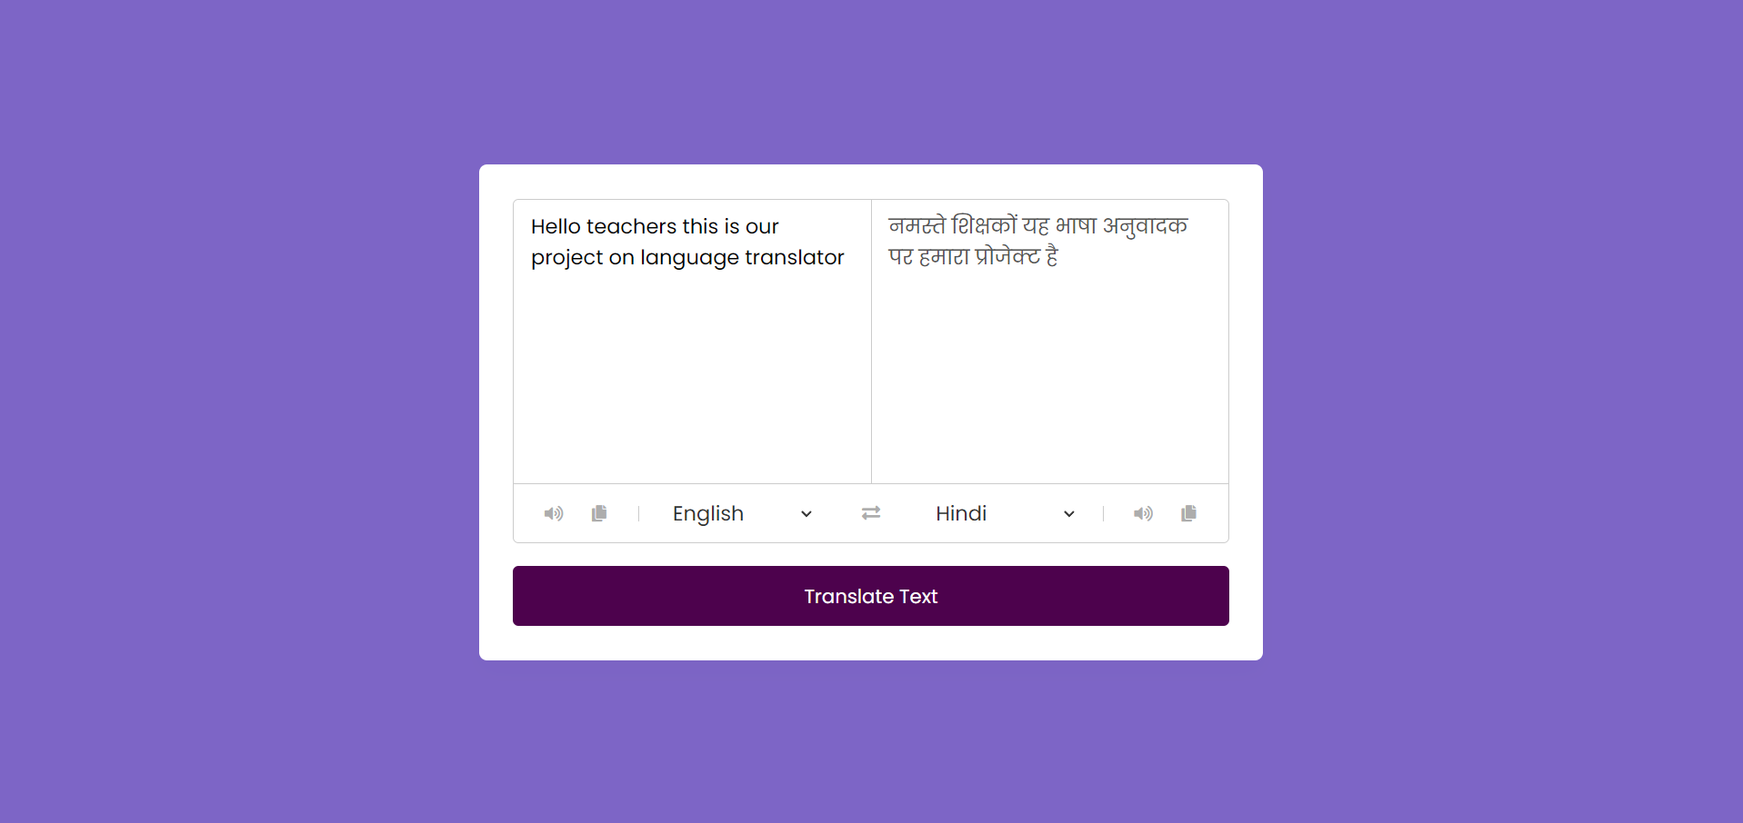
Introduction to Hindi to English Translation
Hindi to English translation is an essential part of bridging the language gap between these two widely spoken languages. With a rich cultural heritage and millions of speakers, the need for accurate and efficient translation services is crucial for communication, education, and business. This process involves converting written or spoken Hindi text into English, while maintaining the original meaning, context, and tone. It requires a deep understanding of both languages, cultural nuances, and the ability to convey the message effectively.
D

Slide 3
Importance of Hindi to English Translation
Preservation of Cultural Context
Global Communication
Enhanced Learning Opportunities
Hindi to English translation plays a vital role in preserving the cultural context of texts, literature, and documents. It ensures that the rich heritage and diversity of Hindi language content are accessible to a global audience.
It facilitates seamless communication between Hindi and English speakers, fostering international collaborations, trade, and academic exchanges. Translation removes language barriers, allowing diverse communities to engage and interact effortlessly.
Efficient translation opens the doors to learning and understanding diverse knowledge, insights, and experiences. It enables access to valuable resources, educational materials, and literature in both languages.

Slide 4

Overview of Translation Tools and Software
1
Machine Translation
These are automated tools that use algorithms to translate text from Hindi to English. While they are efficient for basic translations, they may lack the contextual understanding and nuances required for complex content.
2
Computer-Aided Translation (CAT) Tools
CAT tools assist human translators by providing a platform for translation memory, terminology management, and productivity enhancements. They improve consistency and efficiency in the translation process.
3
Language-Specific Software
These tools are designed specifically for Hindi to English translation, incorporating language-specific features, dictionaries, and linguistic resources to ensure accurate and culturally relevant translations.

Slide 5
Advantages of Using a Translation Tool
1
Efficiency
2
Consistency
Translation tools streamline the translation process, saving time and effort, especially for large volumes of content.
They ensure consistency in terminology and style across various documents, maintaining the integrity of the translated content.
3
Productivity
4
Cost-Effectiveness
Increased productivity and faster turnaround times due to automation and advanced features.
They provide cost-effective solutions, reducing the reliance on manual translation services for routine tasks.

Slide 6



Tips for Accurate Translation
Understanding Context
Review and Revision
Use of Language Resources
Thoroughly review the translated content and seek feedback for accuracy and cultural relevance.
Ensure a deep understanding of the context, cultural references, and idiomatic expressions in both languages.
Leverage dictionaries, glossaries, and language-specific resources for precise and nuanced translations.

Slide 7
Future of Hindi to English Translation
AI Integration
Customization and Adaptation
Human-Machine Collaboration
Advancements in AI and machine learning will continue to enhance the accuracy and efficiency of translation tools.
Tools will be increasingly tailored to specific industries, content types, and cultural nuances for precise translations.
The future will see a harmonious blend of human expertise and machine intelligence in the translation process.

Slide 8
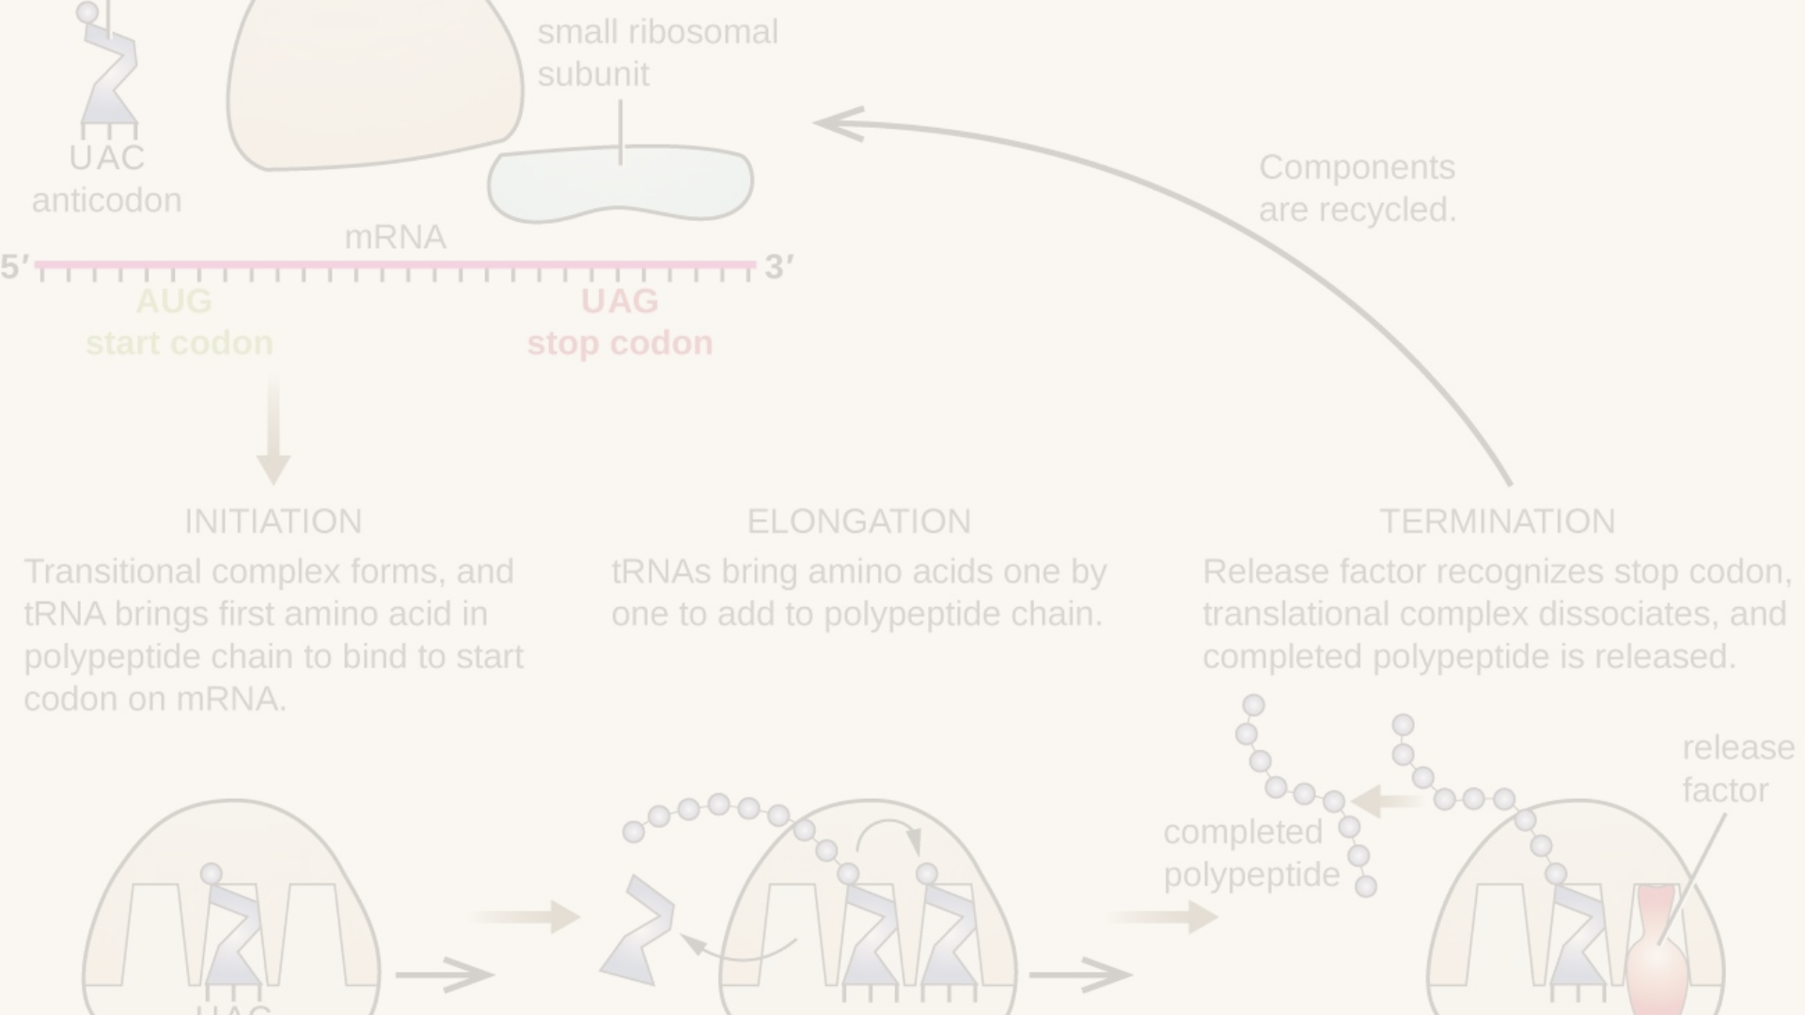
Conclusion and Key Takeaways
1
Cultural Exchange
2
Business Expansion
3
Continuous Learning
Translation fosters a rich cultural exchange, promoting understanding and empathy across diverse linguistic communities.
Accurate translation contributes to global business expansion and market penetration, opening doors to new opportunities.
The field of translation offers continuous learning and development opportunities, driven by technological advancements and linguistic evolution.

Slide 9
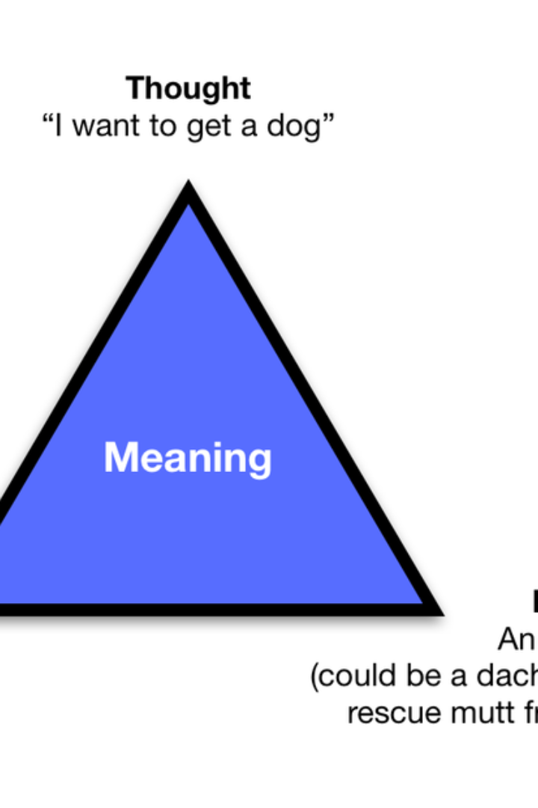
Hindi to English Translation: A World of Communication
As we delve into the world of Hindi to English translation, it becomes evident that this process is not merely about converting words. It's a gateway to cultural understanding, global connectivity, and harmonious coexistence. The seamless exchange of ideas, literature, and knowledge between these two languages enriches our shared experiences and fuels progress in an interconnected world.

