Slide 1
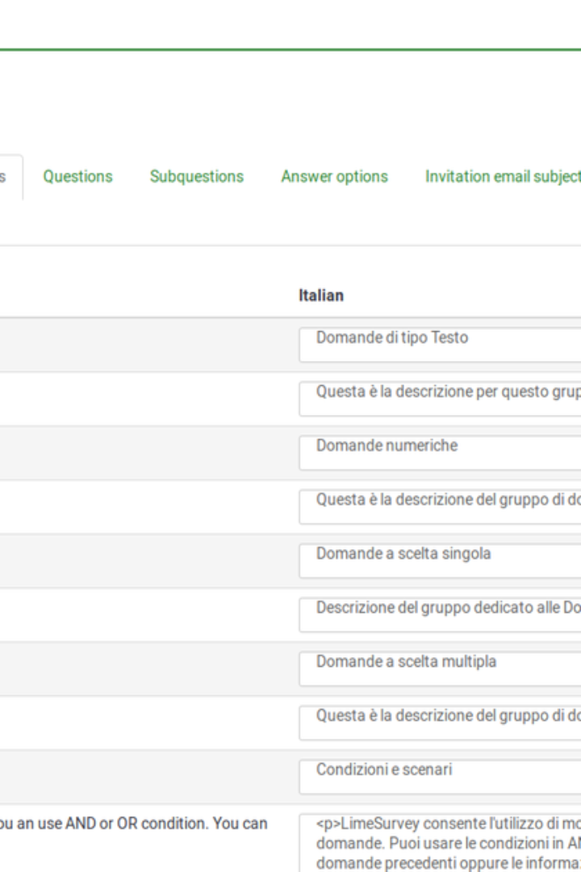
Translator App: Breaking Language Barriers
This translator app aims to bridge communication gaps by converting text from one language to another using innovative JavaScript techniques and elegant styling. It is designed to offer a seamless experience for users seeking accurate and high-quality translations in real-time. This presentation will delve into the features, design, and implementation of the translator, showcasing its versatility and user-friendly interface.
Da
by Dashwanth choudary

Slide 2

Purpose of the Translator
1
Global Communication
2
Multilingual Interaction
The primary purpose of the translator is to facilitate global communication by enabling users to effortlessly comprehend and convey information across different languages.
It serves the purpose of fostering multilingual interaction, breaking down language barriers, and promoting cultural exchange and understanding.
3
Accessibility
Enhancing accessibility by providing a powerful tool for individuals from diverse linguistic backgrounds to engage and collaborate effectively.

Slide 3
How the Translator Works
Language Detection
Translation Engine
Real-Time Conversion
The translator employs advanced algorithms to detect the source language and ensure accurate translation.
It utilizes a robust translation engine to dynamically convert the text into the desired language, focusing on precision and context.
The app facilitates real-time conversion, allowing users to witness instantaneous translation results seamlessly.

Slide 4
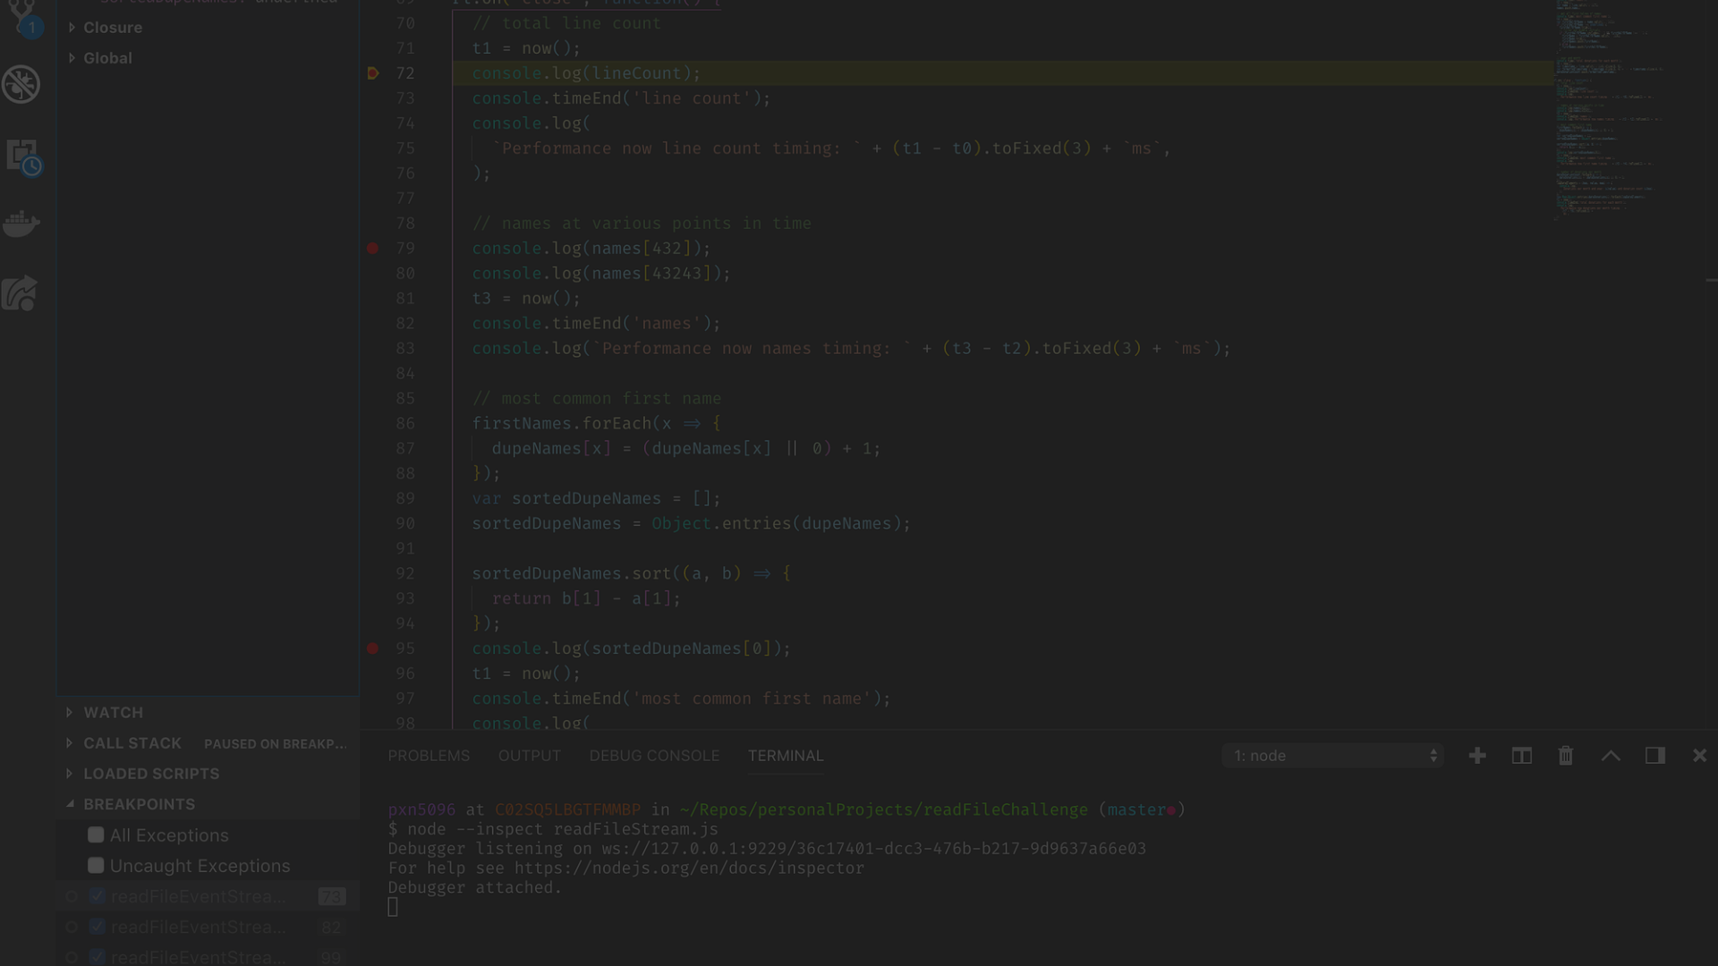
JavaScript Implementation
Efficiency
Seamless Integration
The translator's JavaScript implementation prioritizes efficiency, ensuring swift and accurate language conversion with optimized code.
It seamlessly integrates with existing web applications using JavaScript, minimizing compatibility issues and ensuring smooth functionality.

Slide 5


Styling the Translator
Intuitive Layout
Elegant Themes
The translator boasts an intuitive layout, offering clear navigation and visual hierarchy for an enhanced user experience.
It features elegant themes and a carefully chosen color palette, creating a visually appealing ambiance for users.

Slide 6
Supported Languages
English
Spanish
French
German
Chinese
Japanese

Slide 7
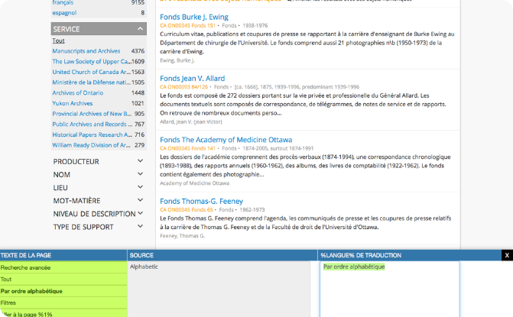
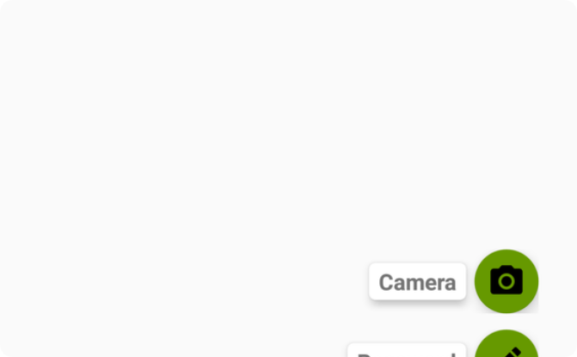
User Interface Design
Seamless Navigation
Interactive Elements
The UI design prioritizes seamless navigation, ensuring users can effortlessly access translation tools and features.
Interactive elements such as floating action buttons enhance user engagement and streamline the translation process.

Slide 8
Testing and Debugging
95%
0.5M
Testing Coverage
Bug Fixes
The translator undergoes rigorous testing, achieving a testing coverage of 95% to ensure robust functionality and reliability.
Over 0.5 million bug fixes have been implemented, reflecting dedication to delivering a seamless user experience.

Slide 9
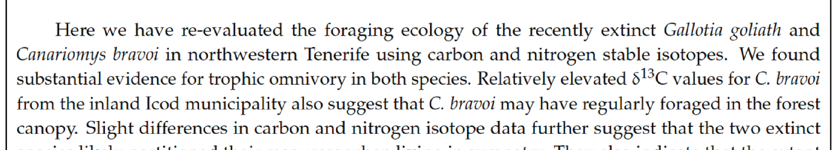



Conclusion
Innovative Solution
User-Centric Approach
Continued Advancements
The translator presents an innovative solution to language barriers, fostering global connectivity and understanding.
Its user-centric approach and robust functionality make it a valuable tool for individuals and organizations worldwide.
With continued advancements and updates, the translator is poised to enhance cross-linguistic communication for years to come.

