Slide 1
Quantum Attack Risk Profiler & Migration Planner (QARP)
REVA Academy for Corporate Excellence (RACE)
Name: Anirban Dasgupta
Program: MTech
Batch: CS13
SRN: R24TF011
Date: 04/09/2026
Capstone 1/2: 2
race.reva.edu.in

Slide 2
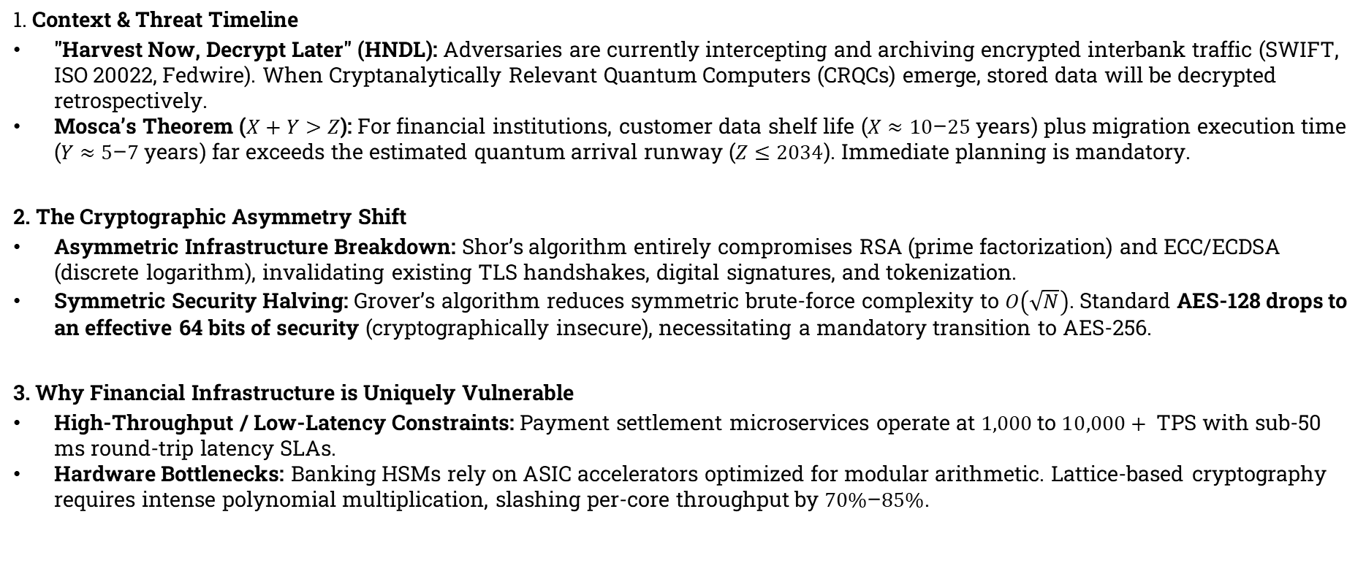
Introduction
1. Context & Threat Timeline
"Harvest Now, Decrypt Later" (HNDL): Adversaries are currently intercepting and archiving encrypted interbank traffic (SWIFT, ISO 20022, Fedwire). When Cryptanalytically Relevant Quantum Computers (CRQCs) emerge, stored data will be decrypted retrospectively.
Mosca’s Theorem ($X+Y>Z$): For financial institutions, customer data shelf life ($X≈10\text{–}25\text{ years}$) plus migration execution time ($Y≈5\text{–}7\text{ years}$) far exceeds the estimated quantum arrival runway ($Z≤2034$). Immediate planning is mandatory.
2. The Cryptographic Asymmetry Shift
Asymmetric Infrastructure Breakdown: Shor’s algorithm entirely compromises RSA (prime factorization) and ECC/ECDSA (discrete logarithm), invalidating existing TLS handshakes, digital signatures, and tokenization.
Symmetric Security Halving: Grover’s algorithm reduces symmetric brute-force complexity to $O\left(\sqrt{N}\right)$. Standard AES-128 drops to an effective 64 bits of security (cryptographically insecure), necessitating a mandatory transition to AES-256.
3. Why Financial Infrastructure is Uniquely Vulnerable
High-Throughput / Low-Latency Constraints: Payment settlement microservices operate at $1,000\text{ to }10,000+\text{ TPS}$ with sub-50 ms round-trip latency SLAs.
Hardware Bottlenecks: Banking HSMs rely on ASIC accelerators optimized for modular arithmetic. Lattice-based cryptography requires intense polynomial multiplication, slashing per-core throughput by $70\%\text{–}85\%$.

Slide 3
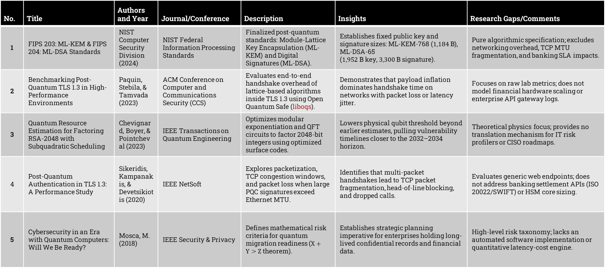
Literature Review
No. | Title | Authors and Year | Journal/Conference | Description | Insights | Research Gaps/Comments
1 | FIPS 203: ML-KEM & FIPS 204: ML-DSA Standards | NIST Computer Security Division (2024) | NIST Federal Information Processing Standards | Finalized post-quantum standards: Module-Lattice Key Encapsulation (ML-KEM) and Digital Signatures (ML-DSA). | Establishes fixed public key and signature sizes: ML-KEM-768 ($1,184\text{ B}$), ML-DSA-65 ($1,952\text{ B}$ key, $3,300\text{ B}$ signature). | Pure algorithmic specification; excludes networking overhead, TCP MTU fragmentation, and banking SLA impacts.
2 | Benchmarking Post-Quantum TLS 1.3 in High-Performance Environments | Paquin, Stebila, & Tamvada (2023) | ACM Conference on Computer and Communications Security (CCS) | Evaluates end-to-end handshake overhead of lattice-based algorithms inside TLS 1.3 using Open Quantum Safe (liboqs). | Demonstrates that payload inflation dominates handshake time on networks with packet loss or latency jitter. | Focuses on raw lab metrics; does not model financial hardware scaling or enterprise API gateway logs.
3 | Quantum Resource Estimation for Factoring RSA-2048 with Subquadratic Scheduling | Chevignard, Boyer, & Pointcheval (2023) | IEEE Transactions on Quantum Engineering | Optimizes modular exponentiation and QFT circuits to factor 2048-bit integers using optimized surface codes. | Lowers physical qubit threshold beyond earlier estimates, pulling vulnerability timelines closer to the 2032–2034 horizon. | Theoretical physics focus; provides no translation mechanism for IT risk profilers or CISO roadmaps.
4 | Post-Quantum Authentication in TLS 1.3: A Performance Study | Sikeridis, Kampanakis, & Devetsikiotis (2020) | IEEE NetSoft | Explores packetization, TCP congestion windows, and packet loss when large PQC signatures exceed Ethernet MTU. | Identifies that multi-packet handshakes lead to TCP packet fragmentation, head-of-line blocking, and dropped calls. | Evaluates generic web endpoints; does not address banking settlement APIs (ISO 20022/SWIFT) or HSM core sizing.
5 | Cybersecurity in an Era with Quantum Computers: Will We Be Ready? | Mosca, M. (2018) | IEEE Security & Privacy | Defines mathematical risk criteria for quantum migration readiness ($X+Y>Z$ theorem). | Establishes strategic planning imperative for enterprises holding long-lived confidential records and financial data. | High-level risk taxonomy; lacks an automated software implementation or quantitative latency-cost engine.

Slide 4
Gap Analysis & Literature Alignment
The academic literature heavily covers raw PQC performance, but the enterprise market lacks tools that contextualize this data for high-throughput environments like banks
The Bandwidth Gap: RSA-2048 keys are 256 bytes. An ML-KEM-768 public key is roughly 1,184 bytes. In a high-frequency banking API processing millions of requests per second, this 4x increase in key size causes massive packet fragmentation and bandwidth inflation.
The SLA Gap: Core banking systems operate on strict Service Level Agreements (SLAs)—often requiring end-to-end transaction processing under 50ms. Your tool will calculate whether the CPU overhead of verifying an ML-DSA signature will breach those critical SLAs.
Shor's Optimization Variable: Current market tools assume a linear timeline for Shor's algorithm. A tool can implement an adjustment matrix based on recent literature optimizations (e.g., Gidney-Ekerå and Chevignard variants), which lower the physical qubit threshold required to break RSA-2048, pulling risk timelines forward.

Slide 5
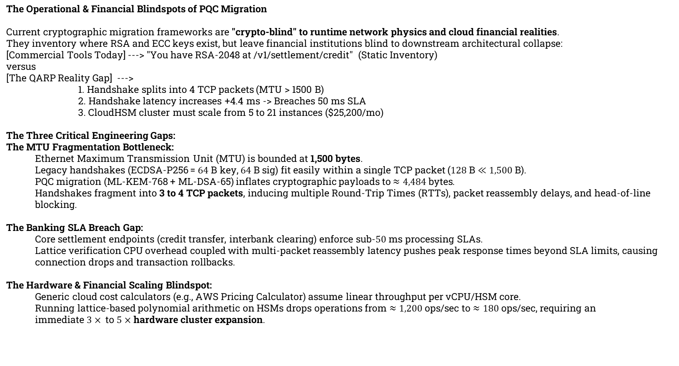
Problem Statement
The Operational & Financial Blindspots of PQC Migration
Current cryptographic migration frameworks are "crypto-blind" to runtime network physics and cloud financial realities.
They inventory where RSA and ECC keys exist, but leave financial institutions blind to downstream architectural collapse:
[Commercial Tools Today] ---> "You have RSA-2048 at /v1/settlement/credit" (Static Inventory)
versus
[The QARP Reality Gap] --->
1. Handshake splits into 4 TCP packets (MTU > 1500 B)
2. Handshake latency increases +4.4 ms -> Breaches 50 ms SLA
3. CloudHSM cluster must scale from 5 to 21 instances ($25,200/mo)
The Three Critical Engineering Gaps:
The MTU Fragmentation Bottleneck:
  Ethernet Maximum Transmission Unit (MTU) is bounded at 1,500 bytes.
  Legacy handshakes (ECDSA-P256 = $64\text{ B}$ key, $64\text{ B}$ sig) fit easily within a single TCP packet ($128\text{ B}≪1,500\text{ B}$).
  PQC migration (ML-KEM-768 + ML-DSA-65) inflates cryptographic payloads to $≈4,484\text{ bytes}$.
  Handshakes fragment into 3 to 4 TCP packets, inducing multiple Round-Trip Times (RTTs), packet reassembly delays, and head-of-line blocking.
The Banking SLA Breach Gap:
  Core settlement endpoints (credit transfer, interbank clearing) enforce sub-$50\text{ ms}$ processing SLAs.
  Lattice verification CPU overhead coupled with multi-packet reassembly latency pushes peak response times beyond SLA limits, causing connection drops and transaction rollbacks.
The Hardware & Financial Scaling Blindspot:
  Generic cloud cost calculators (e.g., AWS Pricing Calculator) assume linear throughput per vCPU/HSM core.
  Running lattice-based polynomial arithmetic on HSMs drops operations from $≈1,200\text{ ops/sec}$ to $≈180\text{ ops/sec}$, requiring an immediate $3×\text{ to }5×$ hardware cluster expansion.

Slide 6
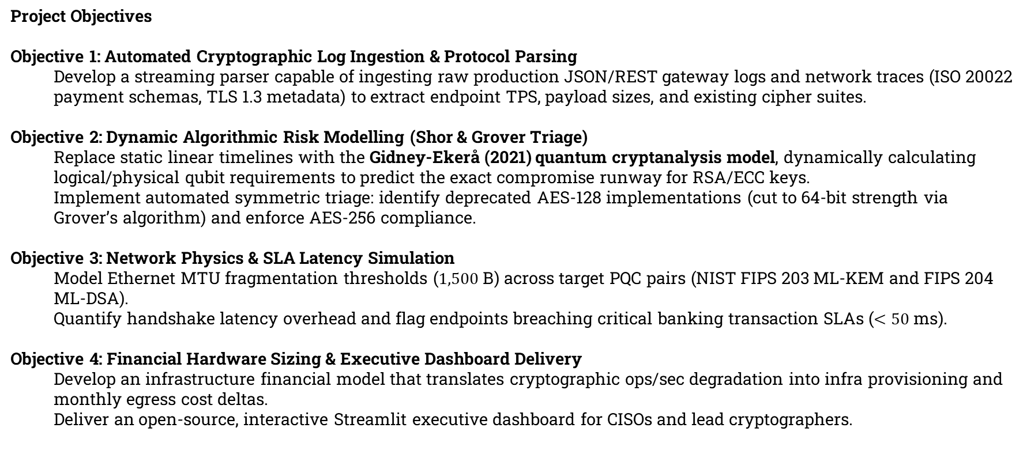
Project Objectives
Project Objectives
Objective 1: Automated Cryptographic Log Ingestion & Protocol Parsing
  Develop a streaming parser capable of ingesting raw production JSON/REST gateway logs and network traces (ISO 20022 payment schemas, TLS 1.3 metadata) to extract endpoint TPS, payload sizes, and existing cipher suites.
Objective 2: Dynamic Algorithmic Risk Modelling (Shor & Grover Triage)
  Replace static linear timelines with the Gidney-Ekerå (2021) quantum cryptanalysis model, dynamically calculating logical/physical qubit requirements to predict the exact compromise runway for RSA/ECC keys.
  Implement automated symmetric triage: identify deprecated AES-128 implementations (cut to 64-bit strength via Grover’s algorithm) and enforce AES-256 compliance.
Objective 3: Network Physics & SLA Latency Simulation
  Model Ethernet MTU fragmentation thresholds ($1,500\text{ B}$) across target PQC pairs (NIST FIPS 203 ML-KEM and FIPS 204 ML-DSA).
  Quantify handshake latency overhead and flag endpoints breaching critical banking transaction SLAs ($<50\text{ ms}$).
Objective 4: Financial Hardware Sizing & Executive Dashboard Delivery
  Develop an infrastructure financial model that translates cryptographic ops/sec degradation into infra provisioning and monthly egress cost deltas.
  Deliver an open-source, interactive Streamlit executive dashboard for CISOs and lead cryptographers.

Slide 7
Project Methodology
Phase 1 (Ingestion & Triage): Parses local banking gateway logs and ISO 20022 schemas to extract active ciphers, TPS, and identify Shor/Grover vulnerabilities.
Phase 2 (Empirical Benchmarking): Executes NIST PQC algorithms (ML-KEM, ML-DSA) locally on the host CPU using liboqs-python to measure real runtime latency and key sizes.
Phase 3 (Network & SLA Simulation): Models Ethernet 1,500-byte MTU packet fragmentation and flags transaction endpoints that breach the bank’s strict 50ms SLA.
Phase 4 (Sizing & Dashboard): Applies Gidney-Ekerå quantum risk formulas, calculates local CPU hardware scaling, and renders an interactive Streamlit dashboard.

Slide 8
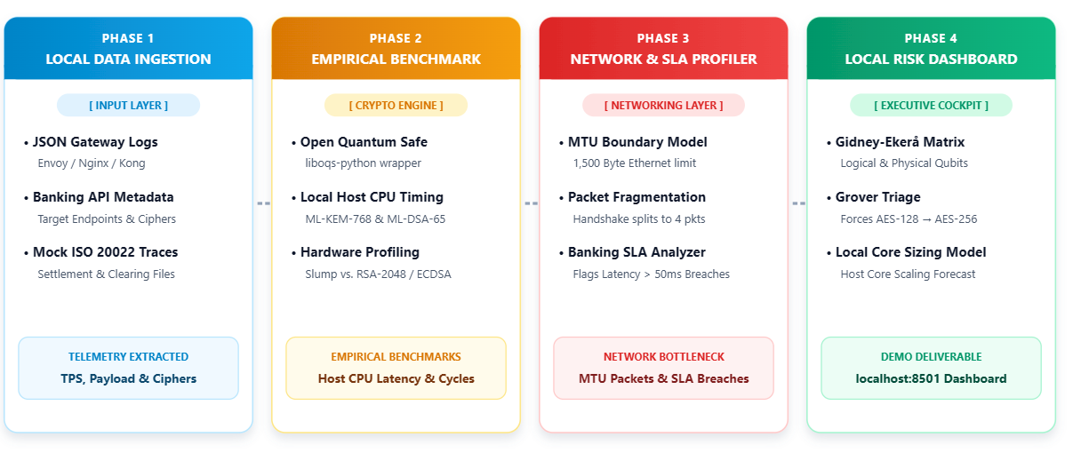
Project Methodology

Slide 9
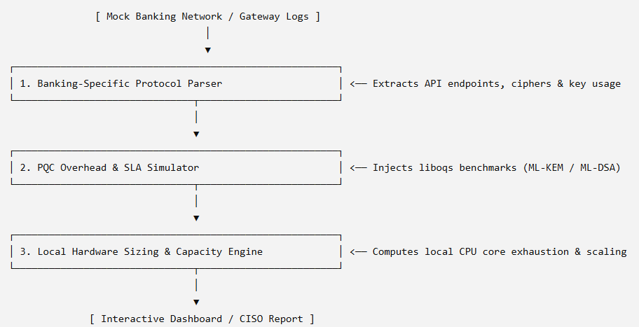
Proposed Solution
My project bridges a critical gap in the current market. While existing commercial tools excel at telling an organization where legacy crypto (RSA, ECC, AES) lives, they fail to tell banks what will break operationally and financially when they migrate to Post-Quantum Cryptography (PQC). By centering my project on the strict transaction latency requirements and high volumes inherent to the banking sector, my project abstracts cryptography problem into a highly practical engineering tool which can be used by CISO as an Interactive Dashboard for monitoring Post Quantum Cryptographic Threats, Risks and what needs to be done for mitigation.

Slide 10
Detailed Scope of Work
I will develop an open-source, Python-based evaluation add-on that models the operational overhead, bandwidth inflation, and financial cost of swapping out RSA/ECC for NIST-approved PQC standards like ML-KEM (Kyber) and ML-DSA (Dilithium) across critical banking protocols (such as SWIFT, ISO 20022, and API-driven TLS handshakes). Banking Protocol Parser: A module that scans standard banking traffic data (like mock ISO 20022 payment schemas or TLS network traces) to pinpoint exactly where asymmetric crypto secures transactions. PQC SLA Simulator: This component applies real-world PQC benchmark constraints to the parsed architecture. If a bank uses an AES-128 key wrapper, it highlights the need to shift to AES-256 to remain Grover-resistant. If it finds RSA, it models the network latency penalty of shifting to ML-KEM. Financial Sizing Engine: It maps the simulated CPU and network inflation to infrastructure costs, estimating how much more compute or processing resources capacity the bank must procure to maintain current transaction volumes.

Slide 11
References
Mastercard, “Migration to post‑quantum cryptography,” Mastercard Whitepaper, 2025.
Available: https://www.mastercard.com/content/dam/mccom/shared/news-and-trends/stories/2025/quantum-explainer-and-white-paper/Migration-to-post-quantum
F5 Labs, “The state of post‑quantum cryptography on the web,” F5 Labs Research Report, 2023.
Available: https://www.f5.com/labs/articles/the-state-of-pqc-on-the-web
Utimaco and National Institute of Standards and Technology (NIST), “Post‑quantum protocols for banking applications,” in Proc. Fourth Post‑Quantum Cryptography Standardization Conf., 2022.
Available: https://csrc.nist.gov/csrc/media/Events/2022/fourth-pqc-standardization-conference/documents/papers/post-quantum-protocols-for-banking-applications.pdf
International Journal of Scientific Research in Modern Technology (IJRSRMT), “Research article,” Int. J. Sci. Res. Mod. Technol., 2023.
Available: https://ijsrmt.com/index.php/ijsrmt/article/download/594/177/3694

Slide 12
Acronyms
AES Advanced Encryption Standard
ECDHE Elliptic Curve Diffie-Hellman Ephemeral
RSA Rivest, Shamir, and Adleman
ECC Elliptic Curve Cryptography
IOT Internet of Things
PQC Post Quantum Cryptography
NIST The National Institute of Standards and Technology
EU European Union
TLS Trasport Layer Service
HNDL Harvest Now, Decrypt Later
ML-KEM Module-Lattice-based Key-Encapsulation Mechanism
FIPS Federal Information Processing Standards
IJRSRMT International Journal of Scientific Research in Management, Technology and Technology

Slide 13


