Slide 1
YAMAGUCHI UNIVERSITY · HIRAKU-GLOBAL · 7TH COHORT · 2026
Bridging Cities, Climate, and People
Urban Thermal Environment Research
from Japanese Regional Cities to International Asia
HEAT-ADAPTIVE WALKABLE CITIES · CROSS-SCALE ANALYTICAL FRAMEWORK
LIU HAIQIANG, Ph.D.
Lecturer (Tenure-track)
Graduate School of Sciences and Technology for Innovation
Yamaguchi University
URBAN THERMAL ENVIRONMENT
INTERNATIONAL COLLABORATION
REGIONAL POLICY
SOCIAL IMPLEMENTATION
01 / 11
TITLE
2026.06
Notes:
[SLIDE 1 — TITLE — ~25s — TIME CHECK: 0:25]
Good morning. My name is Liu Haiqiang. I am a tenure-track Lecturer at Yamaguchi University, working on urban thermal environment.
In one sentence — I bridge urban thermal research with international collaboration, regional policy, and social implementation.
In ten minutes, I will show you why my background fits HIRAKU-Global.

Slide 2
YAMAGUCHI UNIVERSITY · HIRAKU-GLOBAL · 7TH COHORT INTERVIEW
SHEET 02 / 11
PROFILE
Who I am — a researcher trained between Japan and China.
01
JAPAN-TRAINED
02
CHINA-EXPERIENCED
03
JAPAN-RETURNED
Ph.D. (Architectural Environmental Engineering)
Saga University, Japan · 2017
Associate Professor
Zhejiang Sci-Tech University · 2018–2023
Lecturer (Tenure-track)
Yamaguchi University · since Jan 2026
CAREER TIMELINE · 10 YEARS ACROSS BUILDING → PERSON → CITY
2009–2011
2014–2017
2017–2018
2018–2023
2023–2025
2026—
Master's
Saga U.
Ph.D.
Saga U.
Researcher
Saga U.
Associate Prof.
ZSTU
Researcher
Kumamoto City
Policy Institute
Lecturer
Yamaguchi U.
STAGE 1 · BUILDING
STAGE 2 · PERSON
STAGE 3 · CITY
SELECTED DISTINCTIONS & CREDENTIALS
2012
CCTV-featured
2011
Croucher Institute
2020–
3 Advisory Roles
Skills
Patent + Languages
Eco-City 1st Prize on China Central TV
Adv. Study Institute (Hong Kong)
Urban Regen. · Changzhou · Saga Alumni
Patent CN 210135674 U · 中 / 日 / EN
INTERVIEW PRESENTATION · URBAN THERMAL ENVIRONMENT RESEARCH
02/11
LIU HAIQIANG
2026.06
Notes:
[SLIDE 2 — PROFILE — ~35s — TIME CHECK: 0:35]
Briefly — who I am.
Three pillars: Japan-trained (Ph.D. Saga 2017). China-experienced (Associate Professor at ZSTU, 2018 to 2023). Japan-returned (Yamaguchi University since January).
The timeline shows ten years across building, person, and city.
What this gives me is rare — I work natively across Japan and China, through one continuous urban-heat agenda.

Slide 3
YAMAGUCHI UNIVERSITY · HIRAKU-GLOBAL · 7TH COHORT INTERVIEW
SHEET 03 / 11
PROBLEM SETTING
Climate change becomes a local problem — on every street.
STREET SECTION · WHAT AN ELDERLY RESIDENT FACES
THE NUMBERS · FDMA 2024
91,000+
heatstroke emergency transports — Japan, 2023
1,200+ in Yamaguchi · 60% aged 65+
Yamaguchi 65+ share ≈ 35% (national avg ≈ 29%)
Heat × aging × decline — triple challenge concentrated here.
HOT · built-up
COOL · green & wind
MY THREE QUESTIONS
← 500–1000 m daily-activity corridor →
WHERE
is it hot?
WHY
is it hot?
HOW
to cool & re-vitalize the city?
REGIONAL CITIES FACE A TRIPLE CHALLENGE · CLIMATE WARMING + AGING SOCIETY + CITY-CENTER DECLINE
INTERVIEW PRESENTATION · URBAN THERMAL ENVIRONMENT RESEARCH
03/11
LIU HAIQIANG
2026.06
Notes:
[SLIDE 3 — WHY — ~45s — TIME CHECK: 1:45]
Why does this matter?
In 2023, Japan recorded over 91,000 emergency heatstroke transports. Yamaguchi — 1,200 cases, 60 percent aged 65 or older. Yamaguchi's elderly share is about 35 percent — well above national 29.
But not every street is equally hot. The section shows it — built-up zones trap heat; green-and-wind zones stay cool. Elderly residents walk through this contrast every day.
My research asks three simple questions — where, why, and how.

Slide 4
YAMAGUCHI UNIVERSITY · HIRAKU-GLOBAL · 7TH COHORT INTERVIEW
SHEET 04 / 11
RESEARCH TRAJECTORY
10 years, three stages — Building → Person → City.
STAGE 01
STAGE 02
STAGE 03
BUILDING
PERSON
CITY
QUESTION
QUESTION
QUESTION
How does building type & form
shape indoor thermal & energy?
How do indoor conditions
affect learning, health, behavior?
How do GBI, wind & morphology
regulate pedestrian heat exposure?
WORK
WORK
WORK
183 households across 3 cities
Window-to-wall ratio optimization
Residential building types comparison
Classroom thermal × learning
PM2.5 health-effect assessment
Elderly spatial needs
Satellite LST + Sentinel-2 LCZ
Courtyard CFD wind analysis
Kumamoto green-infra mapping
OUTPUTS
OUTPUTS
OUTPUTS
Sustainability · JCEA · Procedia
Building & Env. Q1 (Top 5) · Env. Pollution Q1 · Energies Q1
Sustainability Q2 · Book Chapter · MLIT EBPM-cited
WHAT BINDS THE THREE STAGES
Each stage was pushed forward by a question the previous stage could only partly answer. Stage 3 is where HIRAKU-Global begins.
INTERVIEW PRESENTATION · URBAN THERMAL ENVIRONMENT RESEARCH
04/11
LIU HAIQIANG
2026.06
Notes:
[SLIDE 4 — TRAJECTORY — ~55s — TIME CHECK: 2:40]
Three deliberate stages — building, person, city.
Stage 1 building — how does form shape indoor thermal and energy. Physical side.
Stage 2 person — how do indoor conditions affect learning, health, behavior. My two Q1 first-author papers come from here — Building and Environment top 5, and Energies.
Stage 3 city — how do green-blue infrastructure, wind, and morphology regulate pedestrian heat exposure. This is where the Kumamoto work and the MLIT-cited case sit.
Each stage answered what the previous one could not. Stage 3 is where HIRAKU-Global begins.

Slide 5
YAMAGUCHI UNIVERSITY · HIRAKU-GLOBAL · 7TH COHORT INTERVIEW
SHEET 05 / 11
ORIGINALITY · CORE
Satellite + measurement + CFD + national-level policy — in one workflow.
CROSS-SCALE WORKFLOW · SATELLITE → BLOCK → PEDESTRIAN
01
MULTI-SOURCE
02
CUMULATIVE
km
Satellite RS
+ on-site measurement
+ CFD
Pedestrian-scale
heat retention zones
(not instantaneous T)
LANDSAT-8/9 + SENTINEL-2
LST × LCZ — 30 m resolution screening
BLOCK-SCALE CFD
OpenFOAM — wind × morphology × GBI
03
POLICY-APPLIED
04
MLIT EBPM
Kumamoto City green-
infrastructure policy
(Book chapter A-1)
Adopted by MLIT as
an Evidence-Based
Policy Making case
PEDESTRIAN · WBGT FIELD
Elderly walking corridor, 500–1000 m
m
Methods validated in Sustainability (2024) & Kumamoto book chapter · + Utility Model Patent CN 210135674 U
REAL KUMAMOTO FINDING
Same forest patch — daytime cooling varies 3–5 °C by wind-corridor position
RESEARCH → POLICY → NATIONAL RECOGNITION
Few researchers combine satellite, measurement, CFD, and national-level policy adoption in one continuous workflow.
INTERVIEW PRESENTATION · URBAN THERMAL ENVIRONMENT RESEARCH
05/11
LIU HAIQIANG
2026.06
Notes:
[SLIDE 5 — ORIGINALITY (CORE) — ~65s — TIME CHECK: 3:45]
This is the core of my originality.
Three scales chained as one workflow. Satellite — where heat accumulates. Block-scale CFD — why. Pedestrian WBGT — along elderly walking corridors.
Four originality points. Multi-source data. Cumulative heat exposure. Applied to Kumamoto green-infrastructure policy. And cited by Japan's MLIT as an Evidence-Based Policy Making case.
The real Kumamoto finding — the same forest patch produces 3 to 5 degrees of cooling difference depending on its wind-corridor position.
Few researchers combine all four in one workflow.

Slide 6
YAMAGUCHI UNIVERSITY · HIRAKU-GLOBAL · 7TH COHORT INTERVIEW
SHEET 06 / 11
RESEARCH OUTPUTS
15 peer-reviewed papers · 3 Q1 · 2 led, 1 contributed.
15
10
8
3
peer-reviewed
papers
English
SCI / SCIE
with Impact
Factor
Q1 papers
(2 led + 1 contributed)
Q1 JOURNALS · HONEST AUTHOR POSITIONING
Building and Environment
Energies
Environmental Pollution
IF ≈ 7.1 · Q1 · Top 5 in field
IF ≈ 3.1 · Q1
IF ≈ 7.3 · Q1
Co-first author · led design & supervision
Classroom thermal × learning
First author
Classroom comfort × learning efficiency
Co-author · research-team member
PM2.5 health-effects assessment
FIRST / CO-FIRST AUTHOR PAPERS · PEER-REVIEWED ENGLISH BY YEAR
Sustainability
Kumamoto Pol. ×2
Q2 · first
Japanese · first
JCEA
Lowland Tech.
Energies
Building & Env.
Sustainability
peer-reviewed
peer-reviewed
Q1 · first
Q1 Top 5 · co-1st
Q2 · first
2017
2020
2021
2023
2024
ONE CONTINUOUS LINE: building energy → indoor comfort → PM2.5 → urban heat → green infra → policy
ORCID 0000-0001-7378-5265 · ResearcherID 51035663
INTERVIEW PRESENTATION · URBAN THERMAL ENVIRONMENT RESEARCH
06/11
LIU HAIQIANG
2026.06
Notes:
[SLIDE 6 — OUTPUTS — ~45s — TIME CHECK: 4:30]
Publications — quality first, honest positioning.
Fifteen peer-reviewed. Ten English SCI or SCIE. Eight with impact factor. Three Q1.
I want to be precise — two led, one contributed. As first or co-first: Building and Environment top 5, and Energies. As co-author: Environmental Pollution.
The timeline below shows my first or co-first papers year by year.
What matters more than the count — one continuous research line from building energy to urban policy.

Slide 7
YAMAGUCHI UNIVERSITY · HIRAKU-GLOBAL · 7TH COHORT INTERVIEW
SHEET 07 / 11
INTERNATIONAL COLLABORATION
Organizer, not just participant — three concrete records.
01
SAKURA SCIENCE PROGRAM
02
ZHEJIANG CARBON-NEUTRAL CENTER
03
5-COUNTRY ONLINE FORUM
2019–2020
2021–2022
2022
Organized ZSTU × Japanese
universities student-researcher
exchanges over multiple years
Built the Zhejiang International
Co-op Center on Carbon Neutrality,
as ZSTU representative
Organized international forum:
China · Japan · UK (UCL) ·
Indonesia · Bangladesh
Sustained partnership — paused
by COVID, friendship intact
1 of 4 provincial centers
— ZSTU as core unit
Multi-country coordination
under COVID constraints
INVITED TALKS
Shanghai Inst. for Global City (2025) · Shanghai Normal U. (2025) · Hangzhou Fengjinglishe (2021)
FUTURE NETWORK · BUILDING ON EXISTING FRIENDSHIP
UCL
ZSTU
YAMAGUCHI U.
ZHEJIANG U.
ASIA NODES
Dr. Huanfa Chen
Sakura net
Prof. Jian Ge
Indonesia · Bangladesh
INTERVIEW PRESENTATION · URBAN THERMAL ENVIRONMENT RESEARCH
07/11
LIU HAIQIANG
2026.06
Notes:
[SLIDE 7 — INT'L COLLABORATION — ~50s — TIME CHECK: 5:20]
For me, collaboration means organizing — not just attending.
Three concrete records.
Sakura Science Program, 2019 to 2020 — organized exchanges between ZSTU and Japanese universities. Paused by COVID; friendship intact.
Zhejiang Carbon-Neutral Center, 2021 to 2022 — I helped build one of only four provincial centers, ZSTU as core unit.
Five-country online forum, 2022 — China, Japan, UK at UCL, Indonesia, Bangladesh.
The future network builds on these existing friendships. In all three — I was the organizer.

Slide 8
YAMAGUCHI UNIVERSITY · HIRAKU-GLOBAL · 7TH COHORT INTERVIEW
SHEET 08 / 11
FUNDING & PROJECT LEADERSHIP
≈ 100 million JPY total — and the Japan pattern has already started.
CHINA · 2018–2023
KUMAMOTO · 2023–2025
YAMAGUCHI · since Jan 2026
≈ 100 M
JPY
Municipal
post
# 1
/ 13
8 projects · 5 as Leading Researcher
NSSFC General Project (collaborator)
Hangzhou Public Spaces ¥12 M PI
ZSTU Start-up + Carbon Neutrality
Institute of Policy Research
Institutional rule:
external competitive grants
not permitted from this post
Top-ranked applicant
in Yamaguchi U. regional
research program
(4 selected, within months)
HIGH-COMPETITION ENVIRONMENT
POLICY-OUTPUT · MLIT EBPM-CITED
JAPAN PATTERN HAS STARTED
FORWARD PATH
KAKENHI KIBAN C (FY2026 autumn) → KAKENHI KIBAN B (during HIRAKU)
INTERVIEW PRESENTATION · URBAN THERMAL ENVIRONMENT RESEARCH
08/11
LIU HAIQIANG
2026.06
Notes:
[SLIDE 8 — FUNDING — ~50s — TIME CHECK: 6:10]
Funding — honest picture in three phases.
China, 2018 to 2023. Eight projects, approximately 100 million yen total — five as Leading Researcher. Notable: Hangzhou Public Spaces as PI; NSSFC General Project as collaborator.
Kumamoto, 2023 to 2025. Municipal post — institutional rule did not permit external Kakenhi from this position. Instead — the MLIT-cited policy work.
Yamaguchi, since January. First time eligible. Ranked number one of thirteen — within months. The Japan pattern has started.
Forward — Kakenhi Kiban C autumn, then Kiban B during HIRAKU.

Slide 9
YAMAGUCHI UNIVERSITY · HIRAKU-GLOBAL · 7TH COHORT INTERVIEW
SHEET 09 / 11
RESEARCH PLAN · FEASIBILITY & INTERNATIONAL
Not from zero — pipeline running, partners ready, first grant won.
3 CITIES × 3 WIND REGIMES
METHOD CHAIN · CITY → CORRIDOR
5-YEAR PLAN · HIRAKU PERIOD
SEA OF JAPAN
01
SATELLITE SCREENING
Y1
Y2
Y3
Y4
Y5
N
Landsat-8/9 LST × Sentinel-2 LCZ
Years 1–2
LST × LCZ diagnosis
LST × LCZ diagnosis
CHUGOKU REGION · WESTERN HONSHU
UCL stay (2 months)
02
BLOCK CFD
UCL stay (2 months)
MATSUE
Block-scale CFD
LAKESIDE
YAMAGUCHI
Block-scale CFD
OpenFOAM wind × morphology × GBI
Year 3
Zhejiang U. visit
BASIN
UBE
Zhejiang U. visit
Pedestrian WBGT
COASTAL
03
Pedestrian WBGT
SETO INLAND SEA
PEDESTRIAN VALIDATION
Int'l workshop
Int'l workshop
Synthesis + Kakenhi B
WBGT field measurement
Year 4
Synthesis + Kakenhi B
FEASIBILITY — ALREADY PROVEN
Satellite pipeline running · CFD methodology established · Partners aligned · First Japanese grant won
BUDGET PLAN · STARTUP FUND ¥ 2 M / OVERSEAS DISPATCH ¥ 2 M
¥ 700K
¥ 350K
¥ 300K
¥ 300K
¥ 800K
¥ 400K
Field
equipment
Data &
workstation
Student
RAs
Domestic
fieldwork
UCL stay
Year 2
Zhejiang U.
Year 3
WBGT · loggers ·
radiometers
GIS · CFD ·
storage
Master's students
from Year 1
Yamaguchi · Ube ·
Matsue surveys
2 months · joint
method paper
Comparative
framework
RISK MANAGED · ANCHOR YAMAGUCHI FIRST · STEPWISE EXPANSION · ONLINE COLLAB FALLBACK · KUMAMOTO BASELINE AS REFERENCE
INTERVIEW PRESENTATION · URBAN THERMAL ENVIRONMENT RESEARCH
09/11
LIU HAIQIANG
2026.06
Notes:
[SLIDE 9 — PLAN (CORE) — ~70s — TIME CHECK: 7:20]
This is the HIRAKU project.
Three cities — three wind regimes: Matsue lakeside, Yamaguchi basin, Ube coastal. The contrast is what the science needs.
The method chain. Satellite screening already running. Block CFD methodology already established. Pedestrian WBGT co-designed with Yamaguchi's elderly-care offices.
The five-year plan. Year 1 diagnosis. Year 2 UCL stay. Year 3 CFD plus Zhejiang visit. Year 4 pedestrian field plus international workshop. Year 5 synthesis and Kakenhi B.
This does not start from zero. Pipeline running, partners ready, first grant won. Budget allocation below.
Risk managed — anchor Yamaguchi first, expand stepwise.

Slide 10
YAMAGUCHI UNIVERSITY · HIRAKU-GLOBAL · 7TH COHORT INTERVIEW
SHEET 10 / 11
ASPIRATIONS
Year-by-year KPI · 3I framework × 5 years.
DURING HIRAKU-GLOBAL · YEAR-BY-YEAR KPI MATRIX
3I / YEAR
YEAR 1
YEAR 2
YEAR 3
YEAR 4
YEAR 5
INNOVATIVE
LCZ × LST
diagnosis
UCL joint
method paper
Mechanism
paper (1st)
Comparative
paper
Synthesis +
workflow
INFLUENTIAL
Kakenhi C
submission
First UCL
co-author paper
Q1 mechanism
published
Q1 + int'l
workshop
Kakenhi B
submission
IMPACTFUL
Yamaguchi
baseline data
Ube · Matsue
case design
Heat-risk
maps (3 cities)
Intervention
maps delivered
Policy
guidelines
POST-TENURE · LOCAL-TO-GLOBAL · LONG-TERM ANCHOR
1
LAB
2
REGION
3
W. JAPAN
4
ASIA
5
GLOBAL
Stable group at
Yamaguchi U.
Chugoku-Shikoku
heat toolkit
Urban-thermal
research hub
EU · CN · SE Asia
platform
Local-to-Global
model export
WHAT I GIVE BACK · ACTIVE MEMBER, NOT ONLY RECIPIENT
INT'L WORKSHOP
CHINA–JAPAN BRIDGE
TEACHING & MENTORING
DEPT. & REGION
Year 4 at Yamaguchi
Annual seminar · translation
Grad supervision · seminars
Faculty collaboration · cities
INTERVIEW PRESENTATION · URBAN THERMAL ENVIRONMENT RESEARCH
10/11
LIU HAIQIANG
2026.06
Notes:
[SLIDE 10 — ASPIRATIONS — ~55s — TIME CHECK: 8:15]
What I will do — during and after HIRAKU.
The matrix shows year-by-year deliverables aligned with the 3I framework — Innovative, Influential, Impactful — across five years. Each cell is one specific milestone.
After tenure — I will be a long-term anchor at Yamaguchi University. The rings show the path: lab, region, Western Japan as urban thermal hub, Asia platform, Local-to-Global model.
I am not only a recipient. I give back — international workshop, China-Japan bridge, graduate teaching, and active department service.

Slide 11
CLOSING · 4 FOUNDATIONS · 4 COMMITMENTS
Four foundations — already in motion.
QUALITY
BRIDGE
FUNDING
IMPLEMENTATION
15 papers · 3 Q1
all 1st / responsible author
Sakura · Zhejiang Center
· 5-country forum
≈ 100 M JPY · # 1 of 13
Kumamoto green-infra
+ MLIT EBPM case
Building & Env. · Env. Pollution · Energies
UCL · Zhejiang U. · Asia
Kakenhi C → B
→ Yamaguchi · Ube · Matsue
FOUR COMMITMENTS
RESEARCH
TEACHING & MENTORING
DEPARTMENT & COLLABORATION
REGION & LONG-TERM
Deliver papers,
workflow, and Kakenhi B
Supervise students;
teaching informed by research
Active member of the
faculty community
A long-term anchor at
Yamaguchi University
HIRAKU-Global is the multiplier — not the starter.
Thank you very much. I look forward to your questions.
Notes:
[SLIDE 11 — CLOSING — ~25s — TIME CHECK: 9:10 · FINISH: 9:35]
To close.
Four foundations — already in motion. Quality. Bridge. Funding. Implementation.
And four commitments — research, teaching, collaboration, long-term anchor.
HIRAKU-Global is the multiplier — not the starter.
Thank you very much. I look forward to your questions.

Slide 12
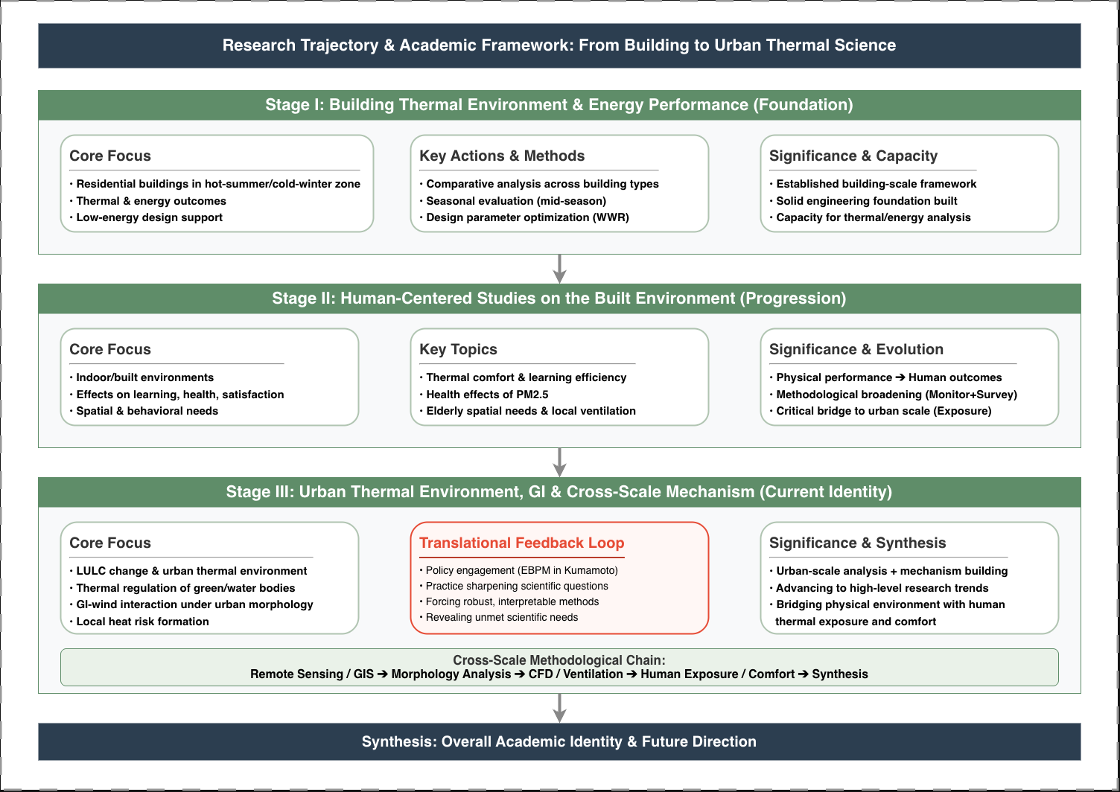
APPENDIX · BACKUP FOR Q&A · NOT PART OF THE 10-MIN TALK
BACKUP A1 / A4
ORIGINAL APPLICATION FIGURE
Research Trajectory & Academic Framework
Figure 1 (application) — full Building → Person → City framework with key actions, methods, and significance.
IF ASKED ABOUT…
My three research
stages in detail
Why each stage
led to the next
Specific methods
per stage
How Stage 3 leads
to this project
Notes:
[BACKUP A1 — Research Trajectory] Use if a reviewer asks for the detailed evolution of my research, the specific methods at each stage, or how the three stages connect. This is the full framework from my application; Slide 4 is its simplified version.

Slide 13
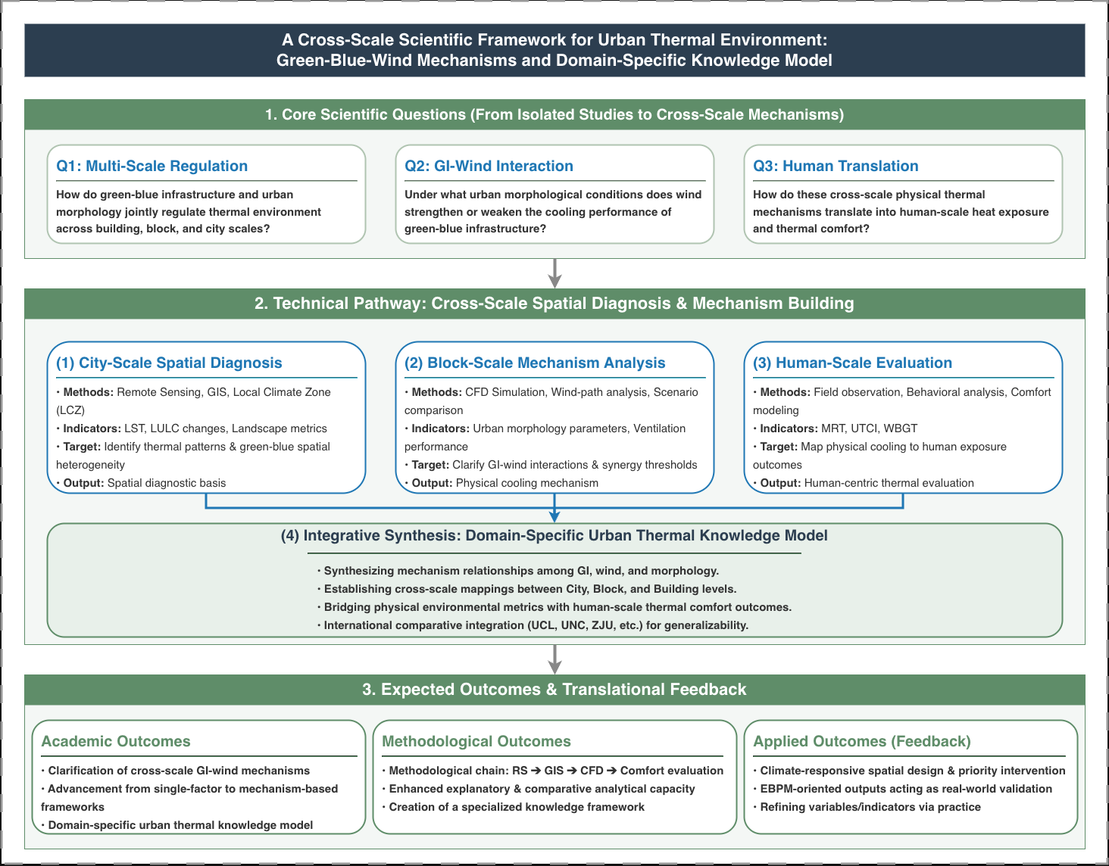
APPENDIX · BACKUP FOR Q&A · NOT PART OF THE 10-MIN TALK
BACKUP A2 / A4
ORIGINAL APPLICATION FIGURE
Cross-Scale Scientific Framework
Figure 2 (application) — green-blue-wind mechanisms, three core scientific questions, technical pathway, and domain-specific knowledge model.
IF ASKED ABOUT…
The 3 core
scientific questions
City / Block /
Human scale detail
How the scales
are integrated
Expected academic
& applied outcomes
Notes:
[BACKUP A2 — Cross-Scale Framework] Use if a reviewer wants the scientific depth behind Slide 5 — the Q0/Q1/Q2 questions, the three analytical scales, and how they integrate into one knowledge model.

Slide 14
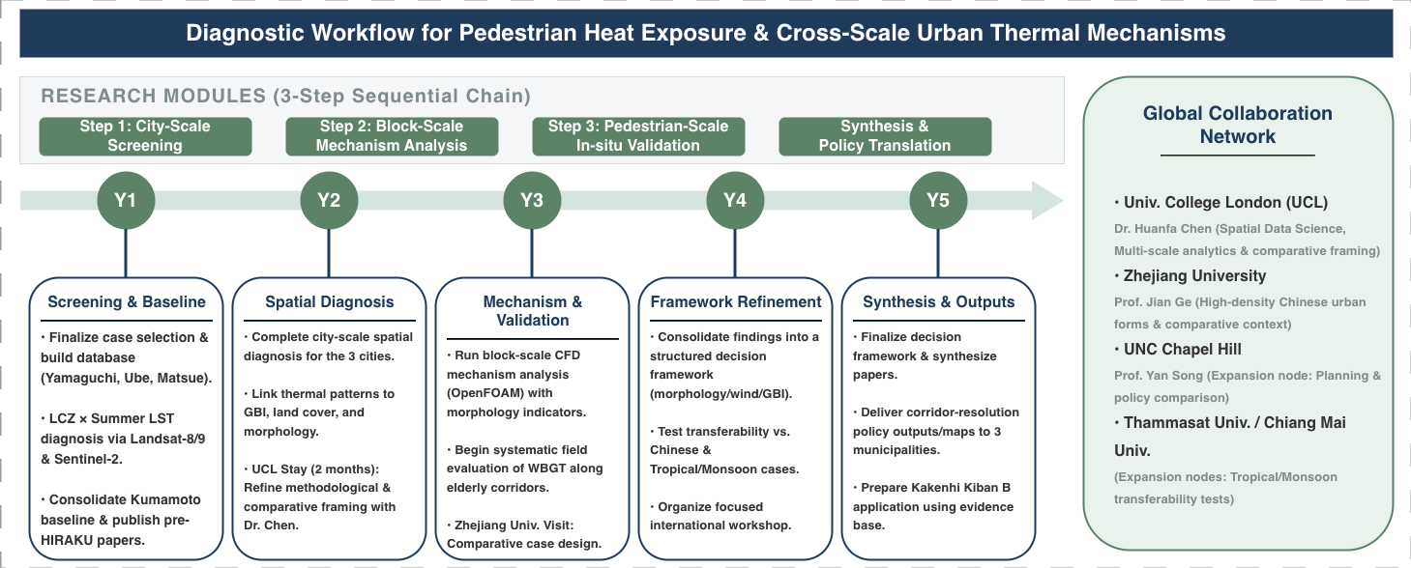
APPENDIX · BACKUP FOR Q&A · NOT PART OF THE 10-MIN TALK
BACKUP A3 / A4
ORIGINAL APPLICATION FIGURE
Diagnostic Workflow & 5-Year Plan
Figure 3 (application) — three-step sequential chain (screening → mechanism → validation) mapped onto the five-year HIRAKU timeline.
IF ASKED ABOUT…
Year-by-year
deliverables
The 3-step
method chain
Where UCL &
Zhejiang fit in
Screening →
validation logic
Notes:
[BACKUP A3 — Workflow & Plan] Use if a reviewer probes feasibility or the year-by-year schedule. Shows the full screening-explanation-validation chain behind Slide 9.

Slide 15
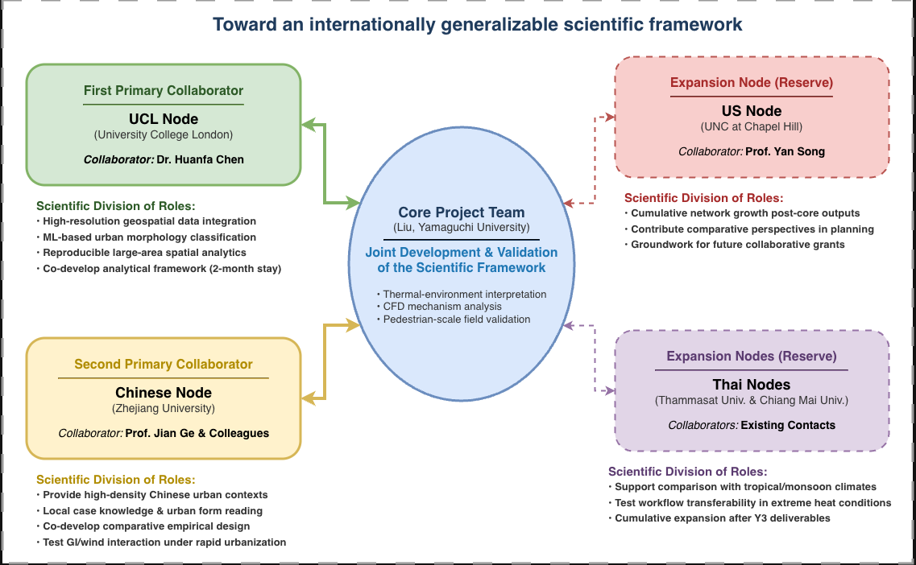
APPENDIX · BACKUP FOR Q&A · NOT PART OF THE 10-MIN TALK
BACKUP A4 / A4
ORIGINAL APPLICATION FIGURE
International Collaboration Framework
Figure 4 (application) — core project team at Yamaguchi with UCL and Zhejiang as primary nodes; US and Thailand as reserve expansion nodes.
IF ASKED ABOUT…
Roles of UCL &
Zhejiang partners
What each partner
contributes
Reserve nodes
(US, Thailand)
How the network
grows cumulatively
Notes:
[BACKUP A4 — Collaboration] Use if a reviewer asks for detail on partner roles, complementarity, or how the network expands. Expands the hub-and-spoke diagram on Slide 7.

