Slide 1
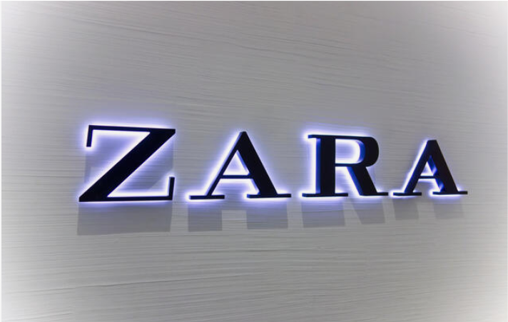
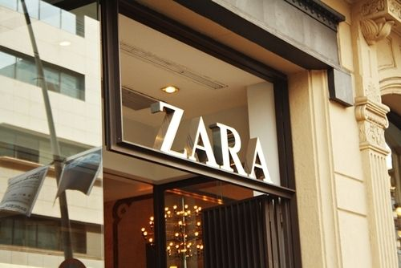
Case by Chara Vega BROWN, Jyotishka DAS, Michele Natacha ELA ESSOLA

Slide 2
Introduction
Zara which was once known as Zorba, inspired by the movie ‘Zorba the Greek’, is a leading Spanish clothing company founded in 1975, which started with a single shop in Spain and has now expanded globally. Zara has now 20000 stores in more than 95 countries. Given the market increase forecasts and investment capabilities, Zara has decided to expand its DC network Europe.
In this study, we aim to identify the distribution centers (DC) to build or to extend for single-source and multi-source supplying, considering the demand of each store should be delivered by a single or multiple DCs respectively, and to determine the DCs to build or extend for multi-source supplying. We will further explore alternative scenarios and their impact on the solutions

Slide 3

Problem Statement
The current DC network is limited to a part of Southern Europe with various capacities. The problem faced is that the DCs operate at full capacity and there is a need of network extension to meet increasing demands and to minimize the costs of either building or extending, while adhering to a budget constraint
Without a network extension, it will be challenging to accommodate the market growth effectively as the current network may not be optimally positioned to serve all the stores efficiently. Overburdened DCs can result in delays and longer lead times, impacting the timely delivery of products.

Slide 4
Key Performance Indicators
While the optimization task is to minimize the global cost of the extensions and constructions, in this analysis we will also consider the following KPI’s:
Average Delivery Time to stores: While the maximum delivery costs have already been added to the constraints, the average delivery time alone is also a very considerable indicator of the value that the delivery service can bring to the Zara stores as stores would no longer need to have long waiting time or delays in the delivery of their products.
Monthly Delivery Costs for stores: Correlated with the delivery time, it is also stand alone a very considerable measure to consider. When we lowered the aggregate of the monthly delivery costs for the stores in the ‘Whatif’ situation, the optimization problem yield completely different solutions (seen later), and therefore has a strong impact on the business decisions.
Capacity of Distribution Centers Post-Optimisation: Decision makers need to assess the capacity of the distribution center to handle the expected volume of goods and fulfill customer orders effectively, as well as the scalability and flexibility of the business.

Slide 5
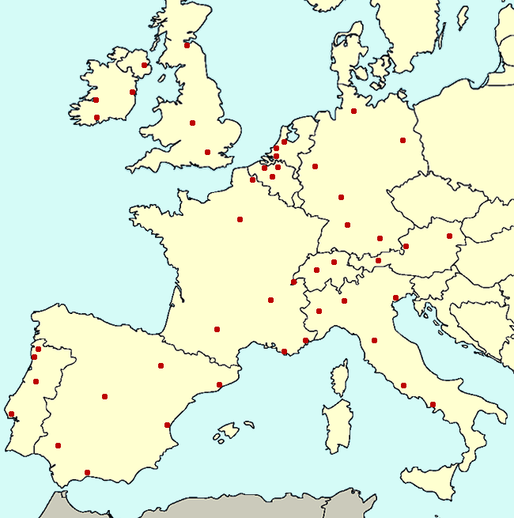
Single-source supplying solution
In a single-source supplying, each store’s demand is delivered by a single Center.
Following our analysis for the single-source ILP problem, we suggest to:
Extend: DC 1 (Madrid) by a capacity of 8000 extra units
Construct: DC 7 & DC 8 (Bordeaux & Barcelona)
Our analytics team has found that €19800 would be the most cost-effective allocation of resources to be used to extend or construct the DCs , while meeting the demand of the stores and staying in the budget.
★
★
★
★ : DC to be extended
★ : DC to be constructed

Slide 6
Multi-source supplying solution
In a multi-source supplying, each store’s demand may be delivered by multiple centers.
Following our analysis for the multi-source ILP problem, we suggest to:
Extend: DC 1 & DC 4 (Madrid & Montélimar) by a capacity of 8600 & 8001 extra units respectively
Construct: DC 7 (Bordeaux)
Our analytics team has found that €5660.1 would be the most cost-effective allocation of resources to be used to extend or construct the DCs , while meeting the demand of the stores and staying in the budget.
★
★
★
★ : DC to be extended
★ : DC to be constructed

Slide 7
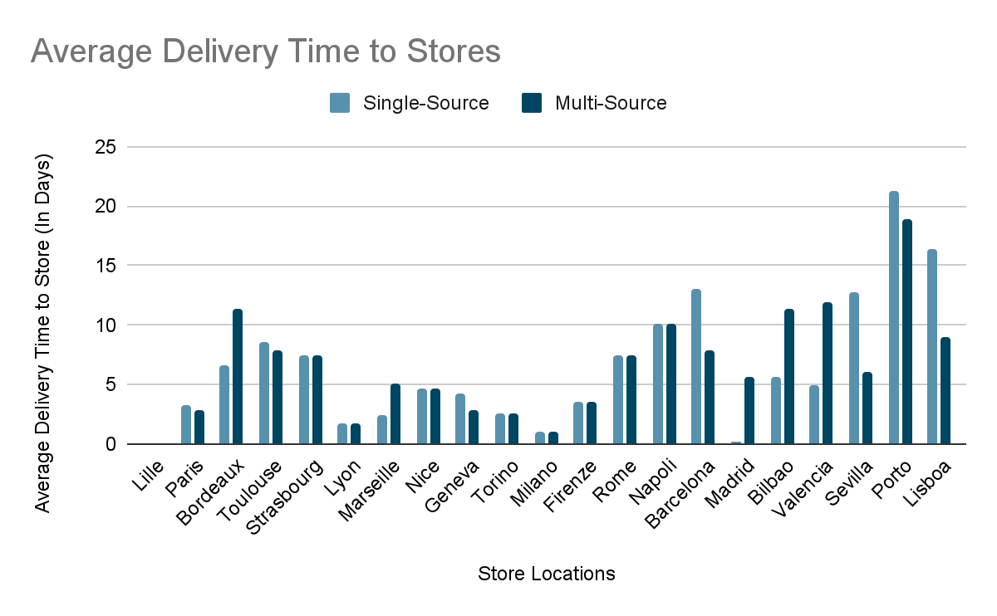
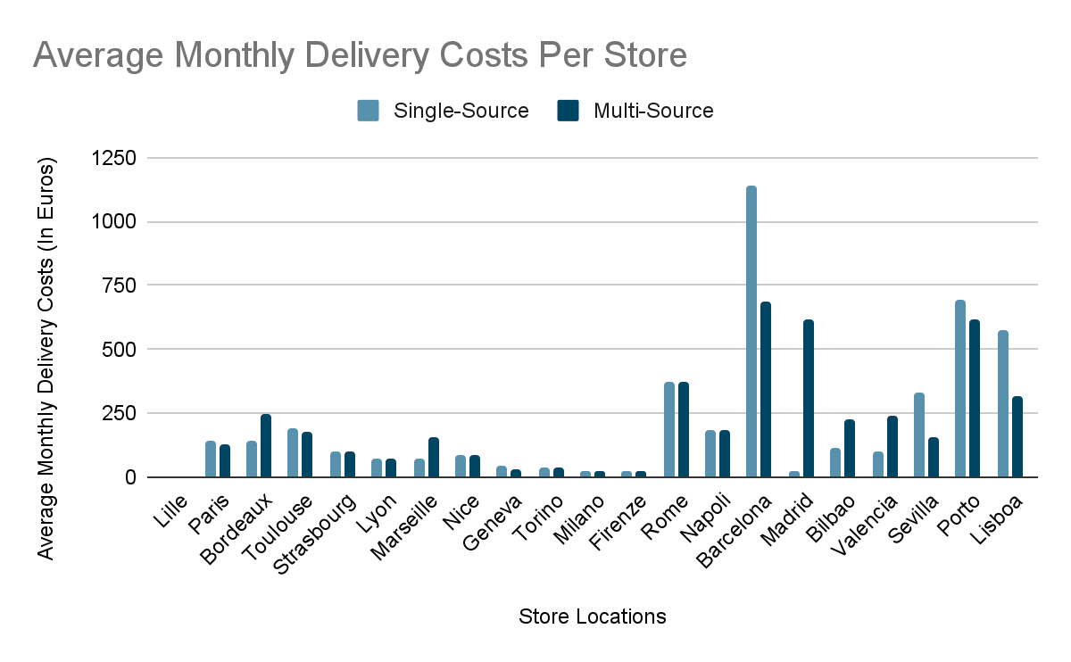
Post-Optimization KPI Analytics
Observation: For all the stores, to suit their demands, multiple source procurement and single source procurement both needs ~138 hours delivery time on average.
But, for multiple source procurement, the construction/extension cost is significantly less (€5660) than that for single source procurement (€19800).

Slide 8
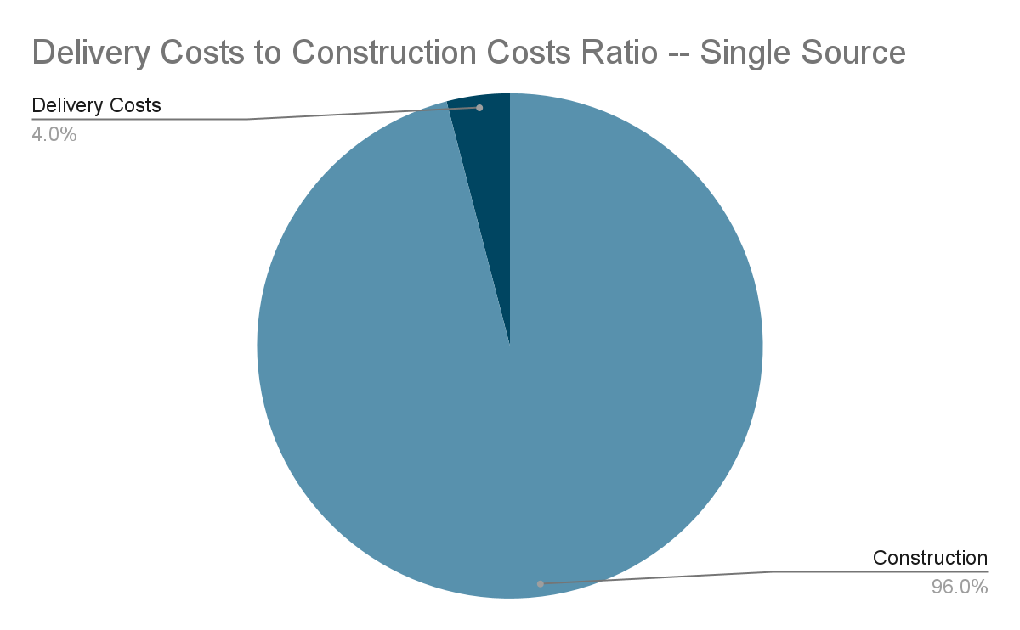
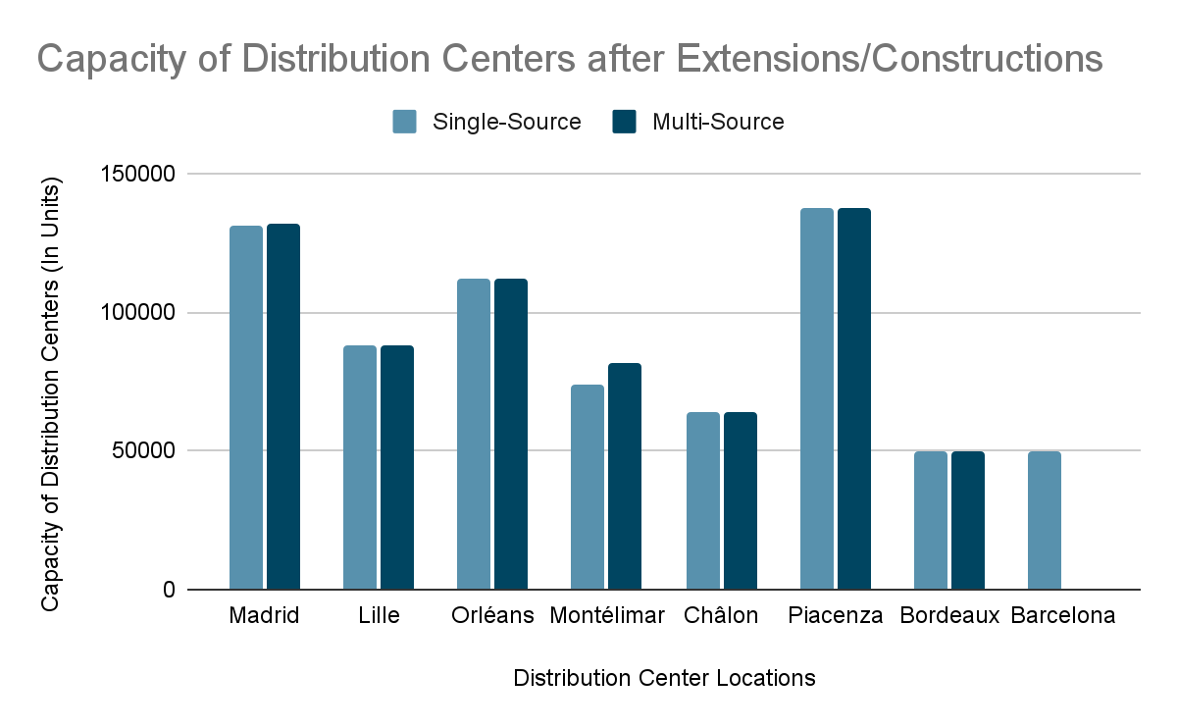
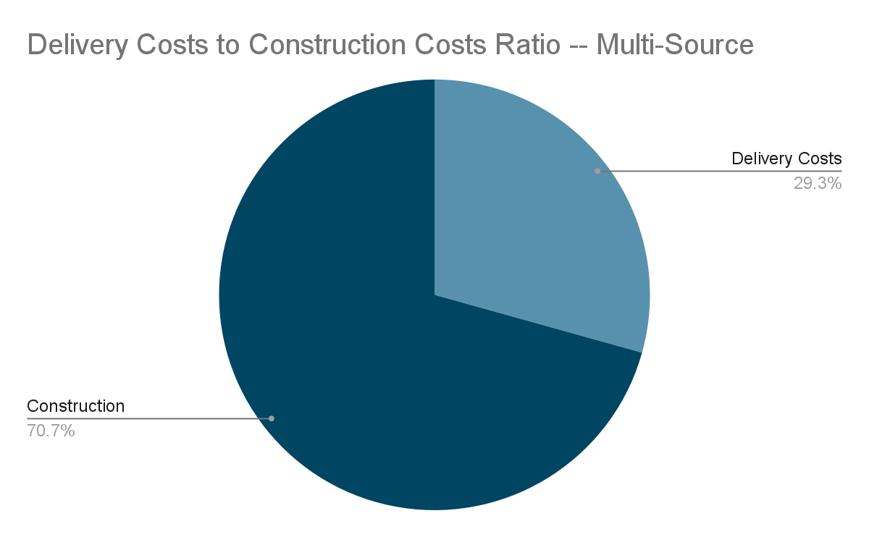
Post-Optimization KPI Analytics

Slide 9
What-If Case 1: Increase lower limit of extensions
What-If Case 1: The extension can provide between 10000 and 13000 extra items instead of between 8000 and 13000 items (applied to multi-source problem). The optimal solution based on our analysis is the following:
Extend: DC 1 & DC 2 (Madrid & Lille) by a capacity of 10000 extra units each
Construct: DC 7 (Bordeaux)
The optimization results in the minimum total of extension and construction costs of 6000 euros.
★
★
★
★ : DC to be extended
★ : DC to be constructed

Slide 10
What-If Case 2: Decrease Monthly Delivery Costs Budget
What-If Case 2: The monthly delivery cost to an aggregated store do not exceed a budget of 3500 euros instead of 4500 euros (applied to multi-source problem). The optimal solution based on our analysis is the following:
No extensions to be made
Construct: DC 7, DC 8 & DC 9 (Bordeaux, Barcelona, and Rome)
The optimization results in the minimum total of extension and construction costs of 39000 euros.
★
★
★
★ : DC to be extended
★ : DC to be constructed

Slide 11
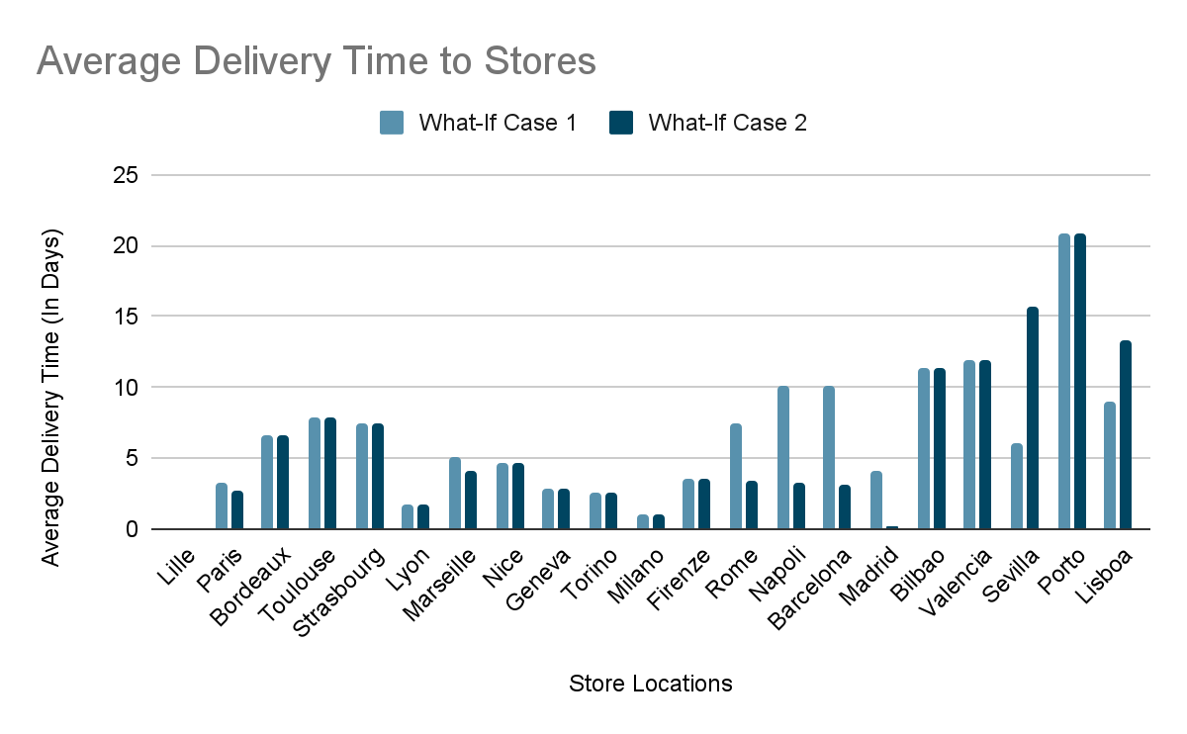
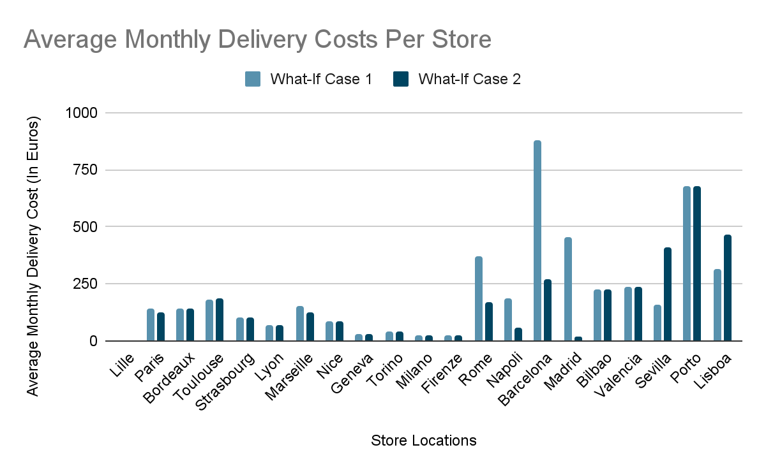
What-If Post-Optimisation KPI Analysis

Slide 12
Summary and recommendation
Suggestions:
Our research strongly suggests to adapt a multi-source supplying model. In the optimal case for single source and multi-source, the average delivery time and costs are similar, yet the delivery costs in the former scenario is considerably higher. The multi-source approach provides much more flexibility and is highly cost effective.
Among all the cases that this analysis encompasses, the one yielding the minimal extension and construction costs is the multi-source supplying solution (with no alterations to the initial constraints). Our analysis yields an optimal solution to this problem of extending distribution centers in Madrid and Montélimar by a capacity of 8600 & 8001 extra units respectively and to construct a distribution center in Bordeaux.
Consider more possible locations to build distribution centers: This analysis was based on the 9 locations provided, and among them, three possible locations to consider construction of distribution centers. We suggest to continue to search for more construction zones at cheaper prices (especially in Portugal where the delivery cost and average delivery costs are the highest). Given this new data, we are always available to reformulate our problem and solve for better optimal solutions.
Looking ahead:
Further analysis could include measures such as the global Supply-Demand Gap. Understanding the supply-demand gap is crucial for strategic planning and business growth. This would be beneficial to evaluate market opportunities, assess the competitive landscape, and identify areas where the supply-demand gap can be addressed to gain a competitive advantage.

