Slide 1
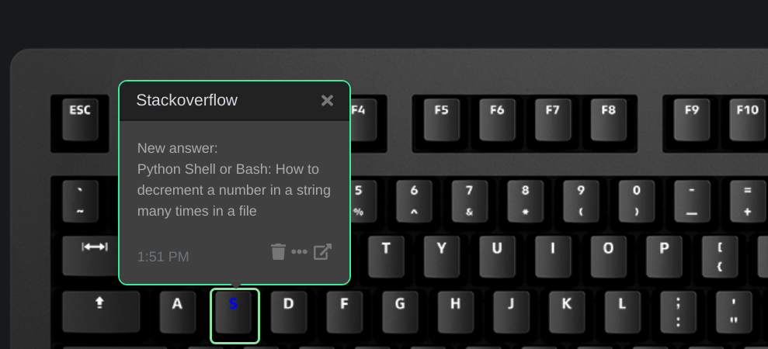
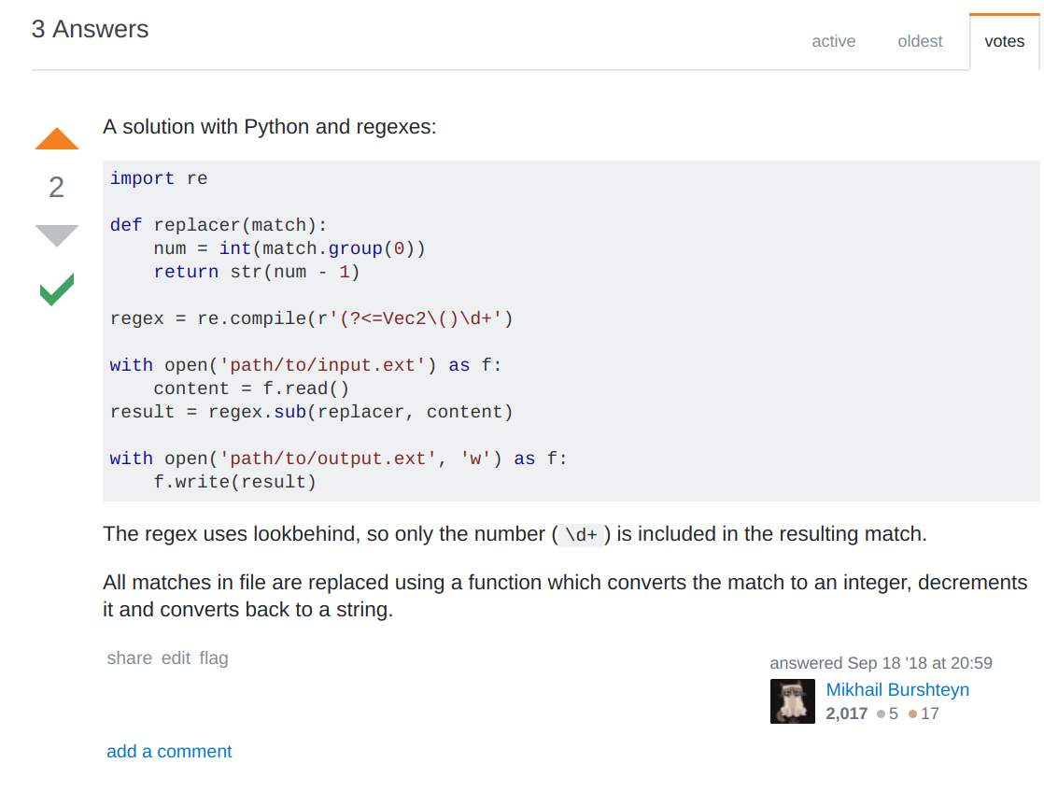
Click to open stackoverflow.com
New item in Stackoverflow inbox.

