Slide 1
Forecasting Kaggle Sticker Sales
Koustav Das
Kaggle Series 2025, Episode 1

Slide 2
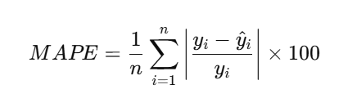
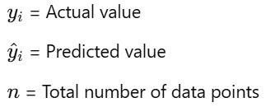
Problem Statement
I need to predict multiple years worth of sales for Kaggle-branded stickers across different stores and countries, considering real-world factors such as seasonality, holidays, and trends. It is a regression problem.
EVALUATION METRIC
MEAN ABSOLUTE PERCENTAGE ERROR (MAPE)
GOAL
BUILD AN ACCURATE PREDICTIVE MODEL USING MACHINE LEARNING.

Slide 3
Dataset Overview
230130 rows and 6 columns.
Columns are id, date, country, store, product, num_sold
1st 5 columns are features and last column is target.
In 1st 5 column, id is numerical and others are categorical columns.
There are null values present in target column. 8871 null values are present in that column which is almost 3.8% of total data points.
After dropping null points there are 221259 data points present.

Slide 4
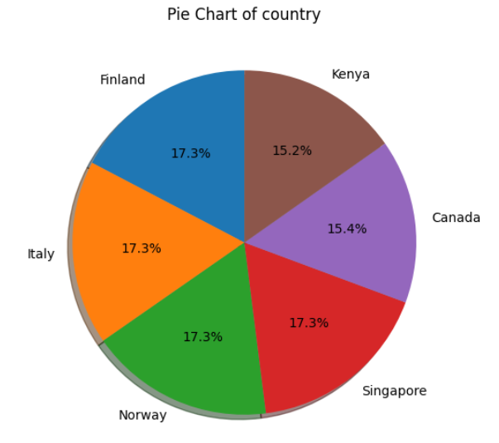
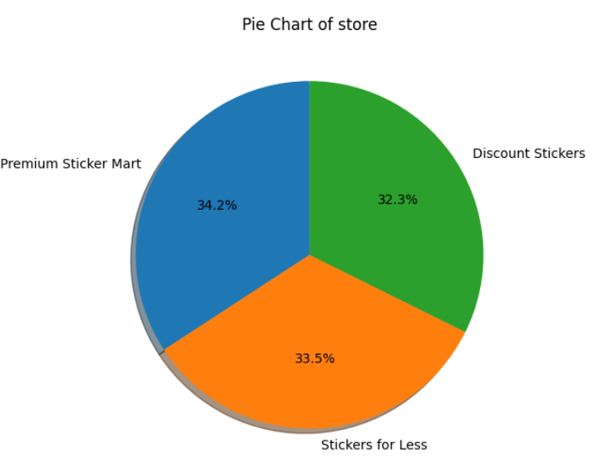
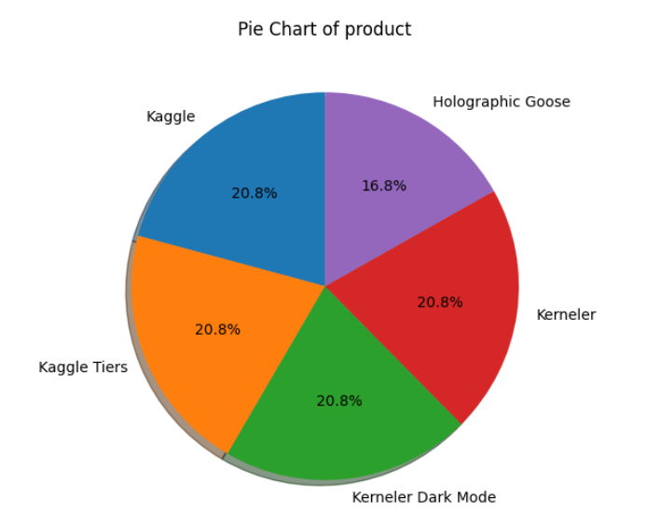
Exploratory Data Analysis (EDA)
Country column:
6 country present.
Countries are: finland, Italy, Norway, Singapore, Canada, kenya.
There are almost same number of data point available in our dataset which is around 17% .
Store column:
there are 3 store named as premium sticker mart, discount stickers, stickers for less.
almost 33% data points are available for each shop in our dataset.
Product column
5 product are there named as Kaggle, Kaggle tiers, kerneler dark modes, kerneler, holographic goose.
Near about 20 % points are there for each category in dataset.

Slide 5
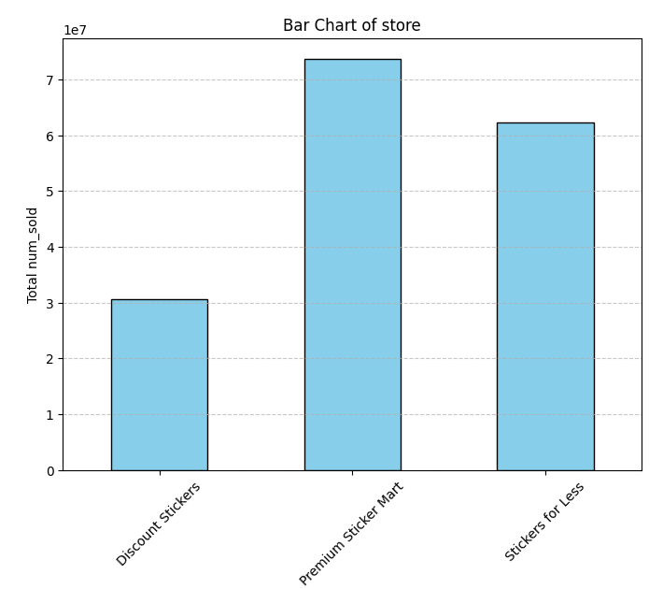
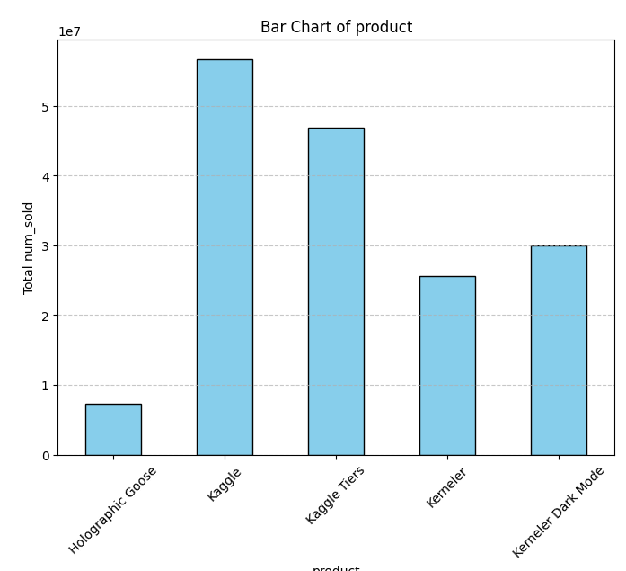
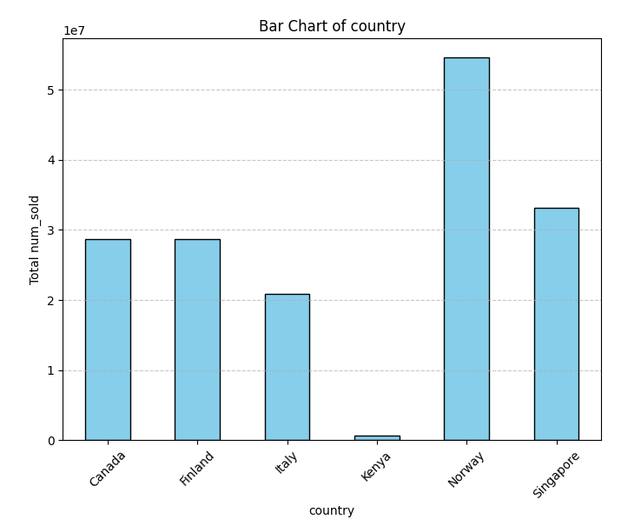
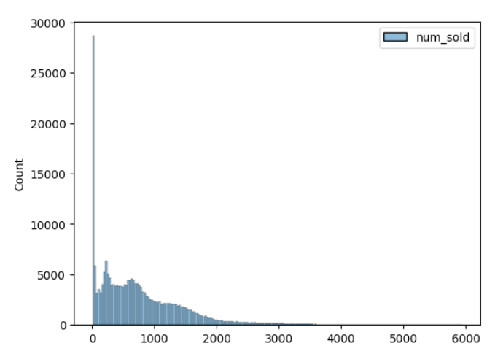
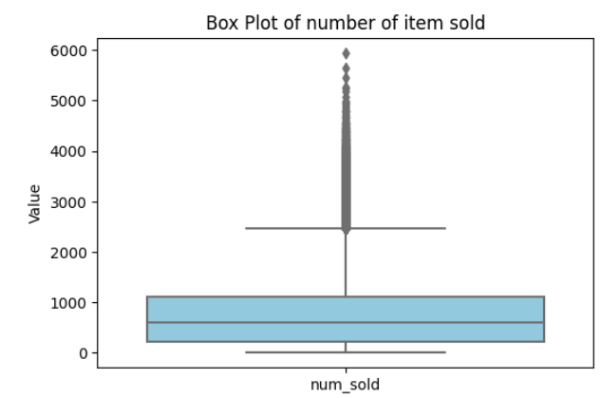
Country column:
Maximum and minimum number of sticker sold from country Norway and kenya respectively.
For others selling amount is kind of similar.
Store column
Premium sticker mart is the most selling store.
Sticker for less and discount stickers is on 2nd and 3rd number.
Product column
Kaggle and Kaggle tiers are the 2 top selling sticker.
Holographic goose is the least selling sticker.
IN OUR TARGET COLUMN VALUES ARE RIGHTLY SKEWED. 25%, 50%, 75% VALUES ARE AROUND 200, 800, 1200 RESPECTIVELY.
OUTLIERS ARE PRESENTS IN RIGHT SIDE SINCE DATA IS HEAVILY RIGHTLY SKEWED.

Slide 6
METHODOLOGY AND APPROACH
Feature engineering:
After dropping the rows with missing values I drop the column id since it is the index number only and I also drop the num_sold column since it is the target column .
to understand trends, pattern in better ways I converted date column in day, month, year column.
From day column I created weekend column which can capture the selling trends in weekends.
Data preprocessing:
Create two pipeline for categorical and numerical features.
Use standard scaler for numerical and one hot encoding for categorical columns.
At last use column transformer to use both pipeline in respective columns all together to maintain stability in preprocessing.
Model selection:
XGB Regressor: A high-performance boosting model that captures complex patterns, reduces bias, and efficiently handles large datasets.
LGBM Regressor: A fast and memory-efficient model that excels in handling categorical features and large-scale data with lower training time.
Voting Regressor: An ensemble of XGB and LGBM that enhances prediction stability and accuracy by combining their strengths.
Other than this I also try to use various other models whose performance are poor with respect to these models. That’s why I have not add them here.

Slide 7


Model training
XGB Regressor:
With base model I got around 0.14 mape value but after hyper parameter tuning I can achieve around 0.09 mape value which is a huge improvement in the model performance.
With hyperparameter tuning I tune the value of eta(learning rate), max_depth, n_estimator. Here learning rate control the step size at each boosting iteration. a lower value makes learning slower but improves generalization, while a higher value speeds up training but risks overfitting. Similarly max_depth determine the depth of each indivisual tree.
Here trees grows level by level, meaning all nodes at a given depth split before going deeper. Works like bfs trees.
XGBRegressor (n_estimator=2000, random_state=42, learning_rate=0.05, max_depth=8)
lgBm Regressor:
With base model I got around 0.19 but after hyper parameter tuning I can achieve around 0.10.
Here I tune same parameter which I tune in xgbregeressor, i also tune reg_alpha and reg_lambda parameter. Here reg_alpha means l1 and reg_lambda means l2 regularization.
Here the trees grows leaf-wise, meaning it selects the leaf with the highest loss reduction and splits it first.
Lgbmregressor (n_estimator=2000, random_state=42, learning_rate=0.05, max_depth=8, reg_alpha=1, reg_lambda=1 )
voting Regressor:
Since my both model work kind of similar that’s why I use voting regressor which use both XGB and LGBM and by averaging their predictions it improves stability, accuracy and performance.
it gives me mape value around 0.08 which is best among three.

Slide 8
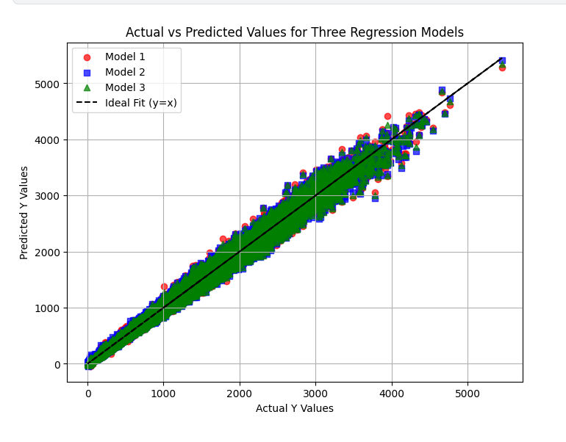
Model performance visualization
FROM THE ABOVE GRAPH WE CAN CLEARLY SEE THAT MODEL 3 IS PERFORMING WELL IN TEST DATASET.
THE PERFORMANCE OF MODEL 1 AND MODEL 2 IS ALMOST SAME.
SINCE THE MODEL 3 IS BEST AMONG ALL, I CHOOSE TO USE MODEL 3 TO PREDICT.

Slide 9
conclusion
Seasonality & Holidays Impact Sales:
Sales patterns show clear seasonal trends and holiday effects, which were captured in the model through feature engineering.
Feature Engineering Improved Accuracy:
Adding time-based features (month, day of the week, holiday indicators) significantly improved model performance.
XGBoost/LightGBM Performed Best:
These models effectively captured non-linear relationships and patterns in sales data, resulting in the lowest MAPE score.
Business Impact:
Helps stores optimize stock levels, reduce overstocking and stockouts.
Provides data-driven insights for sales strategies and demand forecasting.
Future Improvements:
While building various models I came to know about one libraries called as holidays . This is a python library used to manage and generate holiday calendar for various countries, regions and even states. It helps in adding holiday-related features to time-series data. Since in our data set seasonality is a big things that’s why I believe this can improve our model performance.
I will try to use this later to improve this model further more.

Slide 10
Thank you

