Slide 1
Capstone Design Project
Team: Jjangdol
2016314474 윤성빈 2016310703 남득윤
2016314668 위성은 2018310656 이다솔

Slide 2
01
Problem Statement
02
Background and related work
03
Proposed Solution
index
04
Project Plan
05
Project Goals

Slide 3
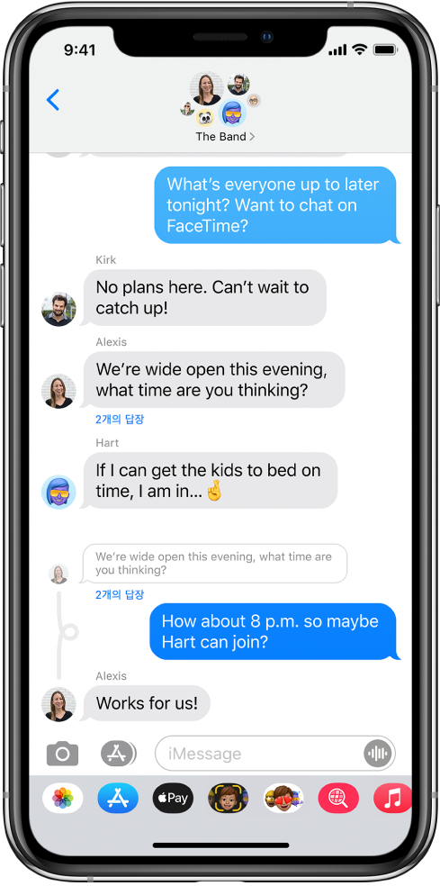
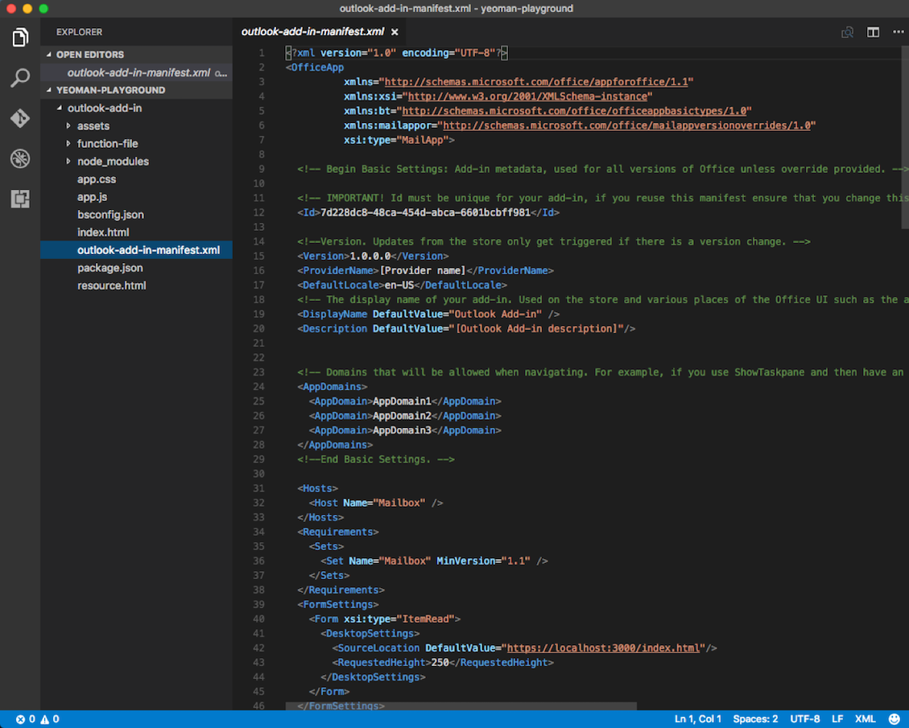

Slide 4
Font is in everywhere

Slide 5
GAN단한 폰트제작기
GANdanhan font maker

Slide 6
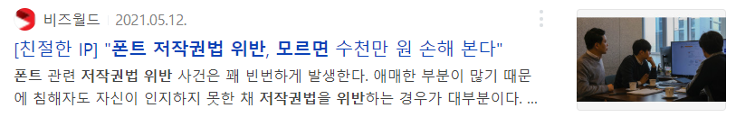
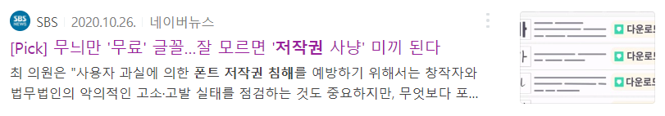
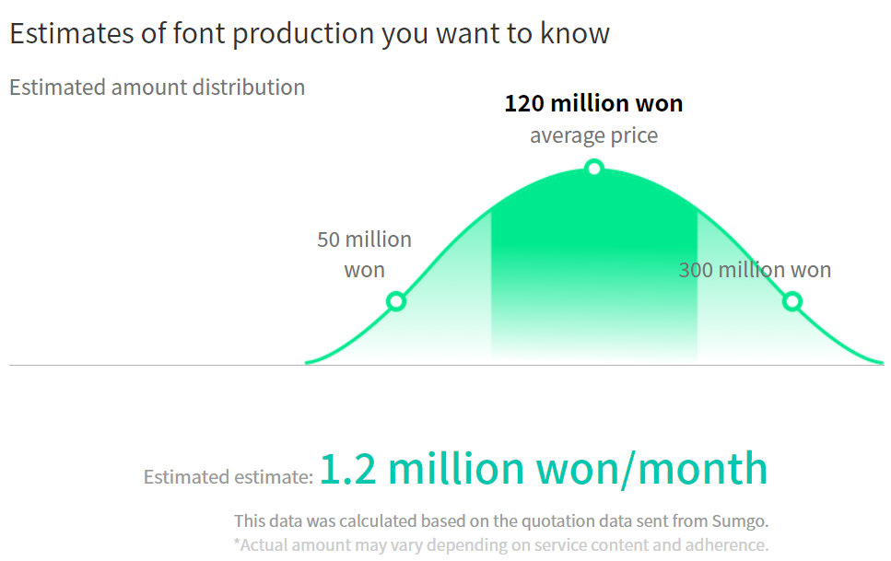
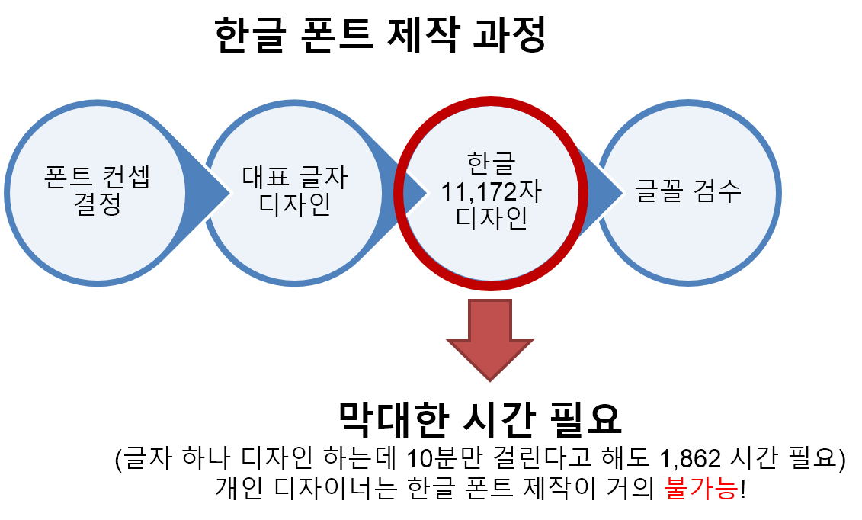
01
Problem Statement
ㆍCopyright Infringement problem
ㆍ Lots of cost and time took for developing fonts in Korean
[The process of making Korean fonts]
Select
font concept
Representative letter design
Korean
11,172
characters design
Inspection
A huge time consumed
(Even if it takes 10 minutes to design a letter, we need 1862 hours.) Individual designer is almost impossible to create Korean fonts
Notes:
Copyright infringement
일반 저작물과 달리 컴퓨터 프로그램 저작물의 경우에는 영리 목적은 물론 비영리/ 개인 목적으로 이용하더라도 저작권 침해 책임이 발생할 수 있다.
It is possible to make super hyper-personized font which is exclusive own
Efficiency
알파벳과 다르게 한글 폰트는 자음과 모음을 조합하면 약 11,500자 정도가 나오며 디자이너가 폰트 하나를 만드는데 일일이 디자인하고 다 만들기엔 약 3개월 정도의 시간이 소모되고 또한 비용도 크다.
Creativity
Express your self using own typography
Get prestige on it

Slide 7
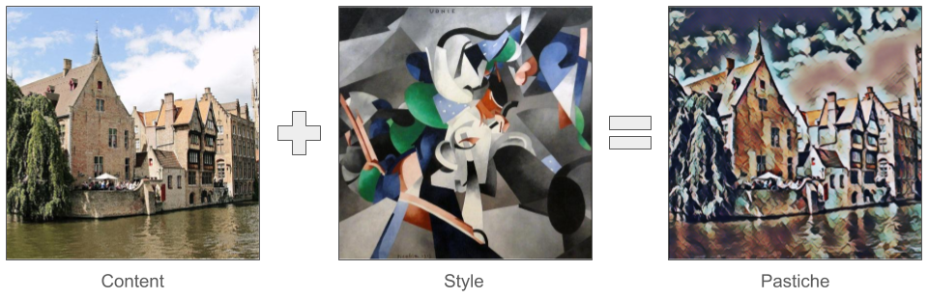
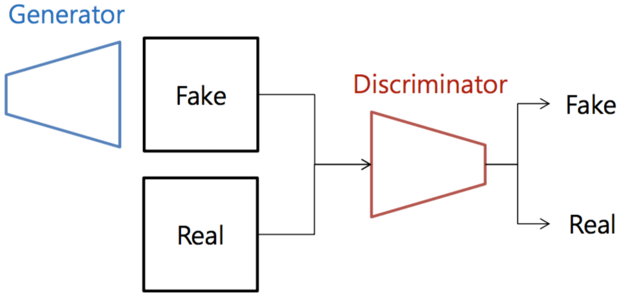
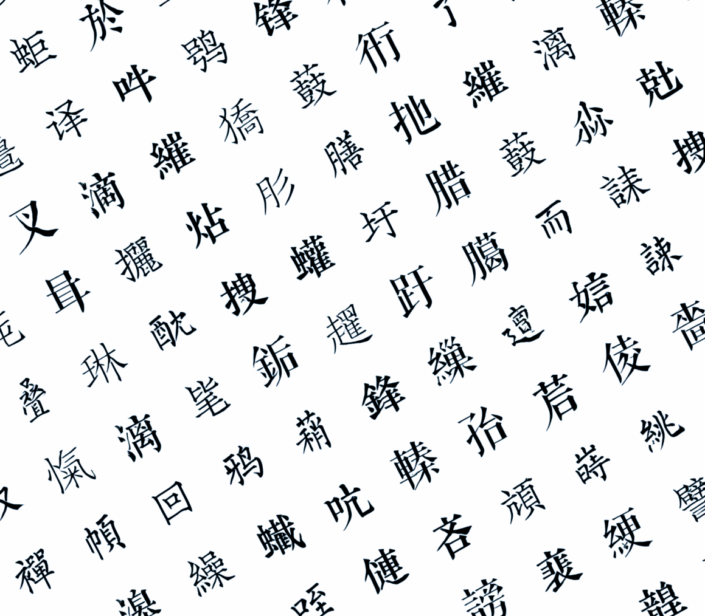
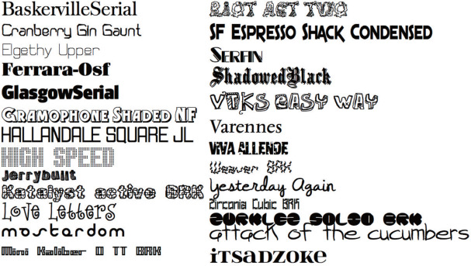
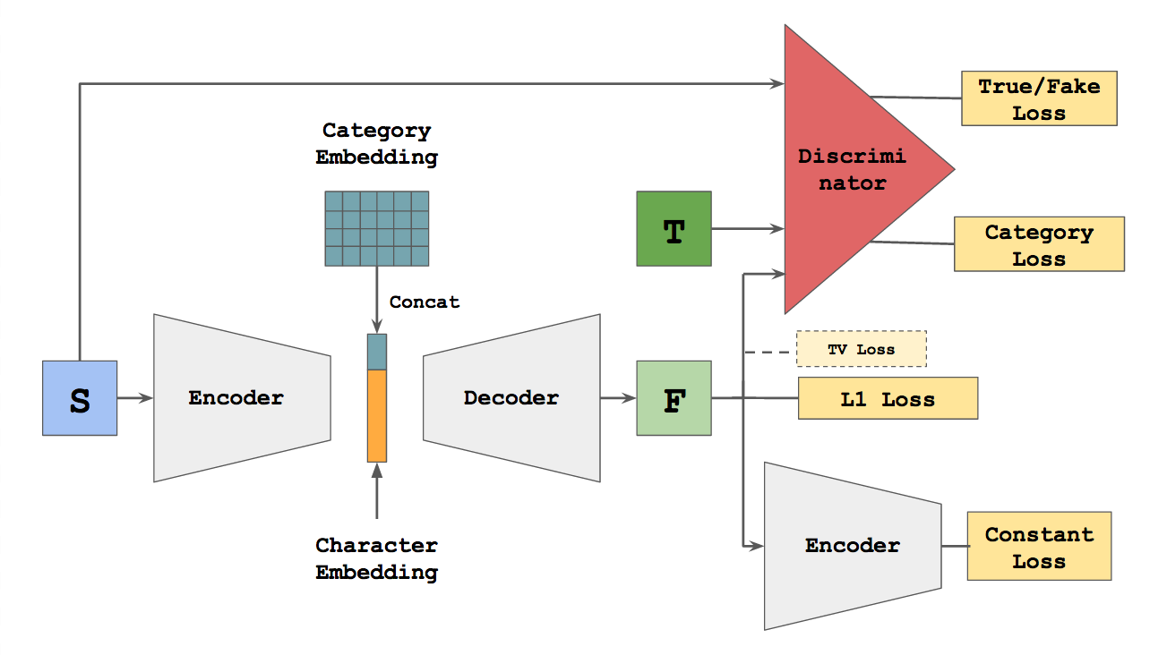
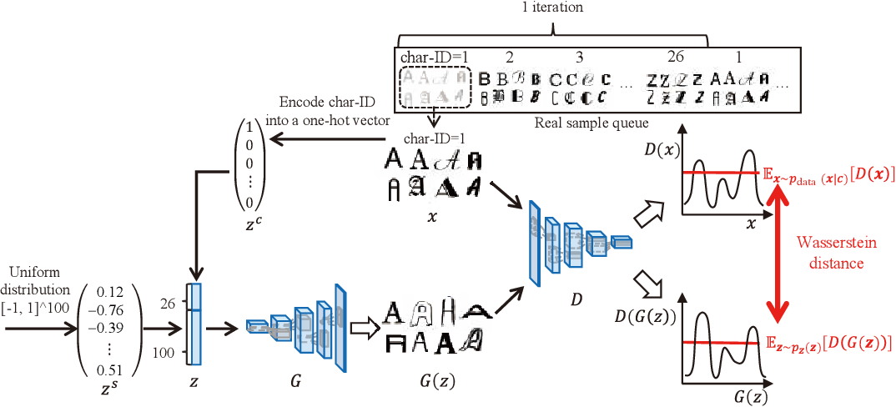
02
Background and related work
Generative Adversarial Networks(GAN)
[Style Transfer]
GAN research on Font Generation
1) Zi2zi
based on pix2pix
2) GlyphGAN
style-consistent font generation based on GANs
BUT, These are not specialized in Korean letters
[zi2zi]
[glyphGAN]
Notes:
Genrative Adversarial Networks is the most fundamental network for these kind of problem
GAN– Generate non-existing data by learning two adversarial Network – Generator and Discrimintor.
Generator generate Fake data. Discriminator discriminate the data. Both aim to perform better and they learn adversarially.
This idea is proposed by Ian Goodfellow at 2014 had a lot of influence on computer vision area.
Style Transfer is one of them.
Among them, we’d found some interesting topics of application in GAN. That is Font Generation.
These are two papers about font generation.
Zi2Zi is based on pix2pix, AC-GAN
GlyphGAN emphasized more abstracted input which results in the “real generation of font”
But they are not specillized in Korean letters.

Slide 8

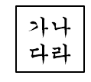



03
Proposed Solution
Enter the representative letter design
GANdanhan font maker
OCR
GAN output to .TTF file
GAN Font Generation
User
Provide a font file in .ttf format

Slide 9
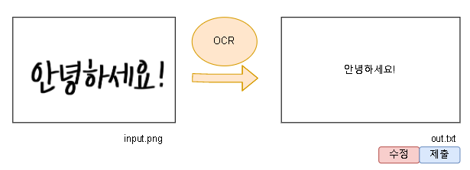
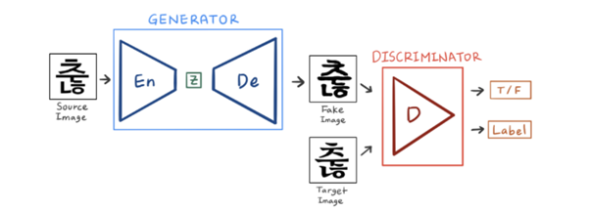
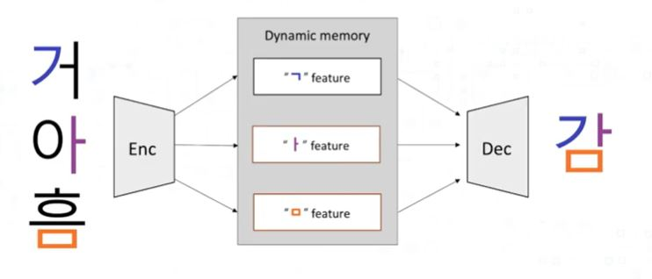
03
Proposed Solution
[Optical Character Recognition(OCR)]
a technology that recognizes text within a digital image
[Wrinie]
[DM-FONT]
DM-FONT is developed by clova ai (NAVER)
and it divides single Korean alphabet and learn by it.
The basic model architecture is GAN, but it specialized in Korean
Notes:
We would use OCR to Generate data to train/
Or to Get User Input.
We’d found Korean handwritten “word” data but not letter. So we might need this tech if we cannot find Korean hand-written dataset.
Also, we consider OCR for the user input data. In this case, user have no need to indicate that what he/she wrote indivisualy
And. the most important part of this work would be this part. That is GAN network
We’d found two Korean specialized Font Generator
Wrinie and DM-FONT. They are based on GAN with Generator implemented in Encoder-Decoder Frame
And DM-FONT is developed by clova ai (NAVER) and has more speciality on Korean letter
that is it divide single Korean alphabet and learn by it.
So, we would like to apply(choice) DM-FONT for out Network which is MIT licence.

Slide 10






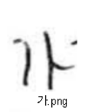
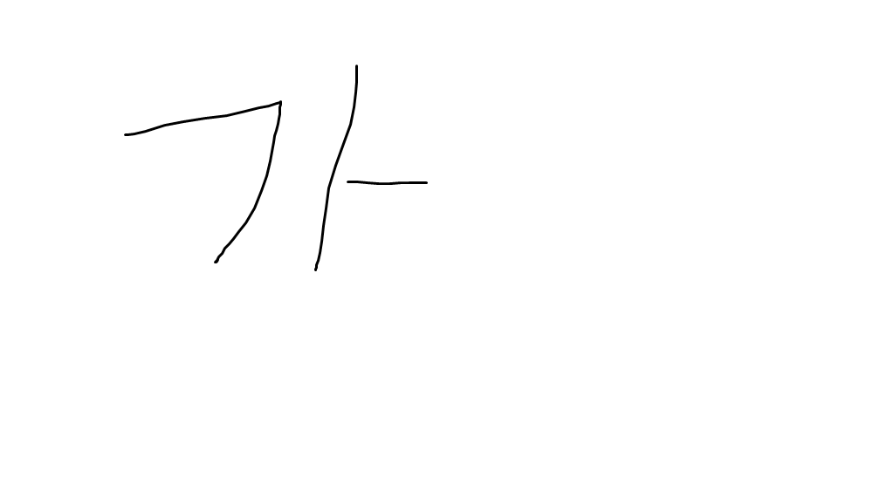

03
Proposed Solution
[Web Tech Stack]
- Upload your own letters
- Download the letters that were made.
Server
Create font files using model and
deliver them to the FrontEnd
FrontEnd
BackEnd
[GAN output to .TTF file]
GAN output
from potrace import Bitmap
https://github.com/fontello/svg2ttf
가.svg
Myfont.ttf
Notes:
웹어떻게 구축하고 (e.g. 언어, 어떤 프레임워크 사용할지)
GAN output = letter image paired with augmentation
PNG to SVG : to prevent font to be blur
Translation would be based on library and open-source project

Slide 11
04
Project Plan
Main Project
member | In Charge
Nam Deuk Yun | AI (GAN model) part
Lee Da Sol | OCR/dataset, support AI
Yoon Seong Bin | .ttf format modification, Web support
Wee Sung Eun | Web Stack development
Sub Project
Application and Modification of GAN, and OCR for project
Sub Project
Create .ttf format file after creating a personal font image file
Sub Project
Create a web that can handle overall works
Notes:
개별 역할 분담과 협업이 명료하게 정의되어 있는가?
한학기 동안 팀이 수행하기에 적절한 난이도 인가?

Slide 12
05
Project Goals
ㆍ Reducing the cost and simplifying the process of making font in Korean
ㆍBe free from copyright issues and express your self using own font
ㆍ Provide service which can create a font in Korean and transform in .ttf file

Slide 13
Design your own font

Slide 14
Thank you

