Slide 1
Big Data Analysis: LAB02
PageRank

Slide 2
Implementation in Sequential Computation

Slide 3
PageRank Algorithm
Power method
t ← 1
Initialize r_{i}¹ randomly for every node
Until every r_{i} does not change
For each node p_{i}
Compute
t ← t+1

Slide 4
Exercise
Given
The graph available at
https://www.dropbox.com/s/zl95rfknyyd7p5r/directed.txt?dl=0
10,000 pages
Page IDs are represented by integers between 0 and 9,999
Each line is in the form of
Current page Ids <tab> list of outgoing page Ids delimited by <tab>
Compute PageRank of every page

Slide 5
Example code of reading a line
try {
String line;
BufferedReader reader = new BufferedReader(new FileReader(filename));
while((line = reader.readLine()) != null) {
}
}
catch(IOException e) {
e.printStackTrace();
System.exit(1);
}

Slide 6
MapReduce Programming

Slide 7
Pseudo Code (MapReduce)
Map
Input
page_rank_values_of_previous_step
current_page_id, list of target_page_ids
Body
emit (target_page_id, pagerank_value_to_distribute)
Reduce
Input
page_id, list of page_rank_value
Body
sum each page_rank_value in the list
emit (page_id, sum of page_rank_values)

Slide 8
Exercise
Given
A small directed graph available at
https://www.dropbox.com/s/szbv5esh344ekw8/pagerank.data.4?dl=0
Compute PageRank using MapReduce
Download the following template
https://www.dropbox.com/s/3fzwb9efrt2qe7w/PageRankTemplate.java?dl=0

Slide 9
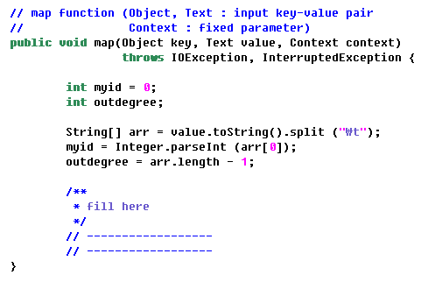
Mapper

Slide 10
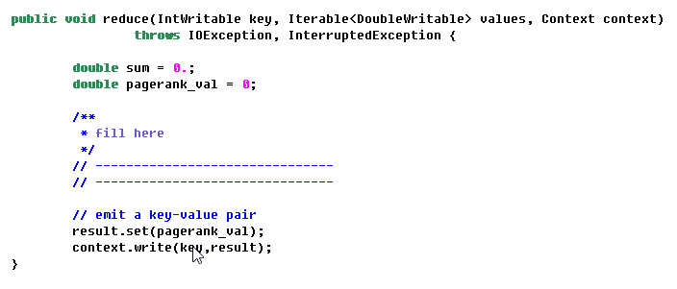
Reducer

Slide 11
Main function
public static void main(String[] args) throws Exception {
Configuration conf = new Configuration();
String[] otherArgs = new GenericOptionsParser(conf,args).getRemainingArgs();
…
npoint = Integer.parseInt(otherArgs[0]);
conf.setInt ("npoint", npoint);
int maxIter = 10; // maximum iteration
initPageRank (conf);
for (int itr=0; itr<maxIter; itr++) {
…
Path outdir = new Path (otherArgs[2]);
if (FileSystem.get(conf).exists(outdir)) {
FileSystem.get(conf).delete (outdir);}
FileInputFormat.addInputPath(job,new Path(otherArgs[1]));
FileOutputFormat.setOutputPath(job,new Path(otherArgs[2]));
job.waitForCompletion(true);
broadcastPageRank (conf, outdir); // broadcast pagerank values for the next step
}

Slide 12
initPage(), broadcatPage()
public static void initPageRank (Configuration conf)
{
for (int i=0; i<npoint; i++)
{
conf.setFloat ("pagerank" + i, (float)(1. / (double)npoint));
}
}
public static void broadcastPageRank (Configuration conf, Path outdir) throws Exception {
FileSystem fs = outdir.getFileSystem (conf);
FSDataInputStream fp = fs.open (new Path (outdir + "/part-r-00000"));
String line = null;
while ( (line = fp.readLine ()) != null ) {
String[] arr = line.split("\t");
int id = Integer.parseInt (arr[0]);
double val = Double.parseDouble (arr[1]);
conf.setFloat ("pagerank" + id, (float)val);
}
}

Slide 13
Setup & config
public class PageRankTemplate{
public static class MapperClass extends Mapper<Object,Text,IntWritable,DoubleWritable> {
…
private void loadPageRank (Configuration config) {
for (int i=0; i<npoint; i++)
{
pagerank[i] = config.getFloat ("pagerank" + i, 0);
}
}
protected void setup(Context context) throws IOException, InterruptedException {
// get the parameters set by the main function (see the main function. we call "conf.set")
Configuration config = context.getConfiguration();
npoint = config.getInt ("npoint", -1);
…
loadPageRank (config);
}
public static class ReducerClass extends Reducer<IntWritable,DoubleWritable,IntWritable,DoubleWritable> {
…
protected void setup(Context context) throws IOException, InterruptedException {
Configuration config = context.getConfiguration();
npoint = config.getInt ("npoint", 1);
}
…

