Slide 1
Big Data Analytics: LAB01
Younghoon Kim
(nongaussian@hanyang.ac.kr)

Slide 2
Content
Overview of Virtual Machine for Hadoop Training
Eclipse installation
Environment Variables
Developing Exercises

Slide 3
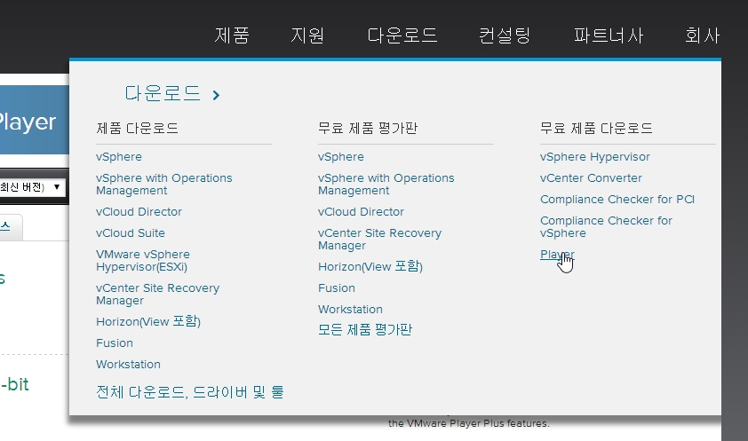
Download Virtual Machine
In this class we will be using Vmware, a desktop virtualization product to run Ubuntu
http://www.vmware.com/kr
홈 > 다운로드 > 무료제품다운로드 > Player
Vmware Player for Windows

Slide 4
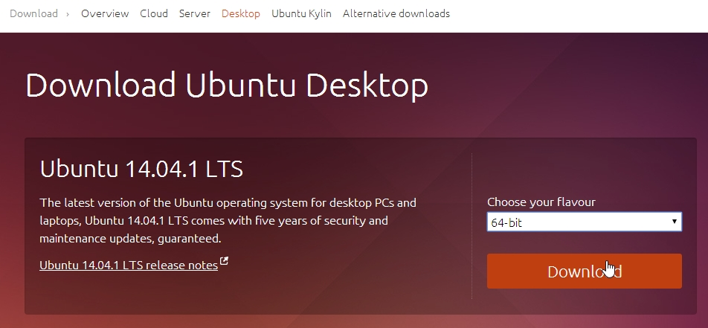
Download Linux
We use the recent version of Ubuntu
http://www.ubuntu.com/
Desktop > click “Get Ubuntu now”

Slide 5
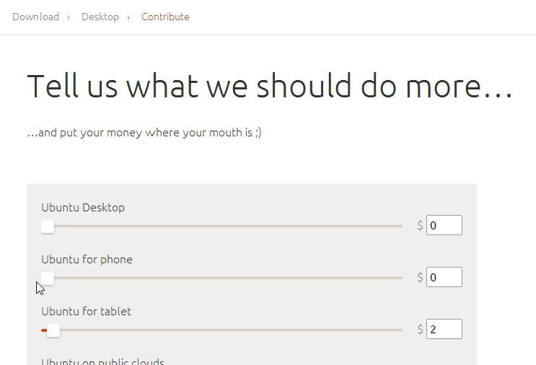
Download Linux
You need not to contribute (set all to zero)
Get an image file:
64bit: ubuntu-<version number>-desktop-amd64.iso
32bit: ubuntu-<version number>-desktop-i386.iso

Slide 6
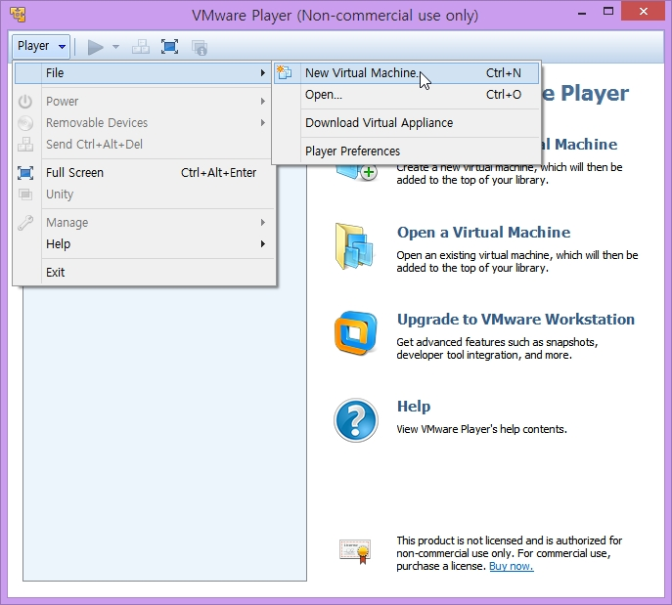
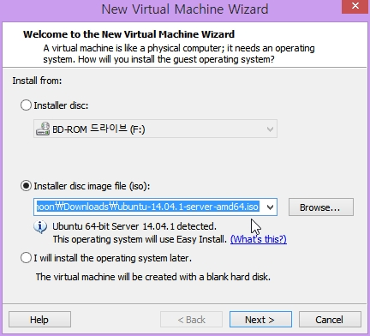
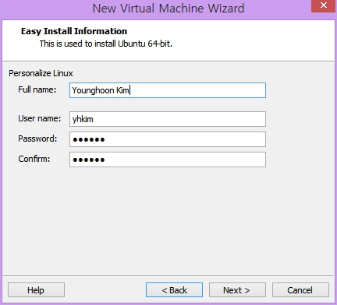
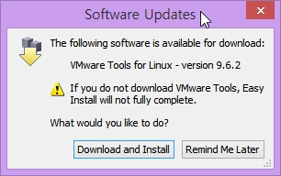
Install Ubuntu On VMware
hadoop
hadoop
hadoop

Slide 7
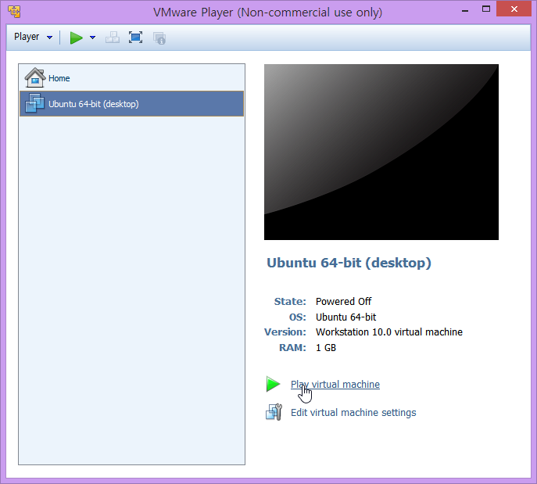
Start Ubuntu!
Select Ubuntu & play the virtual machine

Slide 8
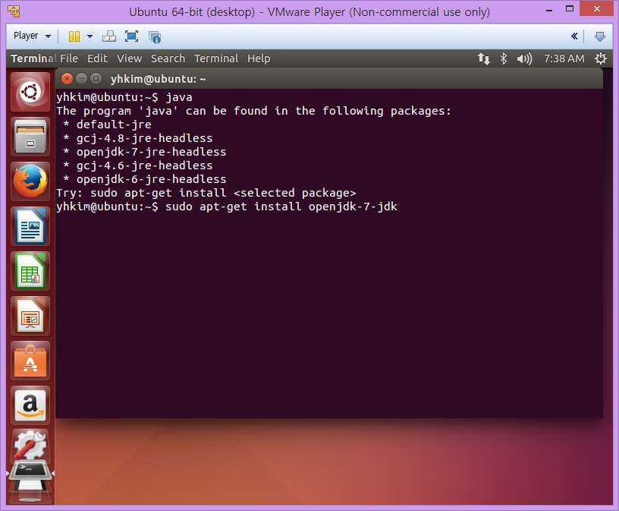
Install Java Compiler On Ubuntu
Check Java version
Install Java using ‘apt-get’ command

Slide 9
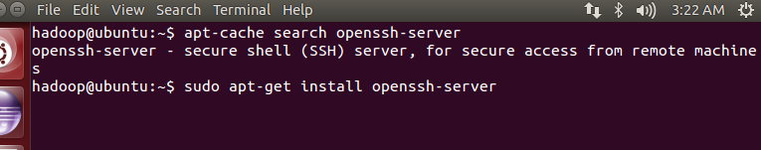
Install SSH Server
$ apt-cache search openssh-server
$ sudo apt-get install openssh-server

Slide 10
Install Hadoop 1.2.1
Download hadoop 1.2.1 package
Web page: http://hadoop.apache.org/releases.html#Download
hadoop-1.2.1.tar.gz file will be appeared in $HOME/Downloads
Install hadoop
$ cd $HOME
$ mv Downloads/hadoop-1.2.1.tar.gz .
$ tar zxvf hadoop-1.2.1.tar.gz
(OPT) Make a symbolic link
$ ln –s hadoop-1.2.1/ hadoop
(OPT) Set PATH
$ echo “export PATH=$PATH:/home/hadoop/hadoop/bin” >> ~/.bashrc

Slide 11
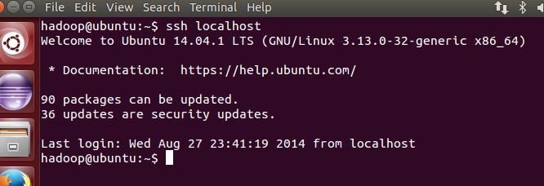
SSH Setting
Setup passphraseless ssh
Execute the following commands:
$ ssh-keygen -t dsa -P '' -f ~/.ssh/id_dsa
$ cat ~/.ssh/id_dsa.pub >> ~/.ssh/authorized_keys
Check
$ ssh localhost
Answer ‘yes’
If you can ssh to the localhost without a passphrase, it’s OK

Slide 12
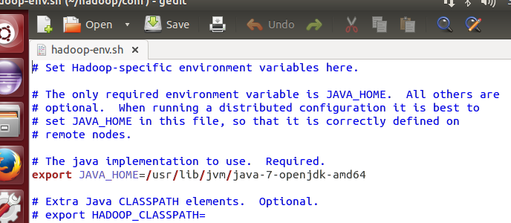
Configuration
hadoop-env.sh
$ cd /home/hadoop/hadoop/conf
$ gedit hadoop-env.sh
Define JAVA_HOME

Slide 13
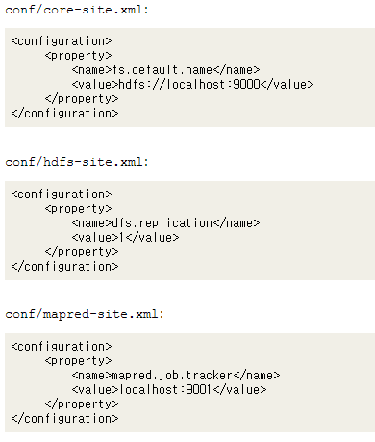
Configuration
$ gedit core-site.xml
$ gedit hdfs-site.xml
$ gedit mapred-site.xml
Copy & paste from:
http://hadoop.apache.org/docs/r1.2.1/single_node_setup.html
or
https://www.dropbox.com/sh/20yyf6r7u4kmh10/AACyaOzUGkSSJC_pDN3n9QQBa?dl=0

Slide 14
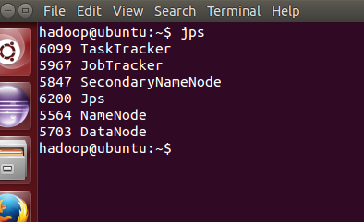
Start Hadoop Daemons
Format a new distributed-filesystem:
$ bin/hadoop namenode -format
Start the hadoop daemons:
$ start-dfs.sh
$ start-mapred.sh
Check
$ jps
If you can find five processes, it’s OK

Slide 15
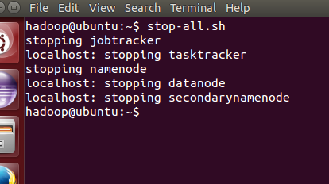
Stop Hadoop Daemons
$ stop-all.sh

Slide 16
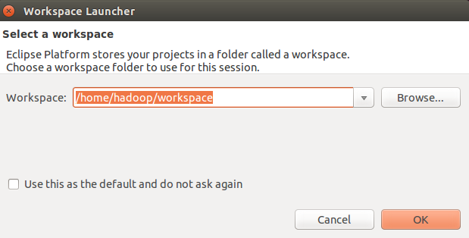
Install eclipse
Install
$ sudo apt-get install eclipse
Run

Slide 17
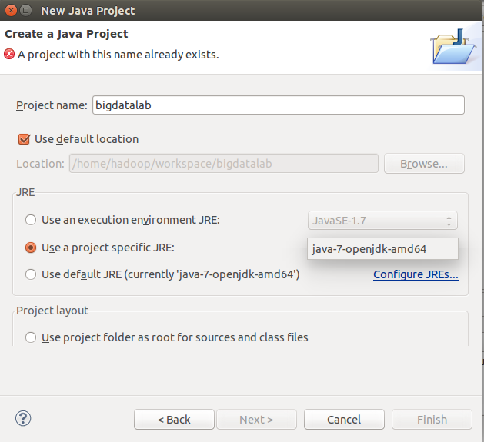
Create A Project
File > New > Project
Select “Java Project”
Set
Project name: bigdatalab
Use a project specific JRE: java-7-openjdk-amd64

Slide 18
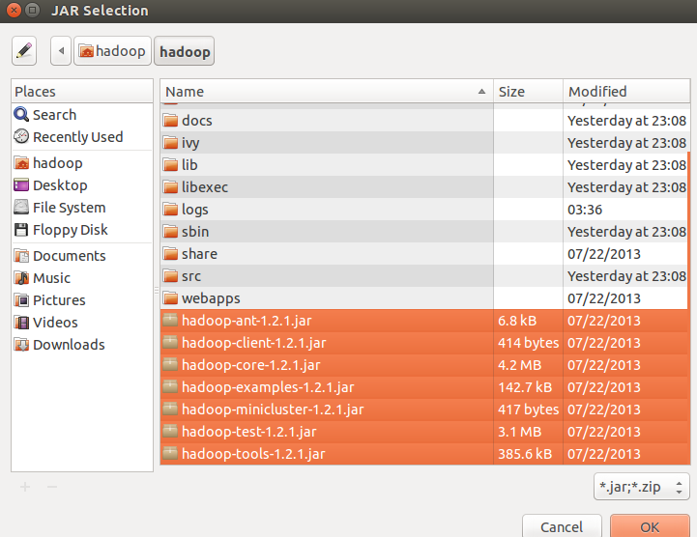
Set libraries
Add Dependencies JARs
Right click on project properties and select Java build path
Select Libraries tab and click Add External JARs
add all jars from $HADOOP_HOME/lib and $HADOOP_HOME (where hadoop core and tools jar lives)

Slide 19
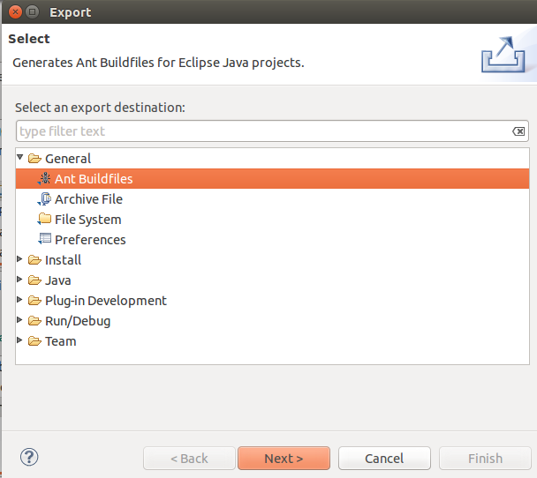
Set Ant Buildfile
File > Export
General > Ant Buildfiles
Check our project ‘bigdatalab’

Slide 20
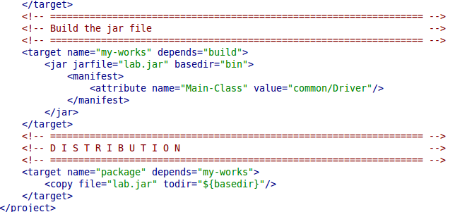
Set Ant Buildfile
Open buildfile.xml and edit as below
Or you can download at
https://www.dropbox.com/sh/20yyf6r7u4kmh10/AACyaOzUGkSSJC_pDN3n9QQBa?dl=0
Top of the file:
Bottom of the file:

Slide 21
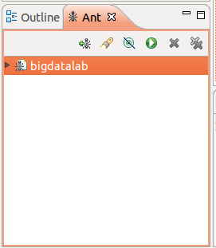
Set Ant Buildfile
Window > Show View > Ant
Add Buildfiles and select buildfile.xml
Click this button to build the jar file

Slide 22
WordCount

Slide 23
Problem
Input
A text file
Download:
https://www.dropbox.com/s/vlxpmkawxu5euee/pg5000.txt?dl=0
Definition
A word: a sequence of characters without any blank
Problem
Given a text file
Count the frequency of every word, i.e., the number of occurrences for every word in the file

Slide 24
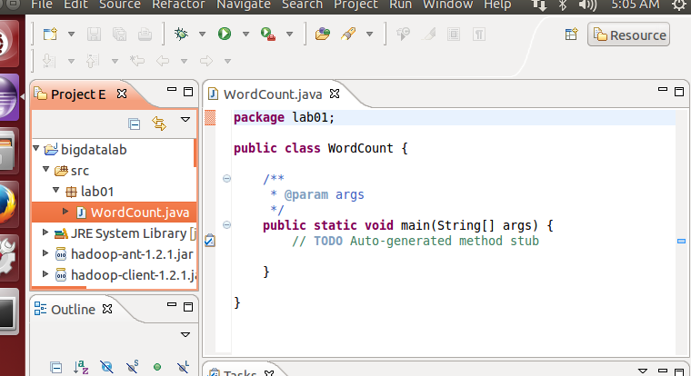
WordCount Class
Create two packages called ‘lab01’ and ‘common’
Download ‘WordCount.java’
https://www.dropbox.com/s/oexko4dvpkdm8ds/WordCount.java?dl=0
Put the file in the directory of lab01
Download ‘Driver.java’
https://www.dropbox.com/s/lnijp64qd4bkdx3/Driver.java?dl=0
Put the file into the directory ‘common’
Build jar file!

Slide 25
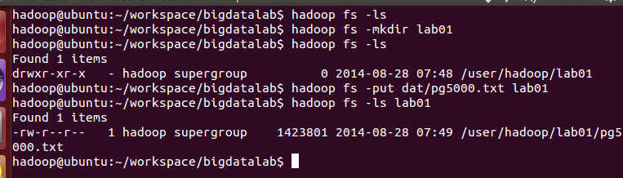
Run the Hadoop Job
$ cd $HOME/workspace/bigdatalab
Run hadoop deamons if they are down
$ start-dfs.sh
$ start-mapred.sh
Put input text files into HDFS
$ hadoop fs -mkdir lab01
$ hadoop fs -put pg5000.txt lab01

Slide 26
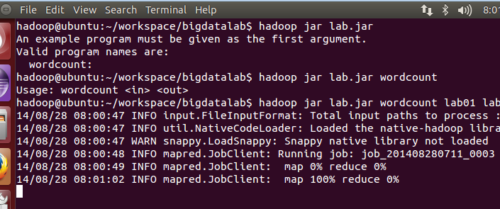
Run the Hadoop Job
$ hadoop jar lab.jar wordcount lab01 lab01_out

Slide 27
How WordCount Works? - Map
<map input key type, map input value type,
map output key type, map output value type
public class WordCount {
public static class TokenizerMapper
extends Mapper<Object, Text, Text, IntWritable>{
private final static IntWritable one = new IntWritable(1);
private Text word = new Text();
public void map(Object key, Text value, Context context
) throws IOException, InterruptedException {
StringTokenizer itr = new StringTokenizer(value.toString());
while (itr.hasMoreTokens()) {
word.set(itr.nextToken());
context.write(word, one);
}
}
}
Output key를 setting 함
(word,one) key-value pair를 emit
Pair는 반드시 선언한 type이어야 함

Slide 28
Wordcount.java - Reduce
<reduce input key type, reduce input value type,
reduce output key type, reduce output value type
public static class IntSumReducer
extends Reducer<Text,IntWritable,Text,IntWritable> {
private IntWritable result = new IntWritable();
public void reduce(Text key, Iterable<IntWritable> values,
Context context
) throws IOException, InterruptedException {
int sum = 0;
for (IntWritable val : values) {
sum += val.get();
}
result.set(sum);
context.write(key, result);
}
}
Output value를 setting 함
(key,result) key-value pair를 emit
Pair는 반드시 선언한 type이어야 함

Slide 29
Wordcount.java – Main
public static void main(String[] args) throws Exception {
Configuration conf = new Configuration(); // job 수행하기 위한 설정 초기화
String[] otherArgs = new GenericOptionsParser(conf, args).getRemainingArgs();
if (otherArgs.length != 2) {
System.err.println("Usage: wordcount <in> <out>");
System.exit(2);
}
Job job = new Job(conf, "word count"); // job 작성, 따옴표안은 설명을 쓰면됨(상관없음)
job.setJarByClass(WordCount.class); // job을 수행할 class 선언, 파일명.class, 대소문자주의
job.setMapperClass(TokenizerMapper.class); // Map class 선언, 위에서 작성한 class명
job.setReducerClass(IntSumReducer.class); // Reduce class 선언
job.setOutputKeyClass(Text.class); // Output key type 선언
job.setOutputValueClass(IntWritable.class); // Output value type 선언
//job.setMapOutputKeyClass(Text.class); // Map은 Output key type이 다르다면 선언
//job.setMapOutputValueClass(IntWritable.class); // Map은 Output value type이 다르다면 선언
job.setNumReduceTasks(2); // 동시에 수행되는 reduce개수
FileInputFormat.addInputPath(job, new Path(otherArgs[0])); // 입력 데이터가 있는 path
FileOutputFormat.setOutputPath(job, new Path(otherArgs[1])); // 결과를 출력할 path
System.exit(job.waitForCompletion(true) ? 0 : 1); // 실행
}
}

Slide 30
Driver.java
package XXX;
import org.apache.hadoop.util.ProgramDriver;
public class ExampleDriver {
public static void main(String argv[]){
int exitCode = -1;
ProgramDriver pgd = new ProgramDriver();
try {
pgd.addClass("wordcount", WordCount.class, "A map/reduce program that counts the words.");
pgd.driver(argv);
// Success
exitCode = 0;
}
catch(Throwable e){
e.printStackTrace();
}
System.exit(exitCode);
}
}
pgd.addClass(닉네임, 클래스이름, 설명)
pgd.driver(argv): 실행

Slide 31
Exercise: Bigram Counting
Bigram
A bigram is a pair of consecutive words
The sentence “Do as I say, not as I do” can be broken into the following bigrams: Do as, as I, I say, say not, not as, as I, I do
Problem
Write a program which counts the frequencies of all bigrams appearing in the given input file

