Slide 1
Adding to Ambient lighting

Slide 2
Hazards
Pans left in stove
Iron left on
Leaving door opened
Water leak

Slide 3
Cooking on stove
Fire happens because there is a pot or other burnable object is left on the stove
If the stove is left on but without anything on top, there is no danger unless something falls on it and causes fire
We need to get into when exactly the fire is preventable

Slide 4
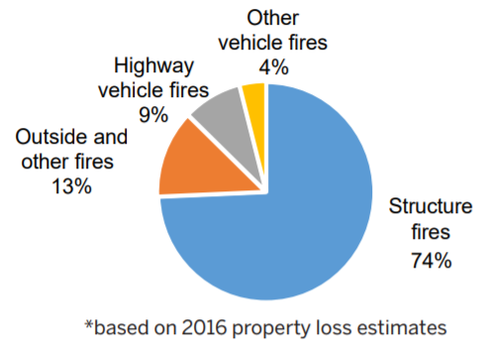
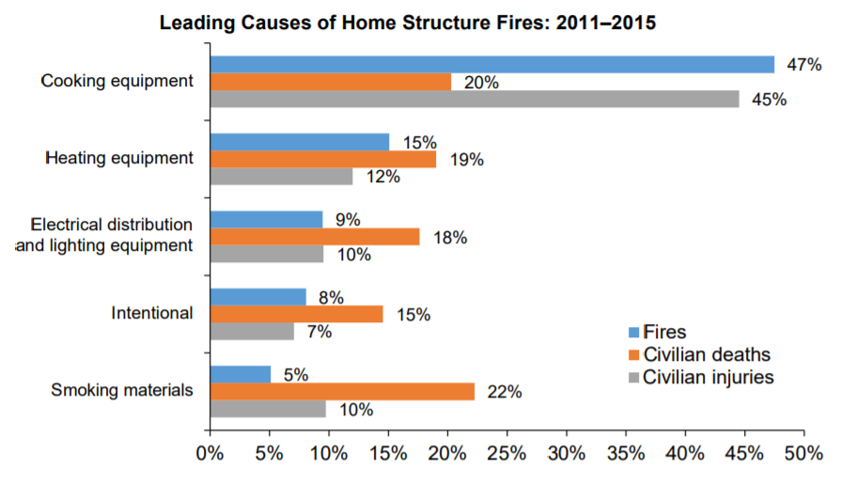
Cause of Structural Fire
According to NFPA, in 2016, home structure fires caused 81% of the civilian fire deaths and 73% of the civilian fire injuries. (Homes include one- and two-family homes, apartments, townhouses, row houses, and manufactured homes.)
Out of the home structure fire, cooking was the number one cause of fire, number one cause of fire injuries and number two cause of deaths
People turn off nuisance alarms because it goes off wrongly and they are annoyed by it, but ⅔ of fire home deaths are caused by no alarms or no working smoke alarms
A lot of false alarms (for every 10 actual fire alarm responses, there are 16 false alarm responses 2009) - solution: choose better fire alarm
A nuisance alarm is an alarm that is triggered by non-hazardous sources such as everyday cooking smoke and steamy showers. The alarm activation is inconvenient and annoying
Solutions out there: choose better fire alarm, many models have feature to turn it off for 15 minutes
Notes:
https://www.nfpa.org/-/media/Files/News-and-Research/Fire-statistics/Overall-Fire-Statistics/osFireLoss.pdf
https://www.nfpa.org/-/media/Files/News-and-Research/Fire-statistics/Fact-sheets/FireLossFacts.pdf
http://www.universalsecurity.com/article/usi-technology/nuisance-alarms
https://www.apartmenttherapy.com/how-to-stop-the-smoke-alarm-from-going-off-in-the-kitchen-164607

Slide 5
False Alarms
People lose faith in fire alarms because of false alarms and fail to take action to evacuate
Notes:
https://www.statista.com/statistics/376692/number-of-false-fire-alarms-in-the-us-by-type/
https://etd.auburn.edu/bitstream/handle/10415/5127/MaryAnn%20May%20Dissertation%20022416.pdf?sequence=2

Slide 6
Scenarios for stove top - #1 reason for home fire
When people leave a frying pan on the stove with oil and food and it starts burning (10~15 min)
When people leave boiling water on the stove and all the water boils off (boil or steam - 10 ~45 min) https://www.bettycrocker.com/how-to/tipslibrary/charts-timetables-measuring/fresh-vegetable-cooking-chart
When people leave water on the stove for hours for stock (1hr+)
People open the door to leave when the stove top on
So there must be a way to turn the alarm off for up to 2hrs (since people might forget to turn it off) and normally have it warn (20min) then go off (40min)
https://www.nfpa.org/-/media/Files/News-and-Research/Fire-statistics/Fact-sheets/FireOverviewFactSheet.pdf

Slide 7
Desired Achievement
Want to decrease and distinguish from nuisance alarms
At the same time we want to alert and lead people to take action
Need a different way of detecting fire on the stove

Slide 8
Scenarios for Iron - statistics
Leaving the iron on without putting it off (http://www.sun-sentinel.com/local/broward/lauderhill/fl-lauderhill-apartment-fire-tuesday-20160223-story.html)
Maybe a periodic alert would be most fitting - and alerts have to be not easy to turn off
Notes:
https://homesteady.com/about-6569231-electric-iron-safety.html
https://www.nfpa.org/News-and-Research/Fire-statistics-and-reports/Fire-statistics/Fire-causes/Appliances-and-equipment

Slide 9
Scenario for door
Left the door open for moving
Left the door open without knowing
About 30 percent of all burglaries are through an open or unlocked window or door.
1 out of 3 residential assaults are a result of a burglary
We want people to be aware that the door is open and needs to be closed
Periodic alerting may be better and need option to turn it off for some time (up to 5 hrs?)
Notes:
http://www.safeguardtheworld.com/statistics.html

Slide 10
Water Leak - statistics
Plumbing issues - average of $5,092 per incident after the deductible, frozen pipes most of the reason
Drain issues - $4,400 per incident after the deductible
Toilet failure - $5,584 per incident, after the deductible
Water heater - $4,444
*Problem: Damage and high cost to repair
Notes:
https://disastersafety.org/ibhs/water-damage-studies/

Slide 11
Ways to alert
Alert when the disaster happens (alert has to be very annoying to catch attention) - strong, urgent alarms
Alert to keep in mind that there is something going on (ambient/periodic alert) - less annoying, habituating (able to habituate to) alarms http://www.berkeleywellness.com/healthy-community/environmental-health/article/how-noise-harms-our-health

Slide 12
Placement of the alarms
At the source
Central Place (living room)
Some portable source (phone/watch)

Slide 13
UX of Alarm
What modes should there be
What options - say how many minutes it has been since the stove/appliance was on (feature optionable)
Can it be scalable?
Customization of the alert sounds - can be earcon, audiocon, song, whatever the customer chooses

