Slide 1
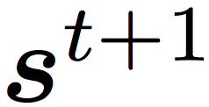


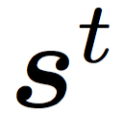







state updated
…
state
: user’s past choices
reward
available articles
system
display set
user
user’s choice

