Slide 1
Framework for efficient Secure Collaborative Analytics
Mimoun Mendoughe & Darya Igonina
Supervisors: Long Gu & Shaza Zeitouni

Slide 2




Goal:
Let’s do medical research

Slide 3

Goal:
Let’s do medical research
Regular SQL Query

Slide 4
Goal:
Let’s do medical research
Regular SQL Query

Slide 5
Goal:
Well can we get statistics ?

Slide 6
Goal of THE framework:
Compute aggregates across multiple databases without exposing individual records.
Delegate computation to untrusted nodes while preserving privacy

Slide 7
Goal of THE framework:
Compute aggregates across multiple databases without exposing individual records.
Delegate computation to untrusted nodes while preserving privacy
Framework for efficient Secure Collaborative Analytics
SECRET SHARING & MULTI PARTY COMPUTATION (MPC)

Slide 8
Goal of THE framework:
Compute aggregates across multiple databases without exposing individual records.
Delegate computation to untrusted nodes while preserving privacy
Framework for efficient Secure Collaborative Analytics (FESCA)
SECRET SHARING & MULTI PARTY COMPUTATION (MPC)

Slide 9
Goal of THE framework:
Compute aggregates across multiple databases without exposing individual records.
Delegate computation to untrusted nodes while preserving privacy
Framework for efficient Secure Collaborative Analytics (FESCA)
SECRET SHARING & MULTI PARTY COMPUTATION (MPC)

Slide 10



Fesca - Setup
Data Analyst
Computing node 1
Data Owner
Computing node 2
SQL Query
Computing node 3

Slide 11
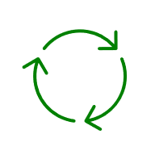
Fesca - Setup
Data Analyst
Computing node 1
Data Owner
Computing node 2
SQL Query
Computing node 3

Slide 12
Fesca - Setup
Data Analyst
Computing node 1
Data Owner
Result #1
Result #2
Result #3
Computing node 2
Receive and combine
Computing node 3

Slide 13

Fesca - Setup
Data Analyst
When combining computation result:
Result #1 Result #2 Result #3
XOR XOR =
Output for the user in plaintext

Slide 14
Fesca – DATA OWNER
Data Analyst
Computing node 1
Data Owner
Computing node 2
SQL Query
Computing node 3

Slide 15
2 out of 3 - Secret SHARING OF 1 BIT
0 =

Slide 16

2 out of 3 - Secret SHARING OF 1 BIT
0 =
1
0

Slide 17

2 out of 3 - Secret SHARING OF 1 BIT
0 =
1
0
1

Slide 18
2 out of 3 - Secret SHARING OF 1 BIT
0 =
1
0
1
Party 1
Party 2
Party 3
1
0
0
1
1
1

Slide 19
Fesca – Data Owner
Hospital_db
Data Owner
Patient ID | Age | Symptoms | Further Details
1 | 31 | Fever | xy
2 | 28 | Head Ache | yz
…

Slide 20
Fesca – Data Owner
Data Owner
Patient ID | Age | Symptoms | Further Details
010001010 | 0111010110 | 1011101010 | 1000010110
110100101 | 0101110101 | 0111100010 | 1000101001

Slide 21
Fesca – Data Owner
Patient ID | Age | Symptoms | Further Details
010001010 | 0111010110 | 1011101010 | 1000010110
110100101 | 0101110101 | 0111100010 | 1000101001
Data Owner
SECRET SHARING
Computing node 1
Computing node 2
Computing node 3

Slide 22
Fesca – Data Owner
Patient ID | Age | Symptoms | Further Details
010001010 | 0111010110 | 1011101010 | 1000010110
110100101 | 0101110101 | 0111100010 | 1000101001
Data Owner
SECRET SHARING
Computing node 1
Computing node 2
Computing node 3

Slide 23
Fesca – DATA ANALYST
Data Analyst
Computing node 1
Data Owner
Computing node 2
SQL Query
Computing node 3

Slide 24
Fesca – DATA ANALYST
SQL Query:
Data Analyst
SELECT AVG(age) FROM hospital_db
Compiler
Table
Column
What operation to execute

Slide 25
Fesca – DATA ANALYST
Data Analyst
Computing node 1
Data Owner
Computing node 2
Table
Column
What operation to execute
Table
Column
What operation to execute
Table
Column
What operation to execute
Computing node 3

Slide 26
Fesca – DATA ANALYST
Data Analyst
Computing node 1
Data Owner
Table
Column
What operation to execute
Computing node 2
Table
Column
What operation to execute
Computing node 3
Table
Column
What operation to execute

Slide 27
Computing node – GENERATING CIRCUIT
Computing node 2
Table
Column
What operation to execute

Slide 28
Computing node – GENERATING CIRCUIT
Table
Column
What operation to execute
Extract operation
SUM
DIVISION
COUNT
AVG
Computing node X

Slide 29
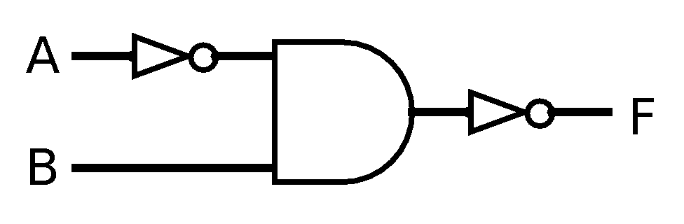
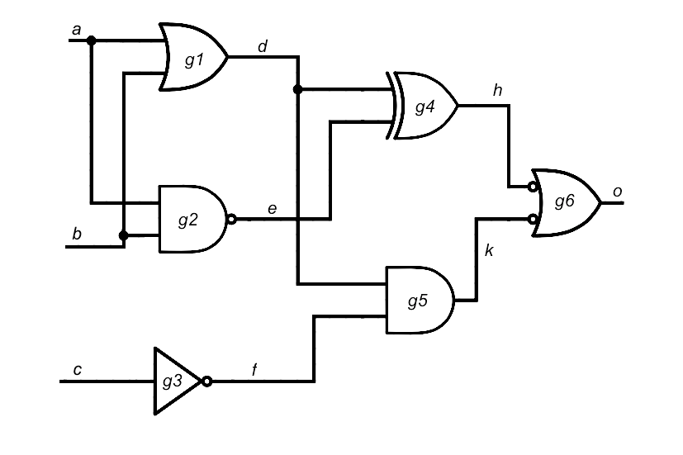
Computing node – GENERATING CIRCUIT
Table
Column
What operation to execute
Extract operation
AVG
Computing node X
SUM
DIVISION
COUNT

Slide 30


Computing node – applying circuit
Computing node X
Result #X
Data received from
Data Owner

Slide 31
SEND RESULTS BACK TO DATA ANALYST
Data Analyst
Computing node 1
Data Owner
Result #1
Result #2
Result #3
Computing node 2
Receive and combine
Computing node 3

Slide 32
DATA ANALYST – COMBINE
Data Analyst
When combining computation result:
Result #1 Result #2 Result #3
XOR XOR =
Output for the user in plaintext

Slide 33
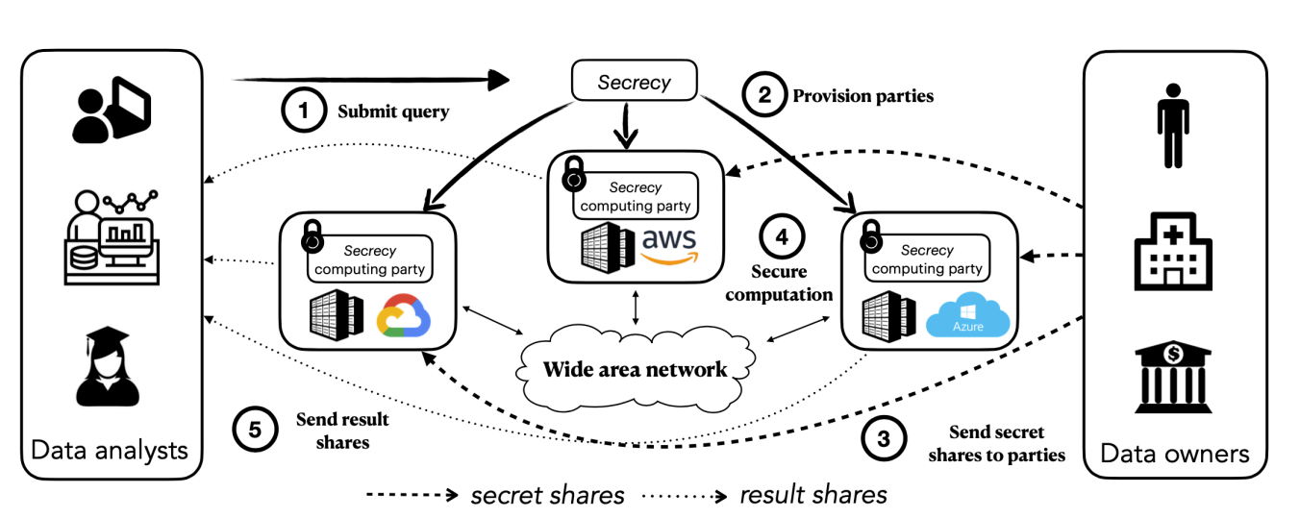
EXISTING WORK
SECRECY Framework
In C++
Tailored to Cloud Providers
No analogue in Rust
Slower networking
Image Source: nsdi23-liagouris.pdf

Slide 34
Thank you!

