Slide 1
Framework for efficient Secure Collaborative Analytics
Mimoun Mendoughe & Darya Igonina

Slide 2




Goal:
Let’s do medical research

Slide 3

Goal:
Let’s do medical research
Regular SQL Query

Slide 4
Goal:
Let’s do medical research
Regular SQL Query

Slide 5
Goal:
Well can we get statistics ?

Slide 6
Goal of THE framework:
Compute aggregates across multiple databases without exposing individual records.
Delegate computation to untrusted nodes while preserving privacy

Slide 7
Goal of THE framework:
Compute aggregates across multiple databases without exposing individual records.
Delegate computation to untrusted nodes while preserving privacy
Framework for efficient Secure Collaborative Analytics
SECRET SHARING & MULTI PARTY COMPUTATION (MPC)

Slide 8
Goal of THE framework:
Compute aggregates across multiple databases without exposing individual records.
Delegate computation to untrusted nodes while preserving privacy
Framework for efficient Secure Collaborative Analytics (FESCA)
SECRET SHARING & MULTI PARTY COMPUTATION (MPC)

Slide 9
Goal of THE framework:
Compute aggregates across multiple databases without exposing individual records.
Delegate computation to untrusted nodes while preserving privacy
Framework for efficient Secure Collaborative Analytics (FESCA)
SECRET SHARING & MULTI PARTY COMPUTATION (MPC)

Slide 10



Fesca - Setup
Data Analyst
Computing node 1
Data Owner
Computing node 2
SQL Query
Computing node 3

Slide 11
2 out of 3 - Secret SHARING OF 1 BIT
0 =

Slide 12

2 out of 3 - Secret SHARING OF 1 BIT
0 =
1
0

Slide 13

2 out of 3 - Secret SHARING OF 1 BIT
0 =
1
0
1

Slide 14
2 out of 3 - Secret SHARING OF 1 BIT
0 =
1
0
1
Party 1
Party 2
Party 3
1
0
0
1
1
1

Slide 15
Fesca – Data Owner
Data Analyst
Computing node 1
Hospital_db
Data Owner
Patient ID | Age | Symptoms | Further Details
1 | 31 | Fever | xy
2 | 28 | Head Ache | yz
Computing node 2
SQL Query
…
Computing node 3

Slide 16
Fesca – Data Owner
Data Owner
Patient ID | Age | Symptoms | Further Details
010001010 | 0111010110 | 1011101010 | 1000010110
110100101 | 0101110101 | 0111100010 | 1000101001

Slide 17
Fesca – Data Owner
Patient ID | Age | Symptoms | Further Details
010001010 | 0111010110 | 1011101010 | 1000010110
110100101 | 0101110101 | 0111100010 | 1000101001
Data Owner
SECRET SHARING
Computing node 1
Computing node 2
Computing node 3

Slide 18
Fesca – Data Owner
Patient ID | Age | Symptoms | Further Details
010001010 | 0111010110 | 1011101010 | 1000010110
110100101 | 0101110101 | 0111100010 | 1000101001
Data Owner
SECRET SHARING
Computing node 1
Computing node 2
Computing node 3

Slide 19
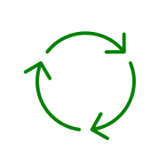





FESCA – SECRECY IN RUST
Data Analyst
Computing node 1
Data Owner
Computing node 2
Receive and combine
Computing node 3

Slide 20
FESCA – SECRECY IN RUST
Data Analyst
Computing node 1
Data Owner
Result #1
Result #2
Result #3
Computing node 2
Receive and combine
Computing node 3

Slide 21
FESCA – SECRECY IN RUST
Execute circuit on a binary share of the table
Computing node X
Retrieve intermediate result and send back to Data Analyst
Translate SQL Query into binary circuit

Slide 22
FESCA – SECRECY IN RUST
Data Analyst
When combining computation result:
XOR XOR =
Output for the user in plaintext

Slide 23
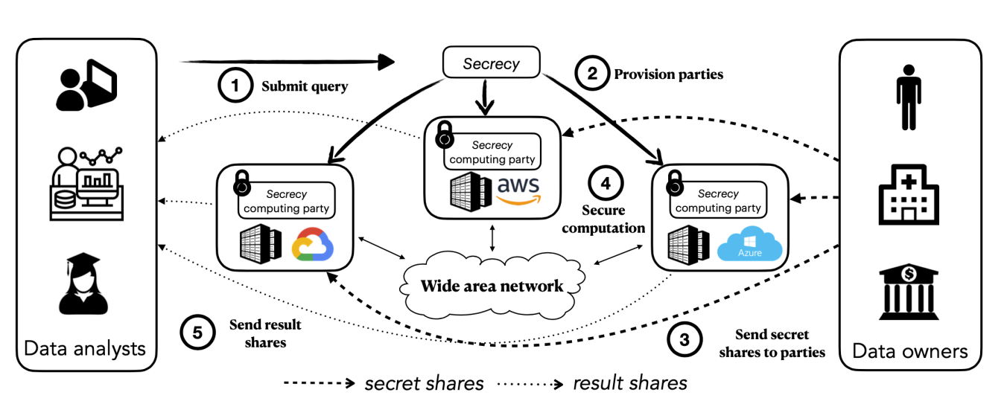
EXISTING WORK
SECRECY Framework
In C++
Tailored to Cloud Providers
No analogue in Rust
Slower networking
Image Source: nsdi23-liagouris.pdf

Slide 24
Fesca - overview
Data Analyst
Computing node 1
Data Owner
Computing node 2
SQL Query
Computing node 3

Slide 25
Sharing Data:
Well can we get statistics ?
Patient ID | Date of Birth | Symtomps | Further Details
1 | 01.01.1990 | Fever | xy
2 | 01.02.1991 | Head Ache | yz
…

