Slide 1
LENDING CLUB CASE STUDY ASSIGNMENT SUBMISSION
Name:
Anand Kumar Mishra
Papiya Das

Slide 2
Understand the consumer and loan attributes to optimise loss due to default, loss of business
Lending club connects borrowers to investors.
Lending club is looking to get insights on attributes which leads to Defaults.
On finding the true contributing factors, it can optimise loss by business by not lending to borrowers who would have paid loan, or lending to borrowers who would default.
This would keep their platform safer for investors, and increase their ROI.

Slide 3
Approach
Start
Understanding the data
Clean and remove data fields which are irrelevant/noise
Perform Univariate analysis, and record the observations
Perform Bivariate analysis, and record the observations
Perform Multivariate analysis, and record the observations
Combine the results
End

Slide 4
39,700+
Lending cases were analyzed

Slide 5
Using
50+
Features

Slide 6
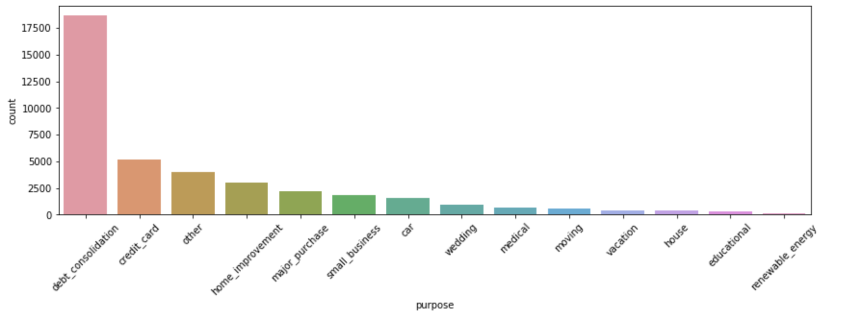
Loans vs Purpose: Debt Consolidation is most asked

Slide 7
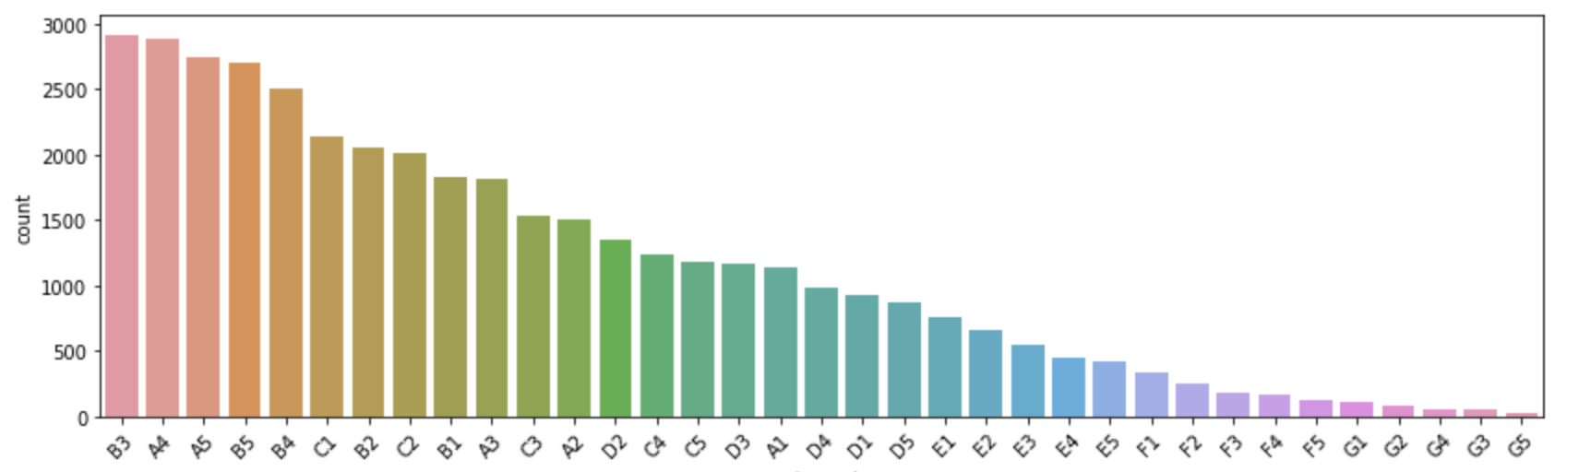
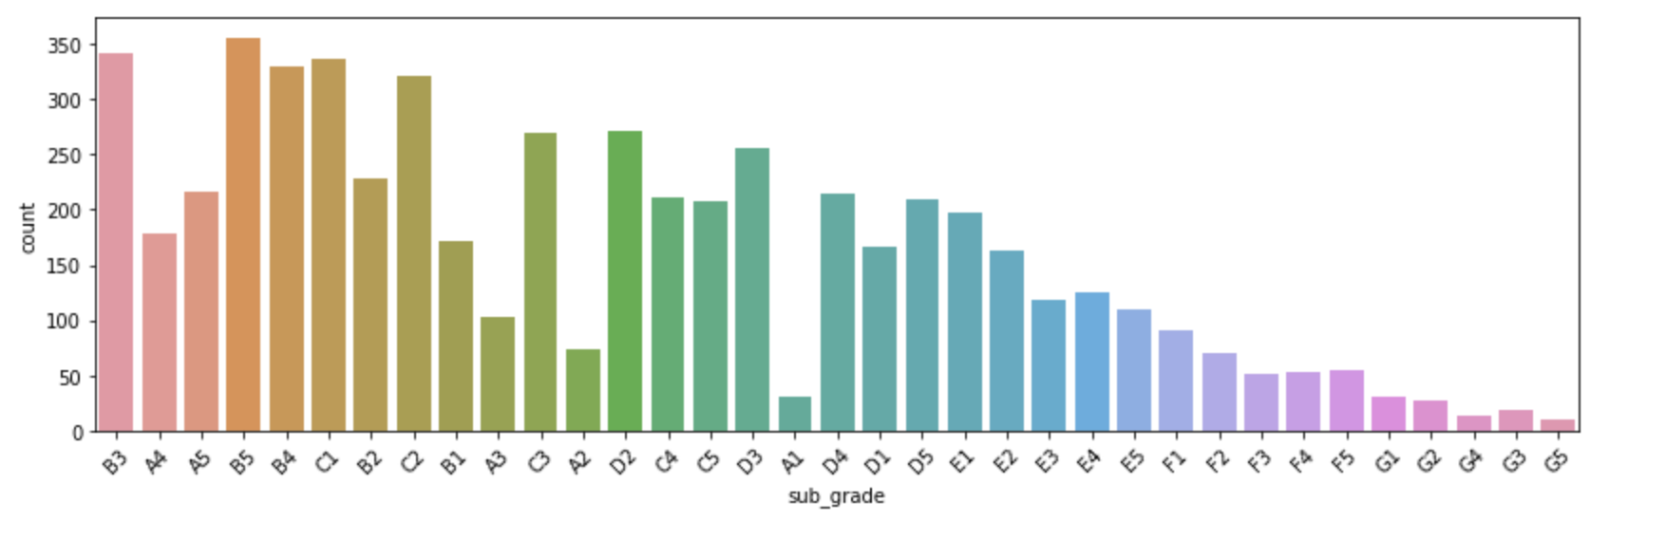
Lending vs Sub Grade
Normal
Defaulters

Slide 8
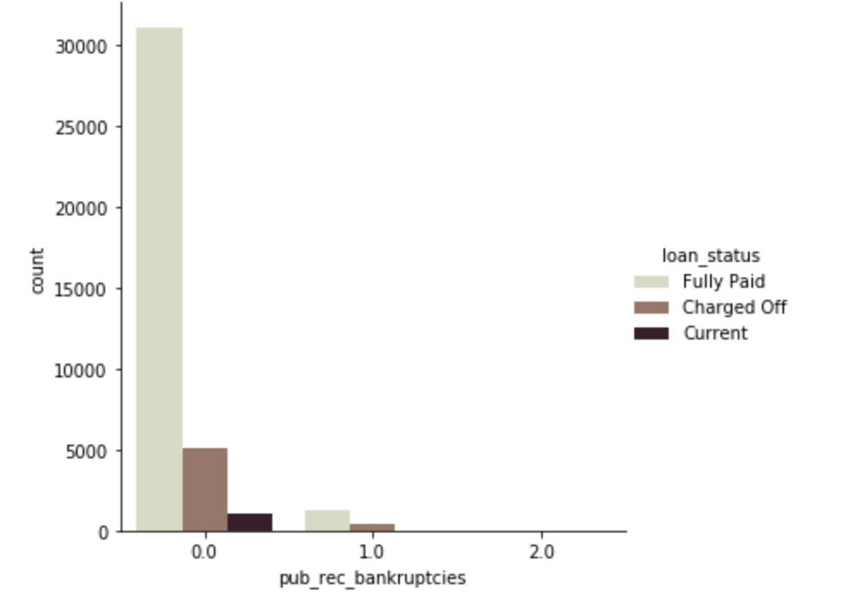
Number of public record of bankruptcy vs Loan Status

Slide 9
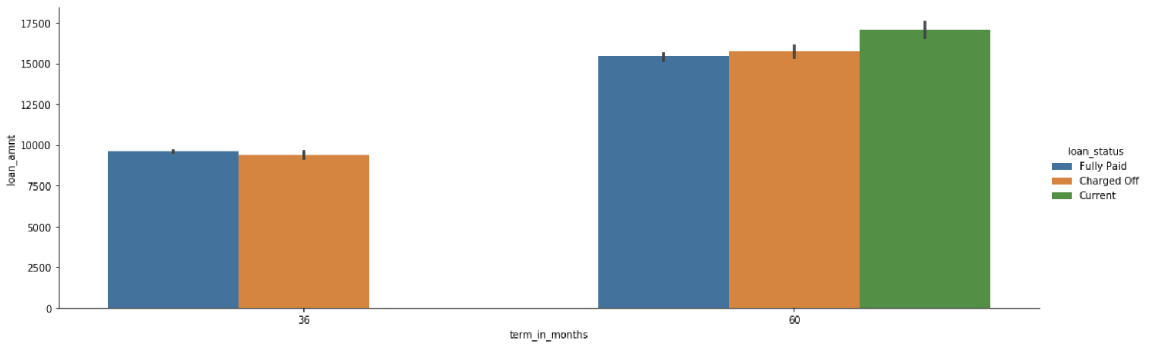
Loan Amount vs Terms in month across loan status

Slide 10
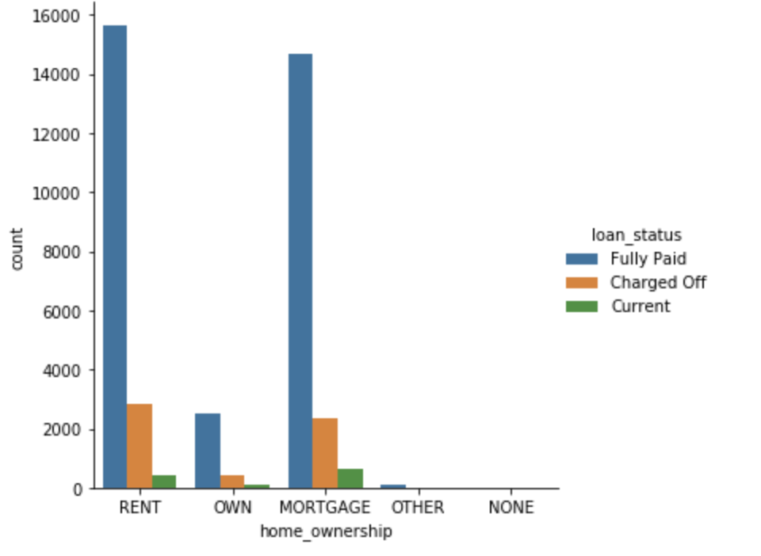
Home ownership across loan status

Slide 11
Home ownership across loan status

Slide 12
Conclusions
Most funds are asked for ‘Deb Consolidation’ purpose, but ‘Small Business’ is the riskiest in terms of risk reward ratio/chances of defaulting.
To minimize chances of default one must invest in sub-grades A1, A2, A3, A4, A5, B1 and B2.
36 month term loans run significantly lower risk of getting ‘Charged Off’.
If verification status is ‘Source verified’ then chances of default is lower.
Most of the charge off happens if home ownership is ’RENT’, followed by ’MORTGAGE’, hence ‘OWN’ed and other home ownership is safer.

Slide 13
Conclusions
If public bankruptcy has been declared once or more then given higher loan amount chances of default increases.
Risk to reward ratio decreases as number open account increases and reaches 7 and starts to decrease afterwards, and become insignificant.
In certain states charge offs are absent in states, 'IA', 'IN', 'ME’.
Most of the charge off(lost payment) occurs to loan amount between 7.5k to 17.5k for small businesses.
There is a positive correlation between ’pub_rec_bankruptcies’ with ’mths_since_last_record’ and ’pub_rec’.

