Slide 1
PHISHING WEBSITE DETECTION by MACHINE LEARNING TECHNIQUES
Presented By
Popy Das
Roll: 09-001-05

Slide 2
Introduction
Phishing is a cyberattack technique used to steal sensitive information.
Attackers mimic legitimate entities.
Goal: Trick users into providing passwords, credit card info, etc.

Slide 3
The Problem
What is the problem?
Phishing mimics legitimate sites to steal sensitive data
Who has this problem?
Individuals
Why should this problem be solved?
Protection of User Data
Organizations
Cybersecurity Professionals
Traditional detection methods struggle to keep up with sophisticated phishing technique
Financial Impact
Trust and Safety

Slide 4
Objectives
Train machine learning models and deep neural networks to detect phishing websites.
Gather phishing and benign URLs to create a dataset.
Extract key features from URLs and website content.
Measure and compare the performance of each model.

Slide 5
Methodology
Collect dataset
Analyse and pre-process the dataset by using EDA techniques
Extract the required features from the URL database
Divide the dataset into training and testing sets
Run SVM, Random Forest, Multilayer Perceptrons, XGBoost, Decision Tree and Autoencoder on the dataset
Evaluate results considering accuracy metrics
Compare the obtained results for trained models and specify which is better

Slide 6
Data Collection
Legitimate URLs: Collected from the University of New Brunswick’s dataset (URL-2016).
5,000 URLs randomly selected from this dataset.
Phishing URLs: Collected from the open-source service PhishTank.
PhishTank provides updated phishing URLs in formats like CSV and JSON.
5,000 URLs randomly selected from this collection.

Slide 7
Feature Selection
1. Address Bar-Based Features:
Domain of URL
Redirection ('//') in URL
IP Address in URL
'http/https' in Domain Name
'@' Symbol in URL
Use of URL Shortening Services
Length of URL
Prefix or Suffix ('-') in Domain
Depth of URL

Slide 8
2. Domain-Based Features:
DNS Record
Age of Domain
Website Traffic
End Period of Domain
In total, 17 features have been extracted from the dataset.
3. HTML and JavaScript-Based Features:
Iframe Redirection
Disabling Right Click
Status Bar Customization
Website Forwarding

Slide 9
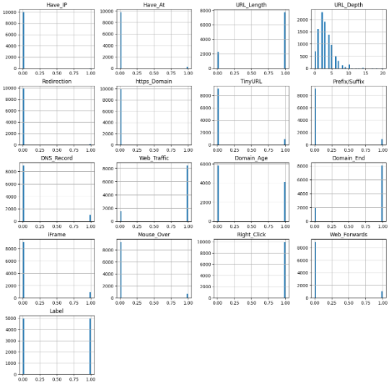
Feature Distribution

Slide 10
Machine Learning Models
This is a supervised machine learning task, classified as a classification problem, where the input URL is categorized as: Phishing (1) and Legitimate (0)
The following classification models are used to train the dataset in this notebook:
Decision Tree
Random Forest
Multilayer Perceptrons
XGBoost
Autoencoder Neural Network
Support Vector Machines

Slide 11
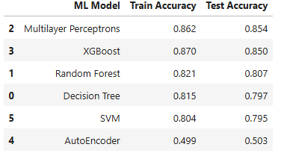
Model Evaluation
The models are evaluated, and the considered metric is accuracy.

Slide 12
Conclusion
The project demonstrates how machine learning models can identify phishing websites.
Extracted URL and domain features help differentiate between legitimate and phishing sites.
The trained models can classify URLs as legitimate or phishing, enhancing online security.

