Slide 1
PRDA – 01 Profit Analysis
Regression Analysis & Visualization
Using MySQL and Power BI

Slide 2
Project Objective
• Access startup data from a remote MySQL database
• Analyze the impact of R&D, Marketing, and Administration spend on Profit
• Visualize relationships using Power BI
• Provide business insights and profit prediction explanation

Slide 3
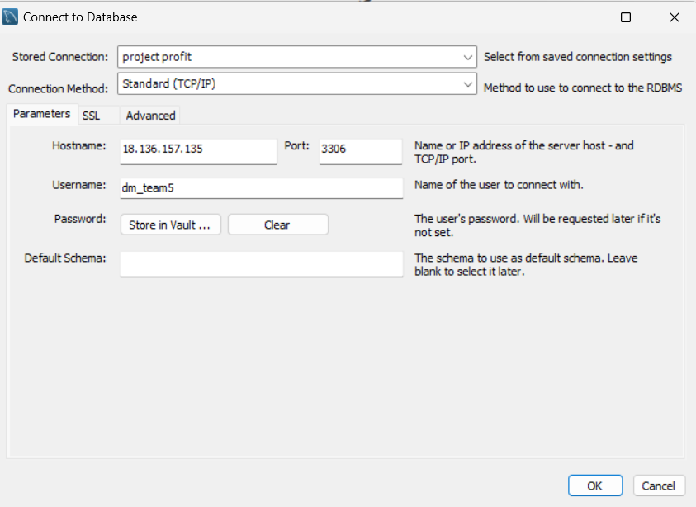
Database Connection Using Given Credentials

Slide 4
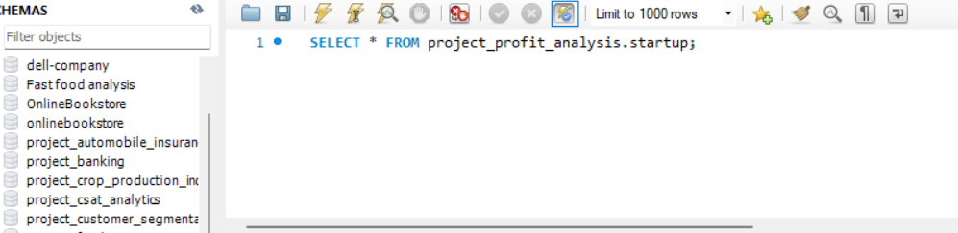
Data Extraction from MySQL Database

Slide 5
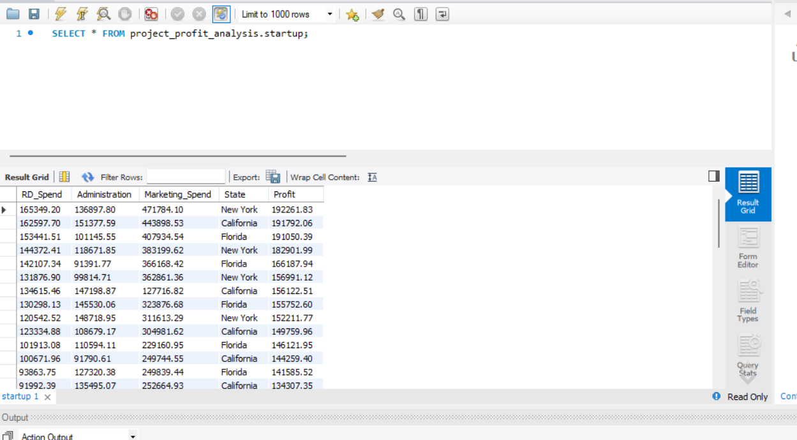
Startup Dataset Retrieved from Database

Slide 6
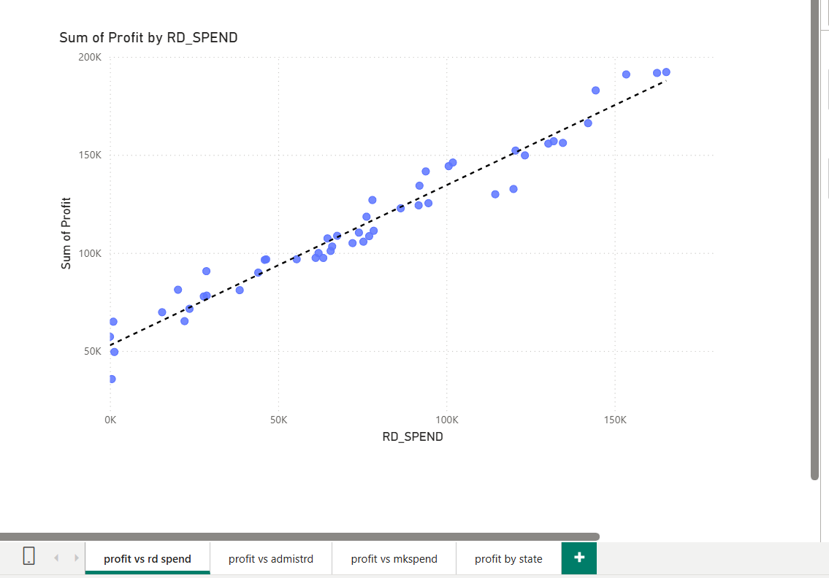
Profit vs R&D Spend (Regression Trend)

Slide 7
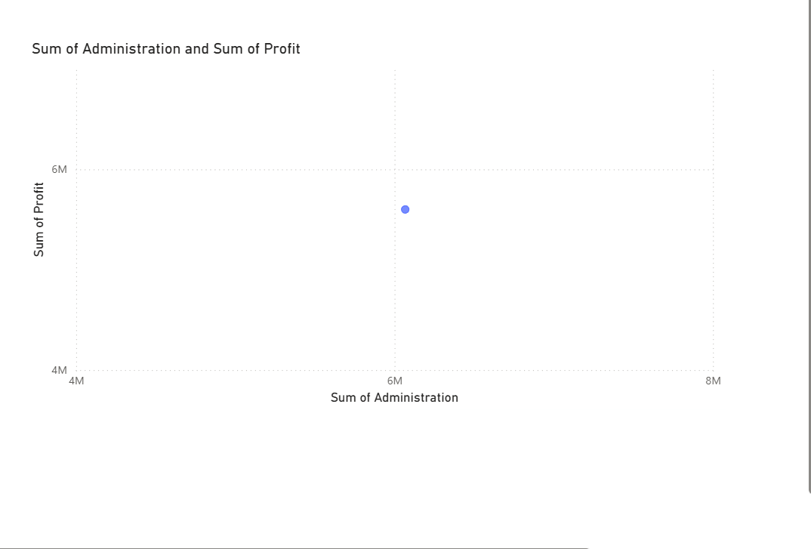
Profit vs Administration Spend

Slide 8
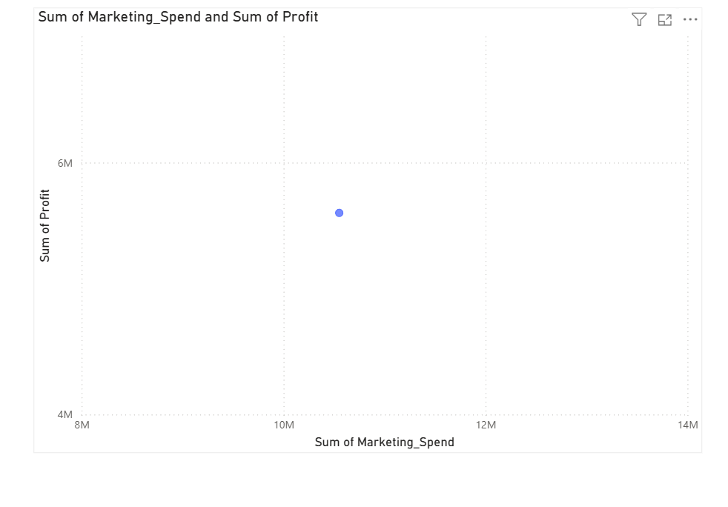
Profit vs Marketing Spend

Slide 9
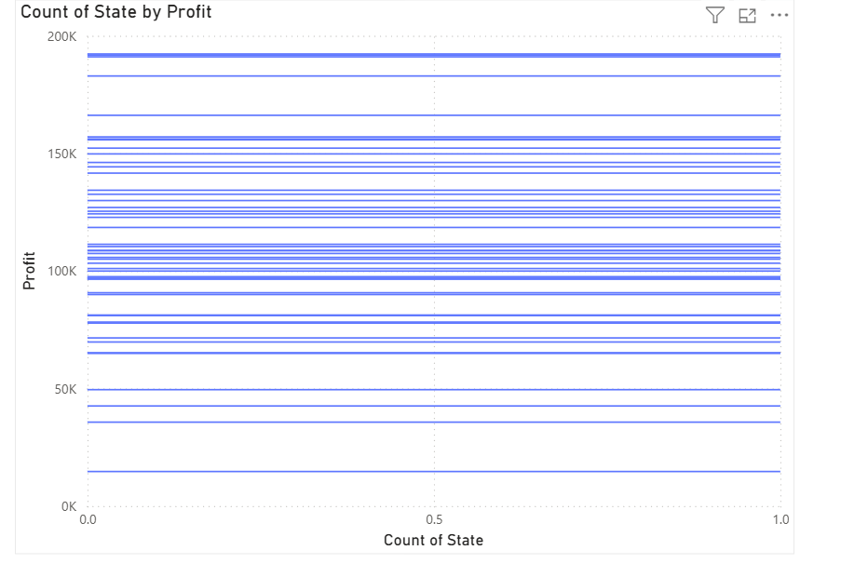
Profit Analysis by State

Slide 10
Key Insights
• R&D Spend shows a strong positive relationship with Profit
• Marketing Spend has a moderate impact on Profit
• Administration Spend has the least influence on Profit
• State-wise analysis shows variation in profitability across regions

Slide 11
Conclusion
The analysis shows that investment in R&D and Marketing significantly improves profitability. Companies should prioritize R&D spending while optimizing administration costs to maximize profit.

