Slide 1
SPARKS TIC 3.0 Conversion Summary
Enabling Zero Trust Compliance in DOT AWS Environment
December 2025

Slide 2
Why TIC 3.0 Matters
TIC 2.0 / MTIPS deprecated for cloud-native systems
TIC 3.0 enforces Zero Trust and removed public ingress
TLS 1.2 inspection required for all DOT cloud traffic

Slide 3
DOT’s Approach to Achieve TIC 3.0 Objectives
TIC 3.0 Objective | Description | Cloud User Approach
Manage Traffic | Observe, validate, and filter data connections to align with authorized activities; least privilege and default deny | - Palo Alto Next Generation Firewall - Gateway Load Balancer - Security Groups
Protect Traffic Confidentiality | Ensure only authorized parties can discern the contents of data in transit; sender and receiver identification and enforcement | - HTTP Strict Transport Security (HSTS) and TLS 1.2 - Web Application Firewall (Cloud Native) - DDOS (Cloud Native) - Palo Alto NGFW
Protect Traffic Integrity | Prevent alteration of data in transit; detect altered data in transit | - Palo Alto Prisma Cloud - Corelight IDS - Keysight Network Tap
Ensure Service Resiliency | Promote timely reaction and adapt future response to discovered threats; policies defined and implemented; simplified adoption of new countermeasures | - Palo Alto Prisma Cloud - Palo Alto Cortex Tools – XSOAR, XDR, Firewall

Slide 4
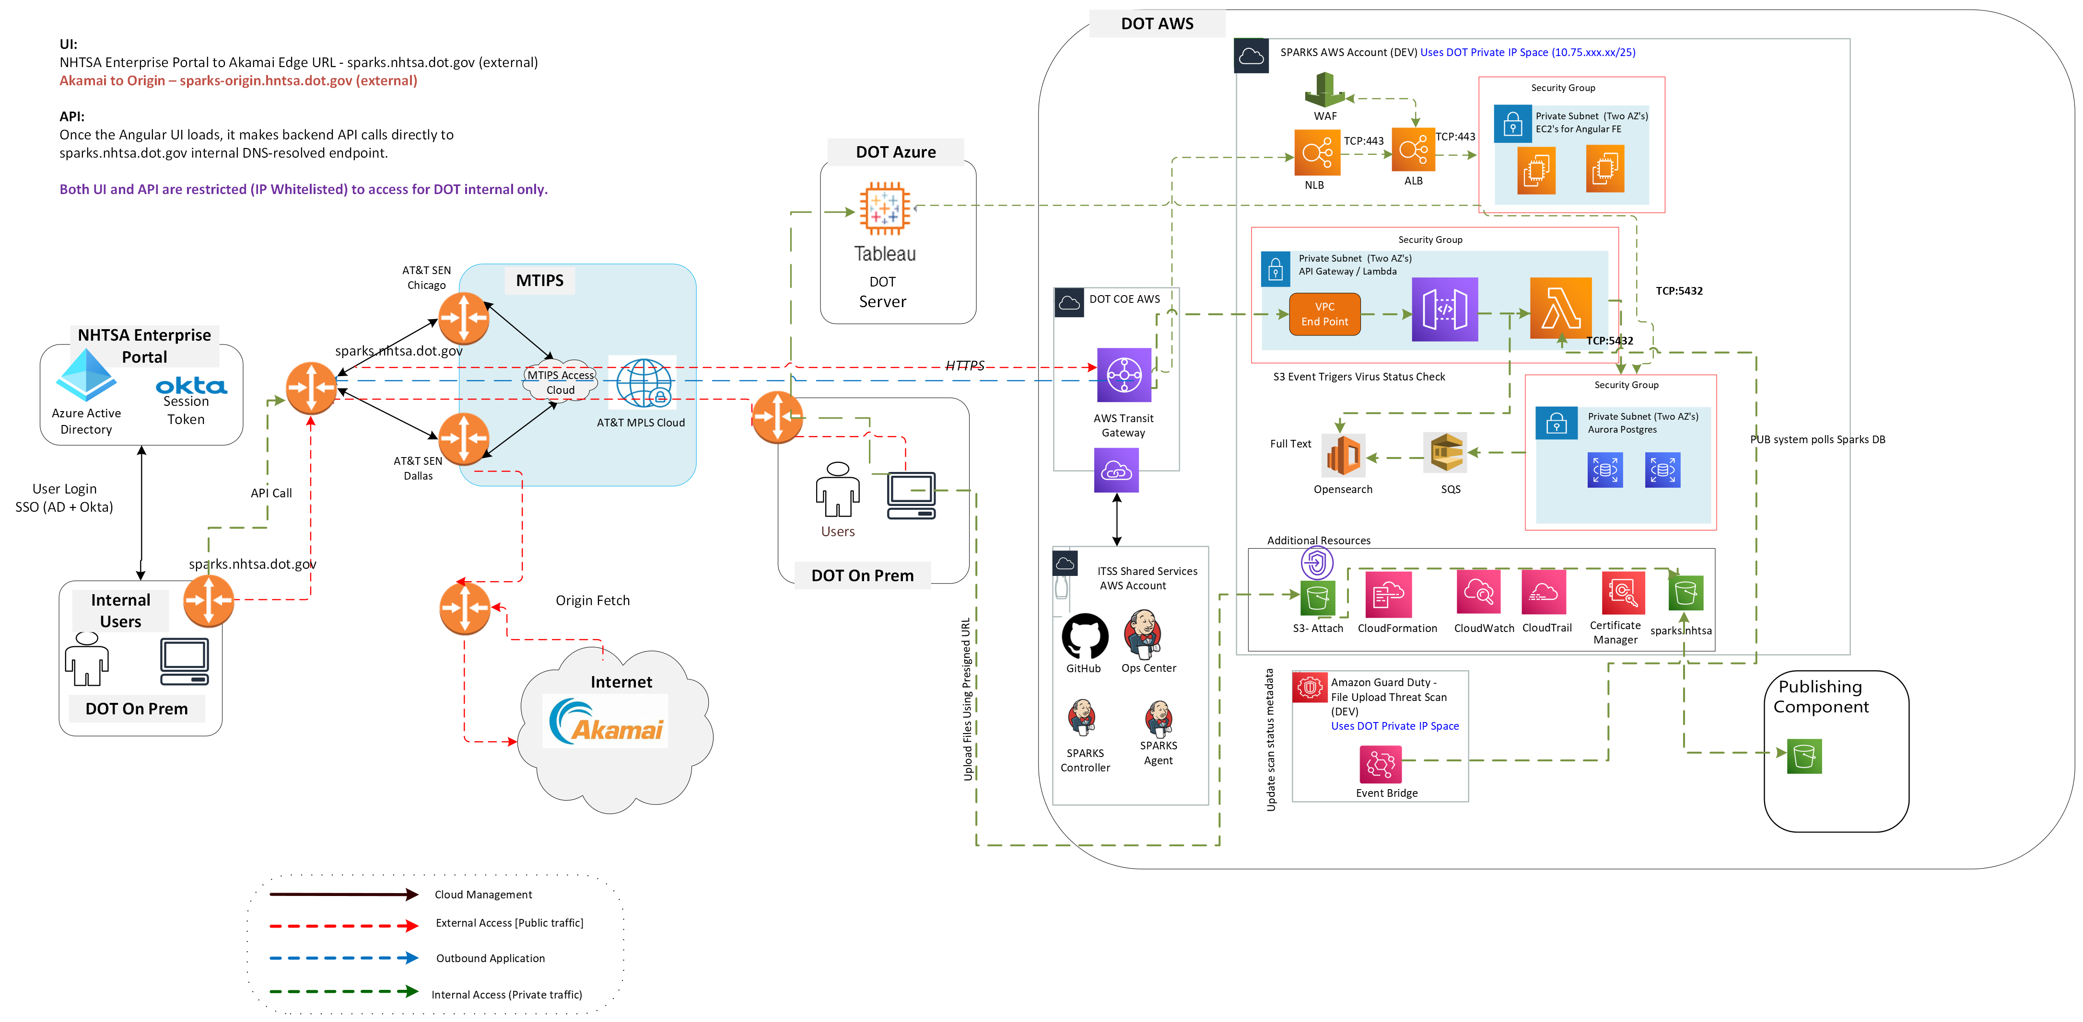
SPARKS with TIC 2.0

Slide 5
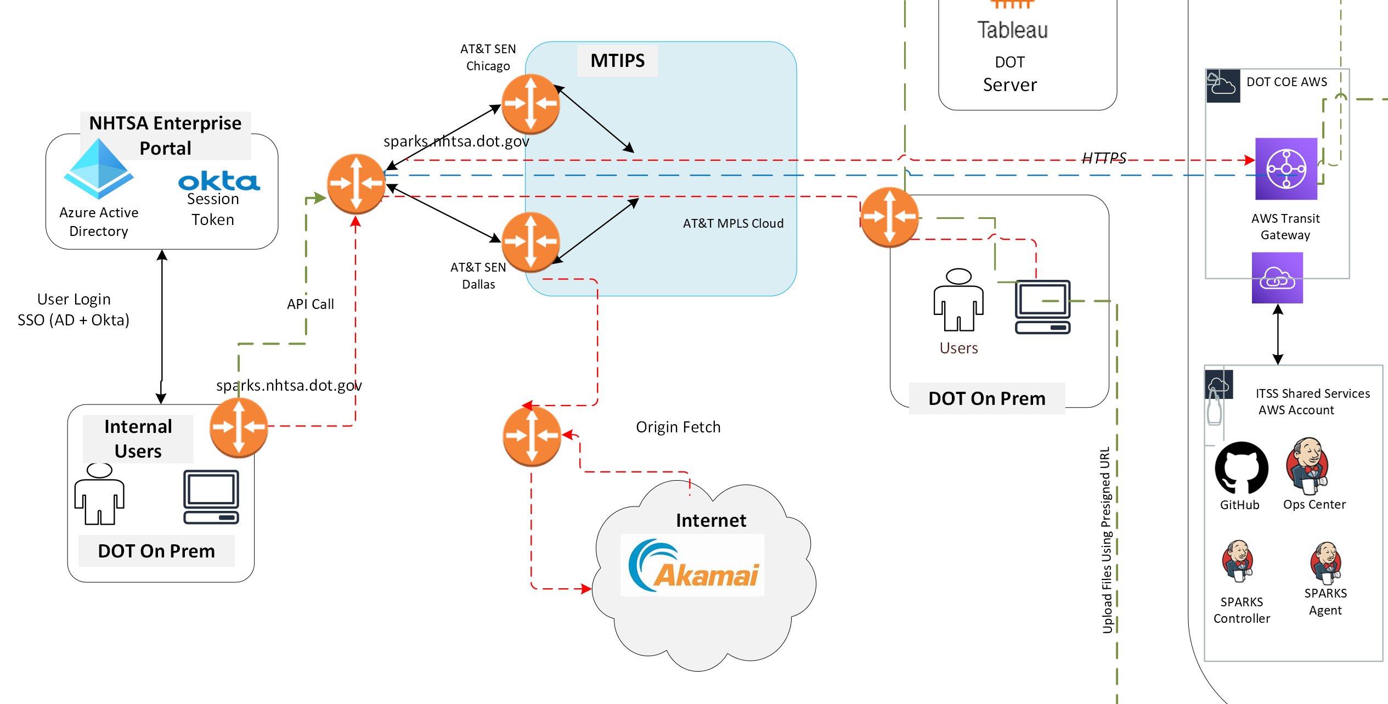
SPARKS with TIC 2.0 (Closer Look)
Angular UI -> ALB -> API Gateway (Regional) -> Lambda -> RDS
Public Endpoints and Publish DNS
TLS 1.1 Inspection

Slide 6
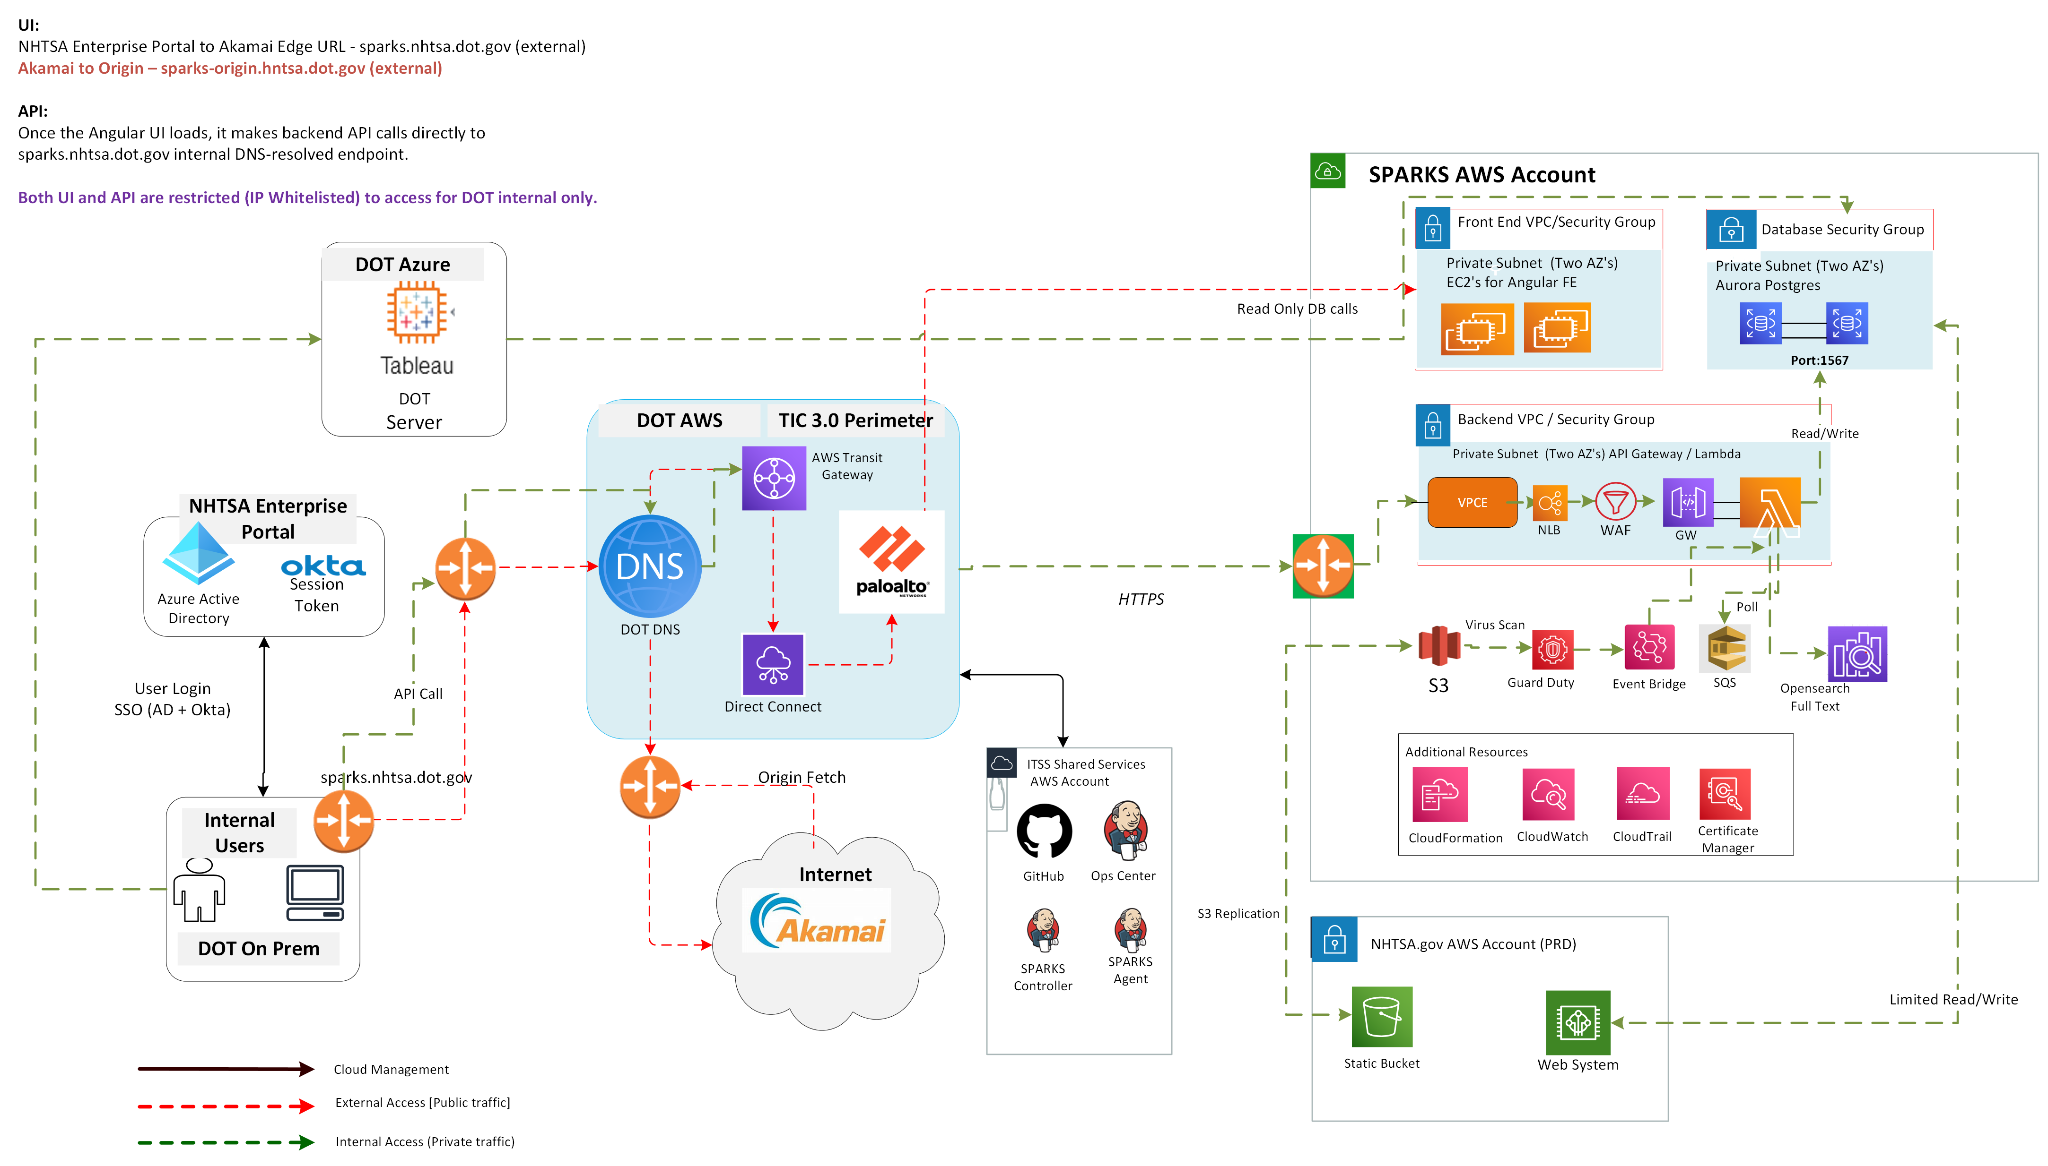
SPARKS with TIC 3.0

Slide 7
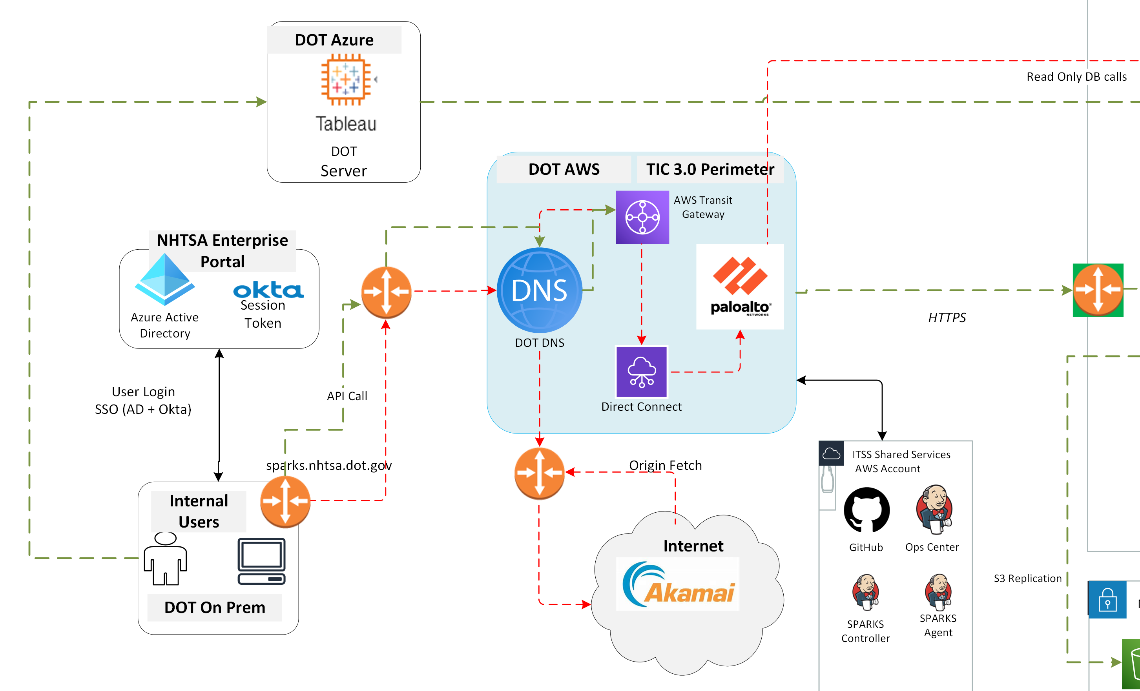
SPARKS with TIC 3.0 (Closer Look)
DOT DNS Resolving internal Domains
Palo Alto performing TLS 1.2 Inspections (enabled via imported SPARKS certs)
IP-based access control to VPC Interface Endpoints
Segmentation between web and app subnets
Logging and telemetry for TIC 3.0 compliance
ALB Removed, NLB for HA

Slide 8
TIC 3.0 Perimeter Components
DOT DNS – Internal Domain resolution
  IPs Whitelisted
Direct Connect – Secure DOT –> AWS Link
Palo Alto Firewall – TLS inspection and Zero Trust Enforcement
AWS VPCE, NLB, WAF, Private API Gateway – only allowed entry point

Slide 9
What Changed in SPARKS
Removed:
  ALBs, Public API Gateway Endpoints
Added:
  Private Gateway, VPCE, ACM Certs, DOT DNS, TLS Inspection, Zero Trust segmentation and Future NLB readiness
Modify:
  Custom Domain from Regional to Private DNS/VPCE

Slide 10
TIC 3.0 Migration Tasks
Task #1
  Create Required Certificates (Single or Multi Domain Certificates). Remember the Passphrase
  Create Private Custom Domains and VPC Interface Endpoints
  Remove ALB dependencies. Create separate private API GW for Frontend and Backend API
Task #2
  Create OST Tickets for Subnet Tagging
Task #3
  Create Firewall Tickets
Task #4
  Clean up resources to be compliant with TIC 3.0. Remove ALBs. Enable VPCE links with existing VPC, Security and Subnets that are tagged.
  Test Application and update API Gateway Routes for least privilege access to enable Zero Trust Compliance

Slide 11
OST Task – Subnet Tagging
Applies Panorama Subnet-Usage
Applies Panorama-Zone
Applies Panorama-Mode
Required before Firewall rules are created.

Slide 12
OST – Firewall Tasks
Allow DOT internal Only CIDRs
Allow VPCE -> API/Lambda Traffic
Enable TLS 1.2 decryption using shared certs
Block all external sources (Zero Trust default)
  IP Whitelisted
Depends on Certificate Creation and Subnet Tagging tasks

Slide 13
SPARKS Ticket References
Subnet Tagging - SCTASK0240731 / REQ0145545
  Provide all subnet ids related to Web and Data
Firewall Updates (Web and API) - CHG0058212
Firewall Updates (Data) - CHG0064894
Firewall (Cert Updates) - CHG0058216/INC0928825
Note: Can combine firewall update effort if certs are created upfront.

Slide 14
Compliance Impact & Remaining Tasks
✔ Zero Trust alignment (no public ingress)
✔ TLS 1.2 across all endpoints
✔ Firewall rules restrictions
Stage and Production environments – Awaiting other tenants to migrate

Slide 15


