Slide 1
Blue Beetles
Siva Naga Santosh Adabala
Gagan Chandra Motamarri

Slide 2
Data Exploration
Checked every column to find the Null Values.
Got a good exposure on Target Column to find the outcomes.
We analyzed the correlation between every column.

Slide 3
Data Cleaning and Preprocessing
There are other than 0 and 1 in the target column, we analyzed the data and changed other values to 0 and 1 based on the features.
Based on the Heat map we removed some unnecessary columns.
Null values are filled with the median
Since it is an imbalanced classification we did random over-sampling to make the distribution unbiased.

Slide 4
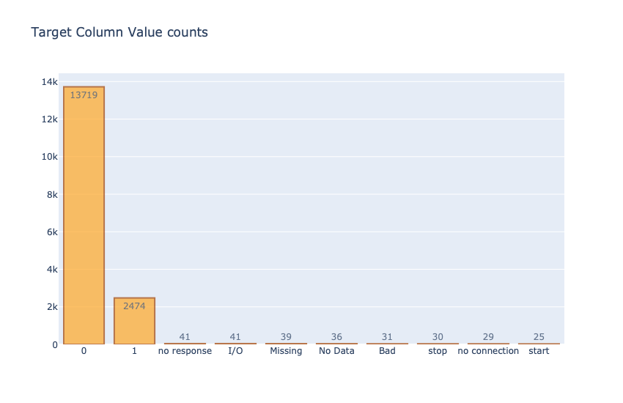
Data Visualization

Slide 5
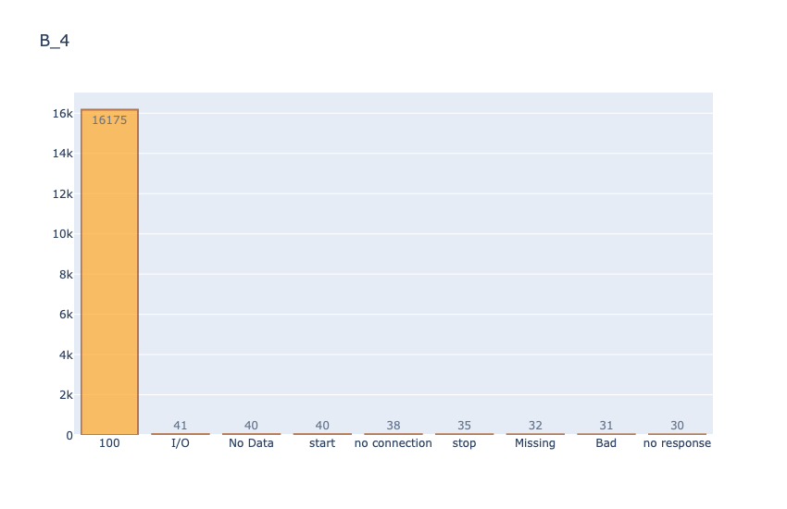
Data Visualization

Slide 6
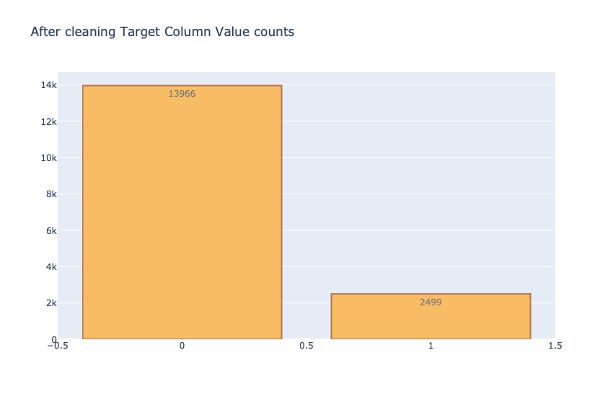
Data Visualization

Slide 7
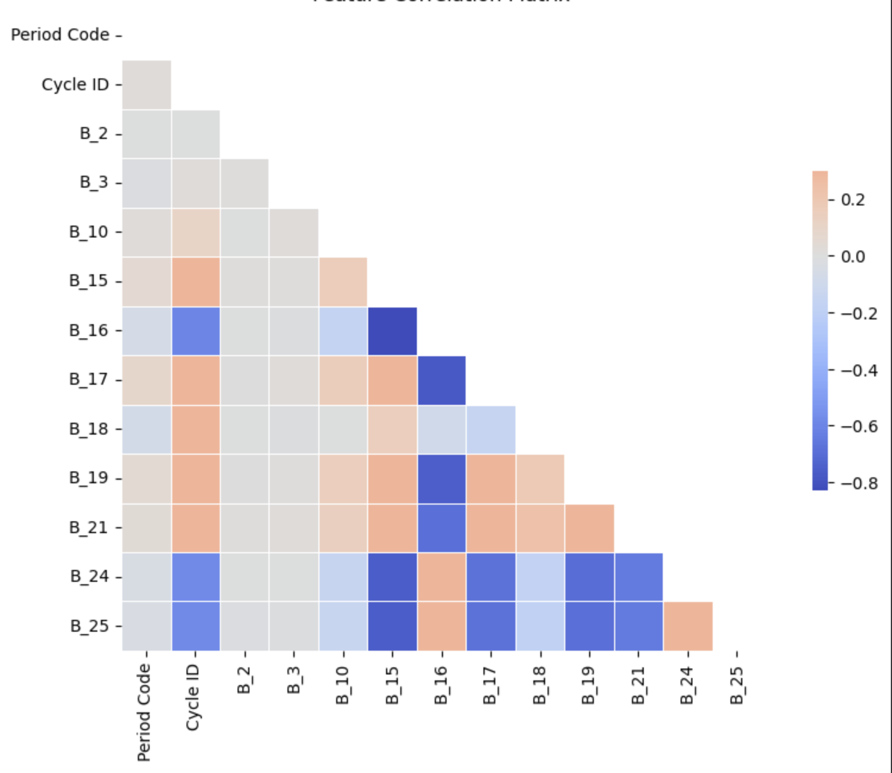
Data Visualization

Slide 8
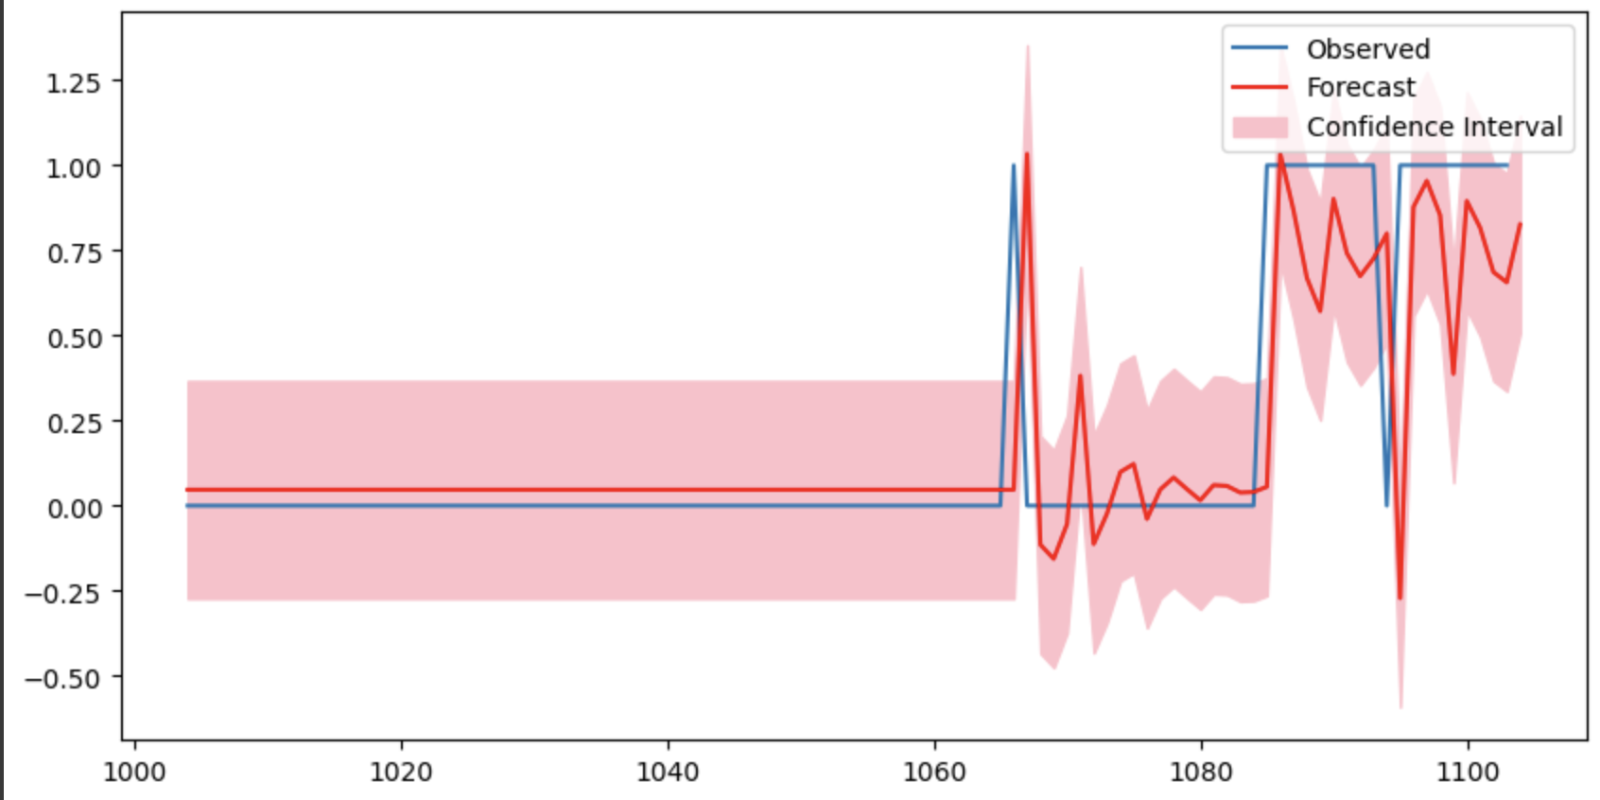
Data Visualization

Slide 9
Feature Engineering
Divided the train data into training and validation sets.
Feature Creation: We derived new features from the existing data that could have a significant impact on the predictive model's performance. This might include creating polynomial features, interaction terms, or aggregating features to capture more information.
Feature Transformation: We applied transformations to the features to change their distribution or scale.

Slide 10
Modeling
Created numerous classification models to predict the test data in order to get the best accuracy.
Model Training:
For each selected algorithm, we instantiated a model and trained it on the training data.
We used cross-validation techniques to ensure that the model's performance was stable across different subsets of the data.
Hyperparameter Tuning:
We used techniques like grid search and random search to find the optimal hyperparameters for the models.
This process involved defining a parameter grid for each model and searching for the combination of parameters that resulted in the best cross-validated performance.
Regularization:
For models such as logistic regression, regularization techniques (L1, L2, or ElasticNet) were applied to prevent overfitting and improve the model's generalization.

Slide 11
Modeling
Model Evaluation:
We used appropriate metrics to evaluate the models' performance. For classification tasks, we used metrics like accuracy, precision, recall, F1-score, and the area under the ROC curve (AUC).
For regression tasks, metrics such as mean squared error (MSE), mean absolute error (MAE), and R-squared were considered.
Model Validation:
The trained models were tested on the testing set to validate their performance.
We looked for signs of overfitting or underfitting and adjusted the models accordingly.
Ensemble Techniques:
We discussed using ensemble methods like Gradient Boosting and Stochastic Gradient Boosting to combine the predictions of several base estimators and improve predictive performance.

Slide 12
Modeling
Model Interpretation:
We interpreted the model results to understand the influence of different features on the predictions.
Techniques like feature importance were used to gain insights into which features were most significant in the model.

