Slide 1


Predicting kingdom of species from codon frequency
Team – Data Miners
George Baker
Dong Zhong
Ellie Cox
Vamsi Tallapu Reddy
Shashikiran Peddireddy

Slide 2
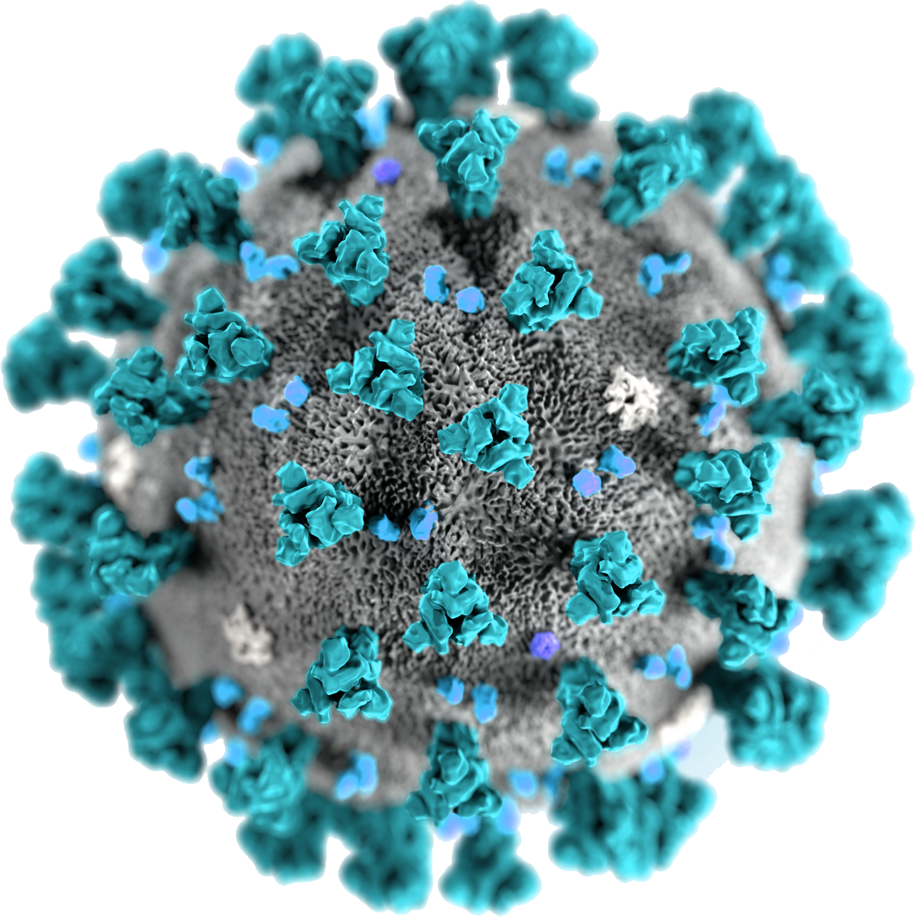
Agenda
Problem Background
Data Scope
Solution Framework
Modeling
Results

Slide 3
Problem Background
We would like to study if organism’s codon usage bias can be used for predicting species kingdoms
We will use the existing genetic datasets to perform machine learning models using codon usage patterns^{[1]}
The protein coding sequences have been obtain and the frequency of usage have been computed^{[2]}

Slide 4
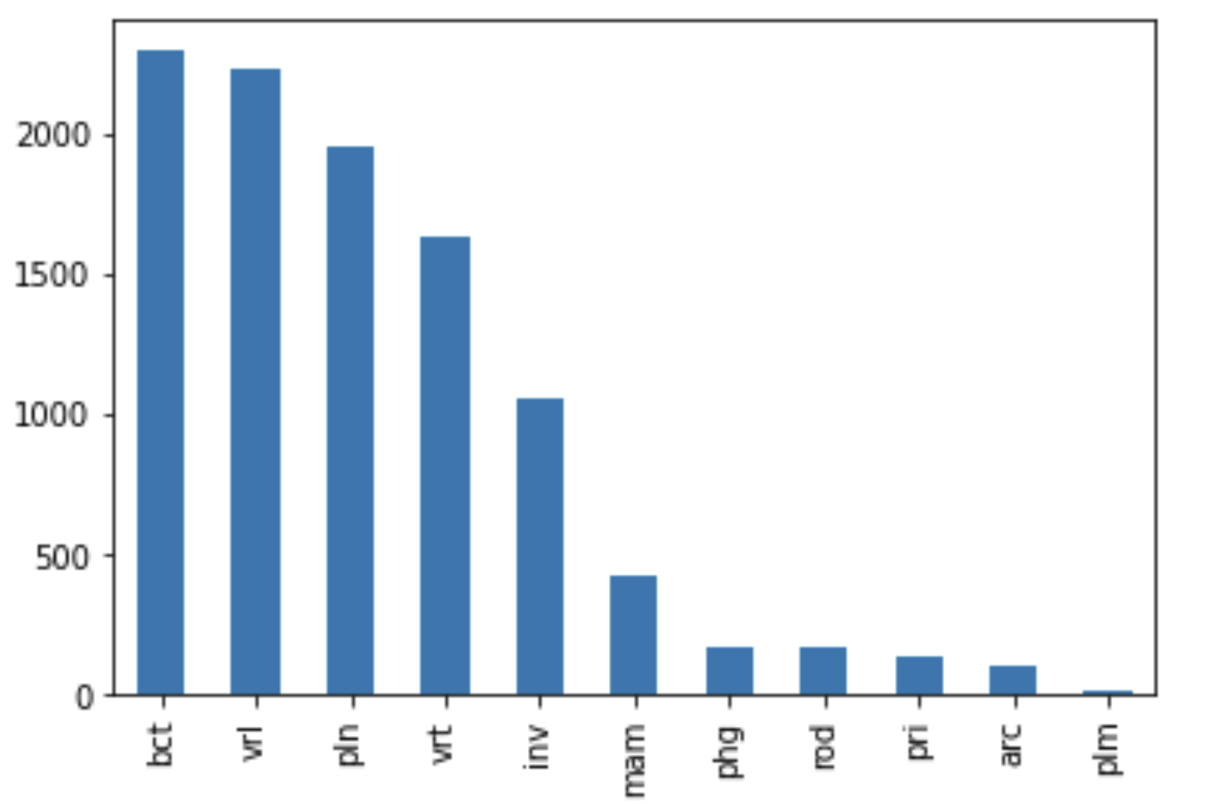
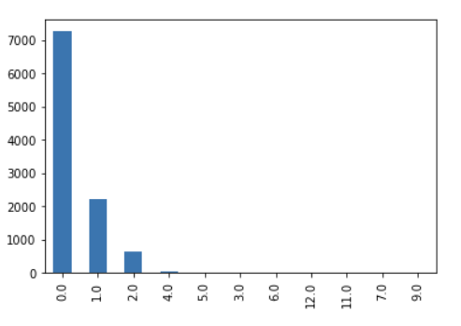
Data Scope
1. Species level data
2. 10,218 data points, 70 columns
3. 11 categories of kingdoms
4. 99.99% clean data
5. Train-validation split – 70:30
Counts of kingdom categories
Counts of DNA Type

Slide 5
Solution Framework
kFold (5 folds) Validation
Logistic Regression
Encoding
Feature Selection
Sanity Checks
Comparisons
Data Pre-processing
Model Preparation
Random Forest
Missing Values
Multi Layer Perceptron Classifier
Grid Search
Learning Curves
Scaling
Feature Engineering
Setting up a pipeline

Slide 6
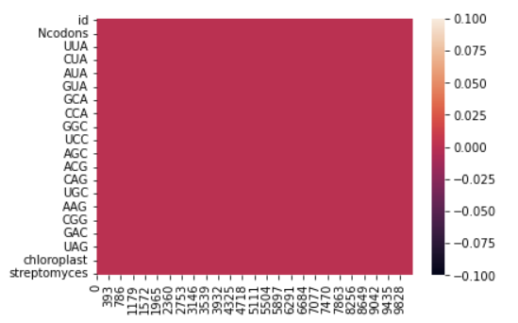
Glimpse of Preprocessing
1 Phaseolus coccineus - 0
2 Acidianus tengchongenses - 0
3 Tomato yellow leaf curl virus-[Almeria] - 0
4 mitochondrion Thalassiosira pseudonana - 0
5 mitochondrion Marmota monax - 0
6 mitochondrion Anolis sagrei - 0
6 chloroplast Venegasia carpesioides - 0
7 chloroplast Eupatorium atrorubens- 0
Feature Engineering

Slide 7
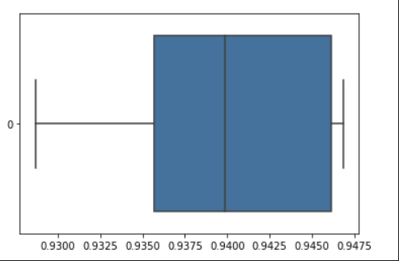
Glimpses of model preparation
Rank | Column
1 | CUU
2 | CUC
3 | CUA
4 | CUG
5 | AUA
6 | GUU
Accuracy
Feature Selection: RFE
Cross Validation results

Slide 8

Model Comparison
MLP Classifier – Accuracy: 95%
2
Random Forest –
Accuracy: 92%
3
Logistic Regression –
Accuracy: 86%

Slide 9
MLP Classifier
MLPClassifier is a neural network that uses backpropagation
It uses gradient descent to calculate gradients
Compared to Random Forests and Logistic Regression MLP Classifier has a higher accuracy and F1 scores for respective targets.
The hyperparameters that we finally selected are:
Five hidden layers(FC)
Each layer containing 200 neurons
100 iterations
Relu activation

Slide 10
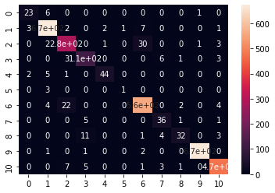
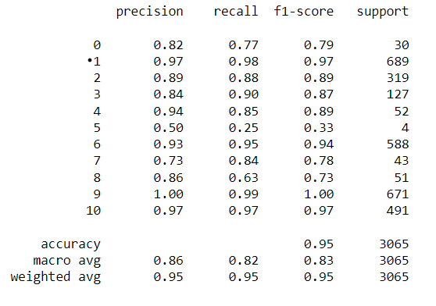
Detailed Results
Actual
Predicted

Slide 11
THANK YOU!

