Slide 1
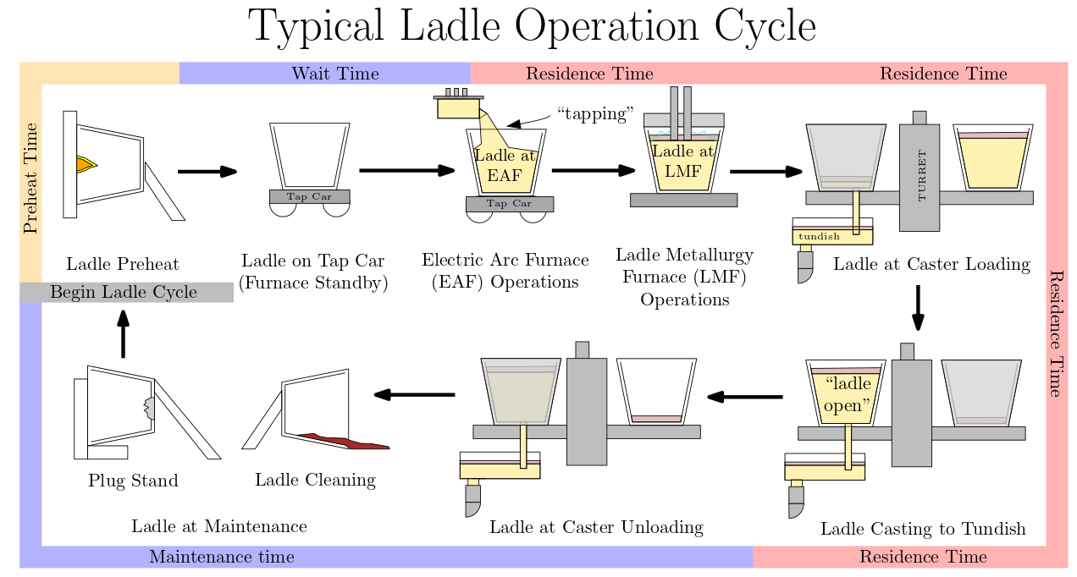
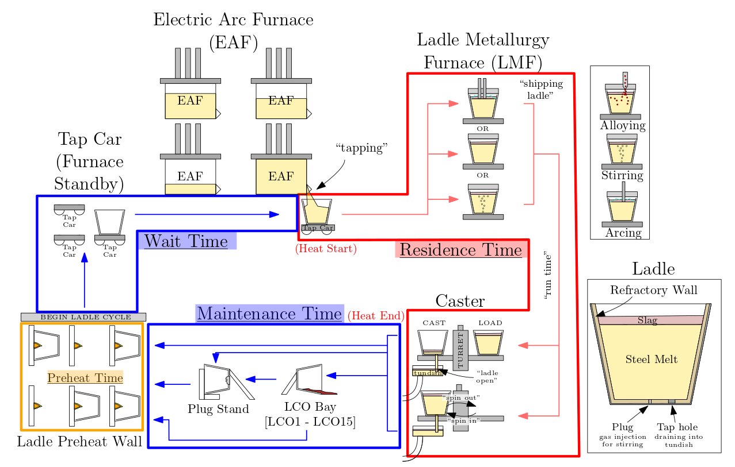
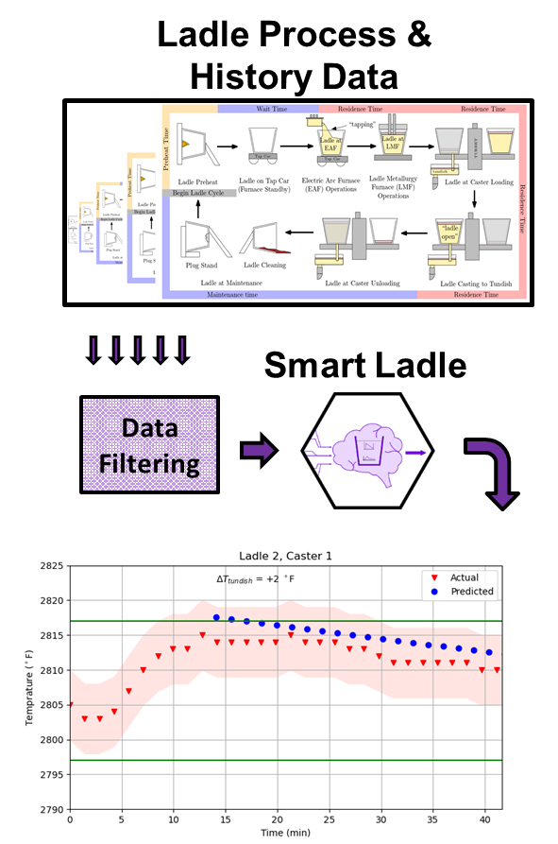
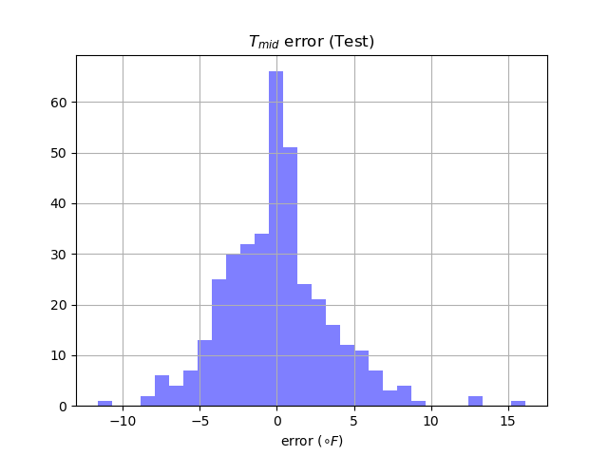
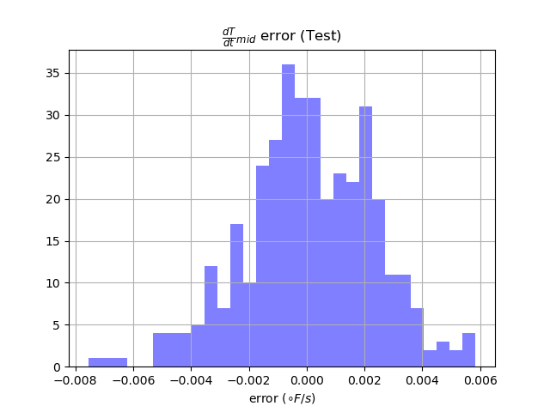
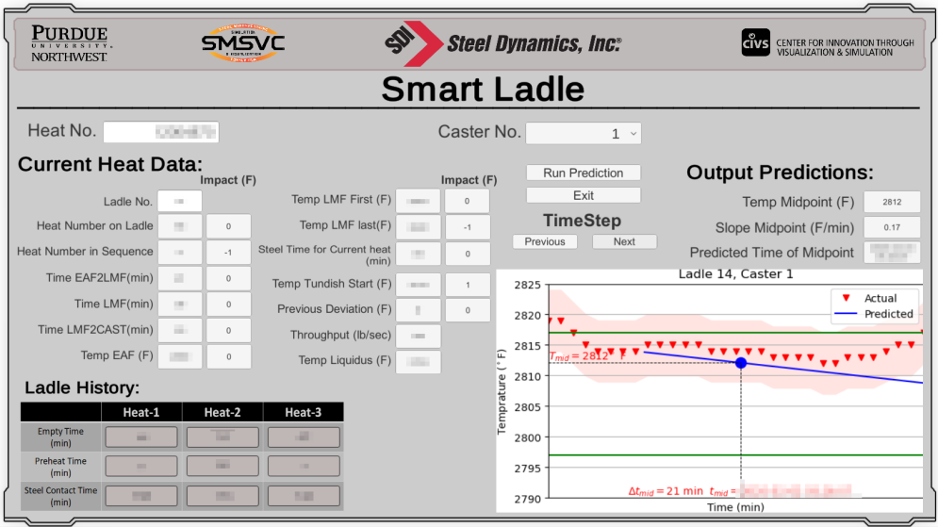
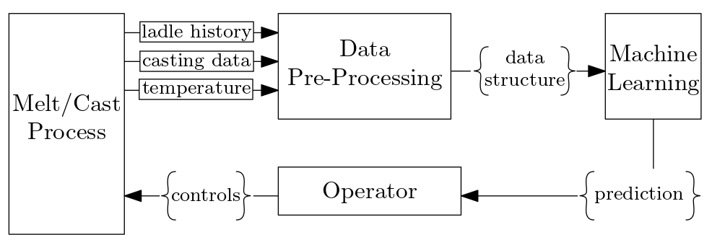
Smart Ladle: AI-Based Tool for Optimizing Caster Temperature
Zhankun Luo
Background
Data Processing
The different stages of the ladle’s process are categorized by the “type” of time. These are separated into preheat time, empty time, residence time. The empty time indicates the ladle has no steel and therefore will rapidly lose heat to the environment. Data was provided by SDI Butler Division and processed using Python and the PyODBC library.
Machine Learning Model
Our testing found that the LightGBM model was best able to provide results for the accuracy and robustness. The Smart Ladle program was written in Python using libraries such as numpy and pyTorch.
Standalone User Interface
To ensure that operators have clear access to the Smart Ladle program and all of the inputs and outputs, a standalone user interface was created in the Unity development environment. Users can enter the target heat number and choose to see a prediction or view data from past heats.
Results and Discussion
The smart manufacturing and Steel 4.0 use modern technologies to reduce costs and improve product quality. One technology that is having impact on many industries is machine learning.
From the BOF/EAF to the caster, the ability to quantify and respond to the variables that affect steel casting temperature is crucial for achieving consistent casting quality and maximizing productivity.
Performance of LightGBM Based Model
For midpoint temperature, Root of Mean Squared Error (RMSE) is 3°F; For slope, RMSE is 0.1 °F/min on test dataset. The maximum error is 15 °F, only 1% data whose error is greater than 10 °F.
Figure 1. Typical ladle operation cycle
Figure 6. Error distribution histogram of predicted tundish midpoint temperature
Figure 3. Ladle process diagram
with different time categories
Figure 4. Procedures of Smart Ladle
application
Objective
This work focuses on the quantifiable relationships between the casting temperature and various factors were developed during the ladle refining process to enable predictions of casting temperature and precise adjustments to steel temperature prior to the ladle reaching the casting stage of the production process.
Figure 7. Error distribution histogram of predicted slope at the midpoint
Conclusions
Methodology
The accuracy of the model has allowed us to begin implementation testing using the standalone interface at SDI Butler Division. Other teams are currently working on enabling the usage of data from other facilities and making the user interface more robust.
In this project, raw data are collected from plant database (real-time and historic process data), then the data including ladle and tundish history data would be clean-up and processed. Eventually, machine learning algorithm provides the prediction of tundish temperature and slope.
Sponsors & Collaborators
The authors would like to thank AIST for providing funding through the 2019 AIST Digital Transformation Technologies Grant, as well as for the support of SDI Butler Division, the Center for Innovation through Visualization and Simulation (CIVS) at PNW, and finally the members of the Steel Manufacturing and Visualization Consortium (SMSVC).
Figure 2. Methodology diagram of Smart Ladle
Figure 5. Graphic user interface of Smart Ladle application

