Slide 1

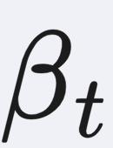
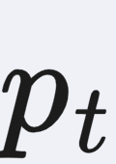
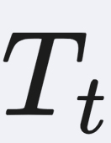
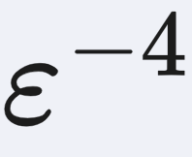
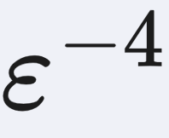
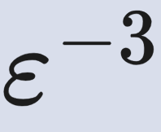
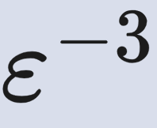
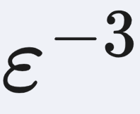
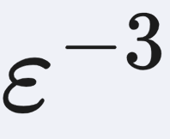


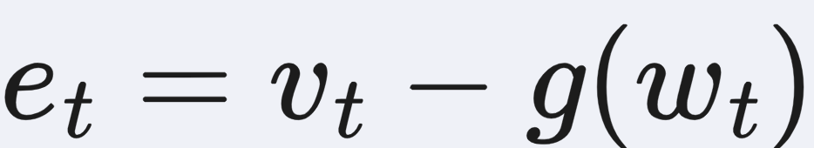
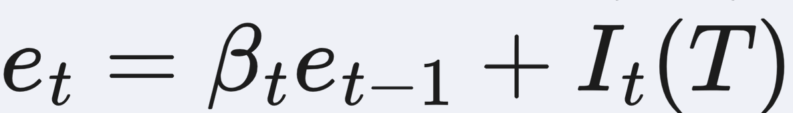
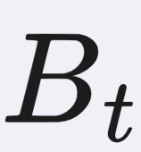
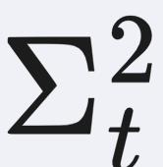
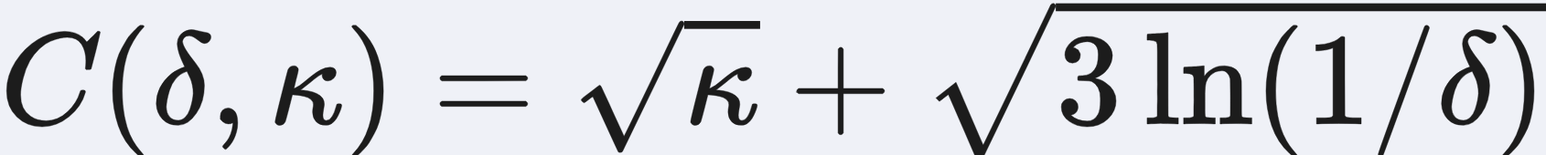

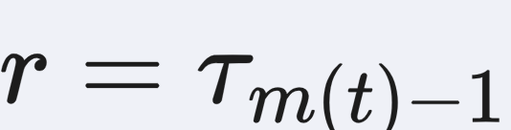
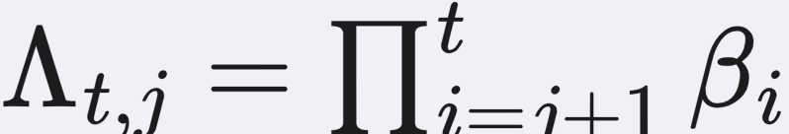
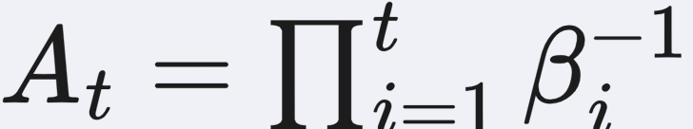
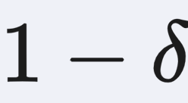
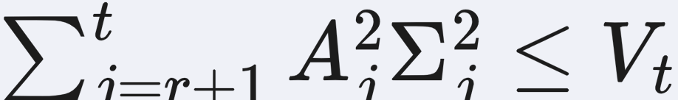
Unified High-Probability Analysis of Stochastic Variance-Reduced Estimation
Zhankun Luo^{1‡}, Antesh Upadhyay^{1‡}, M. Berk Sahin¹, Sang Bin Moon¹,
Anuran Makur¹, Abolfazl Hashemi¹
¹ Purdue University
Problem
Method
Key Results
Reliable estimation along a moving optimization trajectory.
1
Choose predictable memory
, reset probability
, and
FAMILY
MIRROR DESCENT
EXPECTATION CONSTRAINTS
Stochastic optimization must track a moving population
quantity from noisy samples. Estimator-specific, expectation-
based analyses obscure what controls reliability—especially
when errors determine whether a constraint is feasible.
correction
.
Standard
2
Reset with a fresh batch, or combine the current oracle with
corrected memory.
Differential
Second-order
3
Separate conditional bias from centered innovation noise.
Dominant oracle rates from Table 3; logarithmic factors
suppressed. Each family uses its stated regularity assumptions.
Motivation
First variance-reduced improvement for expectation
constraints
Momentum, STORM, PAGE, and SPIDER reuse historical
information differently.
SO WHAT → The same estimator analysis yields high-probability
guarantees in both applications.
; .
Compare memory retention, estimate refreshes, and
movement corrections.
;
.
Unified error bound · Theorem 4.2
SEPARATE ANALYSES
vs.
UNIFIED ANALYSIS
For
, non-reset steps satisfy
Headline Numbers
Estimator-specific
guarantees in expectation.
Common structure, high-
probability control.
. Use bias bound
and centered
variance proxy
.
ε⁻³
3
families
Three families, one design space
For
:
3
regimes
Constrained oracle complexity
9
configurations
CORRECTION
RECURSIVE
RESET-BASED
Improves the prior ε⁻⁴ rate; logarithmic factors suppressed.
Standard
Momentum
Probabilistic / periodic
momentum
Takeaway
Differential
STORM
PAGE / SPIDER
Separate memory, resets, and correction to analyze
estimator reliability once.
Second-
order
SO
Momentum
SO PAGE / SO SPIDER
Initialization: batch error decays with retained memory.
Stronger guarantees for gradient tracking and expectation-
constraint estimation.
Momentum smooths direct noise but incurs drift bias.
Differential updates remove this bias using stochastic
differences. Curvature correction leaves a quadratic residual.
Bias: corrections control accumulated predictable drift.
Fluctuations: a vector-valued Freedman inequality controls
noise over random reset intervals.
Reliability requires predictable parameters, sub-Gaussian
noise, and family-specific regularity. In the constrained
application, the objective and constraint are convex, the
domain is bounded, and stochastic subgradients are bounded
and unbiased.
The same framework covers gradients and scalar constraint
values, in Euclidean and smooth non-Euclidean geometries.
Here
,
,
. The bound holds with
probability at least
when
under the stated
predictability and sub-Gaussian assumptions.

