Slide 1
IAC PATRONS FOUNDATION
IAC Asset Management Portal
Staff, Admin and Management training
Portal overview and daily workflows
20 October 2026
Notes:
Sources: IAC application README.md; docs/SYSTEM_DESIGN_AND_USER_GUIDE.md; docs/API_SMTP_ADMIN_GUIDE.md; docs/API.md. Screenshot sources are synthetic browser test artifacts.
Trainer: demonstrate this workflow with approved synthetic data, then ask participants to identify the next required action. Portal acceptance differs from asset acknowledgement.

Slide 2
ALL PARTICIPANTS
Session plan
01
Management responsibilities and rollout decisions
02
Staff access, equipment review and support
03
Admin setup, custody and register controls
04
Practice: a complete equipment handover
IAC Asset Management Portal
02
Notes:
Sources: IAC application README.md; docs/SYSTEM_DESIGN_AND_USER_GUIDE.md; docs/API_SMTP_ADMIN_GUIDE.md; docs/API.md. Screenshot sources are synthetic browser test artifacts.
Trainer: demonstrate this workflow with approved synthetic data, then ask participants to identify the next required action. Portal acceptance differs from asset acknowledgement.

Slide 3
MANAGEMENT
Management overview
01
One catalog connects equipment to current custody
02
Support tickets retain requests and responses
03
Audit history records changes and accountable actions
04
Approved access limits who can read and change records
IAC Asset Management Portal
03
Notes:
Sources: IAC application README.md; docs/SYSTEM_DESIGN_AND_USER_GUIDE.md; docs/API_SMTP_ADMIN_GUIDE.md; docs/API.md. Screenshot sources are synthetic browser test artifacts.
Trainer: demonstrate this workflow with approved synthetic data, then ask participants to identify the next required action. Portal acceptance differs from asset acknowledgement.

Slide 4
MANAGEMENT
Management decisions and MVP limits
01
Assign owners for inventory, support and data quality
02
Approve employee mappings, notification groups and retention
03
Finance policy and production deployment need owner decisions
04
Management is an audience, not a separate implemented role
IAC Asset Management Portal
04
Notes:
Sources: IAC application README.md; docs/SYSTEM_DESIGN_AND_USER_GUIDE.md; docs/API_SMTP_ADMIN_GUIDE.md; docs/API.md. Screenshot sources are synthetic browser test artifacts.
Explain that advanced analytics and Finance calculations are not promised by this MVP. Management access depends on approved existing roles.

Slide 5
ALL PARTICIPANTS
Who can do what
01
Employee: read own assigned assets and raise tickets
02
Admin: manage assets, assignments, people and masters
03
IT/Admin: work the support queue and complete tickets
04
IT/Admin alone cannot assign inventory or manage accounts
IAC Asset Management Portal
05
Notes:
Sources: IAC application README.md; docs/SYSTEM_DESIGN_AND_USER_GUIDE.md; docs/API_SMTP_ADMIN_GUIDE.md; docs/API.md. Screenshot sources are synthetic browser test artifacts.
Trainer: demonstrate this workflow with approved synthetic data, then ask participants to identify the next required action. Portal acceptance differs from asset acknowledgement.

Slide 6
STAFF
First sign-in and portal access
01
Use your approved email or newest invitation link
02
Complete email verification and sign in
03
Staff roles complete authenticator verification when prompted
04
Accept the portal notice before using the workspace
IAC Asset Management Portal
06
Notes:
Sources: IAC application README.md; docs/SYSTEM_DESIGN_AND_USER_GUIDE.md; docs/API_SMTP_ADMIN_GUIDE.md; docs/API.md. Screenshot sources are synthetic browser test artifacts.
Trainer: demonstrate this workflow with approved synthetic data, then ask participants to identify the next required action. Portal acceptance differs from asset acknowledgement.

Slide 7
STAFF
Equipment review and receipt
01
Open Your assets and select your equipment
02
Check Asset ID, serial number, condition and saved picture
03
Confirm receipt when correct or report a discrepancy
04
Employees view asset details and photos without editing them
IAC Asset Management Portal
07
Notes:
Sources: IAC application README.md; docs/SYSTEM_DESIGN_AND_USER_GUIDE.md; docs/API_SMTP_ADMIN_GUIDE.md; docs/API.md. Screenshot sources are synthetic browser test artifacts.
Trainer: demonstrate this workflow with approved synthetic data, then ask participants to identify the next required action. Portal acceptance differs from asset acknowledgement.

Slide 8
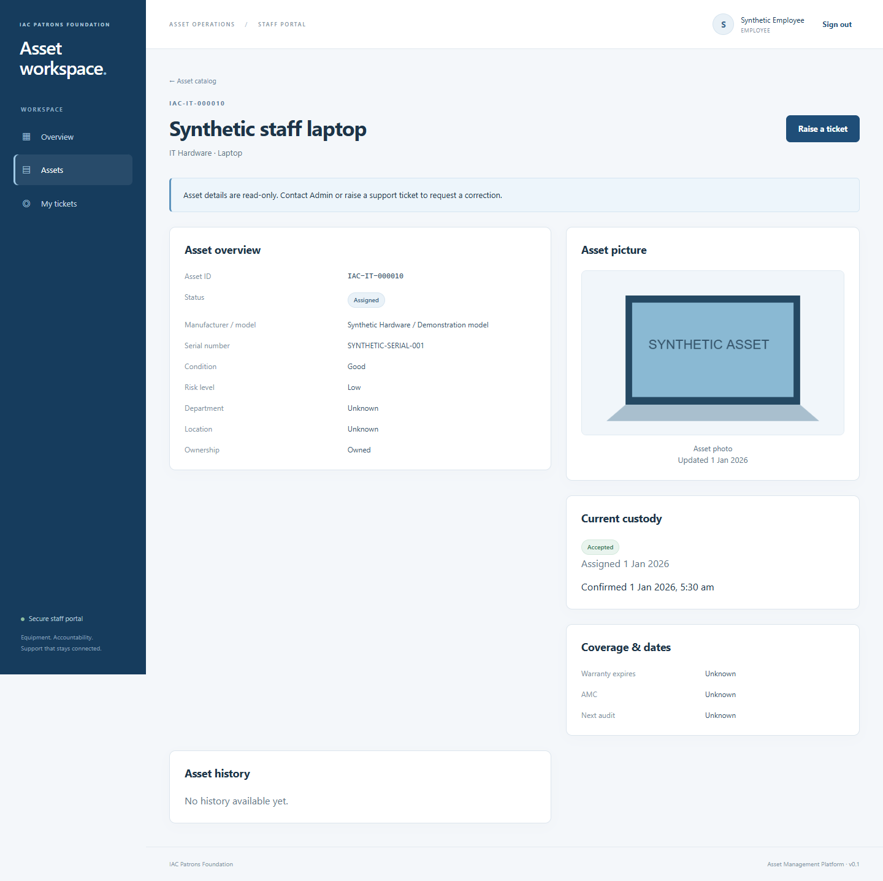
STAFF SCREEN
Employee asset screen
Synthetic training example. Demonstrate the corresponding screen in the portal.
IAC Asset Management Portal
08
Notes:
Sources: IAC application README.md; docs/SYSTEM_DESIGN_AND_USER_GUIDE.md; docs/API_SMTP_ADMIN_GUIDE.md; docs/API.md. Screenshot sources are synthetic browser test artifacts.
Trainer: demonstrate this workflow with approved synthetic data, then ask participants to identify the next required action. Portal acceptance differs from asset acknowledgement.

Slide 9
STAFF
A useful support request
01
Open Support desk and create a new ticket
02
Describe symptoms and troubleshooting already tried
03
Choose category and priority and link your assigned asset
04
Follow public replies without sharing credentials or MFA codes
IAC Asset Management Portal
09
Notes:
Sources: IAC application README.md; docs/SYSTEM_DESIGN_AND_USER_GUIDE.md; docs/API_SMTP_ADMIN_GUIDE.md; docs/API.md. Screenshot sources are synthetic browser test artifacts.
Trainer: demonstrate this workflow with approved synthetic data, then ask participants to identify the next required action. Portal acceptance differs from asset acknowledgement.

Slide 10
ADMIN
People and master setup
01
Approve or invite the correct employee email
02
Wait for activation, verification and portal acceptance
03
Use Master Control for departments, locations and choices
04
Keep permanent codes and deactivate retired editable choices
IAC Asset Management Portal
10
Notes:
Sources: IAC application README.md; docs/SYSTEM_DESIGN_AND_USER_GUIDE.md; docs/API_SMTP_ADMIN_GUIDE.md; docs/API.md. Screenshot sources are synthetic browser test artifacts.
Trainer: demonstrate this workflow with approved synthetic data, then ask participants to identify the next required action. Portal acceptance differs from asset acknowledgement.

Slide 11
ADMIN
Asset creation and laptop photos
01
Create the asset with identity, category and condition
02
Use In Store for equipment ready for first assignment
03
Enter known financial values and leave unknown values blank
04
Preview the picture, enter a reason and explicitly Save photo
IAC Asset Management Portal
11
Notes:
Sources: IAC application README.md; docs/SYSTEM_DESIGN_AND_USER_GUIDE.md; docs/API_SMTP_ADMIN_GUIDE.md; docs/API.md. Screenshot sources are synthetic browser test artifacts.
Trainer: demonstrate this workflow with approved synthetic data, then ask participants to identify the next required action. Portal acceptance differs from asset acknowledgement.

Slide 12
ADMIN
Assignment and transfer
01
Open Asset catalog and choose Assign asset
02
Choose an In Store asset and an eligible Employee
03
Review the handover note and Confirm assignment
04
Transfer custody requires a different employee and a reason
IAC Asset Management Portal
12
Notes:
Sources: IAC application README.md; docs/SYSTEM_DESIGN_AND_USER_GUIDE.md; docs/API_SMTP_ADMIN_GUIDE.md; docs/API.md. Screenshot sources are synthetic browser test artifacts.
Trainer: demonstrate this workflow with approved synthetic data, then ask participants to identify the next required action. Portal acceptance differs from asset acknowledgement.

Slide 13
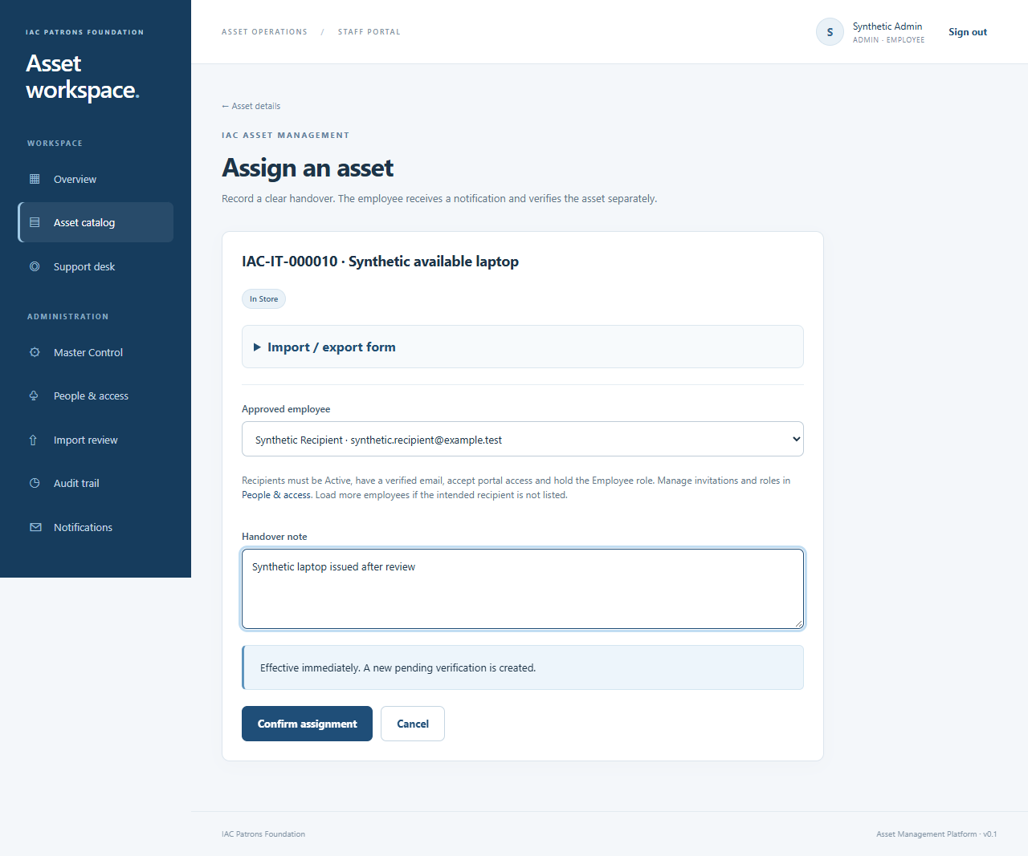
ADMIN SCREEN
Assignment screen
Synthetic training example. Demonstrate the corresponding screen in the portal.
IAC Asset Management Portal
13
Notes:
Sources: IAC application README.md; docs/SYSTEM_DESIGN_AND_USER_GUIDE.md; docs/API_SMTP_ADMIN_GUIDE.md; docs/API.md. Screenshot sources are synthetic browser test artifacts.
Trainer: demonstrate this workflow with approved synthetic data, then ask participants to identify the next required action. Portal acceptance differs from asset acknowledgement.

Slide 14
ADMIN
Return and custody history
01
Record return condition, reason and destination where needed
02
Inspect current custody before another handover
03
Refresh and review when another change causes a version conflict
04
Portal acceptance and equipment receipt are separate evidence
IAC Asset Management Portal
14
Notes:
Sources: IAC application README.md; docs/SYSTEM_DESIGN_AND_USER_GUIDE.md; docs/API_SMTP_ADMIN_GUIDE.md; docs/API.md. Screenshot sources are synthetic browser test artifacts.
Trainer: demonstrate this workflow with approved synthetic data, then ask participants to identify the next required action. Portal acceptance differs from asset acknowledgement.

Slide 15
ADMIN
Excel, CSV and register review
01
Single form: template, one row, preview, Load into form, Save
02
Bulk: template, validate, inspect, confirm and Apply
03
Bulk allows up to 50 rows and a 60,000-byte request
04
Original registers require reconciliation and separate promotion
IAC Asset Management Portal
15
Notes:
Sources: IAC application README.md; docs/SYSTEM_DESIGN_AND_USER_GUIDE.md; docs/API_SMTP_ADMIN_GUIDE.md; docs/API.md. Screenshot sources are synthetic browser test artifacts.
Trainer: demonstrate this workflow with approved synthetic data, then ask participants to identify the next required action. Portal acceptance differs from asset acknowledgement.

Slide 16
IT / ADMIN
Ticket ownership and completion
01
Review the queue and choose an owner where appropriate
02
Public replies reach the reporter; internal notes stay with staff
03
Record the resolution and mark the ticket Completed
04
Completing a ticket leaves equipment custody unchanged
IAC Asset Management Portal
16
Notes:
Sources: IAC application README.md; docs/SYSTEM_DESIGN_AND_USER_GUIDE.md; docs/API_SMTP_ADMIN_GUIDE.md; docs/API.md. Screenshot sources are synthetic browser test artifacts.
Trainer: demonstrate this workflow with approved synthetic data, then ask participants to identify the next required action. Portal acceptance differs from asset acknowledgement.

Slide 17
IT OPERATORS
Email and service administration
01
The API saves the action and queues its notification
02
A separate worker delivers through approved SMTP
03
Queued or SMTP accepted does not prove inbox delivery
04
Use the API/SMTP guide for private setup and troubleshooting
IAC Asset Management Portal
17
Notes:
Sources: IAC application README.md; docs/SYSTEM_DESIGN_AND_USER_GUIDE.md; docs/API_SMTP_ADMIN_GUIDE.md; docs/API.md. Screenshot sources are synthetic browser test artifacts.
Trainer: demonstrate this workflow with approved synthetic data, then ask participants to identify the next required action. Portal acceptance differs from asset acknowledgement.

Slide 18
GUIDED PRACTICE
Training exercise
01
Admin creates and assigns a synthetic asset to a test Employee
02
Employee checks details, acknowledges receipt and raises a ticket
03
IT staff replies and completes the ticket with a resolution
04
Admin checks history and exports a permitted report
IAC Asset Management Portal
18
Notes:
Sources: IAC application README.md; docs/SYSTEM_DESIGN_AND_USER_GUIDE.md; docs/API_SMTP_ADMIN_GUIDE.md; docs/API.md. Screenshot sources are synthetic browser test artifacts.
Use isolated synthetic identities and local Mailpit. Demonstrate each role in turn. No live employee records or external training emails.

Slide 19
ALL PARTICIPANTS
Knowledge check
01
Can an Employee edit the laptop serial number?
02
Does portal acceptance confirm receipt of equipment?
03
Why could an asset or employee be missing from assignment?
04
Does a queued notification prove receipt of email?
IAC Asset Management Portal
19
Notes:
Sources: IAC application README.md; docs/SYSTEM_DESIGN_AND_USER_GUIDE.md; docs/API_SMTP_ADMIN_GUIDE.md; docs/API.md. Screenshot sources are synthetic browser test artifacts.
Answers: No. No. Assets need In Store status and no current custody. Recipients need active Employee role, verified email and accepted portal access. No: email delivery requires separate evidence.

Slide 20
ALL PARTICIPANTS
Daily reference and next steps
01
Staff review equipment and use Support desk for issues
02
Admin maintains custody and resolves import exceptions
03
Management confirms ownership and production readiness
04
Reference guides cover user workflows and API/SMTP operations
IAC Asset Management Portal
20
Notes:
Sources: IAC application README.md; docs/SYSTEM_DESIGN_AND_USER_GUIDE.md; docs/API_SMTP_ADMIN_GUIDE.md; docs/API.md. Screenshot sources are synthetic browser test artifacts.
Trainer: demonstrate this workflow with approved synthetic data, then ask participants to identify the next required action. Portal acceptance differs from asset acknowledgement.

