Slide 1
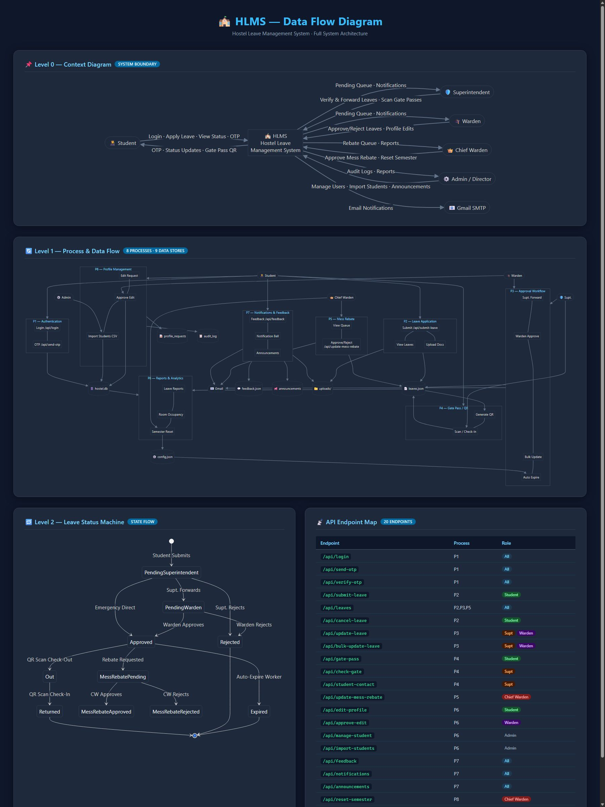
GHEC Hostel Leave Management System
Digitizing and Streamlining Student Leaves & Approvals

Slide 2
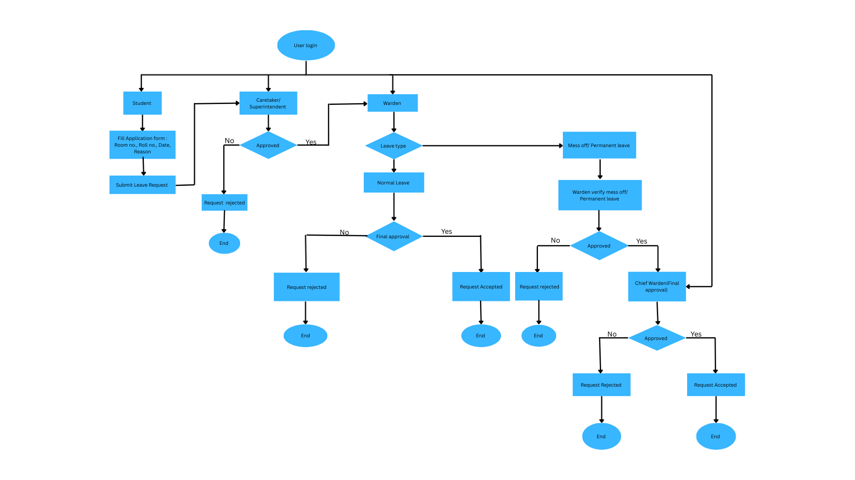
The Problem with Paper-Based Leave Systems
🗂️ Lost Applications
Physical forms misplaced or destroyed, leaving students with no recourse.
⏳ Slow Approvals
Multi-step manual sign-offs cause delays of days for time-sensitive requests.
🔍 Zero Transparency
Students have no visibility into where their application stands at any moment.
📵 Communication Gaps
Parents are never notified, creating safety concerns and uninformed guardians.

Slide 3

The Solution: A Fully Digital Leave Platform
GHEC's Hostel Leave Management System automates the entire leave lifecycle — from application to gate pass — eliminating paperwork and replacing it with a transparent, efficient, and secure digital workflow.
Paperless
Instant Alerts
Every application, approval, and record stored digitally.
Automated notifications keep students and parents informed in real time.
Full Transparency
Secure Records
Live status tracking from submission through final decision.
Protected data with role-based access and audit trails.

Slide 4
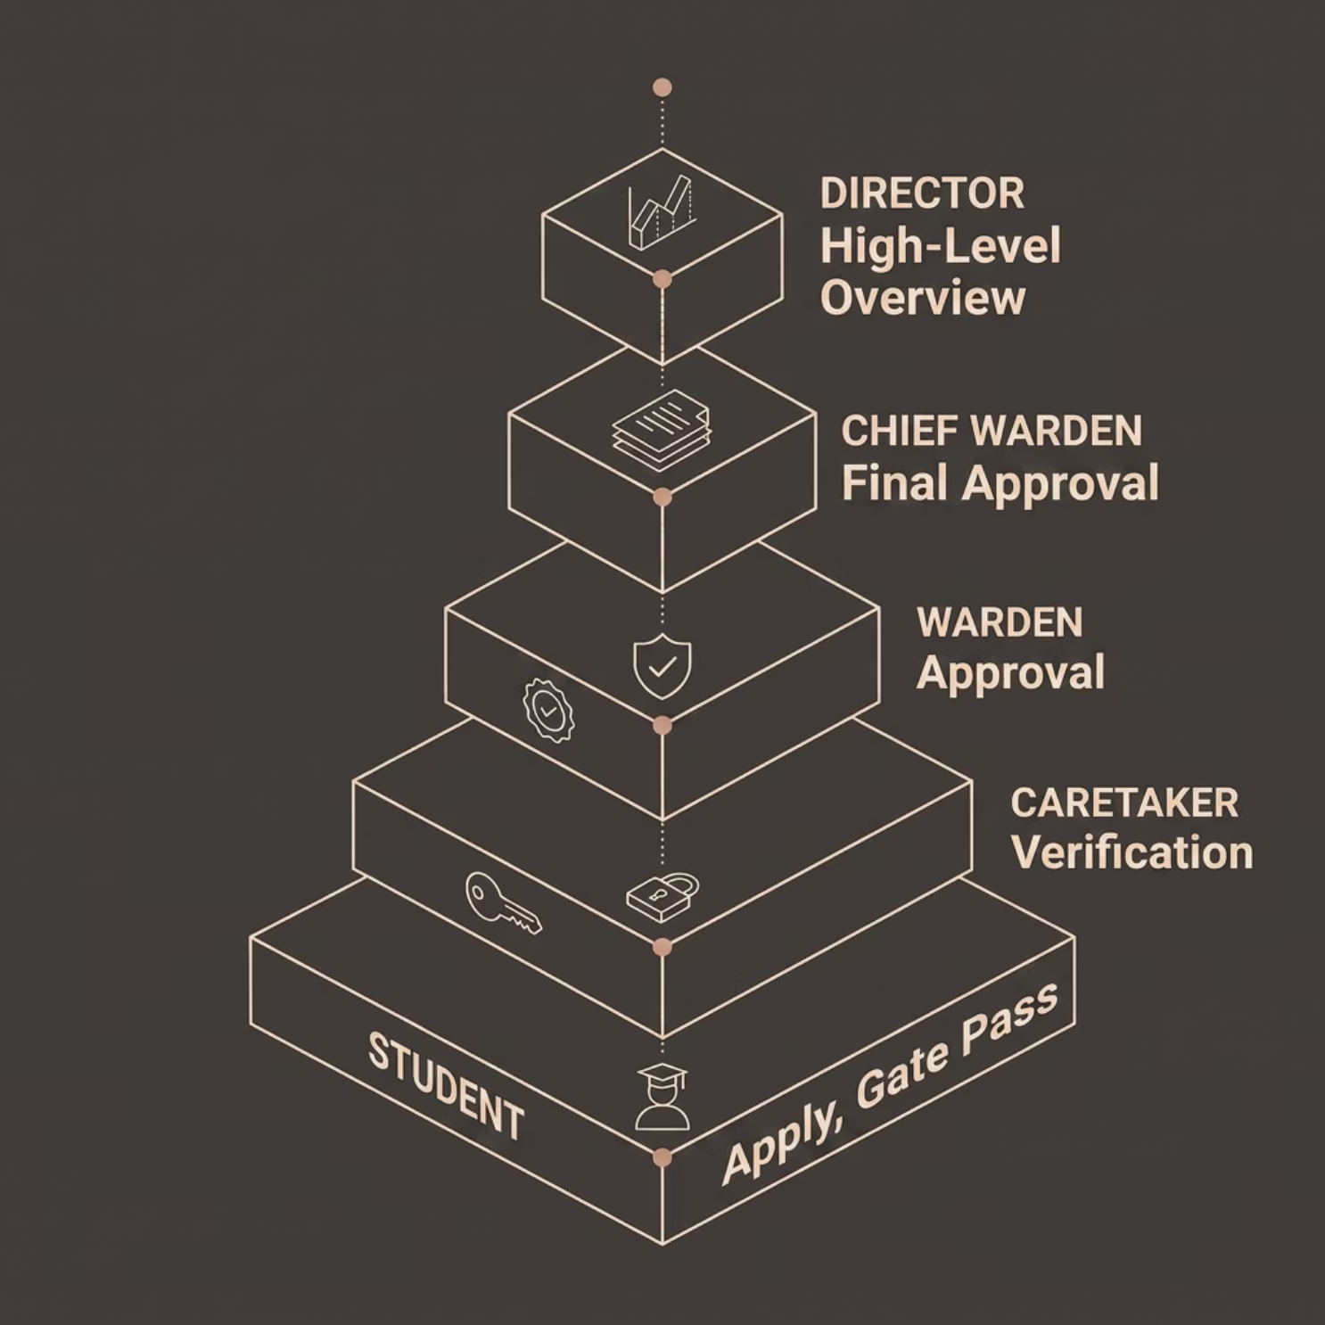

Multi-Tier User Roles
Five distinct roles ensure the right people have the right access at every stage of the approval process.
Student
Caretaker
Apply, track status, and generate gate passes.
First-level verification of leave requests.
Warden
Chief Warden
Second-level review and approval authority.
Final approval, bulk actions, and rebate oversight.
Director
High-level reporting and institutional oversight.

Slide 5

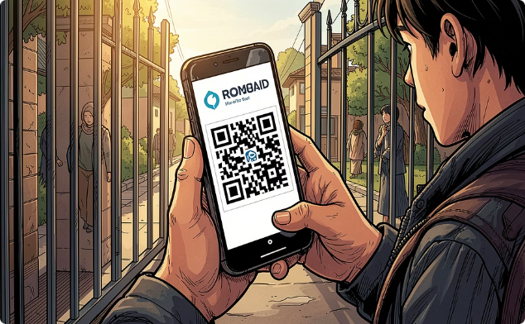
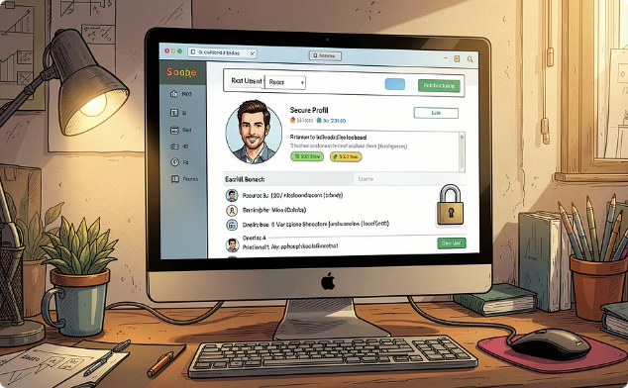
Key Features & Workflows
Leave Application
Digital Gate Passes
Profile Management
Simple, guided forms for Day Out, Night Out, and Home leave types — submitted in minutes.
Auto-generated passes sent to students upon approval — scannable by security at the gate.
Secure student profiles with warden-controlled lockdown — profile edits require formal approval.

Slide 6

AUTOMATED NOTIFICATIONS
Keeping Everyone in the Loop
At every step — submission, approval, or rejection — the system dispatches beautifully branded HTML email notifications automatically.
Student receives real-time status updates instantly.
Parents are notified simultaneously for every leave decision.
No manual follow-up required from hostel staff.

Slide 7
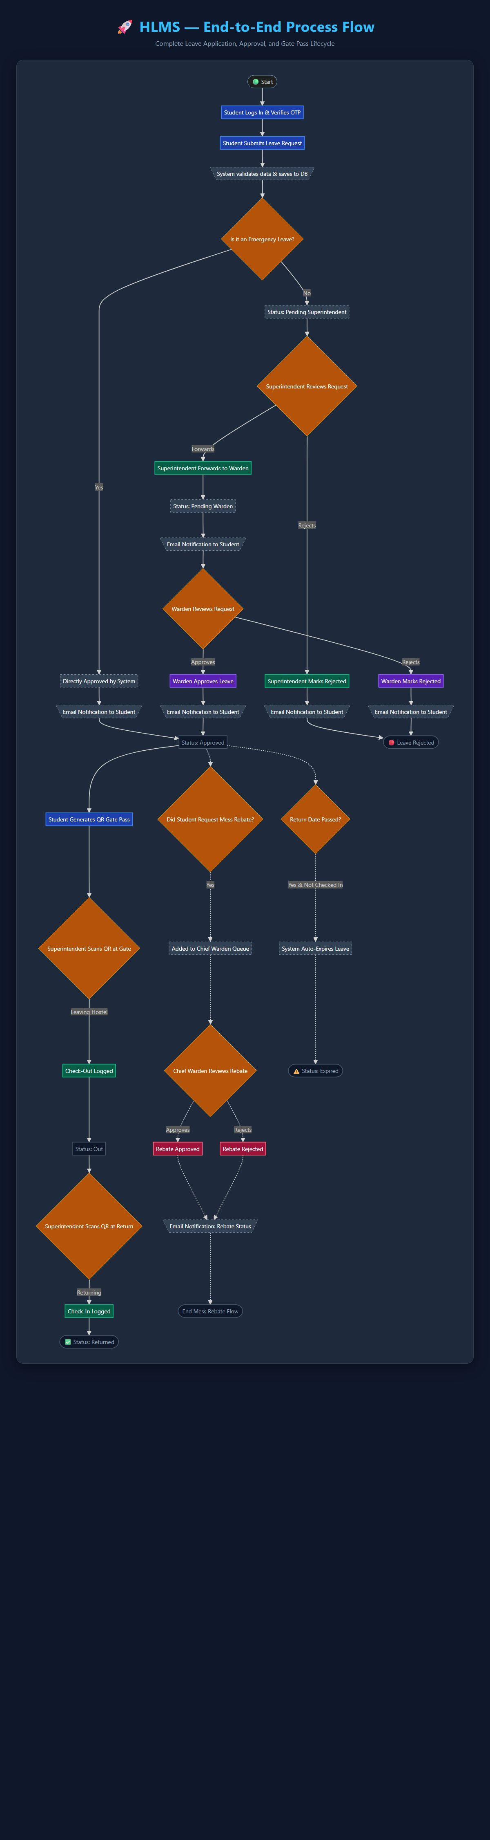
MESS REBATE INTEGRATION
Automated Fee Savings for Students on Leave
When a student is approved for a long-duration leave, the system automatically flags their eligibility for a mess fee rebate — no manual request needed.
Rebate requests auto-generated on leave approval
Chief Warden reviews and approves in one click
Reduces administrative overhead significantly
Creates a clear, auditable rebate record

Slide 8

Administrative Dashboard & Analytics
⚡ Bulk Actions
Approve or reject multiple leave requests simultaneously to cut processing time.
🔎 Search & Filter
Instantly locate any student's leave record by date, type, status, or room number.
📊 Live Tracking
Real-time dashboard view of all active, pending, and completed leaves.
📁 Export Reports
Download complete leave records as Excel or CSV for audits and institutional reporting.

Slide 9
Technology Stack
Built with lightweight, proven technologies — ensuring reliability, low overhead, and easy deployment in institutional environments.
Frontend
Backend
HTML, Vanilla CSS & JavaScript with full Dark / Light mode support.
Custom-built Python HTTP Server — no heavy frameworks, full control.
Database
Email Integration
SQLite for lightweight, portable, and reliable structured data management.
SMTP protocol powers automated, branded HTML email delivery at every workflow step.

Slide 10
Impact Summary & Future Scope
What We've Delivered
What's Next
01
Mobile App
Increased Efficiency
Better Security
Native iOS & Android apps for on-the-go leave management.
Leave cycles that took days now complete in hours.
Digital gate passes and audit trails eliminate unauthorized exits.
02
Biometric Gate Scanning
Fingerprint or face recognition integrated with gate pass verification.
03
Parent Communication
Advanced Analytics
Automated alerts keep families informed and reassured at every step.
Predictive dashboards for leave trends and hostel occupancy planning.

