Slide 1
Deep Learning Prediction Engine on Big Data
Dastagiri Dudekula
1826239

Slide 2
Official Statistics
Social + Economic
Official statistics - reliable and objective information - is crucial for DECISION MAKING.
Correct interpretation of Data (Accountability & Transparency), Professional standards and ethics
Impartial basis to honour citizen’s entitlement to public information
Quality, timeliness, costs, confidentiality, consistency
http://www.unece.org/?id=3207

Slide 3



Big Data
Volume
Velocity
Variety

Slide 4

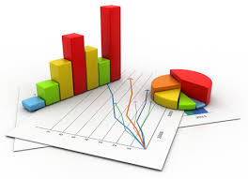
Big Data For Official Statistics
Big Data can keep official statistics relevant–private sector moves fast.
Big Data are part of modernization of statistical systems – new production processes and partnerships.
Big Data are needed for agile statistics –for emergency issues.
Mandated to give direction to the use of Big Data for Official Statistics (on ISSUES related to methodology, quality, technology, data access, legislation, privacy, management and finance, etc.)
https://unstats.un.org/Unsd/nationalaccount/workshops/2018/rio/UNSD.PDF

Slide 5
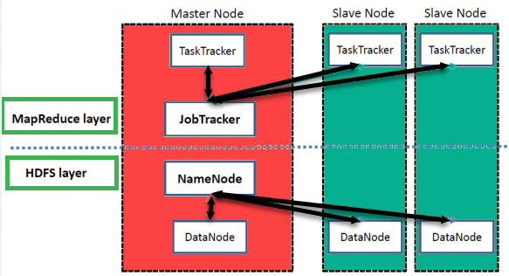

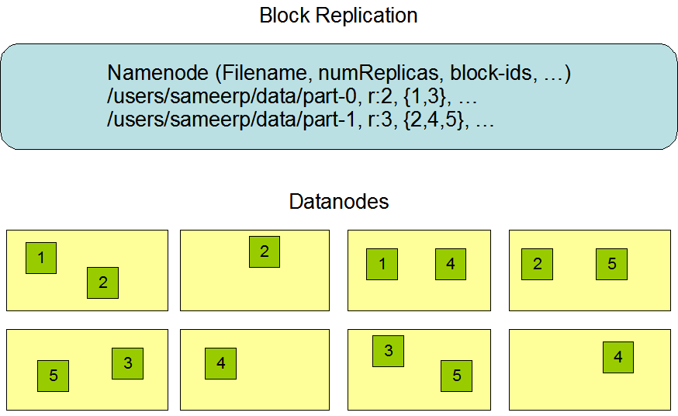
Hadoop Architecture
High Level Architecture

Slide 6
Deep Learning for BDOS
Deep Learning algorithms extract high-level, complex abstractions as data representations through a hierarchical learning process.
A key benefit of Deep Learning is the analysis and learning of massive amounts of unsupervised data, making it a valuable tool for Big Data Analytics where raw data is largely unlabeled and un-categorized.
In the present study, how Deep Learning can be utilized for addressing some important problems in Big Data Analytics, including extracting complex patterns from massive volumes of data, semantic indexing, data tagging, fast information retrieval, simplifying discriminative tasks, streaming data, dealing with high dimensionality of data, scalability of models, and distributed and parallel computing.

Slide 7
Motivation
To mitigate the housing business in a specific region.
Hence, enabling the system to predict the pricing.

Slide 8
Project Architecture
HDFS
Dataframe
Normalization
Modelling
Predictive Result

Slide 9
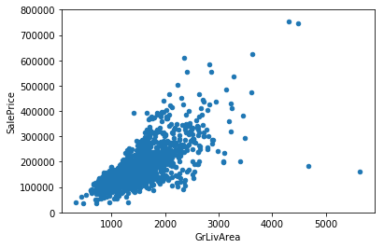
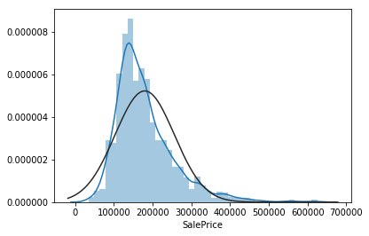
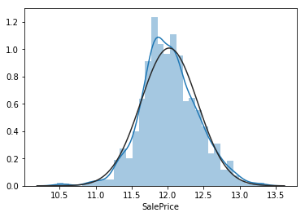
Normalisation
Missing value replacement
Removal of distort statistical values
Log1p transformation to change asymmetric to symmetric in a statistical distribution
Customised feature variables analysis

Slide 10
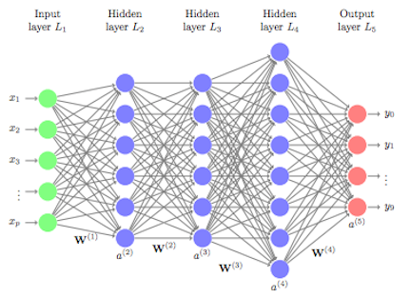
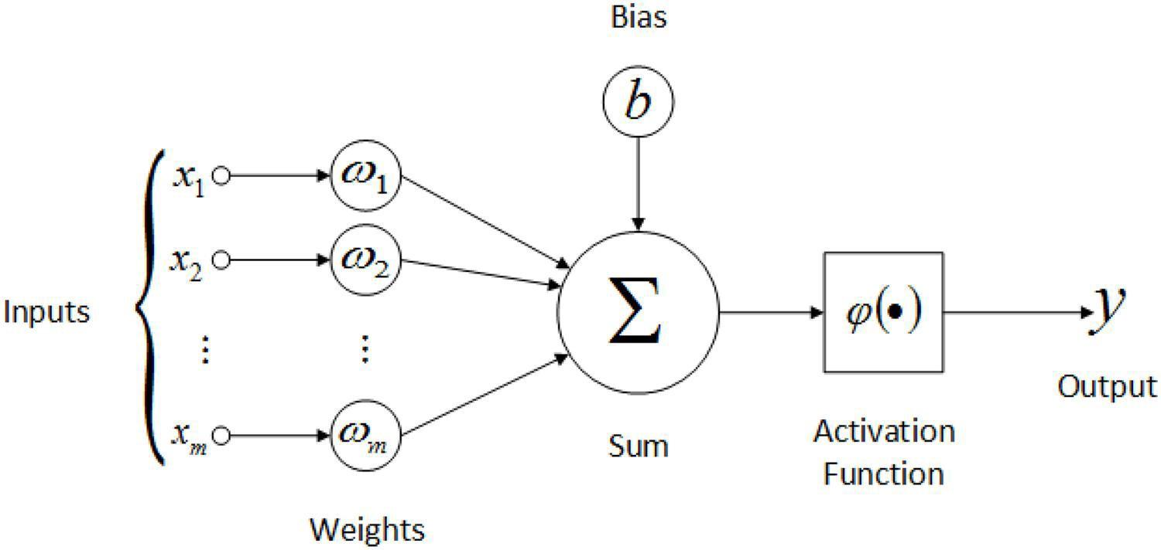
DL Modelling
ReLu : linear regression activation function
f(x) = max(x, 0) ∀ x >= max(x, 0)
f(x) = x ∀ threshold <= x < max(x, 0)
f(x) = negative_slope * (x - threshold) otherwise.
Y* = F( sum(W* ⋅ h*) + b*) <= Output’s
h* = F(sum(W* ⋅ X*) + b*) <= Hidden layer calc

Slide 11


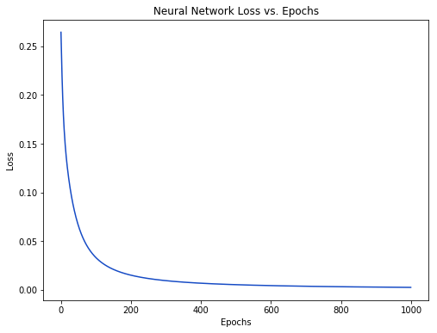
Mean Absolute Error (Loss) = 1/n(∑||(Ytrue-Ypred)||
. Loss as multivariable function: L(W1,W2,..,Wn,B1,B2,..,Bn)
How’d loss L change if we changed W1 ?
Partial derivative answer
. How to change our weights and biases to minimize LOSS?
Backpropagation
Training modelling:
Step1: Choose one sample from dataset (only one at a time)
Step2: Calculate all partial derivatives w.r.t weights and biases
Step3: Update each weight and bias (minimise Loss rate)
Step4: Goto Step1.
Loss steadily decreases as the network learns

Slide 12
Future Enhancement
Multi clustering
Block wise Reading of data (chunkwise).
Direct Normalisation and modelling on HDFS.

Slide 13
References
BDOS lecture slides
https://unstats.un.org/Unsd/nationalaccount/workshops/2018/rio/UNSD.PDF
http://www.unece.org/?id=3207
https://unstats.un.org/unsd/goodprac/bpaboutpr.asp?RecId=1
https://www.oracle.com/big-data/guide/what-is-big-data.html
https://unstats.un.org/Unsd/nationalaccount/workshops/2018/rio/UNSD.PDF
https://hadoop.apache.org/docs/current/hadoop-project-dist/hadoop-hdfs/HdfsDesign.html
https://www.dezyre.com/article/hadoop-architecture-explained-what-it-is-and-why-it-matters/317
https://www.guru99.com/learn-hadoop-in-10-minutes.html
https://hadoop.apache.org/docs/r1.2.1/hdfs_design.html#Data+Replication
https://gerardnico.com/db/hadoop/hdfs/replication
https://bradleyboehmke.github.io/HOML/deep-learning.html
https://victorzhou.com/blog/keras-cnn-tutorial/
https://blog.cloudera.com/gpus-support-in-apache-hadoop-3-1-yarn-hdp-3/

Slide 14

Thank You!!

