Slide 1


Android Platform
C++ TEAM

Slide 2
Motivation
Android is Huge ! Android runs on 84.7% of smart phones worldwide.
255 million Android phones shipped year 2014 alone.
Android developers in the US earn an average salary of $87,500/year and rising fast.

Slide 3
TOP Five OS vs. Market Share 2014/2013
OS | # 2014 Shipment | 2014 (%) | # 2013 Shipment | 2013 (%) | 2014/2013
Android | 255.3 | 84.7 % | 191.1 | 79.6 % | 33.3 %
IOS | 35.2 | 11.7 % | 31.2 | 13.0 % | 12.7 %
Windows | 7.4 | 2.5 % | 8.2 | 3.4 % | -9.4 %
Blackberry | 1.5 | 0.5 % | 6.7 | 2.8 % | -78.0 %
Other | 1.9 | 0.6 % | 2.9 | 1.2 % | -32.2 %
Total | 301.3 | 100 % | 240.5 | 100 % | 25.3 %

Slide 4
Introduction
Android platform is a software stack.
Powered by Linux operating system
Android software development kit
Tons of documentations, blogs and tutorial
Open source under the Apache 2 license
Notes:
Software STACK creating applications for mobile devices (phone / tablets):
--------------------------------------
- Starting from Low level OS managing the device-> system libraries-> application (browser/ player/ contact list).
- Low level operating systems
Android SDK for creating apps
Libraries & development tools
Lots of documentation.

Slide 5
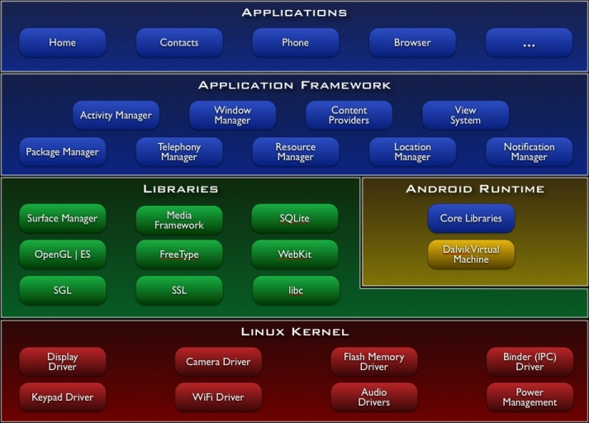
Android Software Stack
Notes:
Several Layers
-Bottom Linux kernal layer, System Libraries, and Android runtime
Above that Rich Application framework (support to develop new applications)
Android standard applications
- Lets look at each layers in detail

Slide 6
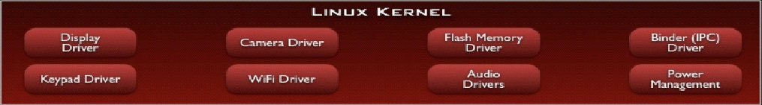
Linux Kernel
Security
Memory management
Process management
File & Network IO
Device drivers
Low Memory Killer
Inter process Communication
Power Management
Notes:
Lowest layer in android platform
Provide core services , generic OS services’
- permission to have proper authorization/restrict of accessing unwanted resources to applications
-Access memory to mulitiple processes symaltaniously
-To access derivers like readio/camera

Slide 7
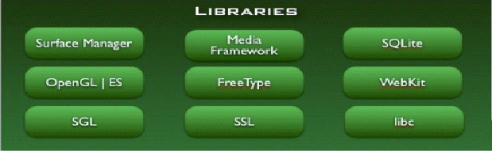
Libraries
Written in C/C++
System C library
Surface manager : Handling UI Windows
Open GL: 2D and 3D graphics
SQLite : Relational DB Engine
Webkit : Browser Engine
Media Framework : Audio Video
Notes:
Handle core performance sensitive activities of the device.
- system C- mathematical computation, memory allocation
-Surface manager : updating the display
-rendering and displaying web pages
-openGL for high performance graphics
-sqlight : managing in memory data bases

Slide 8
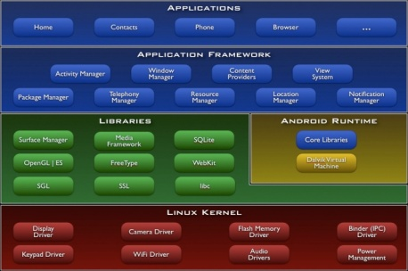
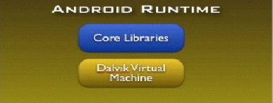
Android Runtime
Core Libraries (Java building blocks)
Java 5 Std edition
App life cycle
Internet/Web services
JUNIT testing
Dalvik VM
Android apps are running by Dalvik VM
Compact and efficient than class files (classes.dex)
Limited memory and battery power
Notes:
- Java 5 : Concurrency mechanism, Data structures, File I/O etc…
- Dalvik VM
1-App written in Java
2-Compiled to Java byte code files
3-Classes coverted to tsingle DEX byte code code file
-4- DVM exectue this dex files
Reason: DVM is designed to run in a resource constrained environment.
Less powerfull, less memory and limited battery life.

Slide 9

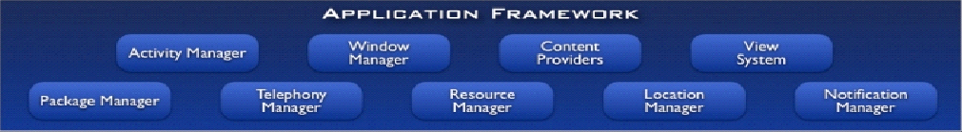
Application Framework
Package Manger : Location, Time, Battery Power
View System : Icons, Text entry boxes, Buttons
Activity manager : Control navigation stack
Notes:
- Rich Application framework (Components support to develop new applications)
-Package Manager : Keep track of all the applications curently installe don your device.
Eg: remaining batter power, current location , time.

Slide 10
Application Framework
Home – main screen
Contacts – contacts database
Phone – dial phone numbers
Browser – view web pages
Email reader –compose & read email
Notes:
- You can subsitute in to your own app with standerd app

Slide 11
Android Development Environment
Eclips IDE or Android Studio
http://developer.android.com/sdk/index.html
Android developer tools (ADT)
Android Emulator
JDK – 7
Install ADT for Eclips
https://dl-ssl.google.com/android/eclipse/
Install Android SDK manager for Eclips
Install Android Virtual Device Manager for Eclips

Slide 12
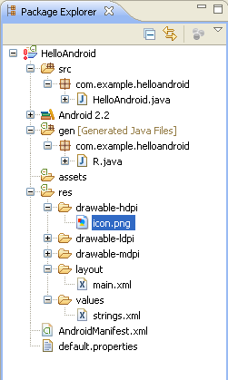
Hello World
Java code for our activity
All source code here
Generated Java code
Helps link resources to
Java code
All non-code
resources
Layout of the activity
Images
Strings used in the
program
Android Manifest
Notes:
- Layout files: Activity_main.xml : Define Application UI layout

Slide 13
Application Components
Layout files : activity_main.xml : Defines application layout
@layout/layout_name
@string/hello
Access different layout based on configuration
Configuration file : AndroidManifest.xml
Packaging information
Required SDK versions
R.java : Auto generated class for accessing layout properties
R.layout.layout_name
R.id.mapButton

Slide 14
Emulators
Pros
Doesn't require an actual phone
Hardware reconfigurable (RAM, SD, Power)
Changes are non-destructive
Test many different devices
Test different characteristics (Battery state, network speed, location coordinates)
Cons
Pretty slow. Frustrated while testing.
Some features are unavailable (Bluetooth, USB)
Some SW application may not available so that app can’t be tested
Actual performance, User experience can be misleading

Slide 15
REFERENCE
http://www.pcworld.com/article/2465045/android-ios-gobble-up-even-more-global-smartphone-share.html
https://www.youtube.com/watch?v=ptjedOZEXPM
http://developer.android.com/sdk/installing/installing-adt.html
https://developer.android.com/training/basics/firstapp/index.html

Slide 16



