Slide 1


Android
3- Permission
C++ TEAM

Slide 2
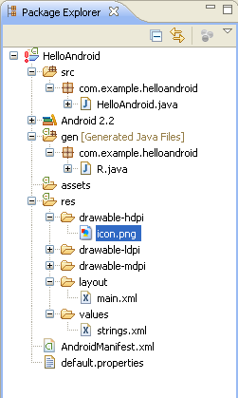
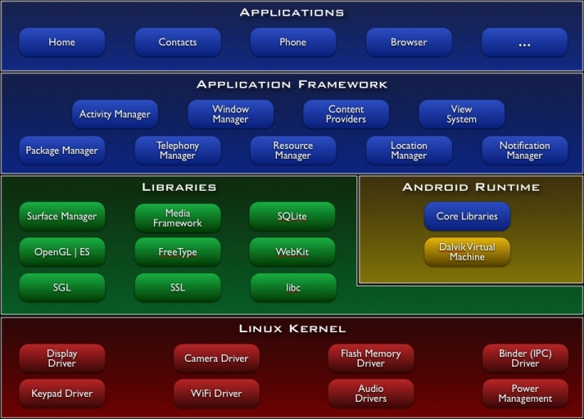
Road Map

Slide 3
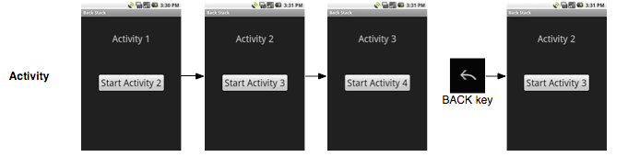
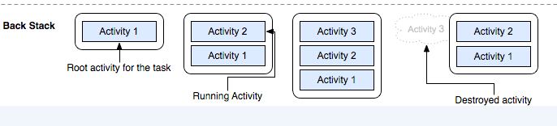
The Task Back stack

Slide 4
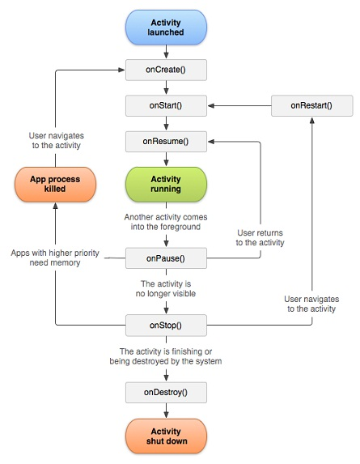
The Activity Life Cycle
protected void onCreate()
protected void onStart()
protected void onResume()
protected void onPause()
protected void onRestart()
protected void onStop()
protected void onDestroy()

Slide 5
Permission
Defining & using application/activity permission
Protects resources & Data
User Information – e.g : Contracts
Cost-sensitive API’s – e.g : SMS/MMS
System Resources – e.g : Camara

Slide 6
Defining Permission
AndroidManifest.xml
Apps can be define and enforce their own permissions
E.g. :
performed some privilege or dangerous operation
You might not want to allow just any other application invoke yours.
Steps
Declare <permission> tags with name & protection level
Give permission themselves
Add additional <intent-filter> so that this activity will respond to implicit intents

Slide 7
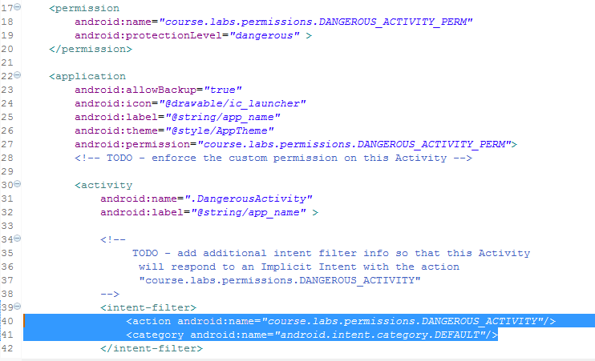
Defining Permission

Slide 8
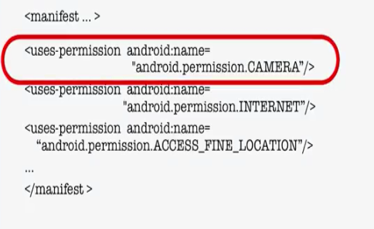
Using Permission
AndroidManifest.xml
Through a <uses-permission> tag
User must accept these permissions

Slide 9
Summary
Android application components
The Activity Class
The Task back stack
The Activity Life Cycle
How To Communicate Between Activities
How to set up permissions on Android apps

Slide 10
REFERENCE
Build first android app: https://developer.android.com/training/basics/firstapp/index.html
Start new Activity: http://developer.android.com/training/basics/firstapp/starting-activity.html
Activity life cycle: http://developer.android.com/training/basics/activity-lifecycle/index.html
Allow other apps to start your activity: http://developer.android.com/training/basics/intents/filters.html
Browser permissions
http://developer.android.com/reference/android/provider/Browser.html

Slide 11



