Slide 1
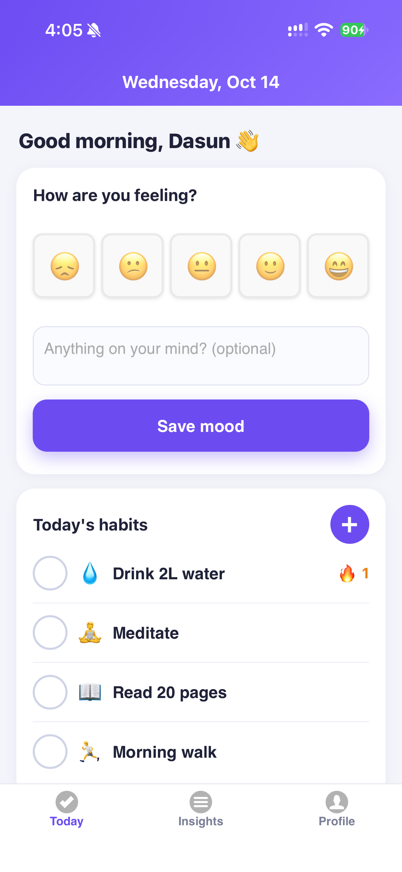
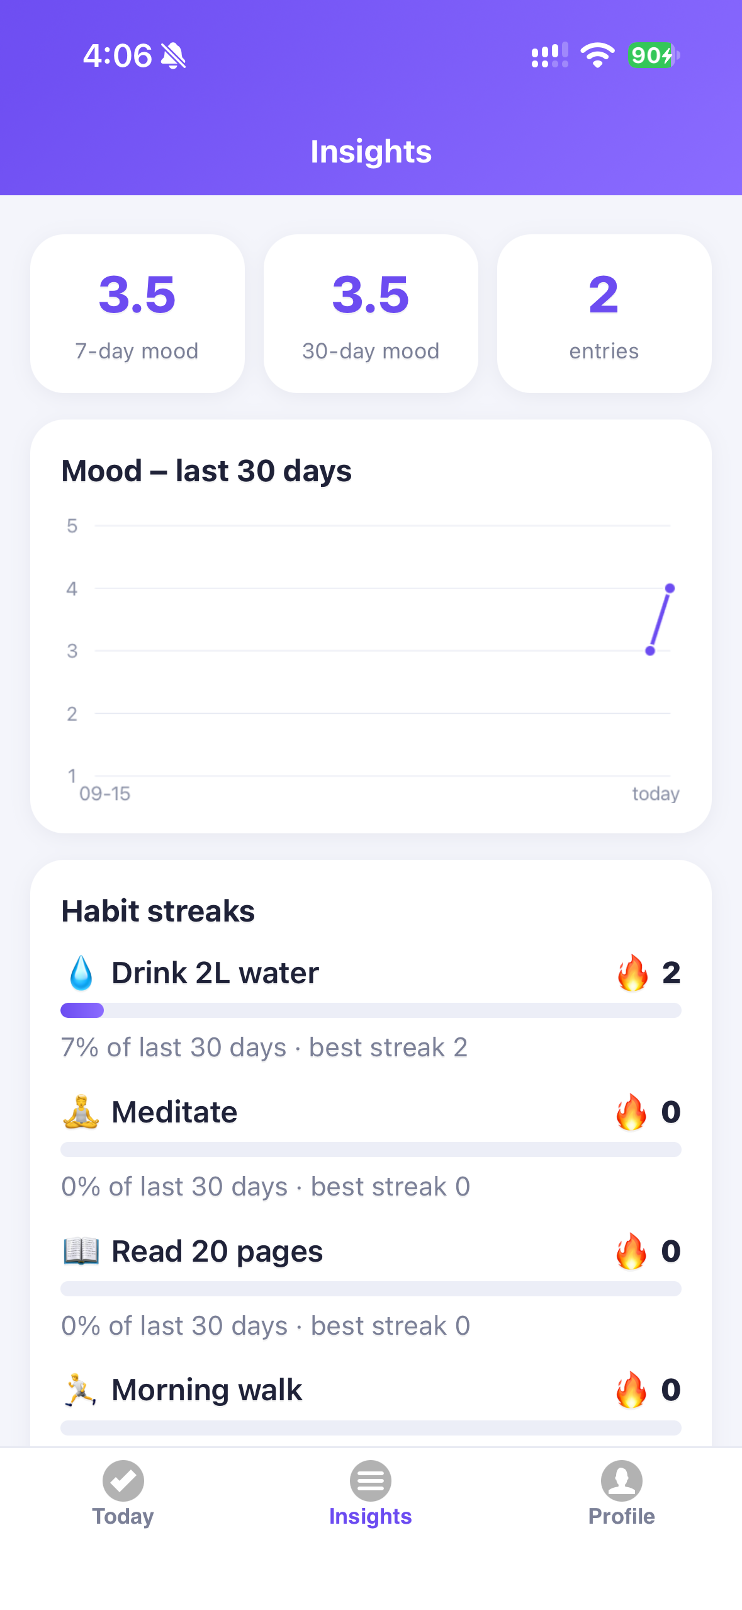
🔥 MoodStreak
Build habits. Understand your mood.
Mobile Apps – Assignment 2 · Full-stack hybrid app
Team: Dasun Priyankara Alagiya Durage (12273809)

Slide 2
Why MoodStreak?
Who it is for and why they would use it
Target audience
The problem
Students and young professionals (18–35) juggling study, work and wellbeing
People building routines (sleep, exercise, reading) who also want to understand how they feel
Anyone who finds clinical wellbeing apps heavy and wants something quick: under 30 seconds a day
Habit apps track what you do; mood apps track how you feel – rarely both in one place
Users can’t see whether a habit actually improves their mood, so motivation fades
Our answer: one tap to log both, then a “mood booster” insight comparing mood on days a habit was done vs. not

Slide 3
Market research & gap
Similar apps (qualitative comparison – general public product knowledge)
App | Habit tracking | Mood logging | Habit ↔ mood insight | Notes
Daylio | partial | ✔ | partial | Mood/activity journal; advanced stats paid
Streaks / Habitica | ✔ | – | – | Streak-focused / gamified; no mood data
Finch | ✔ | ✔ | – | Gamified self-care pet; subscription features
MoodStreak | ✔ | ✔ | ✔ | Free, lightweight, cross-platform (Cordova)
Trends we are riding: growing interest in mental-wellbeing and self-tracking, preference for simple privacy-respecting tools, and data-driven “quantified self” insights.
Monetisation potential: free core + optional premium (export, extra insights, themes).

Slide 4
High-level user requirements
Written from the user’s perspective
Account
Mood
As a user I can sign up, log in and log out so my data is private and available on my phone.
As a user I can log how I feel today (1–5 + note), change it, or clear it.
Habits
Insights
As a user I can add, rename, delete and tick off daily habits and see my streak.
As a user I can see my mood trend and which habits lift my mood.
Reminders
Quality
As a user I can get a daily reminder so I don’t forget to check in.
As a user I expect a fast, easy, attractive app that tells me when I’m offline.

Slide 5
Software architecture
Three-tier hybrid app – every connection to the API is HTTPS
Client – Cordova hybrid app
jQuery Mobile · HTML5 · CSS · JS
Plugins: local-notification,
vibration, network-info, statusbar
Server – Express on Render
Node.js · HTTPS · helmet · CORS
JWT auth middleware · validation
Routers: auth · habits · moods · stats
Database – MongoDB Atlas
Mongoose models:
User · Habit · Checkin
Mood · RevokedToken (TTL)
HTTPS + JSON
Bearer JWT
Mongo wire
(TLS)
Request flow: UI event → jQuery $.ajax → HTTPS → [requireHttps → helmet → CORS → JSON parser → JWT auth] → Router → Mongoose → Atlas → JSON response → UI update.
Hosting: Client APK/IPA via Cordova · API on Render (TLS terminated by platform) · data on Atlas. Secrets live only in environment variables. Source on GitHub.

Slide 6
REST API – all four HTTP verbs in use
Organised with Express Routers, one file per resource
Verb | Endpoint | Used for
POST | /api/auth/signup · /login · /logout | Account + session (logout revokes JWT)
GET | /api/habits · /api/moods · /api/stats/summary | Load today, history, insights
POST | /api/habits · /habits/:id/checkins · /api/moods | Create habit, tick off, log mood
PUT | /api/habits/:id · /api/moods/:id | Edit habit, update mood
DELETE | /api/habits/:id · /habits/:id/checkins/:date · /api/moods/:id | Delete habit, un-tick, clear mood
Middleware chain: HTTPS-only → helmet → CORS allow-list → body limit (10 kb) → JWT authentication → express-validator → router

Slide 7
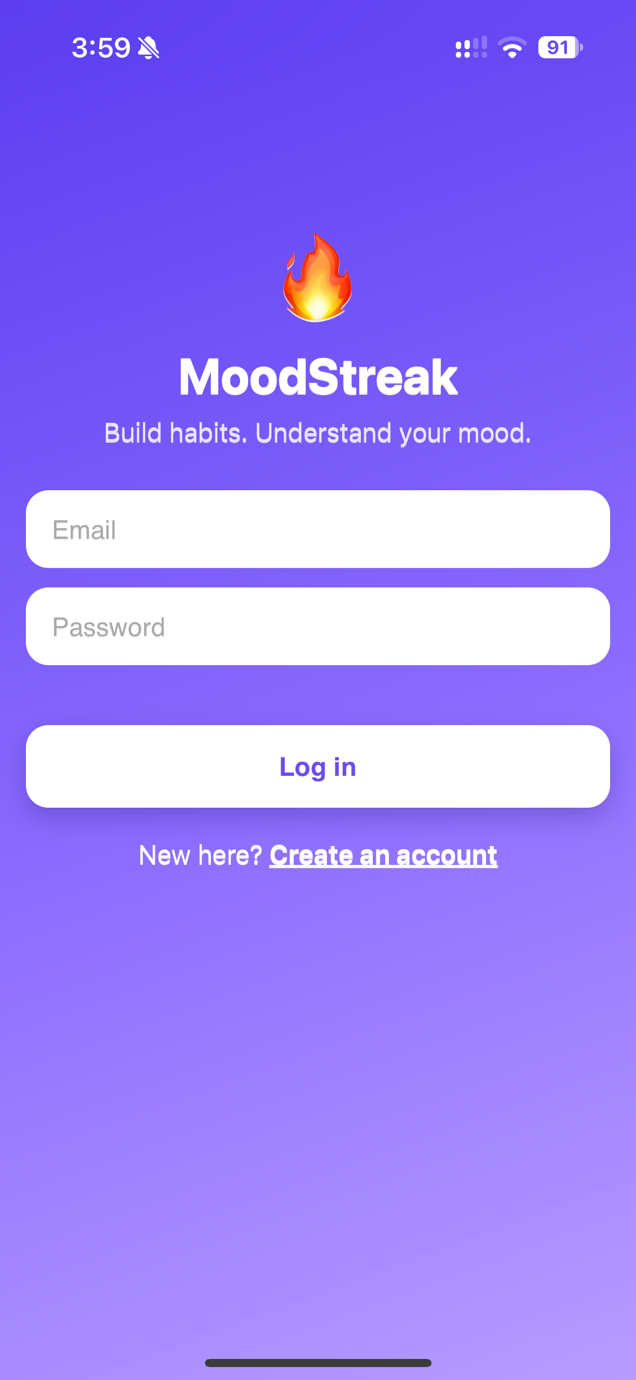
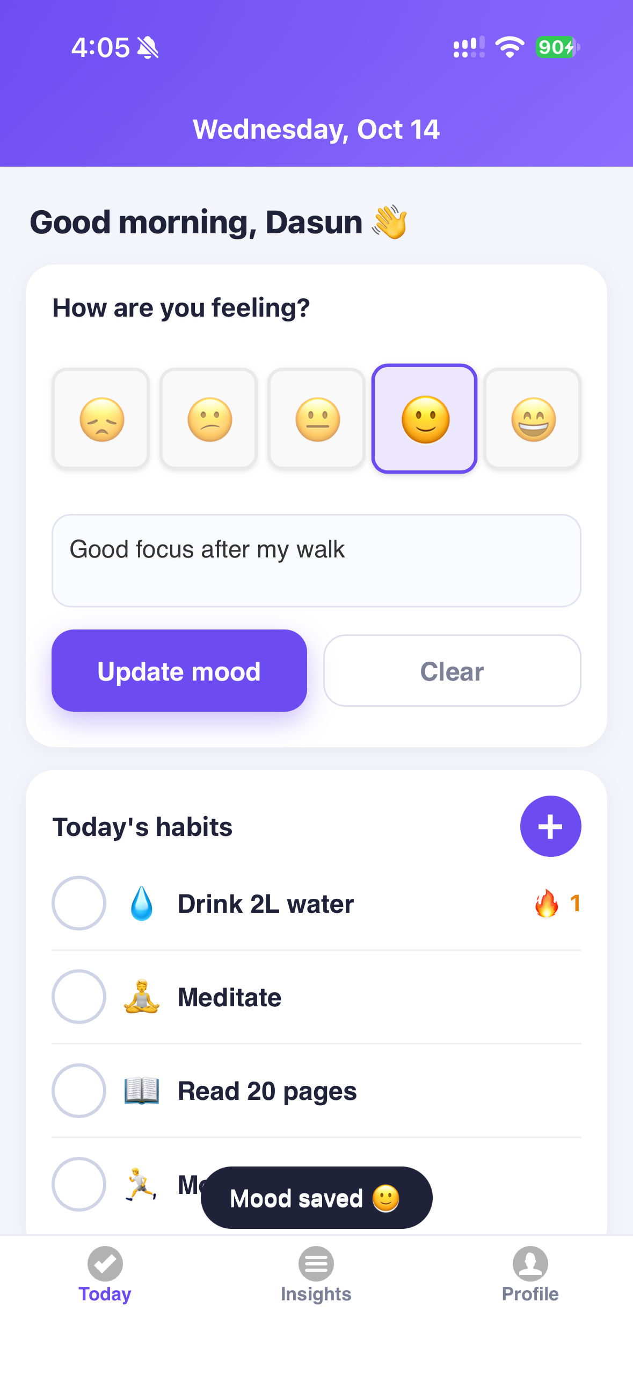
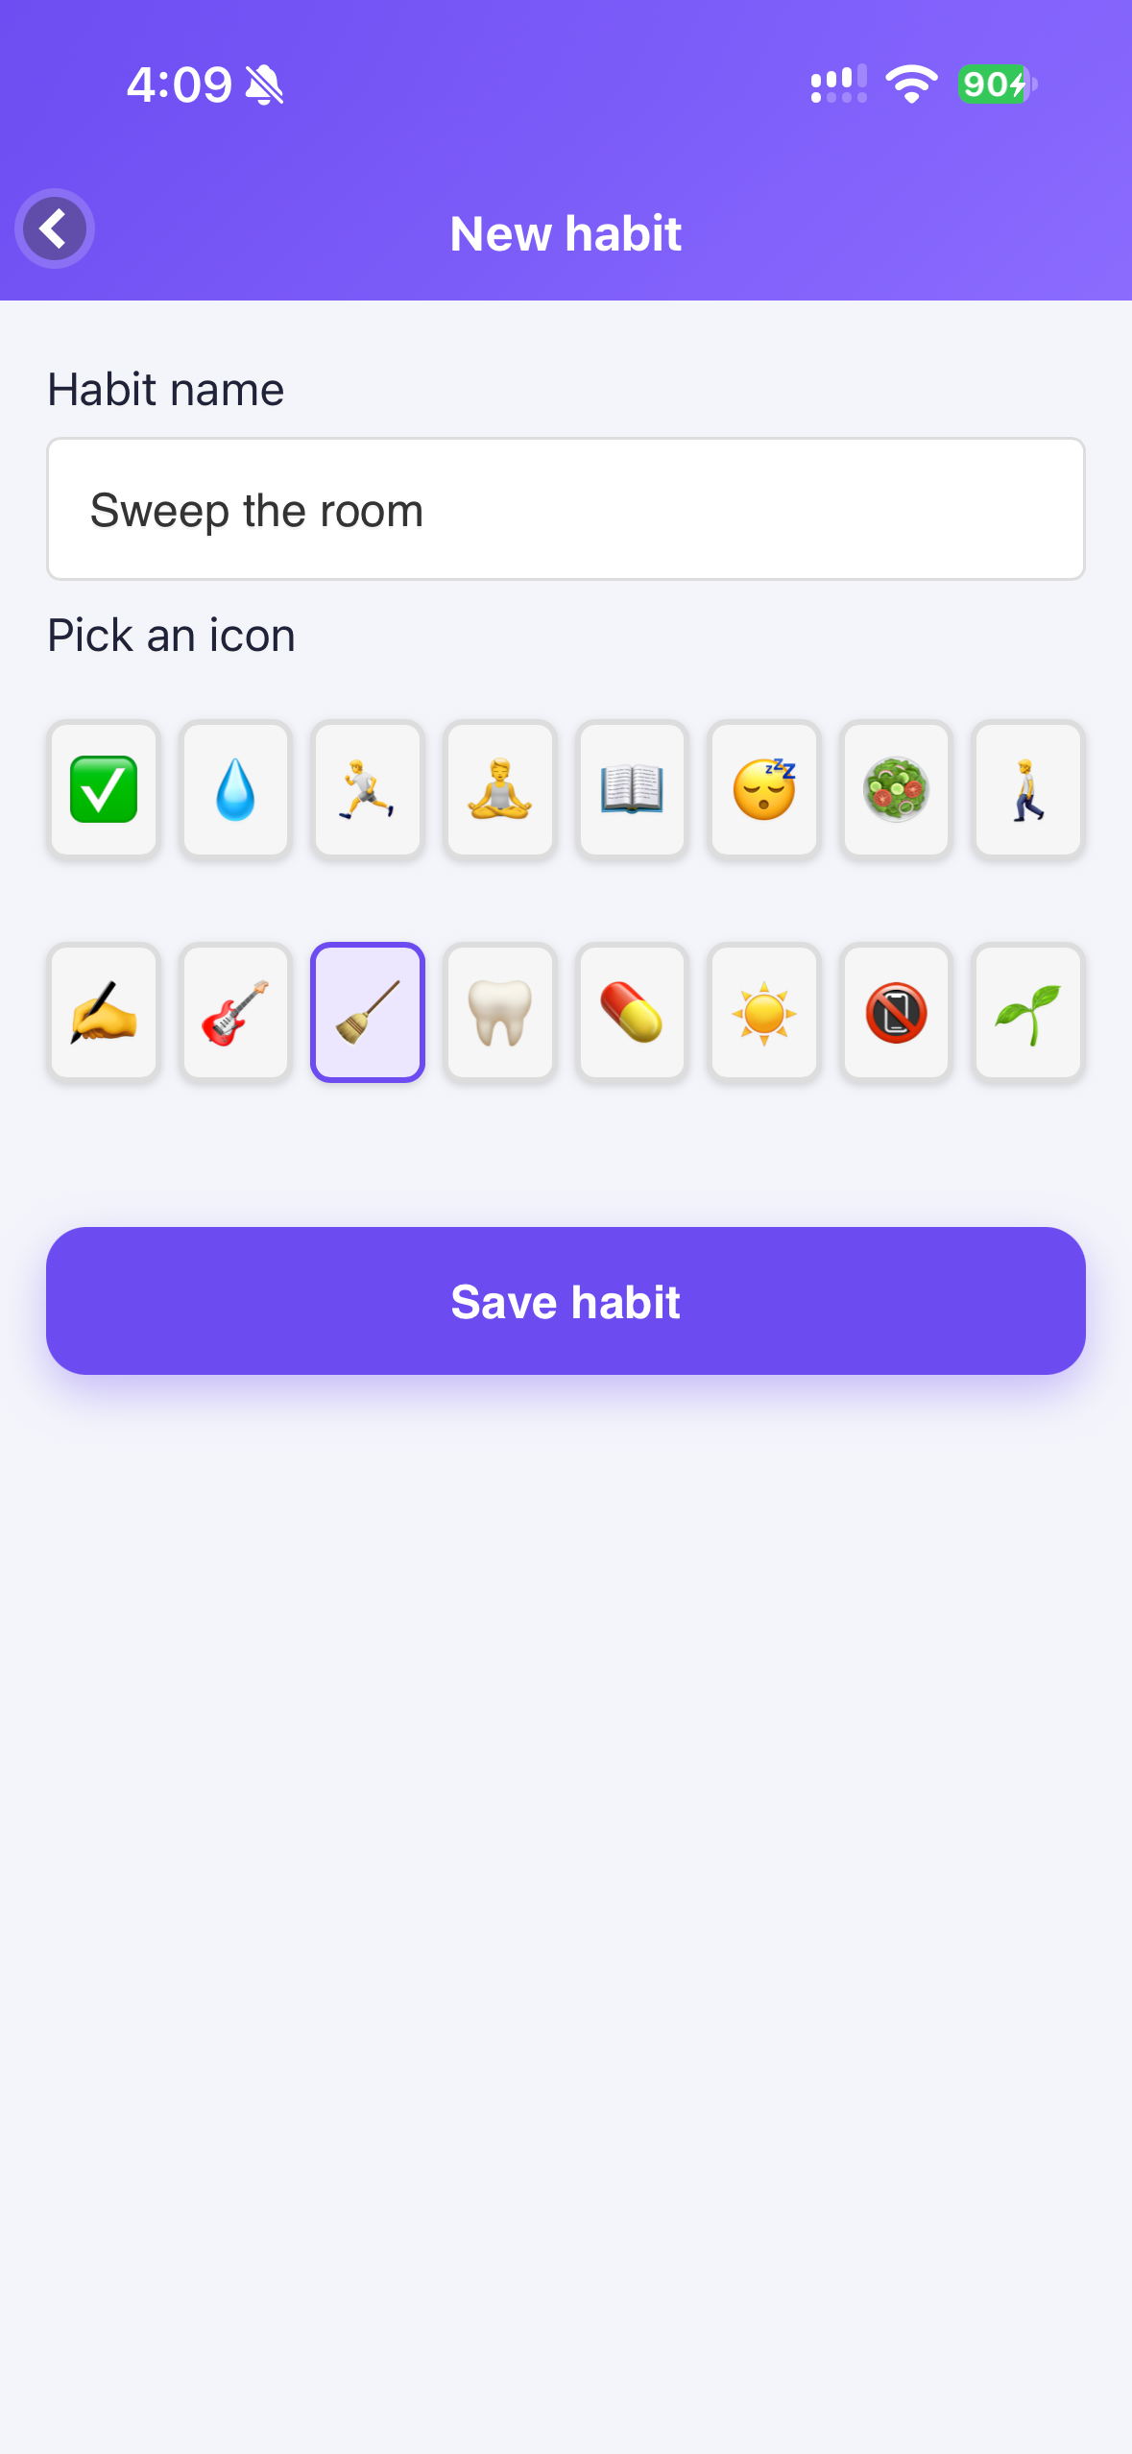
Live demo – main features
Screens captured from the running app
Log in
Today
Log mood & habits
Insights
Add / edit habit

Slide 8
Test results (preliminary)
Automated API tests + scripted UI test run
23 / 23
End-to-end UI run (mobile viewport, HTTPS API)
✔ Wrong password shows error
✔ Login → Today screen
✔ Save / update mood
✔ Tick habit → streak updates
✔ Add, edit (PUT) and delete habit
✔ Insights chart + streaks render
✔ Logout clears session
✔ Deep link to #insights while logged out → login
✔ Script in habit name shown as text (no XSS)
automated API tests passing (Node test runner + supertest)
Auth: signup, duplicate email, validation, login, logout/revocation
Habits & moods: full create/read/update/delete
Streak + mood-lift calculations
Access control: user B cannot read/edit user A’s data
CORS allow/deny, headers, malformed JSON

Slide 9
Vulnerability analysis (preliminary)
npm audit + manual probing of the HTTPS API – reported, not yet fixed
Check | Result | Finding
Dependencies (npm audit) | 0 known | No known vulnerable packages at scan time
No / forged / alg=none JWT | Blocked | 401 for all protected routes
NoSQL injection ({"$ne":null}) | Blocked | 400 via type validation
CORS from unknown origin · plain HTTP | Blocked | No CORS headers; HTTP refused
Brute-force login | Mitigated | 429 after 30 attempts / 15 min
Account enumeration at signup | Low | 409 reveals that an email is registered
No password complexity / lockout | Low | Only length ≥ 8 enforced
JWT in localStorage | Medium | Exposed if any XSS appears; no refresh tokens
Client CSP uses unsafe-inline/eval | Low | Needed by jQuery Mobile; weakens XSS defence

Slide 10
Limitations & next steps
Known limitations
Next steps
Online only – no offline sync
Free Render instance sleeps (cold start)
Streaks use the device’s local date
Vulnerabilities above are not yet fixed
Move token to secure storage; add refresh tokens
Offline queue + sync
Weekly summary notifications; data export (premium)
Biometric app lock (Cordova plugin)

