Slide 1
Paris Principles, FRBR, and WEMI
Resource Description and Access:
A COBEC Workshop
January 29, 2014
Heather Battenberg
Heather.battenberg@bainbridge.edu
Bainbridge State College

Slide 2
Paris Principles (1961) and ISBD
Paris Principles (1961)
Approved by the International Conference on Cataloguing Principles
Scope Single Personal Author
Function Entry Under Corporate Bodies
Structure of the Catalogue Multiple Authorship
Kinds of Entry Works Entered Under Title, Uniform Headings
Use of Multiple Entries for Works, etc.
Choice of Uniform Heading Entry Word for Personal Names
International Standard Bibliographic Description (ISBD)
International Bibliographic Description for Monographic Publications (1971)
Codified the form and content of bibliographic description
Facilitate the exchange of records internationally
Universal bibliographic control
Eight Areas of Description
Title and Statement of Responsibility Physical Description
Edition Series
Material or Type of Resource Specific Notes
Publication, Production, Distribution, etc. Resource Identifier

Slide 3
International Federation of Library Associations and Institutions (IFLA)
Statement of International Cataloguing Principles
September 1997, amended and corrected through February 2008
Meant to align standard practice with the accepted rules
Broadened the Paris Principles
All types of materials, not just textual works
Access through all aspects of bibliographic and authority records
Not just the choice and form of entry
Built on FRBR, FRAR/FRAD, and FRSAR/FRSAD
“This first principle is to serve the convenience of catalogue users.”
Made recommendations for an International Cataloguing Code
IME ICC (July 2003)
IFLA Meetings of Experts on an International Cataloguing Code
Increase the ability to share cataloguing worldwide
In order to achieve this, must promote cataloguing standards
Notes:
FRAR: Functional Requirements for Authority Records (2005)
“defined relationships that have formed the foundations for subsequent modeling on the run up to the creation of RDA”
FRAD: Functional Requirements for Authority Data (2007)
The successor to FRAR
Identifies user tasks
To find, identify, contextualize, and justify
Contextualize the publications of the person, corporate body, or family
Clarify the relationship between the person, corporate body, or family and the name(s) by which they are known
The creator of the authority record should be able justify (or document) the reason for choosing the name and form of heading that has been selected
FRAR and FRAD
Both identify non-personal entities
Concept, event, object, and place
FRSAR: Functional Requirements for Subject Authority Records
FRSAD: Functional Requirements for Subject Authority Data
Further explains how Group 3 entities can be related and controlled within the bibliographic universe
Meant to facilitate international sharing and use of subject authority data

Slide 4
Stockholm Seminar on Bibliographic Records (1990)
Arose from the Changing Environment of the Bibliographic Universe
The expansion of automated systems
The emergence of networked access to electronic information
New forms of electronic publishing
The rise of large-scale, international bibliographic databases
The desire to eliminate duplicate cataloging efforts and reduce overall costs
Shared cataloging
Core/Basic cataloging records
Simplified cataloging (minimum-level records)
Publishing output greater than cataloging output
Needed to respond more effectively to user expectations
Adopted Nine Resolutions
1997 – Functional Requirements for Bibliographic Records (FRBR)

Slide 5
Functional Requirements for Bibliographic Records (FRBR)
Purpose
To outline the function of a bibliographic record
Media
The full range of formats represented in bibliographic databases
Applications
Acquisitions, cataloging, circulation, information retrieval, interlibrary loan, inventory management, preservation, and reference
User needs
Broad range of differing expectations and needs
To recommend a basic functionality and basic requirements for bibliographic records that would meet essential user needs
Addresses the Core/Basic record from the Stockholm Seminar
Identify what is necessary for less-than-full-level records without losing any functionality
To produce a “framework” for the understanding of the functions and purpose of a bibliographic record

Slide 6
Basic Bibliographic Records
Providing a Foundation for Bibliographic Records
Core elements that should be recorded
“Attributes” or characteristics that are essential for describing works, expressions, manifestations, and items as it pertains to FISO
Recording the intended audience
“Relationships” that are essential when describing works, expressions, manifestations, and items as it pertains to FISO
Recording the author
Functional Requirements for Bibliographic Records
Chapter 5 – Relationships
Chapter 7 – Basic Requirements for National Bibliographic Records
7.3 – Basic Level National Bibliographic Record [core]
Notes:
FISO: Find, Identify, Select, Object← TYPO! Should be OBTAIN

Slide 7
The Framework
To identify and clearly define . . .
“entities” or objects of interest to users of bibliographic data
“attributes” or characteristics of those entities
“relationships” between those entities
FRBR became the “conceptual model” for connecting attributes and relationships to user tasks
User-Centered Approach
What the user expects to find
How the is data used
Users
Library patrons (including staff)
Publishers, distributors, retailers
Other users outside the library setting
Notes:
E-A-R: Entities, Attributes, Relationships
Basic functionality of bibliographic records in catalogs
“derived from the logical analysis of the data that are typically reflected in bibliographic records”

Slide 8
The FRBR Tasks (FISO)
Find
Based on user’s search criteria
Identify
Does the item retrieved match the item sought?
Select
Choosing a specific text in the preferred language
Choosing a version that is compatible with the software used
Obtain [or Acquire]
Purchase a copy
Borrow from another library
Access an online version
Retrieve the copy in the local library
Notes:
FRBR User Tasks
“to find entities that correspond to the user’s stated search criteria”
“to identify an entity”
“to select an entity that is appropriate to the user’s needs”
“to acquire or obtain access to the entity described”

Slide 9
Objectives and Functions of the Catalog
Improve the user’s experience in locating needed information
Collocation: The catalog can display . . .
All the works associated with a person, corporate body, or family
All the expressions of the same work
All the manifestations of the same expression
All the items [or copies] of the same manifestation
Circulation
Placing holds not on a specific item or manifestation but on a work or expression
Cut costs for the description of resources and facilitate access to them
When libraries obtain new manifestations, they can link to existing works and expressions that are already present in the collection
This saves time and effort because librarians can reuse subject analyses that have already been done to previous manifestations and apply them to new ones
Position information providers to operate better in an Internet-driven environment and beyond

Slide 10
FRBR Entities
Key objects of interest to users of bibliographic data
Divided into Three Groups
Group 1 [title]
“products of intellectual or artistic endeavor that are named or described in bibliographic records”
Work, Expression, Manifestation, Item
Group 2 [author]
The “entities responsible for the intellectual and artistic content, production, dissemination, or the custodianship”
Person, Corporate Body, Family
Group 3 [subject]
The subject of the endeavor
Concept, Object, Event, Place

Slide 11
FRBR and RDA
FRBR Entities
Can have multiple attributes
Can have relationships with other entities
RDA
A large entity-relationship model
Composed of entities, their attributes, and the relationships between them
A work (entity) is created by (relationship) a person (entity) with particular birth and death dates (attributes).
The work (entity) is also realized through (relationship) one or more expression (entities), which in turn are embodied in (relationship) manifestations (entities), each of which is published by (relationship) a publisher (entity) located at a particular address (attribute).
In addition, the work (entity) may be an adaptation of (relationship) another work (entity) and may have another expression (entity) as its supplement (relationship).
Notes:
http://rdabasics.com/2012/08/24/theoretical-foundations/

Slide 12
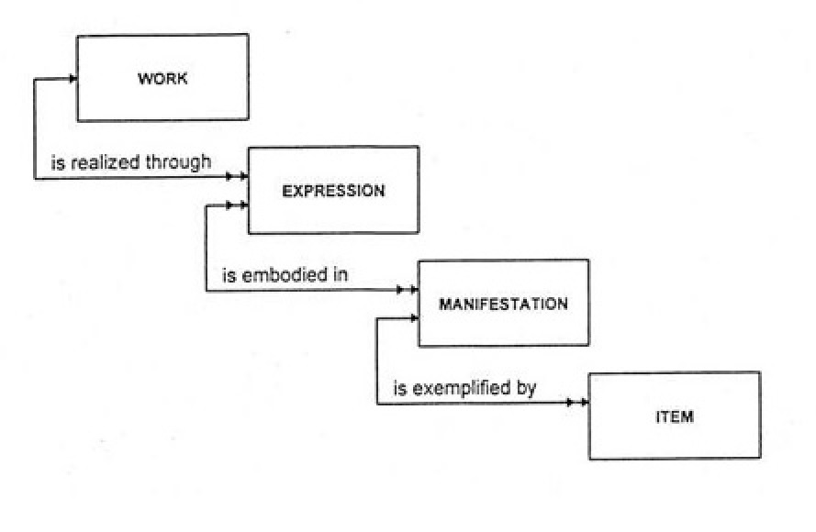
Group 1: WEMI
Notes:
Entities and their primary relationships

Slide 13
WORKS
“A distinct intellectual or artistic creation”
The intangible intellectual product
Abstract concept or idea
Not yet manifested into something physical
Bibliographic Records
Primarily represented by an Authorized Access Point (AAP)
For a title (130 or 730)
130 ;0_; $t Beowulf
For a creator and title (1xx/240 or 7xx $a. $t.)
700 ;12; $a Morrison, Toni. $t Beloved.

Slide 14
WORKS (cont.)
Other MARC21 Fields that Represent a Work
Standard Identifiers
020 – ISBN
022 – ISSN
024 – Other Standard Identifier
046 – Special Coded Dates
$k – Beginning or single date created
$l – Ending date created [if applicable (i.e., for a series)]
380 – Form of Work
381 – Other Distinguishing Characteristics [attributes]
046 ;__; $k 1965 130 ;0_; $a Harlow (Motion picture : 1965 : Douglas) 381 ;__; $a Douglas 380 ;__; $a Motion picture
8xx - Series

Slide 15
EXPRESSIONS
Still abstract
The fulfillment of that idea through words, sound, image, etc.
The physical “realization” of how the work will be communicated or transmitted
Alpha-numeric script, musical notation, sound, visually, a three-dimensional object, symbols, etc.
Example:
A book in English
Lang: eng
A translation of the same book
Lang: spa 041 ;1_; $a spa $h eng 240 ;10; $a … $l Spanish 546 ;__; $a In Spanish translated from English.

Slide 16
EXPRESSIONS (cont.)
MARC21 Fields that Represent an Expression
Standard Identifiers
020 – ISBN
022 – ISSN
024 – Other Standard Identifier
046 – Special Coded Date
$k – Beginning or single date created
$l – Ending date created [if applicable (i.e., for a series)]
130/240 – Uniform Title
$f – Date
$k – Form subheading [manuscripts, protocols, selections, etc.]
130 ;0_; $t Qu’ran. $k Selections. $l English
$l – Language [translation]
$o – Arranged Statement for Music [arr.]
240 ;10; $t Corsaire; $o arr.
$s – Version
240 ;10; $t Messiah. $s Vocal score. $l Dutch & English
381 – Other Distinguishing Characteristics [attributes]

Slide 17
MANIFESTATIONS
The physical embodiment of an expression of a work
“All physical objects that bear the same characteristics, in respect to both intellectual content and physical form”
Books, maps, scores, DVDs, CD-ROMs, streaming videos, etc.
Can exist as a single instance (e.g., a manuscript) or in multiple copies for ease of distribution

Slide 18
ITEMS
A single, physical exemplar of a manifestation
The actual copy of the manifestation that the expression of a work
The flash drive you are working from in the workshop
Items may be of a single form or multiple forms
Multiple Forms: Such as a kit or a book with a CD-ROM

Slide 19
Group 2 Entities
The Creators of WEMI
Persons
Corporate Bodies
Families
Creators are responsible for . . .
The intellectual or artistic content
The physical production, manufacture, and dissemination of manifestations
The custodianship of bibliographic resources
Functional Requirements for Authority Data (FRAD)
Added “families” for the archival community

Slide 20
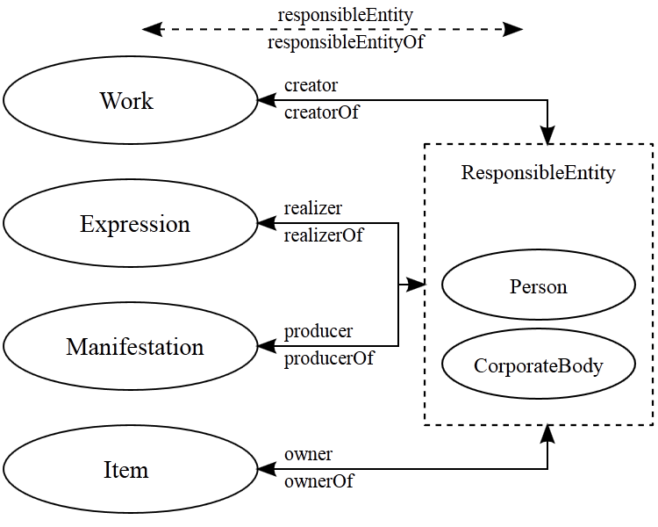
Group 2 Entities (cont.)

Slide 21
Group 3 Entities
The Subjects of WEMI
Concept
Object
Event
Place
Also includes all of the Group 1 and 2 entities
Functional Requirements for Subject Authority Data (FRSAD)
Still under development but will be governed by SACO
Subject Authority Cooperative Program of the PCC
Further explains how Group 3 entities can be related and controlled within the bibliographic universe
Meant to facilitate international sharing and use of subject authority data
Notes:
Concepts: The topics, subject headings, and/or classification numbers that are used to describe what works are about.
Objects: Material things (buildings, found objects, sculptures, vehicles/vessels, etc.).
Event: Things that happen (battles, conferences, exhibitions, etc.).
Place: Geographic locations.

Slide 22
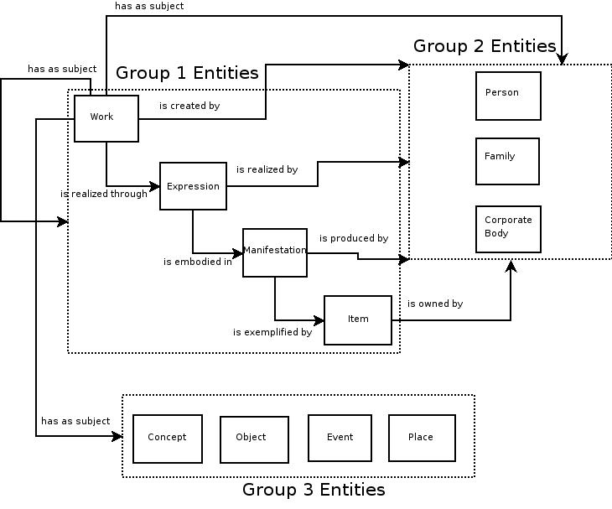
FRBR Entities

Slide 23
Example (Pride and Prejudice)
Work
Pride and Prejudice as fully conceived in the mind of Jane Austen
A summary of Pride and Prejudice
An adaptation (e.g., a film version of Pride and Prejudice)
A satire (e.g., Pride and Prejudice and Zombies)
Expression
A translation of Pride and Prejudice in Russian
An abridged version of Pride and Prejudice
Manifestation
Published by Penguin Books in 1989, ISBN: 8349357640
Item
The book on the shelf
With its particular barcode, provenance, and circulation history
Notes:
Expressions: Abridgements, illustrated editions, revisions, translations, versions, etc.
Manifestations: A single expression may have many manifestations: each reprint is a new manifestation
Library catalogs tend to have separate records for each manifestation.

Slide 24
Example (Dracula)
Work
Dracula as it sprang from the mind of Bram Stoker
The 1992 movie adaptation directed by Francis Ford Coppola
Expression
The first edition published in 1897
An edition with a foreword by Elizabeth Kostova
An edition illustrated by James Pyman
An unabridged reading narrated by Alexander Spencer and Susan Adams
Manifestation
Published by DoubleDay in 1921
Paperback edition published by Penguin Books in 1997
Kindle e-book file
Item
The copy of the item that is available for checkout from the library
The file that has been downloaded onto a specific Kindle

Slide 25
Group Exercise (The Night Circus)
Your library’s copy of the hardback edition that is available for checkout
The Night Circus as conceived by Erin Morgenstern
The paperback edition published by Anchor Books in 2012
The audiobook as read by Jim Dale
Work
The Night Circus as conceived by Erin Morgenstern
Expression
The audiobook as read by Jim Dale
Manifestation
The paperback edition published by Anchor books in 2012
Item
Your library’s copy of the hardback edition that is available for checkout

Slide 26
Group Exercise (The Hunger Games)
The Spanish translation published by Molino, ISBN: 9788427202122
The Hunger Games as conceived by Suzanne Collins
Your library’s copy of the film adaptation as directed by Gary Ross
The audiobook as read by Carolyn McCormick
Work
The Hunger Games as conceived by Suzanne Collins
Expression
The audiobook as read by Carolyn McCormick
Manifestation
The Spanish translation published by Molino, ISBN: 9788427202122
Item
Your library’s copy of the film adaptation as directed by Gary Ross

Slide 27
Bibliography
International Federation of Library Associations and Institutions [IFLA]. (Feb. 2008). Functional Requirements for Bibliographic Records: Final report. http://www.ifla.org/files/assets/cataloguing/frbr/frbr_2008.pdf
IFLA. (2009). Statement of international cataloguing principles. http://www.ifla.org/files/assets/cataloguing/icp/icp_2009-en.pdf
Oliver, C. (2010). Introducing RDA: A guide to the basics. USA: American Library Association.
Welsh, A., & Batley, S. (2012). Practical cataloguing: AACR, RDA and MARC 21. Chicago, IL: Neal-Schuman, an imprint of the American Library Association.

