Slide 1
Cartographic Materials
RESOURCE DESCRIPTION AND ACCESS: A COBEC WORKSHOP PRECONFERENCE
FEBRUARY 3, 2014
GUY FROST
gfrost@valdosta.edu
VALDOSTA STATE UNIVERSITY

Slide 2
Resources to Consult
Cartographic Materials: A Manual for Interpretation for AACR2, 2002 Revision. 2nd ed. Published in 2003. ISBN: 1856045161
  Provides guidelines on determining useful information like scale, relief, coordintates, etc.
PCC RDA BIBCO Standard Record (BSR) Metadata Application Profile
  Provides the standard core requirements for cataloging cartographic material

Slide 3
Online Resources
Many maps produced by agencies in Belize use the North American Datum of 1927 (Clarke 1866) (NAD27) coordinate system (fields 034, 255, 342). To convert to the Sexagesimal system (degrees, minutes, seconds), use the following site: http://www.rcn.montana.edu/resources/tools/coordinates.aspx?nav=11
Other background information: http://earth-info.nga.mil/GandG/coordsys/onlinedatum/CountryNorthAmericaTable.html
UTM zones http://www.jaworski.ca/utmzones.htm

Slide 4
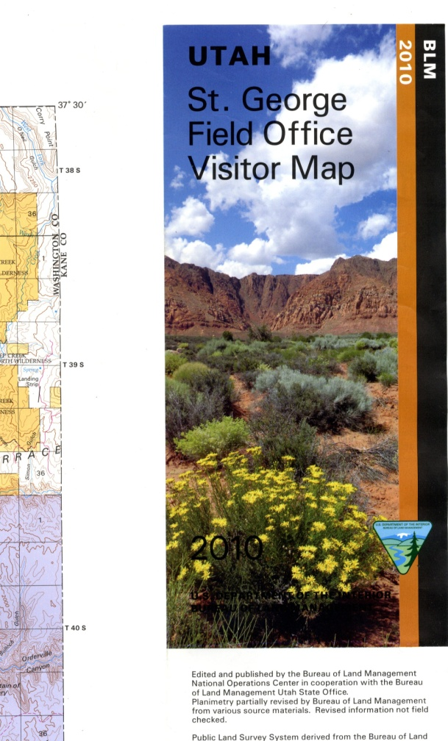
245 – Titles
Maps are either folded, stored flat, or digital
Follow instructions at 2.2.2.2 for
recording title
  Preferred source is the title on the sheet
  Title on folded maps may come
  from two places, panel title (shown to the
  right) or anywhere else on the sheet

Slide 5
Devised Titles (RDA 2.3.2.11.2)
Devise a title for cartographic materials if:
  There is no title on the work
  A title cannot be determined from other sources
When constructing the title, always include the area covered (e.g., Belize), and the subject (e.g., roads, vegetation, etc.)
  For example: If you were cataloging a lunar globe

Slide 6
Edition (250) and Publication Statements (264)
No difference
Consider adding any distribution statements if deemed important

Slide 7
300 – Physical Description (carrier)
Extent ($a): PCC – Always record extent (RDA 3.4.2)
Other Physical Characteristics ($b) (RDA 7.17)
Dimensions ($c) (RDA 3.5.2)
  Folded (RDA 3.5.2.6)
Accompanying material
  PCC - record in $e or repeat the 300

Slide 8
300 Extent
RDA 3.4.2
  Give number of units and appropriate term from the list provided in the instructions
  300;__; $a 1 map
  300;__; $a 7 wall charts
RDA 3.4.2.3 – More than one map per sheet
  300;__; $a 6 maps on 1 sheet
RDA 3.4.2.4 – More than one sheet per map
  300;__; $a 1 map on 2 sheets
  Atlases RDA 3.4.2.5 (e.g., 300;__; $a 1 atlas (xvii, 37 pages, 74 leaves of plates))

Slide 9
300 $b - Color(RDA 7.17.1.3)
Illustrative materials is the same as for other print materials (e.g., optional)
  RDA 7.17 – Color aspects
  300;__; $a 1 map : $b color

Slide 10
300 $c Dimensions (RDA 3.5.2)
RDA 3.5.2.2
  Give the measurements of the face of the map, etc., measured within the neat line (not the entire sheet)
  300;__; $a 1 map ; $c 25 x 35 cm
RDA 3.5.2.4
  Maps in two or more segments designed to fit together (even if on a single sheet), give total for the map
  300;__; $a 1 map on 9 sheets ; $c 264 x 375 cm, on sheets 25 x 35 cm
RDA 3.5.2.6 – Folded maps with panel
300;__; $a 1 map ; $c 9 × 20 cm, on sheet 40 × 60 cm, folded to 21 × 10 cm

Slide 11
340 - Layout
Layout (RDA 3.11)
  LC/PCC Core for cartographic materials
  Used when content is on both sides of a map
  Prescriptive terms found in RDA
  340;__; $k both sides $2 rda
Notes:
This was previously recorded in the 300 $b

Slide 12
Scale (034 and 255)
PCC Core (RDA 7.25)
  Scale; Horizontal Scale (7.25.3); Vertical Scale (7.25.4); Projection (7.25.5)
  Vertical and Horizontal Scales are recorded as: Hemisphere-Degrees-Minutes-Seconds
  Do not use superscript O, apostrophe, and quotation marks in the 255; instead us: degree, miagki snak, and iverdy znak
034;1_; $a a $b 48000 $d W1132230 $e W1124500 $f N0355230 $g N0353000
255;__; $a Scale 1:48,000 $c (W 113°22′30″-- W 112°45′00″/N 35°52′30″--N 35°30′00″)
Notes:
Symbols for minutes and seconds are mathematical symbols with Russian names; in Unicode, they are called: modifier letter prime and modifier letter double prime respectfully (in Microsoft Word, simply Prime and Double Prime)

Slide 13
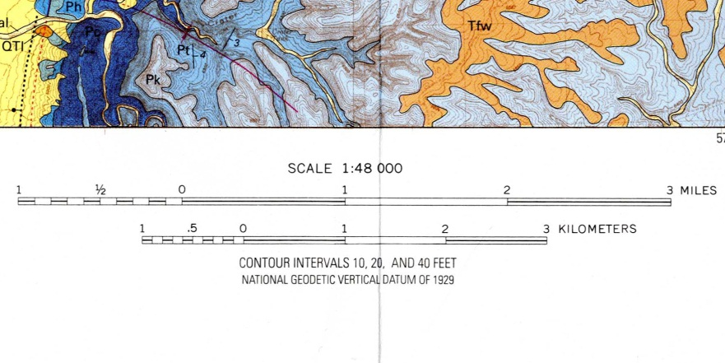
Scale: Constant Ratio (034 $b ; 255 $a)
Usually record as: Scale #:###,###
034;1_; $a a $b 48000 ; 255;__; $a Scale 1:48,000

Slide 14
Determining scale with Miles
See B.2B.1 of the Cartographic Materials manual
  1 mile = 63,360 inches
  as shown by bar graph, 4 inches = 2 miles of Earth
  4:(2 x 63,360)
  or
  1: 2 x 63,360 1: 126,720
  4 4
  or
  1:31,680

Slide 15
Determining Scale with Kilometers
See B.2B.4 of the Cartographic Materials manual
  1 kilometer contains 100,000 centimeters
  10 cm on map represents 5 km of Earth
  10:5 x 100,000
  or
  1: 5 x 100,000
  10
  or
  1:50,000

Slide 16
Scale Cannot be Determined
If the resource lacks vital information in determining scale (e.g., a digital map that does not tell you the distance used on the bar graph) (RDA 7.25.1.3), record the 255 as:
255;__; $a Scale not given.

Slide 17
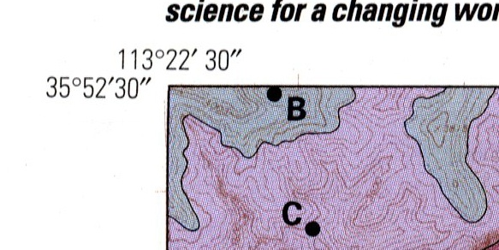
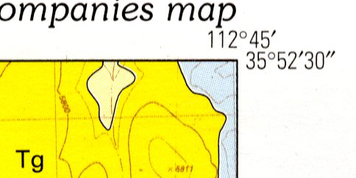
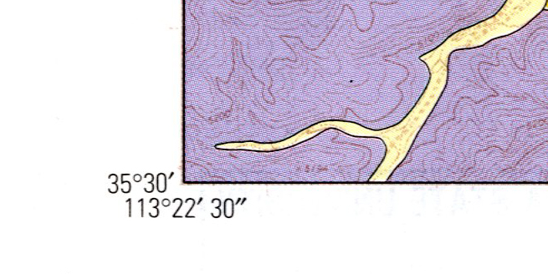
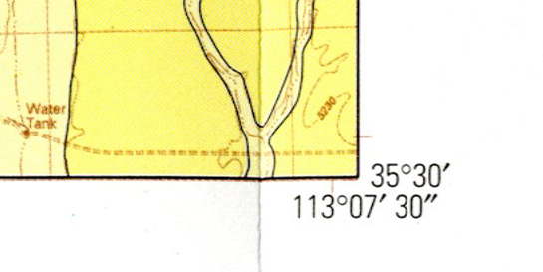
034;1_; … $d W1132230 $e W1124500
$f N0355230 $g N0353000
Longitude: $d left most $e right most
Latitude: $f top most $g bottom most
Notes:
Notice: when minutes and or seconds missing, use 00 in their place

Slide 18
Additional Considerations for Belize Maps (342)
Many Belizean agencies maps have data that should be recorded in the 342 – Geospatial Reference Data
  Maps that have Transverse Mercator as the projection should also have these recorded in the 342
    (R below means = Required by MARC21)
    $a Name (R) –
    $b Coordinate Units
    $q Ellipsoid name
    $k Scale factor (R)
    $g Longitude of central meridian or projection center (R)
    $h Latitude of projection center or projection origin (R)
    $p Zone identifier
    $i False easting (R)
    $j False northing (R)

Slide 19
342 continued
On map: Grid: UTM Zone 16N ($p) drop the N
Projection: Transverse Mercator ($a)
False easting: 500,000 eastings ($i)
False northing: Nil northings ($j) use 0.0
Central meridian: -87.000000 ($g)
Scale factor: 0.999600 ($k)
Latitude of origin: equator ($h) use 0.0
Linear unit: Metre ($b) – use meter
Datum: North American 1927 ($a)

Slide 20
342 continued
The previous example translations to the following in MARC
342;_5; $a North American datum of 1927, transverse Mercator $b meters $q Clarke 1866 $k 0.9996 $g -87.0 $h 0.0 $p 16 $i 500,000 $j 0.0
Maps with “central meridian ##° W) etc. are expressed two ways:
1. Zones to the east of the Prime Meridian are expressed as positive numbers
2. Zones to the west of the Prime Meridian are expressed as negative numbers (as show in $g above)

Slide 21
Other Fields with No RDA Equivalents
006 – Additional Material Characteristics
007 – Physical Characteristics of the Item
008 – Fixed field
040/b – Language of Cataloging (eng for countries where English is the primary language)
041 – if Lang in 008 inadequate
043 – Geographic Area Code (ncbh---)
050 – Classification Number
052 – Geographic Classification
6XX – FRSAD currently not developed

Slide 22
006 for accompanying material
Use the 006 field for accompanying materials (e.g., some maps have a booklet published with it)
006;__; $a t (for the text)
007;__; $a a $b j $d c $e a $f n $g z $h n (for the map)
300;__; $a 1 map (on 2 sheets) : $b color ; $c 28 x 46, folded 8 ½ x 11.
300;__; $a 1 booklet (10 pages) ; $c 28 cm
336;__; $a cartographic image $2 rdacontent $3 map
336;__; $a text $2 rdacontent $3 text
337;__; $a unmediated $2 rdamedia $3 map
337;__; $a unmediated $2 rdamedia $3 text
338;__; $a sheet $2 rdacarrier $3 map
338;__; $a volume $2 rdacarrier $3 text
Notes:
Terms in the $3 are not prescriptive; choose whatever makes sense and be consistent through the 336-338 group

Slide 23
007 - Maps
Required by the PCC
  Category of Material ($a)
  Specific Material Designation ($b)
  Color ($d)
  Physical Medium ($e)
  Type of Reproduction ($f)
  Productivity/Reproduction Details ($g)
  Positive/Negative Aspect ($h)
Typical color map:
700;__; $a a $b j $d c $e a $f n $g z $h n
Typical Atlas in Color:
700;__; $a a $b d $d c $e a $f n $g z $h n

Slide 24
Leader and 008
PCC Required
  Type of Record (Type: e)
  Bibliographic Level (BLvL: m (if monographic))
  Type of Date/Publication Status (DtSt: various choices)
  Date 1 and Date 2 (Dates: , )
  Place of Publication, Production, or Execution (Ctry: )
  Relief (Relf: ) with a 500 descriptive note
  Projection (Proj: ) with the 255
  Type of Cartographic Material (CrTp: )

Slide 25
Leader and 008 Cont.
  Government Publication: (GPub: f) (for Belize govt. pubs.)
  Form of Item (Form: ) (blank of print maps)
  Index (Indx: 0 or 1)
  Special Format Characteristics (SpFm: various)
  Language (Lang: )
  Modified Record (MRec: ) (if applicable)
  Cataloging Source (Srce: d) (unless you’re PCC then c)

Slide 26
500 Notes
Make notes
  Relief
    500;__; $a Relief shown in contours and spot heights.
  Indexes (e.g., to adjoining maps)
  Legends (if considered important)

Slide 27
RDA Suite of Simple Map
  008 - Descriptive Cataloging Form (Desc: i)
040;__; $a … $b eng $e rda $d …
336;__; $a cartographic image $2 rdacontent
337;__; $a unmediated $2 rdamedia
338;__; $a sheet $2 rdacarrier

Slide 28
043 – Geographic Area Code
Coded added when the subject content has or reflects geographic subject matter (for all resources not just maps)
043;__; $a ncbh--- for Belize (and British Honduras)
used for
651;_0; $a Belize
650;_0; $a … $z Belize
650;_0; $a … $z Belize $z Belmopan.
610;20; $a Turneffe Island Resort.

Slide 29
052 – Geographic Classification
Typically constructed after Library of Congress Classification, but other schemes can be used
Belize City
  Classification Number for maps: G4824.B4
  G is dropped
  Cutter for city moved to $b
  052;__; $a 4824 $b B4
  Other Cities (G4824) to be used for Maps:
  Belmopan (.B44) Benque Viejo del Carmen (.B47)
  Corozal (.C6) Monkey River (.M6) Orange Walk Town (.O7) Punta Gorda ( .P8) San Ignacio (.S24) San Jose Soccoths (.S25) Stann Creek (.S7)

Slide 30
052 – Geographic Classification Cont.
Districts (G4823)
Belize District (.B4) Cayo District (.C3) Corozal (.C6) Orange Walk (.O7) Stann Creek (.S7) Toledo (.T6)
Regions (G4822)
Ambergris Cay (.A4) Belize River (.B4) Coasts (.C6) Maya Mountains (.M3) Monkey River [River] (.M55) Mountain Pine Ridge (.M6) Pulltrouser Swamp (.P8)
General (G4820); by Subject (G4821)

Slide 31
Subject Genre/Forms (655)
Library of Congress Genre/Form Thesaurus (lcgft)
locate using: http://authorities.loc.gov/webvoy.htm
Search for: Maps – Browse Narrower Terms
655;_7; $a Digital maps $2 lcgft

Slide 32
Subjects (6XX) other than 655
If the work is “about” maps $x
If the work “is” a map or atlas $v
650;_0; $a Oil wells $z Belize $v Maps.
650;_0; $a Roads $z Belize $z Dangriga $v Maps.
651;_0; $a Belize $v Atlases.

Slide 33
Online Maps
Some are born digital
  Describe the map as above
  Add 006 for the computer aspect
  Add 008 Form: o for online
  Adjust the 337-338 as appropriate
  Scale may need to be recorded as
  034;0_; $d $e $f $g
  255;__; $a Scale not given $b …
Some are digitized versions of Print Maps
  If original is known, add 776
  Take data that cannot be determined from the original print version if possible

