Slide 1
Continuing Resources: Integrating Resources
RESOURCE DESCRIPTION AND ACCESS:
A COBEC WORKSHOP
JANUARY 29, 2014
GUY FROST
gfrost@valdosta.edu
VALDOSTA STATE UNIVERSITY

Slide 2
What is an Integrating Resource?
Updating Loose-leaf Publications
  Base volume(s) that have replacement pages or additions integrated throughout the whole work
Updating Databases
  Logically interrelated data stored together
Updating Websites
  Material is continually added, updated, replaced, deleted

Slide 3
Characteristics of an IR
Continuing
  issued over a time in a series of iterations with no predetermine conclusion
  Most integrating resources are continuing
Finite
  issued with a predetermined conclusion
  Complete with a finite number of iterations
    Ex. COMO 2013 Website

Slide 4
Iterations
A discrete instance, either when it’s first published or after it has been updated
Each issuance used to determine changes to transcribed fields
  Requires the continual maintenance of the bib records to reflect the latest iteration

Slide 5
Integrating Resources in MARC21
Form of Record is for Serials with the BLvL changed
BLvL: i (RDA and LC-PCC PS 2.13.1.3)
SrTp: d (database); l (print); or w (website)
Freq: k (for those resources updated more often than daily—OCLC BFaS)
Online Resources:
006;__; $a m (computer file)
007;__; $a c (Electronic Resource)
006/007 – other (e.g., digital audio)

Slide 6
Source of Information
Website (RDA 2.1.2.4): “choose a source of information identifying the current iteration of the resource as a whole” or if the current iteration cannot be determined, “treat the sources of information identifying its individual contents as a collective source of information for the whole”

Slide 7
General Guidelines
Creating New Records (RDA 1.6.3):
  If IR changes to Multipart Monograph or Serial
  If Multipart Monograph or Serial changes to an IR
  If a new base volume is issued
  Edition changes
  Mergers or Splits
Otherwise, as each iteration is received, the record is updated to reflect any changes
  Notes are added if considered important
  Access points are added/updated if important to user tasks of identification and/or selection

Slide 8
Fields Typically Updated
Based on Current Iteration
Title (245a)
Statement of Responsibility (245c)
Edition (250)
Material Specified Details (362)
Publication Statement (264)
Physical Description (300)
Series Statement (490)

Slide 9
Cont.
Based on First and/or Last Iteration
Dates of Publication, distribution, etc.
Areas based on All Iterations
  Notes (5XX, 7XX)
  Standard Number (ISSN) and Terms of Availability 022, 037, etc.)

Slide 10
Changes in Media and Carrier
(RDA 3.1.6.2)
If a change in Media Type occurs, a new description is required
  e.g., print to microform (337 “unmediated” to “microfilm role”)
  Exception: If resource is inconsistent; make general notes for their behavior
If a change in Carrier occurs, update the record and make a note if considered important unless change also changes Media Type
e.g., videocassette to DVD, “media type” (video) does not change; no new record; update to reflect changes

Slide 11
245 $a
If there are changes in the Title Proper with the latest iteration (RDA 6.1.3.3.2)
  Update record to reflect the change
  Update any Authorized Access Points to reflect the change

Slide 12
245 $c Statement of Responsibility
If responsibility changes for the resource, update the Statement of Responsibility for the change (RDA 2.4.1.10.3)
Make notes on changes or deletions in the Statement of Responsibility if considered important
Update any Authorized Access Points to reflect the current iteration (RDA 6.1.3.3.1)

Slide 13
246 – Variant Titles
2.3.6 – General instructions on variant titles
2.3.2.5 – Titles in more than one form
  Exception: Choose as the title proper the full form
    Add the acronym or initialism as other title information
    make an added entry for the acronym or initialism
    See LC PCC PS 2.3.6.3, section Best Practices for Making Variant Titles for Other Titles Borne by an Item – F. Other title information from MARC field 245

Slide 14
247/547 – Former Title
Changes in Title Proper
  Provide a Former Title Access point to previous title (RDA 2.3.7.3)
  Include the dates the resource identified itself under the older title in $f (RDA 2.20.2.3)
  247;10; $a Taxation of intangible assets, $f 1997–1998
  or, if following RDA examples,
  547;__; $a Earlier title proper: Taxation of intangible assets, 1997–1998.

Slide 15
250 Edition Statement
Change the Edition Statement to reflect the current iteration (RDA 2.5.1.6.3)
  If edition statement is merely dropped, make a note after updating the 250 if considered important
  Exception, if the edition has a distinct change (2nd to 3rd), make new description

Slide 16
264/550 – Production, Publication, Distribution, Manufacture Statements
If recording Production, Publisher, Distributor, and/or Manufacturer information and there is a change with the latest iteration, update the record to reflect the change (RDA 2.7.1.5.3, RDA 2.8.1.5.3, RDA 2.9.1.5.3, and RDA 2.10.1.5.3)
Record earlier place and/or name in a note if considered important (550 Issuing Body Note)

Slide 17
264 with Changes - RDA 2.20.7.5.3
264;_1: $3 1990-1994: $a Salem, New Hampshire : $b Butterworth Legal Publishers
264;21; $3 1995-<1996>: $a Charlottesville, Virginia : $b Michie
264;21; $3 <1998>-1999: $a Charlottesville, Virginia : $b LEXIS Law Publishing
264;31; $3 2000- $a Huntington, New York : $b Juris Publication, $c [1990]-
N.B.: See LC-PCC PS 1.71: Temporary/Uncertain Data for use of angle brackets

Slide 18
300 - Physical Description
Extent:
  If number of base volume is unknown: RDA 3.4.1.10
  300;__; $a volumes (loose-leaf)
  If number of base volumes is known: RDA 3.4.5.19
  300;__; $a 2 volumes (loose-leaf)
  300;__; $a 1 online resource
Dimensions:
  Update record if dimensions change (RDA 3.5.1.8.2)

Slide 19
310/321 - Frequency of Updates
Frequency is Core for LC (RDA 2.20.12.3)
  Includes quarterly updates
  310;__; $a Updated quarterly
  Freq: q Regl: r
  310;__; $a Continually updated
  Freq: k Regl: r
  310;__; $a Updated irregularly
  Freq: _ Regl: x
  Change in Frequency (RDA 2.20.12.4)
    310;__; $a Updated quarterly, $f 2002
    321;__; $a Updated monthly, $f 1988-2001

Slide 20
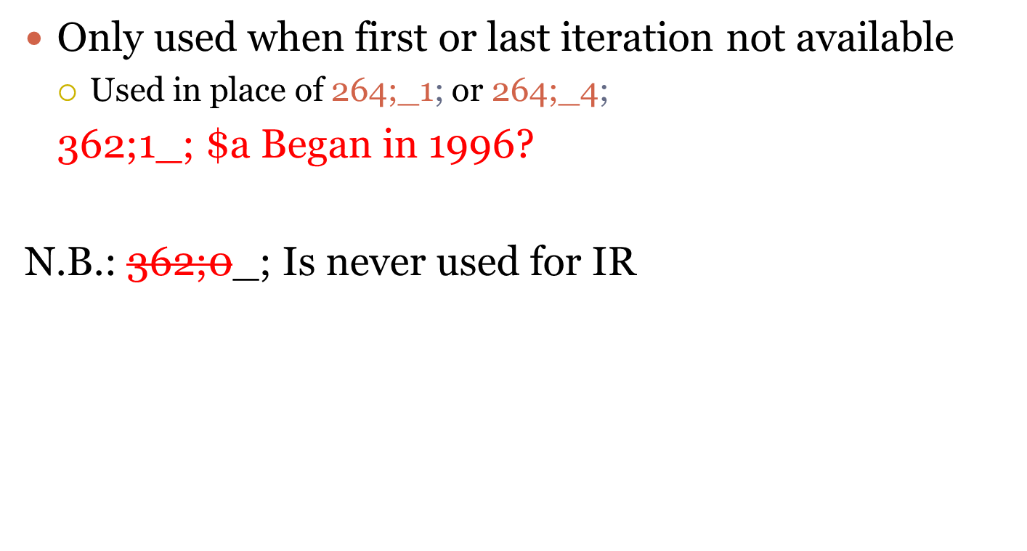
362/1 Publication Note

Slide 21
336-338
Record as many 336-338 fields as necessary to represent the resource as a whole
336;__; $a text $2 rdacontent
336;__; $a cartographic image $2 rdacontent
337;__; $a computer $2 rdamedia
338;__; $a online resource $2 rdacarrier

Slide 22
490/500
If the series statement changes, revise the series statement to reflect the change (RDA 2.12.1.6.2)
Make a note on changes in the series when later iterations lack it or include it (RDA 2.20.11.5.2)

Slide 23
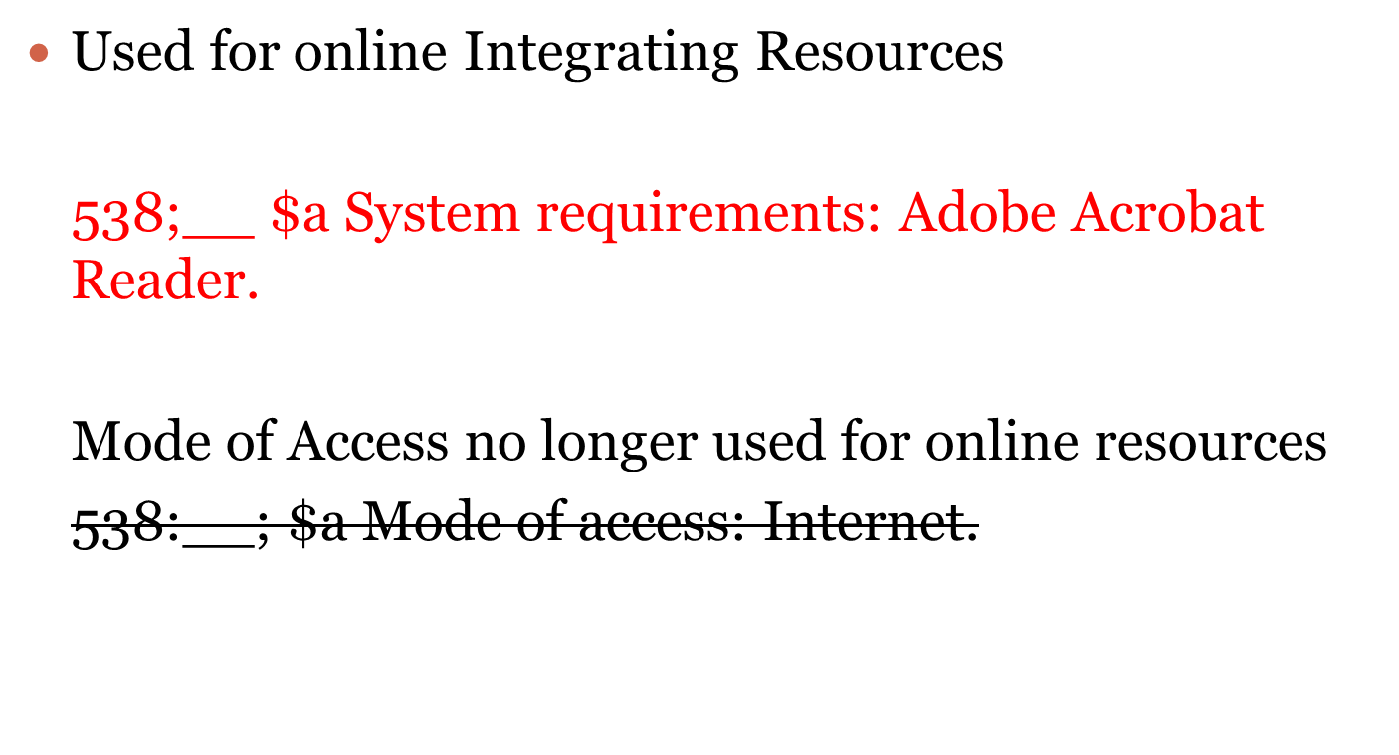
538 – Equipment or System Requirements (RDA 3.20)

Slide 24
580, 760-787 – Linking notes
580 – “Description of the complex relationship between the item described in the record and other items that cannot be adequately generated from the linking entry fields 760-787.“—LC MARC21; Explanatory note
  Previous edition when title has changed (775)
  Part of a larger resource (773 or other 7XX)
  Other relationships
  580;__$a Forms part of the Frances Benjamin Johnston Collection.
  773;1_$t Frances Benjamin Johnston Collection.

Slide 25
588 – Source of Description; Title Note
Note on the iteration used for identification RDA 2.20.13.4
588;__; $a Identification of the resource based on: 1994 edition through update number 10
Includes Latest Issue Consulted (RDA 2.1.2.4)
Online Resources:
588;__; $a Identification of the resource based on contents viewed October 21, 1999; title form title screen.
Source of Title Note
  Can also be placed in 500 field

Slide 26
Identifier of Manifestation
(RDA 2 15.1.4)
RDA Core
020 -- ISBN number
022 – ISSN number w/ 222 Key Title
222 – “Unique title for a continuing resource that is assigned in conjunction with an ISSN recorded in field 022 by national centers under the auspices of the ISSN Network”--LC

Slide 27
Access Points
Make additional access points for “any persons, families, or corporate bodies associated with the current iteration of an integrating resource” RDA 18.4.2.3
  Retain older if considered important

Slide 28
Other Machine Actionable Fields (3XX, 5XX)
May duplicate other data fields
Selected Examples:
347 – Digital File Characteristics (RDA 3.19); duplicated 516 free text note field
347;__; $a text file $b PDF $b HTML $2 rda
343 – Planar Coordinate Data (for cartographic materials) (RDA 7.27)
343;__; $b International feet.

