Slide 1
Monographs Part 2: Single Volumes, Multivolumes, etc.
RESOURCE DESCRIPTION AND ACCESS:
A COBEC WORKSHOP PRECONFERENCE
JANUARY 30, 2014
GUY FROST
gfrost@valdosta.edu
VALDOSTA STATE UNIVERSITY

Slide 2
264 – Publication Statements: Dates
The following pages are a guide to publication dates (264;_1; … $c)
On Title page: 2006
No date of Title Page; Title Page Verso: [First] Published 2006 – No other dates provided
DtSt: s Dates: 2006
264;_1; $a … $c 2006.

Slide 3
264 – Dates Cont.
Title Page Verso: ©2006 – no other date provided
DtSt: s Dates: 2006
264;_1; $a … $c [2006]
Title Page Verso: ©2006 ; First COBEC paperback 2007 – this makes it a new manifestation
DtSt: r Dates: 2007, 2006
264;_1; $a … $c [2006]
264;_3; $a … $c 2007.
264;_4; $c ©2006
588;__; $a Description based on 2007 reprint.
Notes:
Note: For the second example, LC will ignore the reprint date and treat is like the first (in reality, however, some LC catalogers are treating it as a reprint)

Slide 4
264 – Cont.
On Title Pages Verso: Title Page Verso: ©2006 ; First COBEC paperback 2007 ; Transferred to Digital printing 2009
DtSt: r Dates: 2009, 2006
264;_1; $a … $c [2006]
264;_3; $a … $c 2009.
264;_4; $c ©2006
588;__; $a Description based on 2009 digital reprint.

Slide 5
264 – Cont.
On Title Pages Verso: ©2006 ; First COBEC paperback 2007 ; Transferred to Digital printing 2009 ; on Colophon Breinigsville, PA, December 9, 2010
DtSt: r Dates: 2009, 2006
264;_1; $a … $c [2006]
264;_3; $a … $c 2009.
264;_3; $a Breinigsville, PA : $b [Lightning Source], $c 2010.
264;_4; $c ©2006
588;__; $a Description based on 2009 transfer to digital printing; printed on demand December 9, 2010.
Notes:
Poking around on the Internet may yield the company that has been contracted out to do print-on-demand. The date is largely ignored. Optionally record the 264;_3; for the print on demand manufacturer as well as add information in the 588 note.

Slide 6
Multivolumes
264 – Publication statements
  Some multivolumes works are published all at once
  008: DtSt: s Dates: 2013
  264;_1; $a … $c 2013
  300;__; $a 3 volumes
  Some multivolume works are published over a period of time (RDA 2.8.6.5)
  008: DtSt: m Dates: 2013, 9999.
  264;_01; $a … $c 2013-
  300;__; $a volumes (RDA 3.4.1.10) – LC/PCC does not do this

Slide 7
RDA and MARC21 Expansion
Many old fields and subfields have been expanded/repurposed for a variety of resources
Most will be machine actionable, yet still has a semantic aspect for keyword retrieval

Slide 8
Other Resources: Braille Book
Form: f
007;__; $a f $b b $d u $e u $f n $g n
336;__; $a tactile text $2 rdacontent
337;__; $a unmediated $2 rdamedia
338;__; $a volume $2 rdacarrier
546;__; $b braille code (RDA 7.13.4)

Slide 9
Other Resources: Sign Language (chiefly graphic)
Lang: eng
041;1_; $a eng $a sng
336;__; $a still image $b rdacontent
336;__; $a text $b rdacontent
337;__; $a unmediated $b rdamedia
338;__; $a volume $b rdacarrier
546;__; $a Includes English words and their sign language equivalents; the sign system represented is American Sign Language.

Slide 10
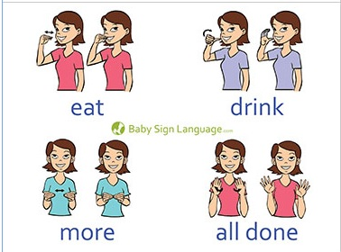
Example of Graphic Sign Language Resource
Dictionary is chiefly graphic, with some text defining sign
Image © Baby Sign Language.com; Used by permission.

Slide 11
Large Print
Form: d
336;__; $a text $b rdacontent
337;__; $a unmediated $b rdamedia
338;__; $a volume $b rdacarrier
340;__; $n large print $2 rda

Slide 12
Manga, Graphic Novels, Comics
Cont: 6 EntW: 6 (CR)
336;__; $a still image $b rdacontent
336;__; $a text $b rdacontent
337;__; $a unmediated $b rdamedia
338;__; $a volume $b rdacarrier
Can also be used for art books that have significant illustrative material
Notes:
CR = Continuing Resource

Slide 13
New field 347 – Digital File Characteristics
  Is It Clearly Stated or Obvious? - follow RDA instructions
  i.e.: On disc: DVD video
  347;__; $a text file $b PDF $2 rda
  or
  347;__; $a streaming video file $b QuickTime $2 rda
  No indication of content, or not obvious – see next slides

Slide 14
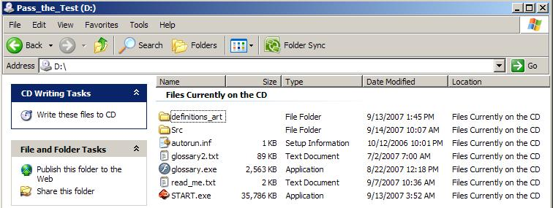
Determining Content for Media for 347 Field
Pop DVD, CD, or CD-ROM into computer
Open “My Network Places” – Select Drive for Media – Note File Extensions and Type of file

Slide 15
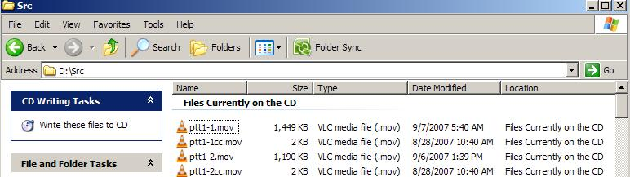
Folders
Look in all folders and note all file extensions and “Type of File”

Slide 16
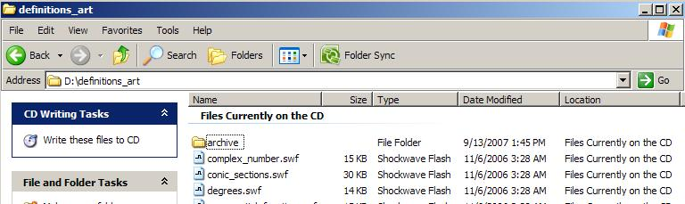
Type of File Column
Some File names are simple

Slide 17
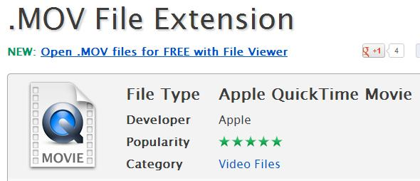
File Extension Help
Use the following site to assist in determining file type: http://www.fileinfo.com/

Slide 18
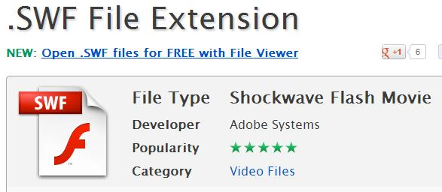
Another Example

Slide 19
Future Developments
Field 385 – Audience Characteristics
  More guidance is needed on subfield coding and preferred source code ($2)
245;10;$a Inglés para niños.
385;__; $m Age group $a Children $2 ericd
385;__; $m Language group $a Spanish Speaking $2 ericd
$m = demographic term
245;10; $a Essential Spanish for policemen, lawyers, and judges
385;__; $n occ $a Police $a Lawyers $a Judges $2 lcsh
$n = demographic code

Slide 20
Future Developments Cont.
Field 386 – Creator/Contributor Characteristics
  Same issues of guidance as 385
100;1_; $a Mozart, Wolfgang Amadeus, $d 1756-1791.
240;10; $a Sonatas, $m violin, piano, $n K. 8, $r B♭major
386;__; $a Child composers $2 lcsh
For a work Mozart composed at age 7.

