Slide 1
Basic Cataloging of Scores in RDA
RESOURCE DESCRIPTION AND ACCESS:
A COBEC WORKSHOP
JANUARY 29, 2014
GUY FROST
GFROST@VALDOSTA.EDU
VALDOSTA STATE UNIVERSITY

Slide 2
Transcription
For scores, the transcription fields are generally the same as that for books.
  Instruction numbers for title, statement of responsibility, etc. are the same as for books
However, scores also bring with them additional characteristics that need to be addressed (e.g., score with parts, arrangements, etc.)
There are also additional fields, some new and some old that have been repurposed, with additional guidance in RDA, LC-PCC PS and the MLA guide (see next slide)

Slide 3
Governance
The Music Library Association (MLA) has a cataloging arm, Bibliographic Control Committee, that has provided documentation to help catalogers of music transition to RDA
  Best Practices for Music Cataloging : Using RDA and MARC21, Draft February 11, 2013
  this covers both scores and sound recordings
  http://bcc.musiclibraryassoc.org/BCC-Historical/BCC2013/RDA_Best_Practices_for_Music_Cataloging.pdf
  Also useful as a guide from the PCC
  PCC RDA BIBCO Standard Record (BSR) Metadata Application Profile, January 1, 2013 revision
  this outlines what the PCC regards as essential in a MARC record for scores and sound recordings
  http://www.loc.gov/aba/pcc/scs/documents/PCC-RDA-BSR.pdf

Slide 4
Titles – Scores in a Single Volume
Follow LC-PCC PS including both alternatives
Take what you see, or, Appendix A per local policy – use catalogers judgment
Take titles from: title page first; cover second (RDA 2.2.2.2)
It desired, add a variant title from spine or caption, etc., using the 246
Notes:
In AACR2, the caption was the preferred source of the title, in RDA, it is cover.

Slide 5
Scores Issued in 2 or More Parts
Choose as the chief source of information the piece the represents the item as a whole (a comprehensive description)
    Score with part(s) – Use score with cover or wrappers (RDA 2.1.2.3c)
    Parts alone – If there is a cover or wrapper, follow RDA 2.1.2.3c
      If lacking, typically go in score order when choosing as chief source (RDA 2.1.2.3d)
    If none of these work, catalogers judgment with 500 note (RDA 2.20.2.3)

Slide 6
Scores with Accompanying Media
If affixed to the cover or endpapers, choose the score as the preferred source of information
If both housed together in a single carrier (e.g., a box with a CD and booklet or score, CD booklet in jewel case, etc.)
  Choose the carrier as the main part. Note, the CD insert is visible through the jewel case and by extension becomes part of the carrier. Apply 2.2.2.3 or 2.2.2.4 as appropriate
Code an 006 and/or an 007 for the media; a $e in the 300 field (or repeat the 300 for the media); code 336-338 suite for the media; and 344-347 fields as appropriate

Slide 7
Other Title Information (RDA 2.3.4)
Follow LC-PCC PS – Record any other title formation found with the title proper
All other instances of other title information should follow RDA 2.3.6 and record it as a Variant Title in the 246; use indicators 13, or 1_ with $i
All $i subfields used in linking fields (246, 7xx) have the same construction.
1. First word capitalized
2. End descriptive phrase with a colon.
e.g., $i At head of title:
Notes:
Note, LC is moving away from coded data and as such are preferring the 246;1_; $i rather than 246;1#; $a (# being the defined indicators found in MARC21)

Slide 8
Example:
On title page: An anthology of piano music Volume I The Baroque period selected and edited by Denes Agay
On cover: An anthology of piano music Volume I
The Baroque Period
A repertory of keyboard works by masters of the 17th and 18th centuries
Selected and edited by Denes Agay
245;03; $a An anthology of piano music. $n Volume I, $p The Baroque period
246;30; $a Baroque period
246;1_; $i Subtitle on cover: $a Repertory of keyboard works by masters of the 17th and 18th centuries

Slide 9
250 – Edition Statement
Designation of Edition (Low Voice, Tenor, etc.) no longer included in the $c Statement of Responsibility
  If statement is not linked to the title, record in the 250 field
  250;__; $a Low voice.
Format of Notated Music (e.g., Study Score) no longer include in the 254 (RDA 7.20.1.3); record only if on the item
250;__; $a Conductor’s score.
250;__; $a Score and parts.

Slide 10
254;_0; - Production
Production here refers to where and when the composer wrote the music
  Production data is recorded in the 264;_0;
  It can also be recorded in the 046;__; $k beginning date $l ending date
046;__; $k 1947
264;_0; $c New York : $b Paul Hindemith, $c 1947.
264;_2; $a New York : $b Schott, $c 1950.
264;_4; $a ©1950
Notes:
This was previously recorded in the 045 field e.g., 045;0_; $b d1947

Slide 11
264;_1; - Publication
Follow LC-PCC PS
  Record all names appearing anywhere on the item if feasible
If choosing to record the Distribution Statement with the Publication and/or Copyright Statement, do not record the date (unless a publication date is not present or inferred)
264;_2; $a Milwaukee, WI : $b Hal Leonard Corporation
MLA recommendation is to record the latest copyright date (see page 23: 2.11) whether recorded or transcribed, i.e., record it in all cases
Notes:
The use of the latest copyright date for music is another departure from AACR2. Copyright in general for music has always been an issue. See: Music OCLC Users Group Newsletter, number 109, December 2011 and number 112, Decemeber 2012 (ISSN 0161-1704)

Slide 12
300 – Physical Description
“volume” no longer used as the initial term of extent. Instead, use score
  300;__; $a 1 score (viii, 50 pages)
  but,
  300;__; $a 1 score (2 volumes (120 pages))
  300;__; $a 1 score (2 volumes (viii, 56 pages; viii, 74 pages))
Record the number of parts as part of the extent. RDA separates score and parts by “and” MLA still uses the plus sign “+”
  300;__; $a 1 score (48 pages) + 2 parts
  but,
  300;__; $a 1 score (2 volumes)

Slide 13
336-338 Content/Media/Carrier
336;__; $a notated music $2 rdacontent
337;__; $a unmediated $2 rdamedia
338;__; $a volume $a rdaccarrier
or, if the resource being cataloged is a single sheet printed on 1 or both sides:
336;__; $a notated music $2 rdacontent
337;__; $a unmediated $2 rdamedia
338;__; $a sheet $a rdaccarrier

Slide 14
380 – Form of Work (RDA 6.3.1.3)
Form of work can be recorded in the Authorized Access Point, separately (380), or both; if given in the APP, give it also in the 380 (MLA)
  Used to distinguish two works or expressions with the same title
  100;1_; $a Menken, Alan.
  240;10: $a Beauty and the beast (Musical)
  245;10; $a Beauty and the beast
  380;__; $a Musical

Slide 15
381 – Other Distinguishing Characteristics of Works and Expressions (RDA 6.18)
If recorded in the Authorized Access Point, also record it in the 381 field
  RDA limits this field for vocal to instrumental and instrumental to vocal arrangements; MLA says if in the AAP, routinely record it in the 381
100;1_; $a Debussy, Claude, $d 1862-1918.
240;10; $a Chansons de Bilitis (Songs). $p Chevelure, $o arranged
380;__; $a Songs
381;__; $a Arranged

Slide 16
382 – Medium of Performance (RDA 6.15)
Record Medium of Performance if also recorded in the Authorized Access Point or if it is readily ascertainable
  $a Medium of Performance
  $b Soloist
  $d Doubling instruction (i.e., 1 performer for 2 or more instructions)
  $n number of performers
  $p Alternate medium of performance
  $s Total number of performers
  $v Notes
  245;10; $a Pièce, flûte ou hautbois ou violon et piano
  382;01; $a flute $a piano $2 lcmpt
  382;01; $p oboe $v alternative for flute $2 lcmpt
  382;01; $p violin $v alternative for flute $2 lcmpt

Slide 17
382 - Continued
Some of the MLA instruction contradict RDA’s… prefer following MLA’s especially if it supports Identifying and Selecting
6.15.1.6.2 – Omit Elements
RDA – key of instrument, or other terms that differentiate the instruments voice (alto, soprano, etc.)
MLA – Include if useful (terms are from the lcmpt)
- presenter’s recommendation is to always include it when outside the norm
  382;01; $a soprano saxophone $a piano $2 lcmpt

Slide 18
A Note on Future Developments
Library of Congress Medium of Performance Thesaurus for Music (LCMPT) – anticipated date of approval is February 10, 2014
  Includes a controlled list of terms that will be used in the 382 field
  Will be instrumental is the replacement of Medium of Performance in subject headings (Sonatas (Flute and piano))
  Genre forms for music will move from 650 to 655 (lcgft) beginning late 2014 and early 2015
  What is all means:
  650;_0; $a Sonatas (Flute and piano)
  will be deleted from LCSH in favor of:
  382;01; $a flute $a piano $2 lcmpt
  655;_7; $a Sonatas $2 lcgft

Slide 19
383; Numeric Designation of Musical Work (RDA 6.16.1.3.3)
Old field with new subfields for music
  $a – Serial number
  $b – Opus number
  $c – Thematic Index Number
  $d – Thematic Index Code (i.e., name of author)
  $e – Publisher Associated with Serial or Opus Number
  $2 – Source Code
  AAP: Marcello, Benedetto, $d 1686-1739. $t Sonatas, $m recorded, continuo, $n op. 2. $n No. 5.
  383;__; no. 5 $b op. 2 $c C768 $d Selfridge-Field $e Sala
  383;__; no. 5 $b op. 2 $c C768 $d Selfridge-Field $e Roger
  383;__; no. 12 $b op. 1 $c C768 $d Selfridge-Field $e Walsh
Notes:
Slefridge-Feld is the author of the thematic Catalog. His entry, C768, provides the opus numbers, the serial numbers, and the publishers associated with each. All of these have been recorded in the bibliographic record as shown.

Slide 20
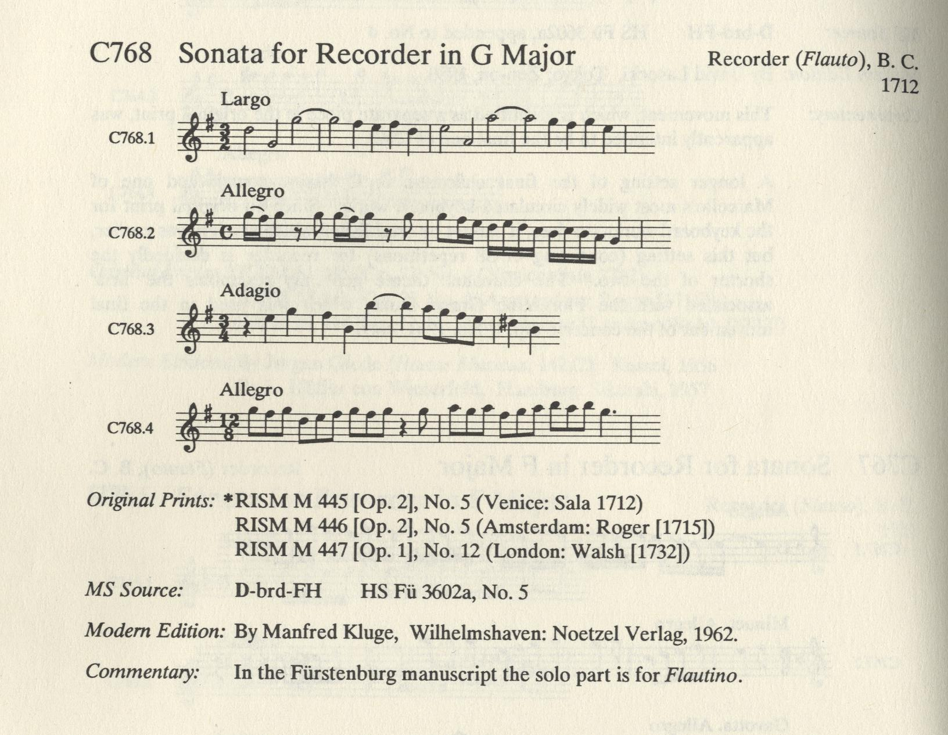
Thematic Catalog Example
Notes:
For a cataloger, the primary purpose for a thematic cataloger is to positively identify works by composers. For some composers, the AAP will include the entry number (C768 above). K. numbers for Mozart works or BWV numbers for J.S. Bach come from this type of resource (e.g., Bach, Johann Sebastian, $d 1685-1750. $t Adagios, $m harpsichord, $n BWV 968, $r G major)

Slide 21
384 – Key of Music (RDA 6.17)
Most useful when distinguishing two works with the same title apart
Two First Indicators to choose from:
  0 – original key
  1 – arrangement (used in conjunction with 008-TrAr: and 240 $0 arranged)
  TrAr: c
  100;1_; $a Bach, Johann Sebastian, $d 1685-1750.
  240;10; $a Sonaten und Partiten, $m violin, $n BWV 1001-1006. $p Sonata,
  $n no. 1; $o arranged
  245;10; $a Sonata in a minor for marimba alone / $c J.S. Bach …
  500;__; $a Original: Sonata in g minor for solo violin
  381;__; $a Arranged
  382;__; $a marimba
  383;__; $a BWV 1001 $b Schmieder
  384;0_; $a G minor
  384;1_; $a A minor

Slide 22
546 – Form of Notation (RDA 7.13.3)
Form of notation used in the score (graphic, staff, braille, etc.)
546;__; $b staff notation.
N.B.: many sources show staff recorded as a capital (MLA) or lowercase (RDA and OCLC) , choose the form OCLC uses

Slide 23
Identifiers (024, 028 (RDA 2.15))
Various Numbers that are associated with the manifestation; record all that are present on the item
  020 – ISBN (unusual for scores but they can occur)
  024 – ISMN, EAN, ISMN-13, and UPC
  028 – Plate Number, Publisher number, etc.
    Plate Numbers (usually centered or printed on every page)
    Publisher numbers (e.g., Hal Leonard’s stock number)

Slide 24
Other Fixed Field Codes
AccM: Allows for the coding of note worth text with scores (e.g., historical or biographical information); used with 041;_;$e (librettos) or $g (other)
Comp: Form of Composition (e.g., concertos, country music)
Fmus: Format of music (study score, full score, etc.)
Part: indicates that the resource has or is parts
TrAr: Indicates whether the item is transposed (arranged from original key to another), an arrangement, or both
048 – Number of Musical Instruments or Voices Code
  A much broader version than the new 382 field

Slide 25
Checklist of MARC Fields for Scores
008: Type:, Comp:, AccM:, Part:, TrAr:, Fmus:, LTxt:
024;__; $a
028;__; $a
046;__; $k $l
1XX;__; $a
240;__;
245;##; $a
250;__; $a
264;_4; $c
300;__; $a
306;__; $a
336;__; $a
337;__; $a
338;__; $a
380;__; $a
381;__; $a
382;__; $a
383;__; $a
384;__; $a
546;__; $b

