Slide 1
NAVIGATING THE RDA TOOLKIT
RESOURCE DESCRIPTION AND ACCESS:
A COBEC WORKSHOP
JANUARY 29, 2014
GUY FROST
GFROST@VALDOSTA.EDU
VALDOSTA STATE UNIVERSITY

Slide 2
Types of Subscriptions
Site
  Unlimited Registered Users
  Can Share Workflows Site-wide and to Public
Solo-User
Training and Classroom
Consortia and Group (this is what the University System of Georgia has)
  Can contain Site and Solo Subscriptions

Slide 3

Accessing The Toolkit
http://www.rdatoolkit.org/
  IP, URL Authentication, Username/Password
  username: 2014rdatraining
  password: rda2014

Slide 4

Logging In
Login with Username and Password Provided by ALA
login
  Institution name will appear at the top right
  Notice it now asks for Profile Name and Password

Slide 5
Creating the User Profile
Why Create a Profile?
  Save Searches
  Bookmarks
  Workflows
  Maps
Click on the Create Profile Icon

Slide 6
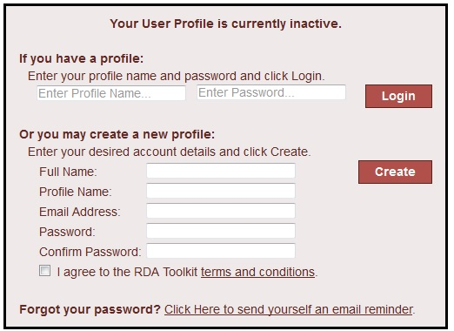
Filling in the Blanks
No requirements mandated for Password
  Can use capitals, numbers, etc.

Slide 7

Not Quite Done
Managing Your Profile
Allows you to completely revise what you just did

Slide 8
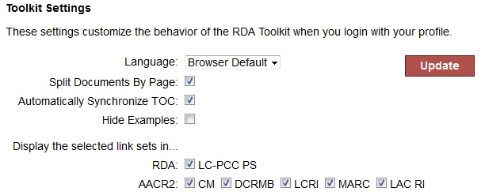
Toolkit Settings
LC-PCC PS = Library of Congress and the Program for Cooperative Cataloging Policy Statements (Replaced LCRI)
CM = CONSER manual
DCRMB = Descriptive Cataloging of Rare Materials (Books)
LCRI = Library of Congress Rule Interpretations
MARC = Machine Readable Cataloging
LAC RI = Canadian Rule Interpretations

Slide 9
User Menu
Go button logout
Advanced Search
Support

Slide 10

Tabs in the Left Pane
RDA TOC ; RDA Browse Tree
Tools:
  RDA: Element Set ; RDA Mappings ; RDA Examples ; Workflows ; Maps ; Entity Relationship Diagram (ERD) ; Schemas
Resources
  AACR2 ; LC-PCC PS ; Other

Slide 11
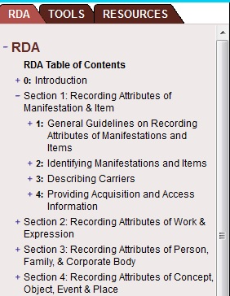
Browsing
Navigating Through RDA using the “Browse Tree”
  Use + and - signs to expand
  and collapse Sections and
  Chapters

Slide 12
WEMI
Note in the previous slide how chapters are divided:
  Manifestations and Items together (Tangible characteristics)
  Works and Expressions Together (Abstract characteristics)
  This consists of the Group 1 entities outlined in FRBR

Slide 13
FISO
The FRBR concept of Find, Identify, Select, Obtain
In RDA, chapters dealing with: Persons, Families, and Corporate Bodies
  Covers the first two components: Find and Identify
    Core requirements for AAP (Authorized Access Point)
    How aspects of the entity in the APP are recorded (Spacing of initials, abbreviations, etc.)
    This consists of Group 2 entities outlined in FRBR

Slide 14
Exercise
Scenario: Two resources by the same author. One uses accent marks in the name, one does not. There is no AAP in the authority file.
How should you record the name (i.e., with or without diacritic marks) in the 100 field?

Slide 15
FRSAD
Functional Requirements for Subject Authority Data
  In RDA, chapters dealing with: Concept, Object, Event, Place
  Yet to be developed for RDA
  This consists of Group 3 entities outlined in FRBR

Slide 16
Exercise
Scenario: Title page has Second edition; Spine has 2nd edition; CIP has 2nd ed.
  Using the Browse Tree on the Left Pane
    Locate the Section for Editions
  Question:
  What is the Preferred Source for Transcribing the Edition Statement?

Slide 17
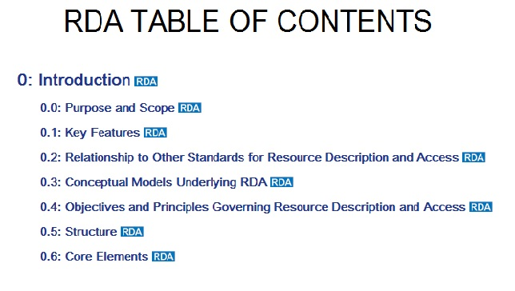
Table of Contents
The Table of Contents mirrors that of the print Resource
Allow for quick Navigation to Desired Content

Slide 18

Navigating The Pages
Content may be broken up into Pages
  Can select any of these to view
  The green arrow allows to go back to the previous page
  If desired, can be turned off by editing you Profile

Slide 19


Synching the Table of Contents
Helps users know where they are in the Toolkit
  Bold in the left pane browse area
  Only synchs to clicked links, either in the text or via the Browse pane
    If scrolling and it is desired to synch to the instruction number further down the page; use the manual Synch TOC button

Slide 20


Quick Searching
Searching for specific instruction numbers
  Type the instruction number and click on the Go icon
  Use quotation marks around the instruction number to generate a results list
    Shows related instructions
    Provides cross references to other instructions when found within the text
    Includes false hits

Slide 21
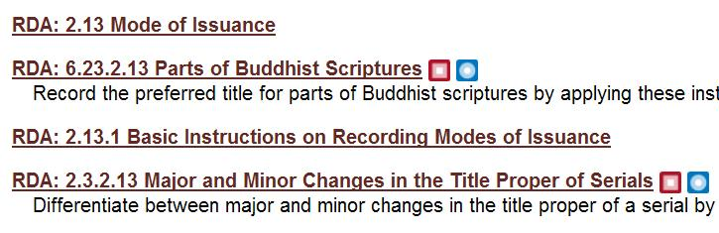
Results List
Provides the body of related instructions (e.g., 2.13 Mode of issuance) Basic Instructions
Core Instructions

Slide 22
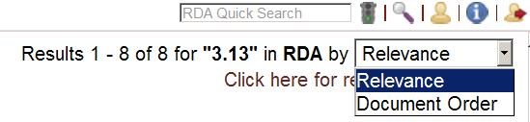
Reordering of Results
Results are retrieved by relevance first
Document Order will allow base instructions to file in order

Slide 23
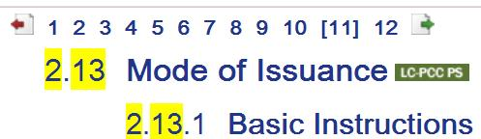

Highlighting of the Text
After selecting an instruction number, the original search is highlighted in yellow
Use the Return Icon to navigate back to your original results

Slide 24
Basic Searching
Allows for Boolean AND, OR, and NOT as well as proximity searching w/#
Default searching of multiple words is AND
Truncation via *
Searching not case sensitive
Punctuation is ignored

Slide 25
Exercise
Repeat Diacritic search:
- using truncation on the term diacritical
- coming “name” for a Boolean search

Slide 26
Advanced Searching
Good for navigation from known AACR2 rules to relevant RDA instructions
Can exclude Content
Save Searches for future reference
Exercise:
Click LC-PCC PS and RDA
Search for “Sign language” with quotes

Slide 27

Exercise
Clear “Clear Previous Search”
Search for AACR2 rule 8.7B18 (Contents Note)
  Choose: Recording Relationships for Related Works
  Click on the LC-PCC PS
  Scroll to the top of this policy statement
    Note the differences in practice between LC and the PCC

Slide 28
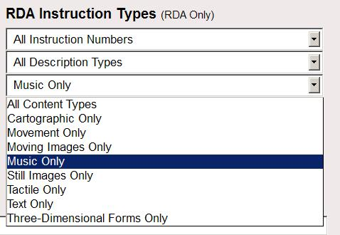
Searching by Content Type
Clear previous search
Using the pull down
menu change the
selection to
Music only
As you search term, type in: notation

Slide 29


Saving this Search
Click on the Advanced Search icon again
  Previous search should be displayed
At the bottom of the screen, name your search
Find your saved search for future use under your user profile

Slide 30

Bookmarking
Used when you have specific instructions you want to easily retrieve again
Example: Carrier type (338)
  Search for Carrier type as a quoted phrase
  A look at the first one, 3.3.1.3, reveals the target instruction
  Click on the bookmark icon

Slide 31
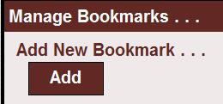
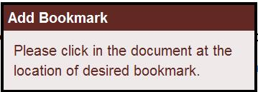
Manage Bookmark Dialogue Box
Click the Add button:
Instructions pops up
indicating the need to select where you want the bookmark to start
click anywhere on the instruction number

Slide 32
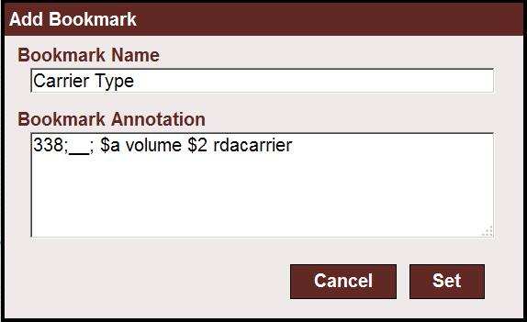
Final Add Dialogue Box
A New Dialogue Appears
  Add name; optionally add annotation
  Click on “Set” when ready

Slide 33


Where are My Bookmarks?
Icon appears next to Instruction number
Listed in Personal Profile

Slide 34
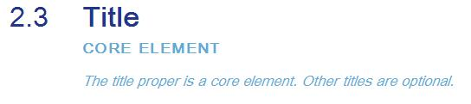
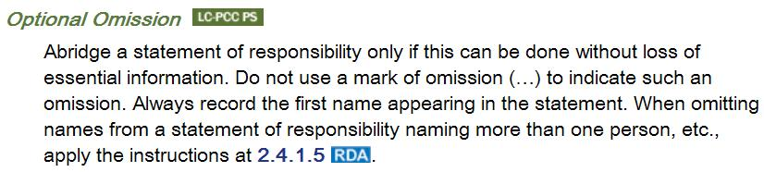
Core Elements and Optional Omissions
Core Elements are clearly labeled in light blue text

Slide 35

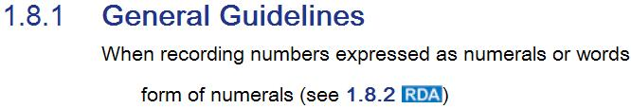
Helpful Embedded Links
Links to the Glossary
Use Browser back button to return to original spot
Links to LC-PCC PS
Click on to the RDA Browse Tree to return to the instructions
Links to related RDA instructions (references)

Slide 36
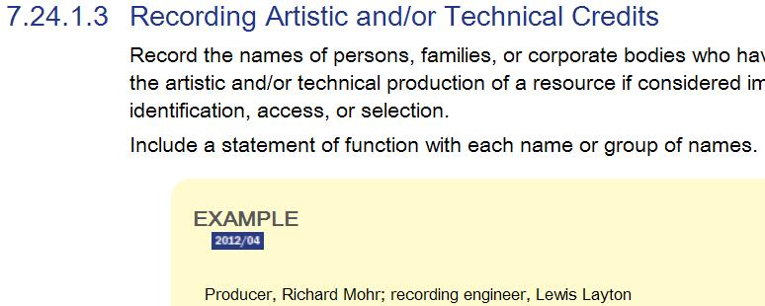
Examples
Here also shows date of revision
Note: examples do not included preceding or ending punctuation

Slide 37
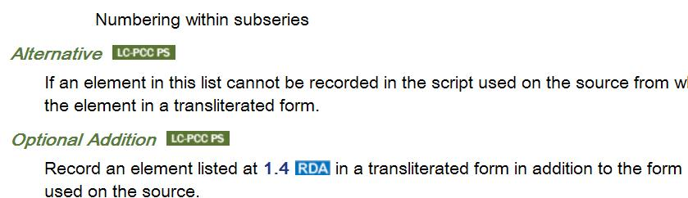
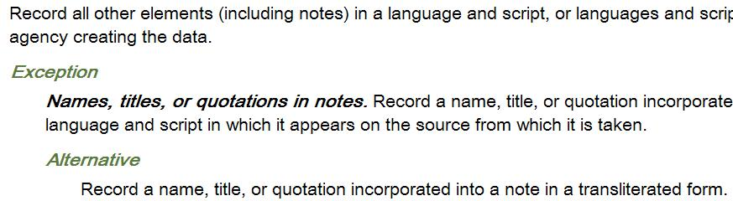
Alternatives, Additions and Exceptions

Slide 38
Other Content in the Toolkit
AACR2
Library of Congress Program for Cooperative Cataloging Policy Statements (LC-PCC PS)
Workflows and other documentations created by other subscribers
Mappings to other schemas
  MARC21

Slide 39
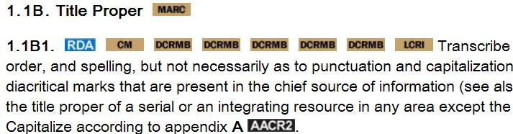
AACR2
Allows for the navigation to a myriad of standards (Caveat: in Catalogers Desktop)
- MARC
- RDA
- CM (CONSER Manual)
- DCRMB (Descriptive Cataloging of Rare Materials (Books)
- LCRI

Slide 40
RDA MAPPINGS
RDA TO MARC Bibliographic Mappings
  Allows a quick link from the RDA instructions to MARC21
MARC Bibliographic to RDA Mappings
  Quick links from MARC fields to RDA
RDA to MARC and MARC to RDA Authorities
RDA to MODS (Metadata Object Description Schema) (an XML schema)

Slide 41
Exercise
You are cataloging a dictionary of sign language chiefly made up of images with added text defining sign
  RDA wants you to record the language note (i.e., form of sign language) as part of the Accessibility Content
  Locate the instructions for Accessibility Content
  Read the LC-PCC PS for these instructions
  Use the RDA to MARC Mapping under Tools and navigate to examples in the MARC field

Slide 42
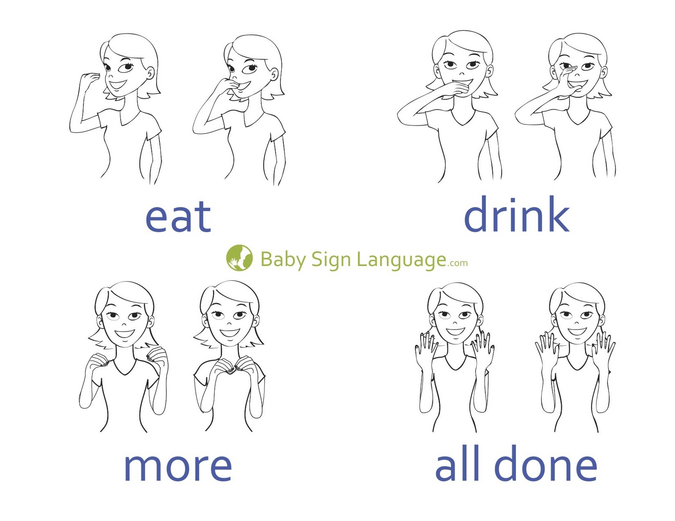
Example:
Image source: BabySignLanguage.com

