Slide 1
Workflows
RESOURCE DESCRIPTION AND ACCESS:
A COBEC WORKSHOP PRECONFERENCE
FEBRUARY 4, 2014
GUY FROST
gfrost@valdosta.edu
VALDOSTA STATE UNIVERSITY

Slide 2


Creating Workflows
You must be logged into your personal profile in RDA
It is helpful to have Instruction Numbers written down
Click on Tools-Workflows-Create Workflow
Once named, Workflow can be saved continuously
  Will appear in the Global Workflows section of the Tools tab

Slide 3
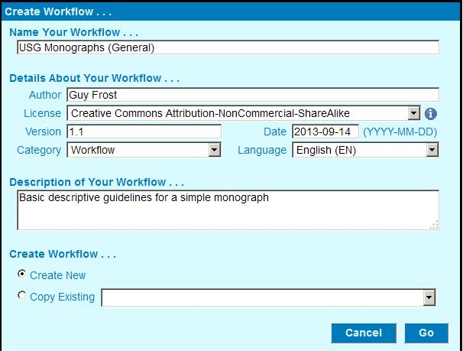
Starting Template

Slide 4
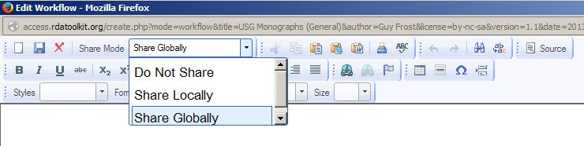
The Text Editor
Change the pull down to “Share Globally” if you want others to see what you’ve done
  - This can be changed later in your profile

Slide 5

The Icons
Links to RDA instructions (which you must know in advance)
Most remaining icons are standard to text editors or word processing programs

Slide 6
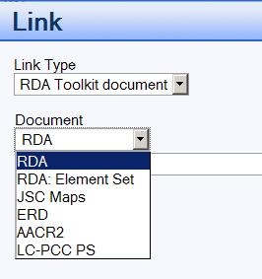
Choosing the Resources
Select: RDA
Toolkit document
Choose RDA or
LC-PCC PS

Slide 7
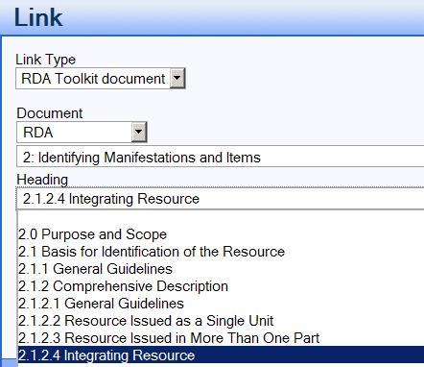
Navigating the Selections
Choosing the
Section opens a
new pull down menu
Select the specific
instruction needed
Click the OK button to insert it

Slide 8

Editing Workflows
Can only alter Workflows that you created
  Change the name (Metadata)
  Change who can view it (Change Sharing Mode)
  Edit
  Delete
Locate the Workflow You Created Under Your Profile click the edit icon next to the workflow
Edit, save as before, and your done

