Slide 1
Earthquake Damage Prediction Analysis
Damage Analysis and prediction of damage caused to buildings during earthquakes

Slide 2
Team Members
G V Datta Adithya, 19BCE7119
Polu Venkata Sai Pavan Kalyan, 19BCE7414
Karamsetty Kaushik, 19BCD7137
Shiva Kumar Jalla, 19BCE7778

Slide 3
Abstract
Around the world, we face numerous natural calamities, and earthquakes are one of the most prominent calamities amongst them.
This project was developed as a means as estimating the damage that can be caused due to an incoming earthquake so that people residing in the danger zone can take steps to relocate and avoid the incoming disaster.
The data that we are utilizing in this project is collected on the basis of the damage that was suffered by the various buildings located in the calamity zone, and this project was made to analyze this data to develop a prediction model to estimate the damage that could be done to buildings for future earthquakes.

Slide 4
Problem Definition
The prediction of damage caused to buildings due to earthquakes.
Resolution of this problem statement allows for us to receive statistical analysis on how effective an earthquake is on a particular building and the probably of the building being unable to withstand the impact.

Slide 5
Data Processing Steps
Data Cleaning
Data Reduction
Data Transformation
Data Visualization
Implementation of the Decision Tree Algorithm
Implementation of the Naïve Bayes Algorithm

Slide 6
Data Preprocessing
Data Preprocessing has been done in three steps in this project, these specifically are, Data Cleaning, Data Reduction, and Data Transformation.
These steps have been done through the removal of NA values, which provides us with a cleaner dataset, with values for each section.
Next, we have detected and removed Outliers which allows for us to discard abnormal collections of data, in order to maintain relatively accurate data to work with.
Finally, we perform checks for the various traits present for each building that was affected and attach them to the specific column.

Slide 7
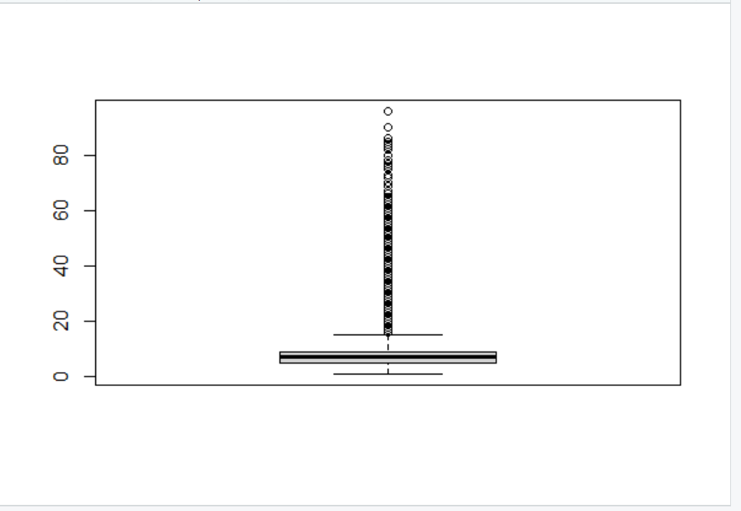
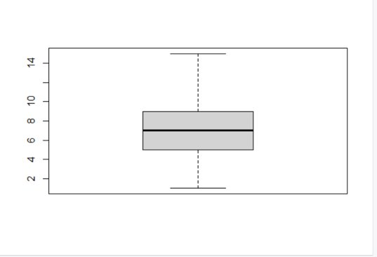
Data Preprocessing
Before removing outliers based on "PERCENTAGE"
After removing outliers based on "PERCENTAGE"

Slide 8
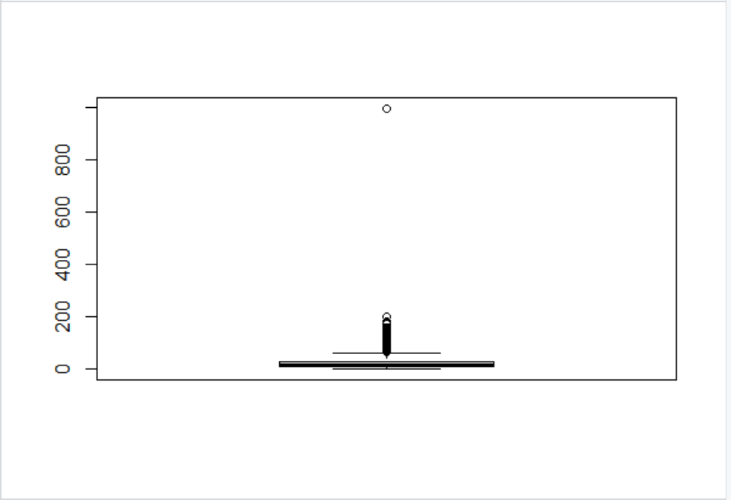
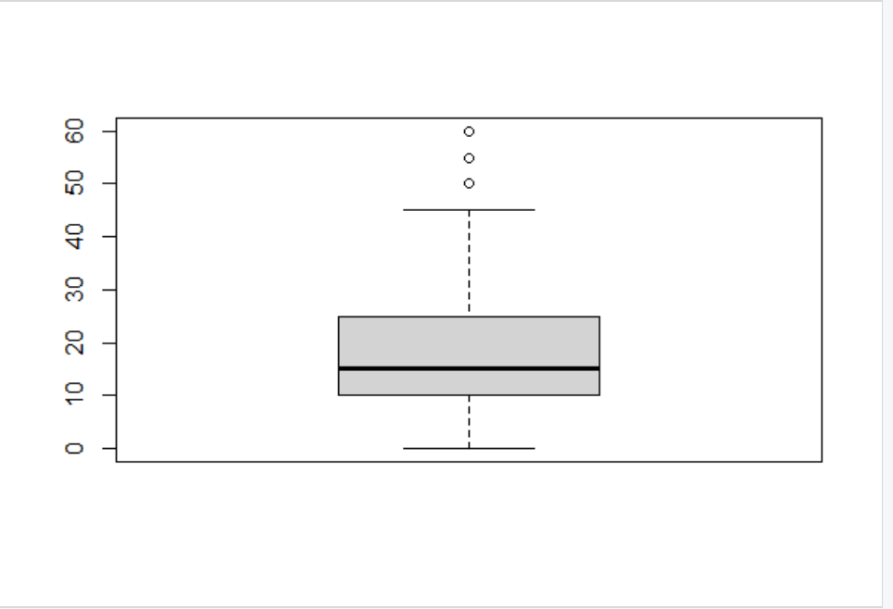
Data Preprocessing
Before Removing Outliers
After removing outliers based on "AGE"

Slide 9
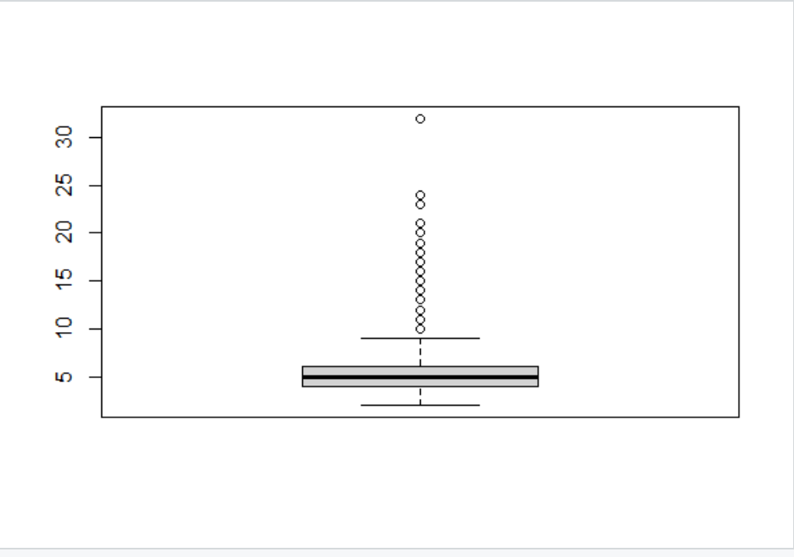
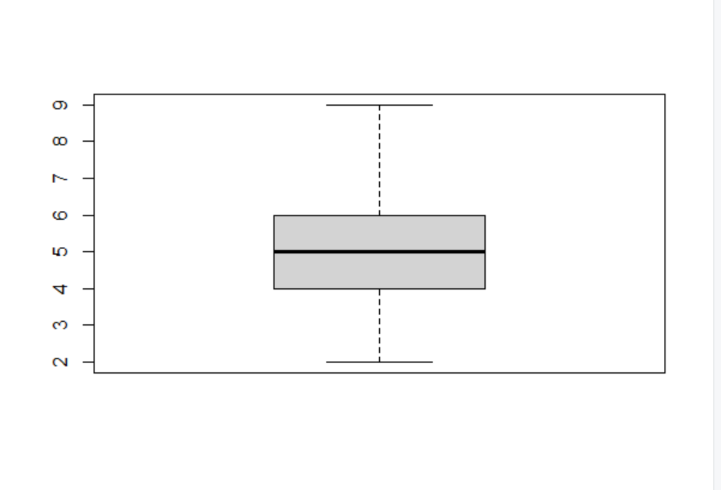
Data Preprocessing
Before removing outliers based on "HEIGHT_PERCENTAGE"
After removing outliers based on "HEIGHT_PERCENTAGE"

Slide 10
Data Visualization
After performing the pre-processing, the data was visualized using the ggplot2 library, for different measures.
Bar plot for the individual damage grade performance.
For the continuous column age and continuous area percentage, a dot plot was retrieved.
For the distribution of each attribute, a Q-Q plot was retrieved.
For the LAN surface condition, a density plot was retrieved.
For taking a measure on age, area_percentage, and height_percentage on damage_grade, we have set up violin plots.
Jitterplots have been retrieved for the land surface condition and the damage grade.

Slide 11
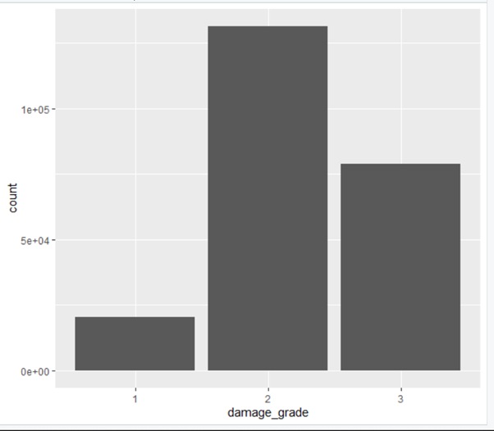
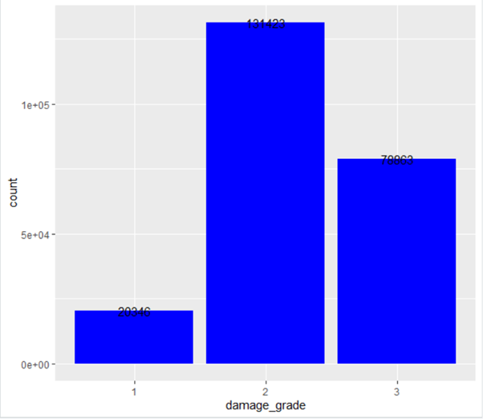
Damage Grade Performance

Slide 12
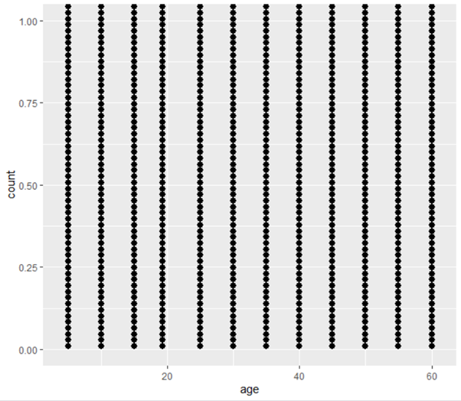
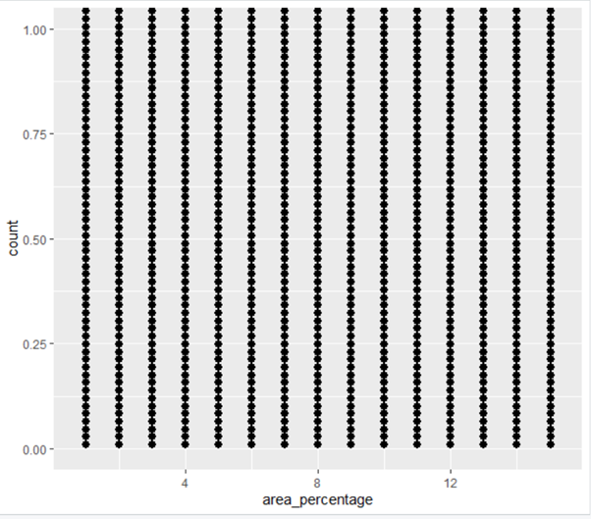
Continuous column age and continuous area percentage

Slide 13

Machine Learning Prediction Algorithms
According to the analytics that we have gathered, we then proceed to work on ML models that can predict the results.
Finally, apply the suitable algorithms that are required for the Data Set and Predict the Result.
The two algorithms that we are going to utilize for the prediction model are the Decision Tree Algorithm and the Naïve Bayes Algorithm.

Slide 14
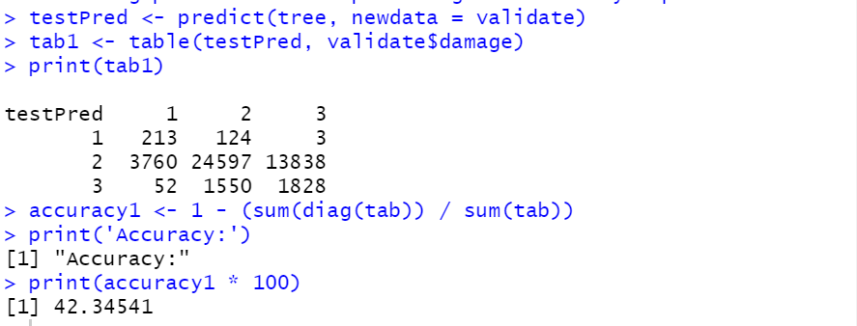
Testing predictions and providing the accuracy report

Slide 15
Decision Tree Algorithm
The Decision Tree Algorithm is a general, predictive modelling tool with applications spanning several different areas.
In general, decision trees are constructed via an algorithmic approach that identifies ways to split a data set based on various conditions.
It is one of the most widely used and practical methods for supervised learning.
In this analysis, we have used the randomforest package to perform predictions.

Slide 16
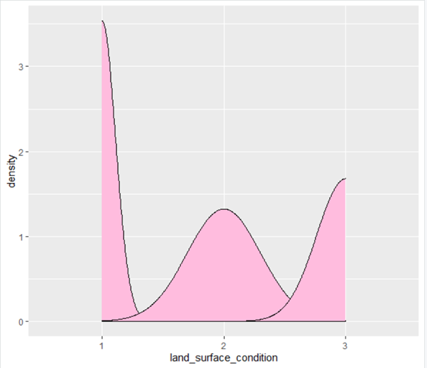
Distribution of each attribute

Slide 17
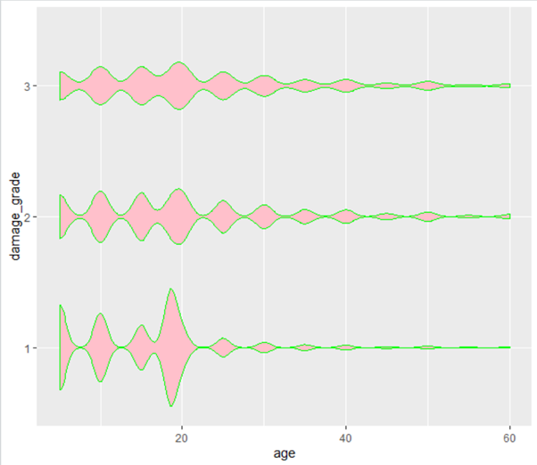
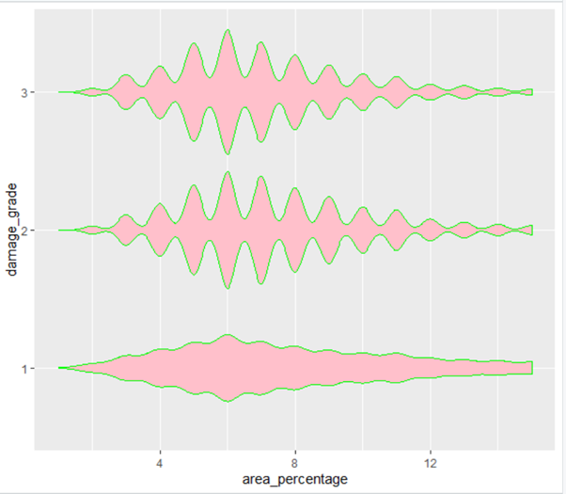

Slide 18
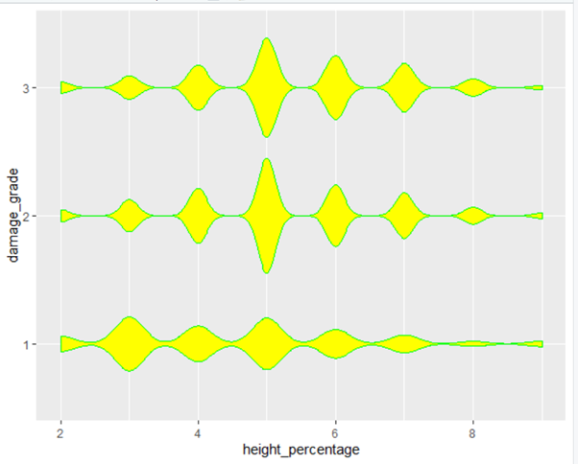
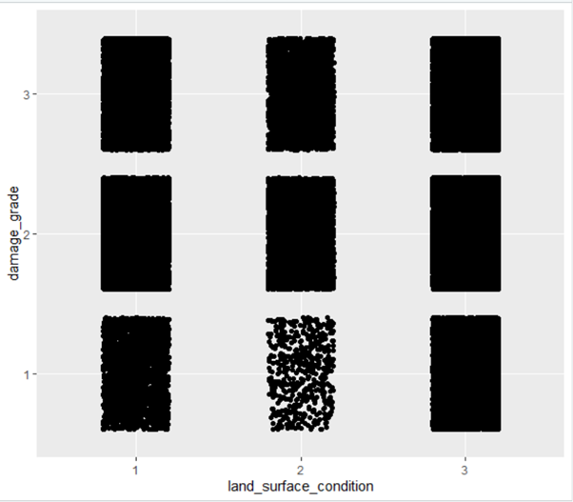
Jitter plots

Slide 19

Naïve Bayes Algorithm
The Naive Bayes Algorithm is a one of the popular classification machine learning algorithms that helps to classify the data based upon the conditional probability values computation.
It implements the Bayes theorem for the computation and used class levels represented as feature values or vectors of predictors for classification.
Naive Bayes Algorithm is a fast algorithm for classification problems.

Slide 20
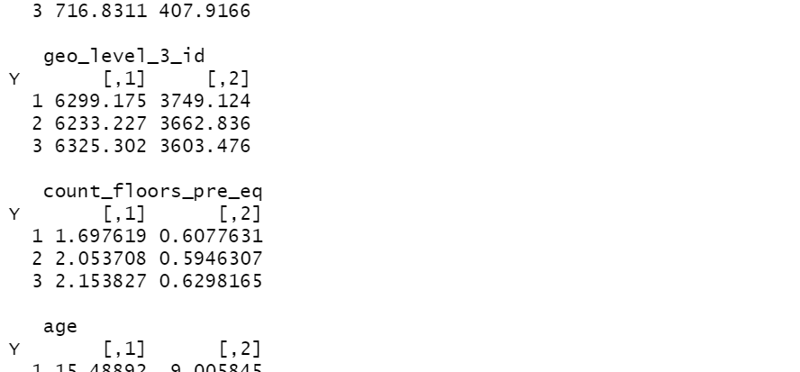
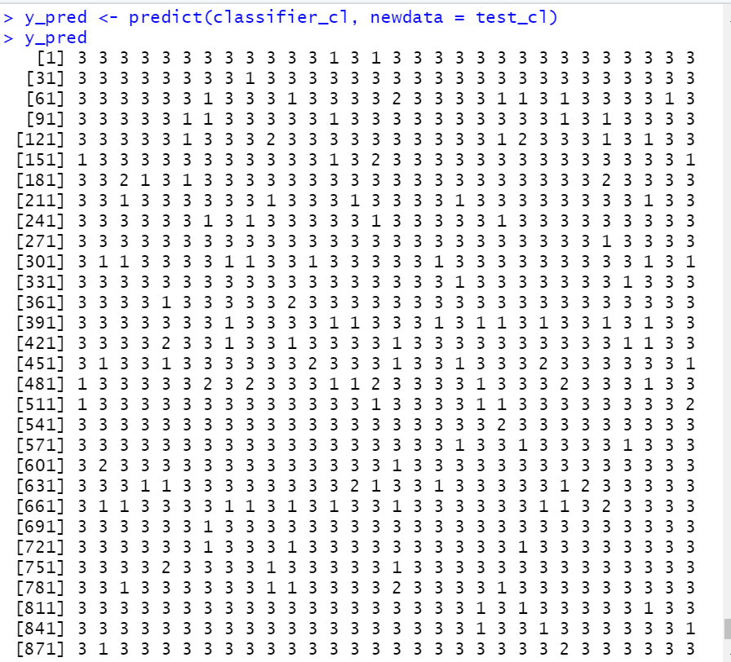
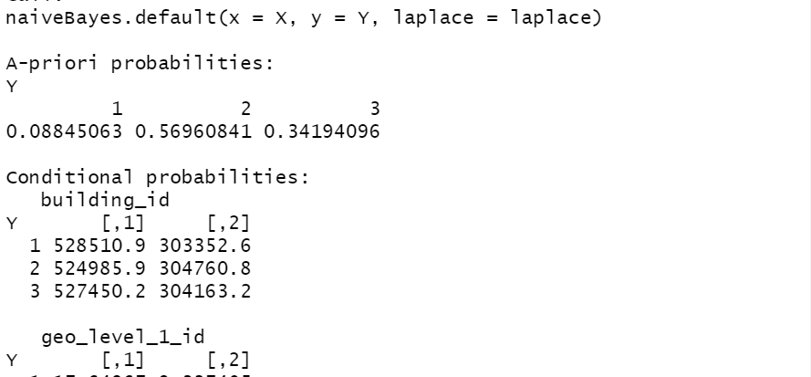
Naive Bayes Classifier for Discrete Predictors

Slide 21
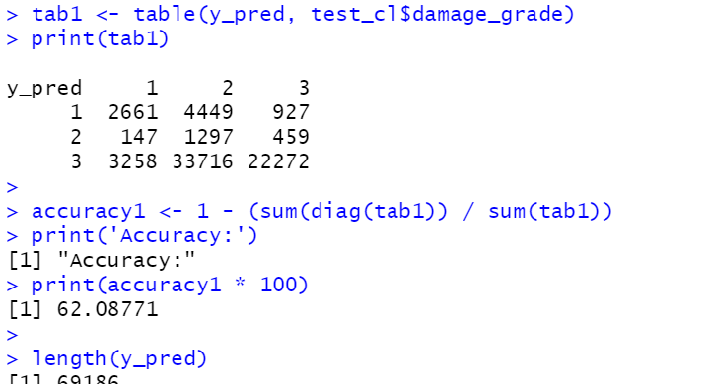
Finding Accuracy

Slide 22
Conclusion
Going through the various observations that were provided in the dataset, it became very evident that there was a pattern of repetition in the details for a few particular buildings.
Studying and parsing through the datasets, the patterns grew more evident and as a result, we decided that it would be a good idea to work on forming a prediction model using effective prediction algorithms such as the Decision Tree Algorithm and the Naive Bayes Algorithm.
The models were developed to find the accuracy from test datasets.
Overall, the prediction model was a success and this project can be used as a means to estimate the impact of any future earthquake, to assess the damage that could be caused, and take precautionary measures further ahead of time.

Slide 23
References
This project is currently being hosted at, https://github.com/dat-adi/earthquake-analysis
Dataset for the earthquake analysis was taken from Kaggle, https://www.kaggle.com/mullerismail/richters-predictor-modeling-earthquake-damage/activity
The link to the competition conducted for the analysis of this data, https://www.drivendata.org/competitions/57/nepal-earthquake/
An article on how to predict the damage to a building in Python, https://medium.com/swlh/predicting-damage-to-building-due-to-earthquake-using-data-science-e85a62adc0c0

Slide 24
Thank you!

