Slide 1
Orkanskader
EN.601.675
Machine Learning
Hurricane Damage Estimation
Fall Semester
vgadham1, mbrownr1, ywen15, rzhang89

Slide 2
Problem Statement
The impact of hurricanes and what we seek to do
Prediction & Application
The frequency and intensity of hurricanes have posed incremental challenges for coastal regions, specifically in the state of Florida. Devastating to the local economy and infrastructure.​
We seek to determine the area-of-effect for counties based on their proximity to the eye of the storm. Further leading into estimating the financial damage done by the hurricanes to residential properties.​
• Phase I: predicting the hurricane’s affected area radius based on latitude, longitude, sea level, wind speed, and pressure.​
• Phase II: estimating the damage to residential property in relation to the proximity to the eye of the storm, represented by the hurricane’s radial impact.​
Notes:
Our project idea is inspired by the news about hurricanes and the damage they caused in the state of florida and other coastal regions. We aim to predict the area of effect of hurricane and thus estimate the economic damage by counties. Doing so serves both the local residents and the insurance companies providing services to this region, as it allows them to better estimate their losses and react upon this information.

Slide 3
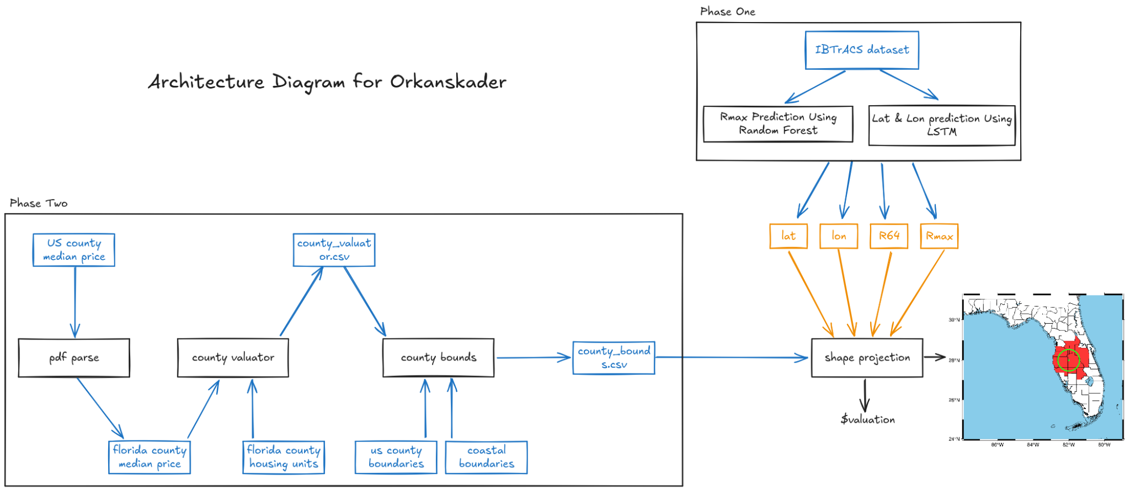
*IBTrACS stands for International Best Track Archive for Climate Stewardship
Notes:
We divided our project into two phases. In the first phase, we aim to predict the both the area of damage and the location of the hurricane in latitude and longitude from the existing data of the current hurricane. In the second phase, we will combine the output of the first phase with the housing value data to visualize the affected area and estimate corresponding damage.

Slide 4
Phase One:
Hurricane Impact Area Prediction

Slide 5
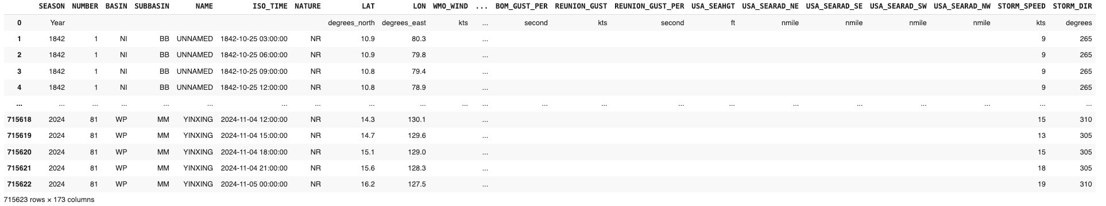
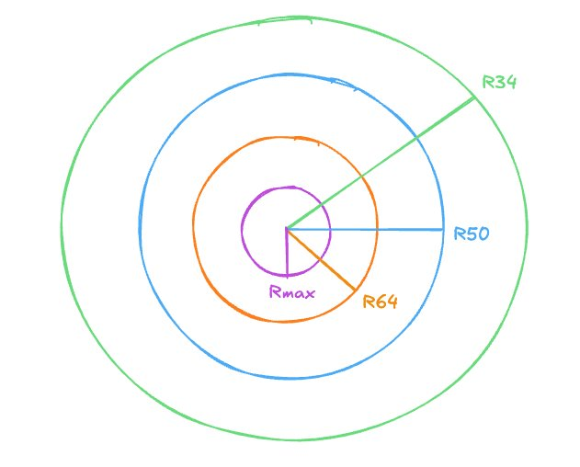
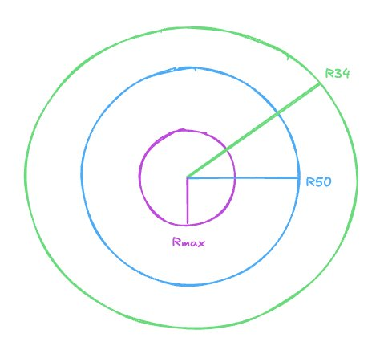
Background
Phase One
IBTrACS
Max Wind Speed >= 64 knots
Max Wind Speed < 64 knots
Notes:
We are using the dataset gathered from ibtracks hurricane dataset. Some important parameters we use are Rmax, R64, R50, and R34. If the max speed is not exceeding certain speed, then we dont have a radius for that speed.
The higher the speed, the smaller its radius
Talk about the specific feature selection in the next slide

Slide 6
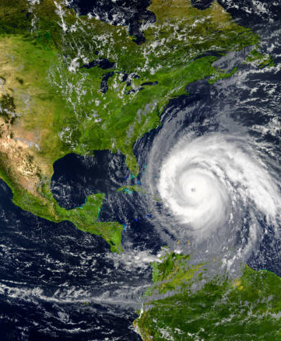
Challenges
Phase One
Missing Data; High dimension
Data missing
R64 missing when maximal wind speed < 64 - able to impute
Random missing of other parameters​ - need to remove row
Too many features
Why not PCA? Nonlinearity, low transferability
Used commonly used features from literature
Notes:
Data missing: 1. If max wind speed is below a certain range, the corresponding R will be missing, it can be fixed by setting this value to 0 as it makes intuitive sense to do so
2. Otherwise, data is missing randomly and we are not clear what caused it as we dont know about the data collection process, the only thing we can do is to remove these data since we can’t fix them in any way
Why not using pca: 1. Pca doesnt work well for non linear data(is it so? I forget)
2. The features we selected exists across different datasets, thus can be extended well
3. Compared with PCA, thus features are selected by experts and may have some meaning academically

Slide 7
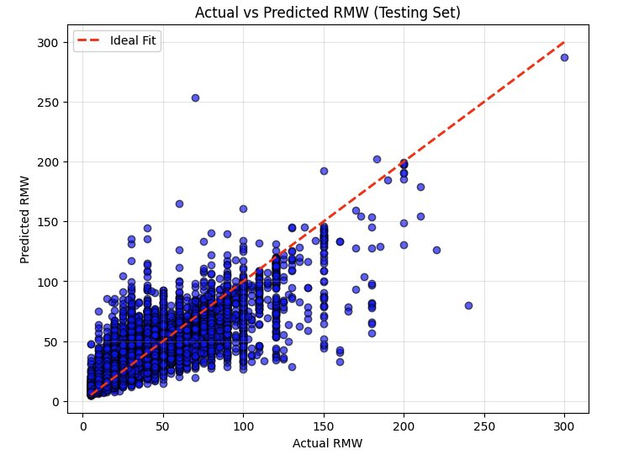
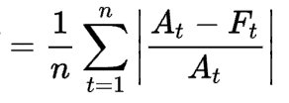
Random Forest: Direct Fit
Phase One
The attributes that were utilized or calculate for this phase are listed as below:
Features:
LAT
LON
USA_WIND
USA_R34_NE
USA_R50_NE
USA_R64_NE​
Target: ['USA_RMW']​
Data Split: ​80% Train, 20% Test
Parameters: ​n=100
*MAPE: 24.2%
*MAPE, or Mean Absolute Percentage Error, is calculated as:
Notes:
The first approach we tried is directly estimating Rmax from the features including location and wind speed using Random Forest Regression. It works better than very simple models such as linear regression as the correlation between our data is clearly non-linear. On the other hand, we prefer using a random forest over deep learning as it is more suitable for the amount of computational resource we have and the relatively small data size in our hands. As shown by the graph, we achieved a mean absolute percentage error of 24.2%.

Slide 8
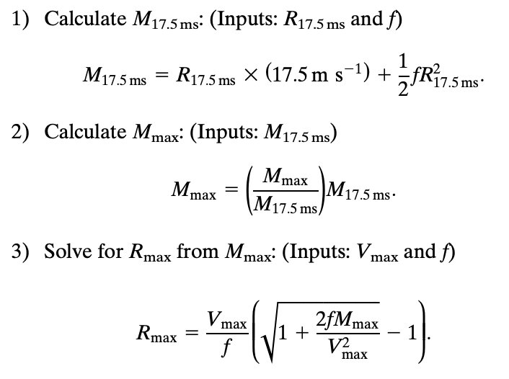
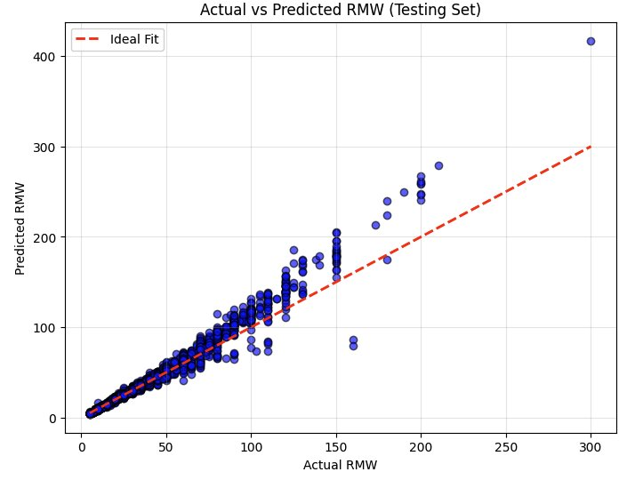
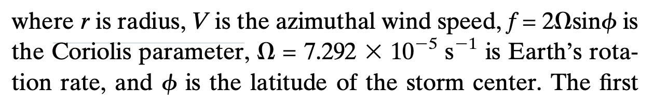
Random Forest: Formula
Phase One
Features: ['LAT','LON', 'USA_WIND','USA_R34_NE']​
Target: ['USA_RMW']​
Data Split: ​80% Train, 20% Test ​
Parameters: ​n=100 ​
MAPE: 3.6% ​
Notes:
To improve our previous prediction, we used an existing study that provides an equation to estimate R_max. From this equation, we can predict Mmax and use it to calculate Rmax, and the result is more accurate with this approach as it achieves a MAPE of 3.6%.
We further discovered that the same estimation formula can predict R64 with a similar accuracy.

Slide 9
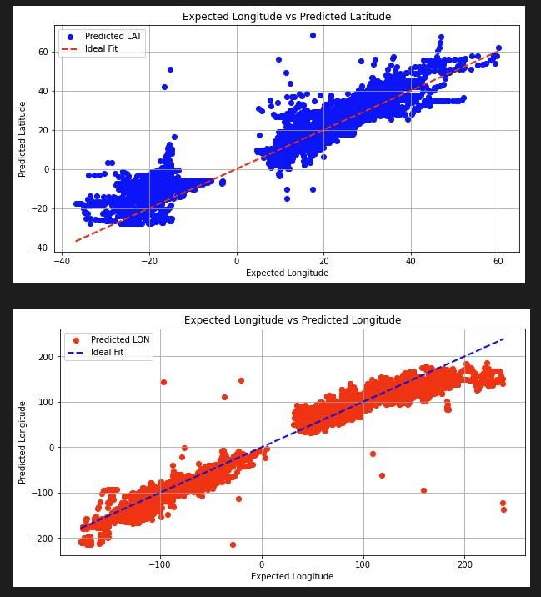
Coordinate prediction
Phase One
Predicting the next eye of the storm is of utmost importance for preparation, evacuation, and initial damage estimation.
Potential thread of investigation: Predicting the hurricane’s future lat and lon from existing data using an LSTM model.
Predicted values are linearly correlated to the actual values​.
Higher precisions needed to be useful in practice
Notes:
We also predicted the eye of the storm’s location in the next time stamp based on the past information of the hurricane such as past movements. We used the LSTM model because it remembers patterns over time, making it a good choice in this situation. Our result generally correlates with the actual values linearly. Yet we still observe some extremely far outliers and a large average deviation from the ideal fit, suggesting that higher precision is needed for our model to be useful in practice.

Slide 10
Phase Two:
Damage Estimation
Notes:
In the first phase, we predicted the range and location of the eye of the storm.
These attributes are important to start the second phase of the project, which is estimating the financial damage caused by storm from the center of the storm.

Slide 11
Challenges
Missing data: Evaluating by street or zip codes within the city was near impossible.​
Representative samples: Apartment housing and mobile homes are valued differently.​
Data unavailability: No "directly" available dataset for the financial valuation of county-based residential property. (even in SEPHER 2.0!)
Phase Two
Notes:
Initial stage; we wanted to retrieve data at the street level or atleast at the zipcode level. However, Zillow and US census dataset did not have data at the level that we wanted.
As such, we zoomed out and worked with estimating the damage at the county level.
Different kinds of houses such as apartments, mobile homes and individual houses.
Our estimations focused largely on the individual houses
Reduced the property valuation for apartment-style housing and obviated mobile homes entirely (as these do not fall into category of insured households).
Even based on county, it was difficult to find the “one dataset that meets them all”. SEPHER 2.0 came very close to it, having aggregated multiple datasets into one but in the end, we decided on merging smaller datasets to satisfy our requirements better.

Slide 12
Datasets
01
SEPHER 2.0
Measurement: Percentage%
Percentage of individual housing units
These are the datasets that have been utilized to extract attributes for visualization and damage estimation.
To solve the issue of missing data and the lack of a “one true dataset”, we decided to merge multiple datasets.
02
US County Boundaries​
Measurement: Shapefile
Shapes of all Counties in Florida​
03
Florida County Boundaries
Measurement: Shapefile
Denotes which counties are coastline
04
County Median Home Prices and Monthly Mortgage Payment
Measurement: Valuation ($)
Price of a home in a county
05
National, State, and County Housing Unit
Measurement: Census Data
All Housing Units (including apartments)
Notes:
We still utilized SEPHER 2.0 to retrieve a few statistics on the ratios of apartments and the number of mobile homes in counties affected by the storm circle.
The US County boundaries was used to retrieve the polygonal shape of the counties present within Florida.
The Florida County Boundaries dataset was used to determine which counties are coastline and thus have higher chances of being damaged by the storm.
The County Median Home Prices was utilized to retrieve the mean valuation of a home in the county.
The NSCU is used to determine the number of houses present within the county. This is further filtered out using the SEPHER dataset.

Slide 13
Assumptions
Phase Two
Median Home Prices are Gaussian variates
National Average, 62% of Housing Units are single family homes.​
Insurance Payouts are Gaussian variates of Home Value
rmax_coastal damage,
N(2.5%, 10%, #homes)​
rmax damage​
N(1.5%, 10%, #homes)
r64 damage​
N(1.0%, 10%, #homes)
Data distribution; diverse house types; insurance payout

Slide 14
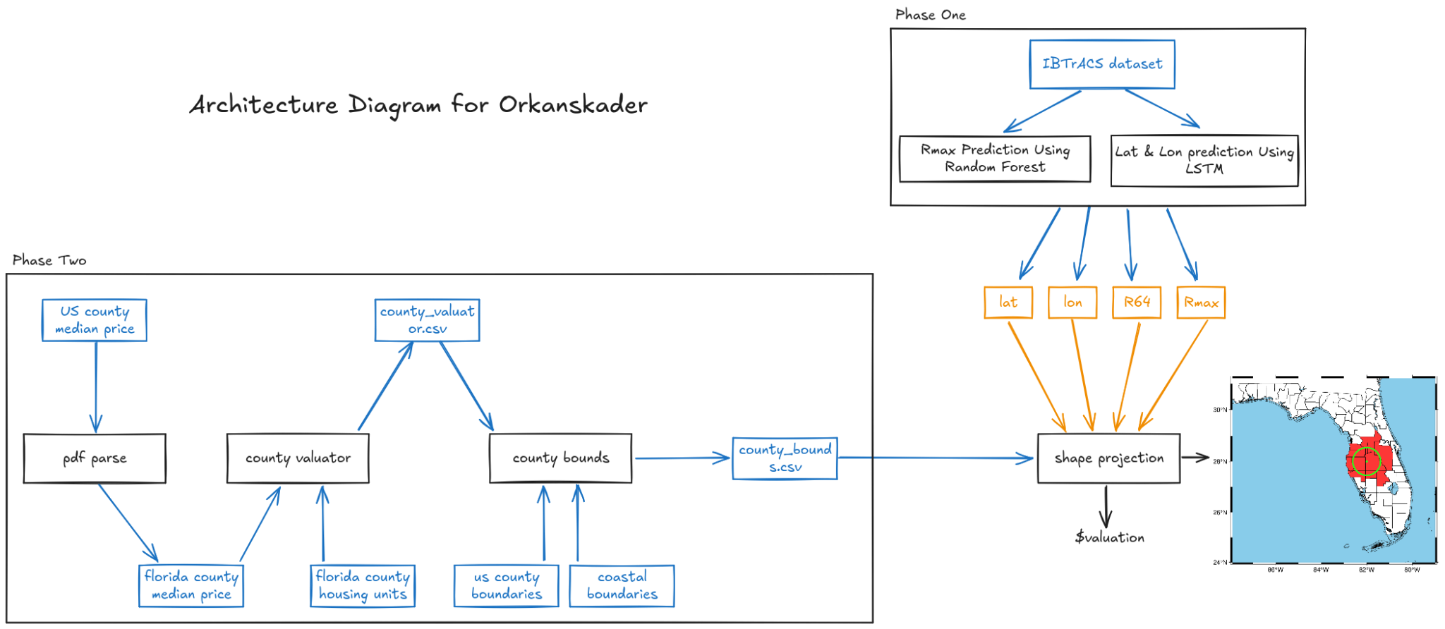

Slide 15
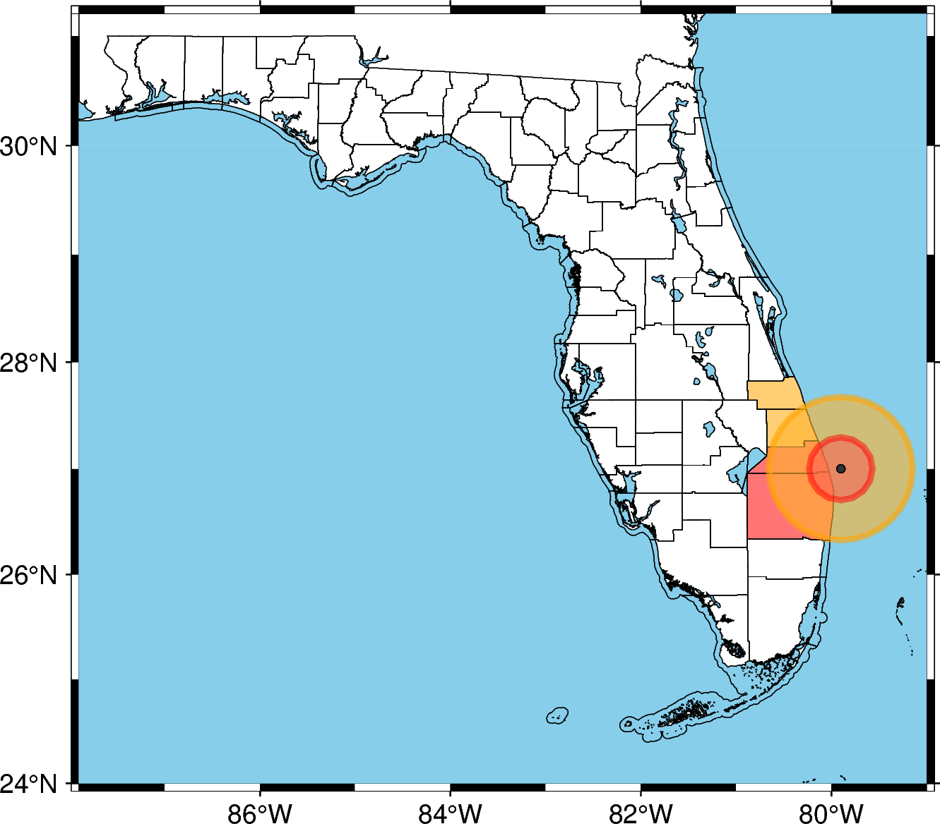
Damage Estimation and Modelling
Phase Two
Given an R_64 value and the R_max value generated from phase one, we can model predicted damage.​
Total County Valuation: $367,822,158,492.00
Total Damage: $6,678,643,324.56
Compare to Hurricane Wilma (2005): ~$19 billion dollars​

Slide 16
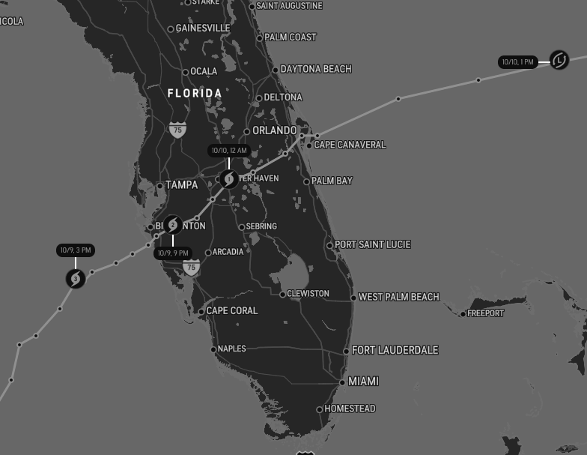
Future Scope
Phase Two
Current approach is single-point, can support time series later on.
Linkage with insurance and company claims.
Real-time prediction and valuation estimation.
Localization support with zip codes instead of counties.

Slide 17
Questions?

