Slide 1
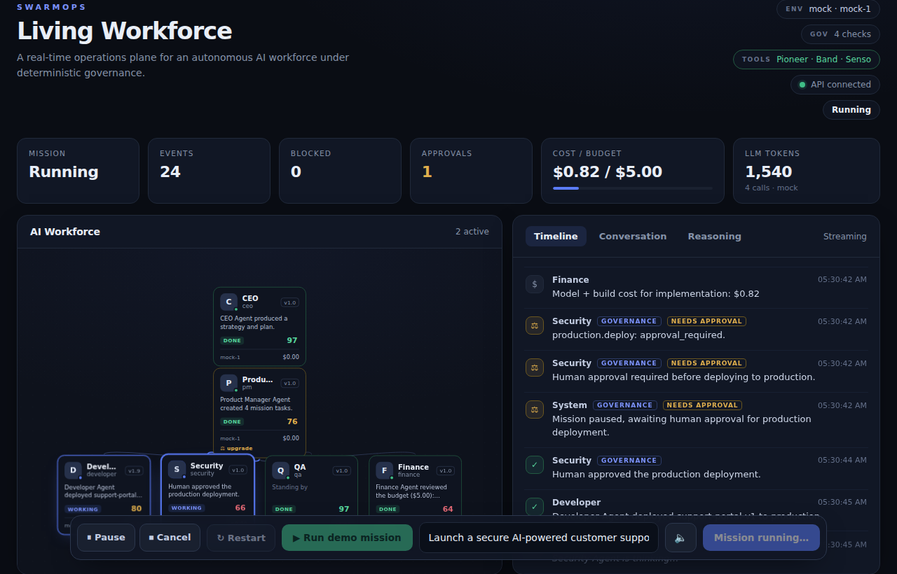
THE AI WORKFORCE OPERATING SYSTEM
SwarmOps
Govern. Audit. Evolve.
The management layer that makes an AI workforce safe to run in a real company — deterministic governance, human approvals, full audit, and safe self-evolution, above any agent runtime.
Live governance + a self-evolving AI workforce, on one control plane.
PostgreSQL
FastAPI
Next.js + React Flow
Deterministic Governance
▶ Live: swarm-ops-self-evolwing-agents-hack.vercel.app · deployed on Vercel + Render, autonomously QA'd by Replay
Built for the Self-Evolving Agents Hackathon · github.com/datAgent77/SwarmOps_self_evolwing_agents_hack
Notes:
SLIDE 1 — HOOK (~25s) AI agents are moving into the enterprise faster than anyone can govern them. They can deploy code, move money, and touch customer data — with none of the controls we demand of human employees. SwarmOps is the operating system for AI workforces: the management layer that makes an AI workforce safe to run in a real company. Govern, audit, evolve. And it's live — deployed on Vercel and Render, and QA'd by Replay.

Slide 2
THE PROBLEM
Agents are entering the enterprise — ungoverned.
!
Irreversible actions
Agents deploy code, move money, and export customer data — because the model decided to. You can't ship that to a real company.
§
No human gate, no accountability
None of the controls we demand of human employees: authority, approvals, an audit trail, or a way to say no.
↺
Ungovernable "self-improvement"
Bolt-on self-improvement means agents rewriting their own prompts or code — no audit, no human sign-off, no rollback.
That is ungovernable — and unsafe.
Notes:
SLIDE 2 — THE PROBLEM (~30s) Multi-agent systems are impressive — right up until an agent does something irreversible: deploys to production, exports customer data, blows a budget, because the model decided to. You can't ship that to a real company. And bolt-on "self-improvement" usually means agents rewriting their own prompts with no audit, no human gate, no rollback. That's ungovernable, and unsafe.

Slide 3
THE SOLUTION
Deterministic governance. A living workforce.
1
Mission
A six-agent AI company takes a real objective
2
Agents reason
Plan, build, review — via any LLM provider
3
Governance · no LLM
A pure policy engine decides: allow · approve · block
4
Enforce + persist
Deterministic governance decides
Deploys pause for a human; exports are blocked
✓
No LLM, no randomness in the enforcement path.
✓
The backend is the source of truth
5
Audit → live dashboard
Refresh anytime — nothing is lost.
Append-only trail in Postgres, streamed live
Everything is auditable
✓
Every action, decision & approval is an immutable event.
Notes:
SLIDE 3 — THE SOLUTION / DEMO (~45s) Six AI agents — CEO, PM, Developer, Security, QA, Finance — run a real mission: launch a secure support portal. They reason and hand off to each other, but every governed action passes through a deterministic policy engine with no LLM in the path. Watch: the Developer wants to deploy to production — the mission pauses for a human. I approve, it deploys. Then an agent tries to export the customer database — blocked instantly, and audited. Three guarantees: deterministic governance decides, Postgres is the single source of truth, and everything is an immutable, auditable event. TIP: pause on the approve and the block — your strongest beats. Show the live demo or video here.

Slide 4
WHY IT'S SELF-EVOLVING — AND WHY THAT'S SAFE
The workforce improves itself — safely.
How it rewards itself
Why it's safe
Measure
Agents can never touch executable code
1
✓
A deterministic evaluator scores each agent 0–100 from persisted mission data — not the agent grading itself.
Evolution writes config data rows only — no code generation.
Detect weakness
Versions are immutable
2
✓
Penalties for blocked actions, needed approvals, retries, cost.
A new version is a new row; nothing is overwritten.
Propose a data-only fix
High-risk change requires a human
3
✓
Maps the weakness to a concrete config change — never code.
Same governance gate as a production deploy.
Govern the upgrade
Reversible & auditable
4
✓
Immutable new version; high-risk needs human approval.
Full history; rollback to any legitimate version; every step logged.
Behind resilient, pluggable adapters:
Pioneer · routing
Band · comms
Senso · context
cited.md · publish
Notes:
SLIDE 4 — SELF-EVOLVING & SAFE (~40s) The moment a mission ends, the workforce grades itself — a deterministic evaluator scores each agent from real data, finds weaknesses, and proposes a fix. The important part: it's safe by design. Agents can never touch executable code — evolution only writes config data. Every version is immutable. High-risk changes need the same human approval as a production deploy. Everything is reversible and auditable. The workforce improves over time, but can never become the thing that breaks.

Slide 5
TOOL USE — HOW WE USE EACH SPONSOR
Each sponsor owns a part of the governed loop.
REASON
COORDINATE
REMEMBER
PUBLISH
Pioneer
Band
Senso
cited.md
Adaptive inference — 50+ models from one endpoint, improving over time.
Agentic mesh — agents live in chatrooms and talk via @mentions.
Context OS — a programmable knowledge base for agents.
Endpoint for the agentic web — agents publish verifiable, cited content.
We use it: Every agent reasons through Pioneer (adaptive routing).
We use it: Inter-agent conversation + governance events mirrored to a Band room.
We use it: Ingest mission artifacts; retrieve verified context into agent memory.
We use it: Publishes the audit-grounded mission report — a real, verifiable action.
providers/llm/pioneer.py
providers/comms/
providers/context/
publishing/ · providers/publish/
Deployed & QA'd — live on Vercel + Render, and autonomously tested by Replay QA on the real deployment (5th sponsor tool). Every integration is key-gated, so a sponsor outage never breaks a mission.
Notes:
SLIDE 5 — TOOL USE (~40s) Every part of this loop uses a sponsor tool. Agents reason through Pioneer's adaptive inference, coordinate over Band, and pull verified context from Senso. When a mission finishes, they take a real action — publishing an audit-grounded report to cited.md, where every governance line cites its policy. Each integration sits behind a resilient adapter, so a sponsor outage never breaks a mission. And we deployed it live and ran Replay's autonomous QA on the real app. Five sponsor tools, in production.

Slide 6
WHERE THIS GOES
The management layer for the AI workforce.
NOW
NEXT
FUTURE
Governed AI Workforce
Enterprise Workforce Management
Multi-company Platform
Deterministic governance, human approvals, full audit, safe self-evolution — for one AI company.
Auth, roles & multi-tenant authorization; workforce analytics; approval routing; org-wide audit.
A governance & analytics plane across many orgs and any agent runtime — the OS for the internet of agents.
Self-improving, measurable, reversible — and governed the whole way down.
Live: swarm-ops-self-evolwing-agents-hack.vercel.app
github.com/datAgent77/SwarmOps_self_evolwing_agents_hack · 69 backend tests · deterministic governance · immutable, governed evolution
Notes:
SLIDE 6 — VISION / CLOSE (~30s) Where does this go? Today, a governed AI workforce for one company. Next, enterprise workforce management — auth, roles, analytics. Ultimately, a governance plane across many organizations and any agent runtime — the OS for the internet of agents. SwarmOps: self-improving, measurable, reversible — and governed the whole way down. Thank you. ========================= Q & A ========================= Q: Deterministic governance — no LLM? Yes: pure function, no LLM / randomness. The model proposes; it can never approve or bypass. Same input -> same decision. Q: Self-modifying AI — is it safe? Agents never touch executable code; evolution writes config data rows only. Versions are immutable; high-risk needs human approval; all reversible + logged. Q: Can agents game their own scores? No — a deterministic evaluator scores from the immutable audit trail (what actually happened), not the agent's self-report. Q: You ran on Mock — real models? Provider-agnostic behind one interface (Claude/OpenAI/Gemini/Pioneer/Mock); any real provider drops in with one env var. Q: Real vs scripted? Reasoning, scoring, and evolution are real and data-driven; only the mission objective + governed action set are fixed for a reliable demo. Q: Diff vs CrewAI / AutoGPT / LangChain? Not a competing framework — the governance & management layer ABOVE any runtime. You can run CrewAI underneath it. Q: Production-ready? Hackathon-scoped (no auth/multi-tenancy yet, single process), but the core governance/audit/evolution is real and covered by 69 backend tests. Roadmap: auth, roles, multi-tenant analytics. Q: Sponsor outage mid-mission? Every sponsor sits behind a resilient adapter with a local fallback; the mission always completes (proven by a test). Q: Is the cited.md report trustworthy? Grounded entirely in the Postgres audit trail; every governance line cites the exact policy it enforced — verifiable by construction. Q: What did Replay find? 6 user journeys, 5 low-severity accessibility/contrast findings, no functional bugs. Q: Who's the customer? Any company deploying autonomous agents that take real actions — needs the same controls for AI employees as for humans: authority, approvals, audit, safe improvement.

