Slide 1
Exploring Undergraduate Peer Mentors’ Creativity in Mathematical Task Development
Nathan N. Alexander Assistant Professor, Department of Curriculum and Instruction, School of Education Assistant Professor, Program in Data Science, Center for Applied Data Sciene and Analytics (CADSA)

Slide 2
“Each One, Teach One”
Part of a book project focused on students’ transition from high school to colleg
Based on six years of research at an all-male liberal arts college in the United States
Culturally relevant pedagogy as noted by Ladson-Billings (2014)

Slide 3
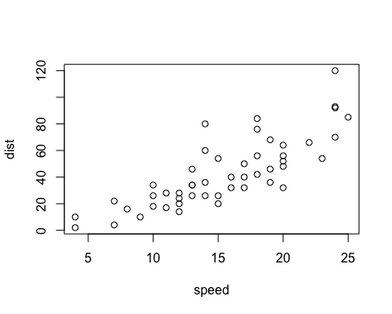
A scatterplot.

Slide 4
Mathematical matter
Typical matter (TM)
Everyday matter (EM)
Contextual matter (CM)

Slide 5
Network theory
Small world networks: How a network can be formed that has low average path length yet still has high clustering.
$N$ nodes
$m$ neighbors per node
$M$ is the number of links

Slide 6
Parameters
Beta is the probability of rewiring each link
Randomly choose beta x $M$ link.

Slide 7
Characteristics
Low average distance
High clustering
Small world networks can be characterized as having low average distance between nodes but high clustering.
Research question: Does a collaborative community of undergraduates exhibit the features of a small world network?

Slide 8
References
Ladson-Billings, G. (2014). Culturally relevant pedagogy 2.0: Aka the remix. Harvard Educational Review, 84(1), 74–84.

