Slide 1
DATA 202 - Week 2
Foundations Nathan Alexander, PhD

Slide 2
Part I: Context

Slide 3
What is statistics?
Statistics is a science. As a result, it follows a set of well-defined steps or methods. As we explore new terms and definitions, we will gain a better understanding of what statistics encompasses.
DEFINITION: Statistics
Statistics is the science of collecting, organizing, analyzing, interpreting, communicating, and visualizing data and information.
There are a multitude of ways to describe the steps, terms, and various processes undertaken in a statistical study. Importantly, statistics calls for questions where we explore difference or change. We use variation to understand differences within or between a set (or sets) of measurements.

Slide 4
Notes from Pelham (2013) reading
“Statistics are a set of mathematical procedures for summarizing and interpreting observations” (p.5).
Descriptive statistics vs. Inferential statistics
Pelham describes descriptive statistics as “statistics used to summarize or describe a set of observations”, whereas inferential statistics are defined as “statistics used to draw inferences about a set of observations” (p. 5).

Slide 5
Descritpve measures
Central tendency: the “average” of a set of observations (i.e., mean, median, mode)
Dispersion: how data vary (i.e., range, variance, standard deviation)
EXAMPLE – entering values in R
Assume we have a small set of data: 2, 2, 4, 4. We can input and compute this data in R using the following code:
# Generate sample data x <- c(2, 2, 4, 4)

Slide 6
# compute the mean m = sum(x)/4 m
[1] 3

Slide 7
# compute the median median(x)
[1] 3

Slide 8
# compute the mode mode(x)
[1] "numeric"
table.x <- table(x) table.x
x 2 4 2 2

Slide 9
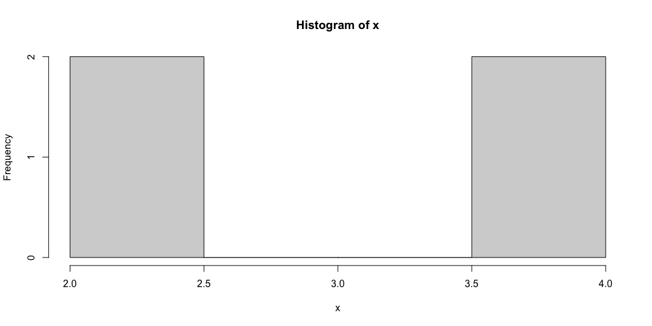
# create a histogram hist(x)

Slide 10
You also may recall the standard deviation, $S$, of a set of values is calculated using:
$$S=\sqrt{\frac{Σ{\left(x−m\right)}^{2}}{n}}$$
EXAMPLE – Standard deviation of a set
Assume we have a small set of data: 2, 2, 4, 4. Using the formula for standard deviation above, where $x$ is the score, $m$ is the mean (sometimes referred to as $\overset{‾}{x}$), and $n$ is the sample size, we get the following:
$$\frac{{\left(2−3\right)}^{2}+{\left(2−3\right)}^{2}+{\left(4−3\right)}^{2}+{\left(4−3\right)}^{2}}{4}=\frac{1+1+1+1}{4}=1$$
Most formulas of this nature are programmed into R/RStudio, but for more advanced modeling, we learn how to input raw data and formula into the software.

Slide 11
Inferential measures
Pelham notes that “the basic idea behind inferential statistical testing is that decisions about what to conclude from a set of research findings need to be made in a logical, unbiased fashoion” (p. 13). However, with a more critical lens on the development of statistics and some of the assumptions made in the mathematical models, we need to consider more concretely about the role of theory and context in making inferences about data.

Slide 12
What should it mean to be critical in the context of statistics?
Notes from Duncan (n.d.) reading.
On Canvas, in the Week 2 folder, there is a document titled “Critical Thinking” by Jennifer Duncan. This document is one example of how we can frame what it could or should mean to be critical in statistics. Please review this document.

Slide 13
Using a higher order of thinking. Duncan emphasizes that critical thinking is a higher order of thinking with different advanced thinking skills, and offers a few suggestions.
We base our thinking on logic and not on feelings.
We should look deeper into inferences for hidden assumptions or values.
Ask complex questions that help build a critical inquiry.

Slide 14
Asking complex questions. Duncan breaks down the process into a few sub-questions.
Who is the implied audience?
What are the strengths and weaknesses of the argument?
What are the underlying assumptions and values?

Slide 15
Using a variety of thinking processes. Duncan defines a process around analyzing, synthesizing, interpreting, and evaluating information that helps with our thinking.

Slide 16
Reflecting on how we answer a question. Duncan ends with a set of questions that help us think about different points of view, if we have clarity, and if more details are needed.

Slide 17
Part II: Content

Slide 18
The quantification of information can help us understand and represent important situations. We’ll begin by exploring the concept of a set, and how it is defined in mathematics and used to frame various situations.

Slide 19
DEFINITION: Set
A set is a well-defined collection of elements or items.
A set is characterized by its contents, or what is generally referred to as a set’s elements. If we are given two sets, the sets are considered equal if and only if they have exactly the same elements. The basic relation for sets is that of membership in a particular set.
We write $x∈X$ to indicate that the object $x$ is an element (or member) of the set $X$.

Slide 20
A FEW IMPORTANT NOTES:
Note 1: We tend to label sets using capital letters.
For example, we may label two different sets as $X$ and $Y$ or as $A$ and $B$.
Note 2: We use curly brackets { and } to enclose the elements of a set.
Parentheses ( and ) are often used to indicate a point like $\left(x,f\left(x\right)\right)$ or an open interval
Square brackets [ and ] are often used to separate sets or to indicate a closed interval.
Note 3: We tend to list the elements of a set using lower case letters with subscripts, $x_{i}$.
The $i$ in $x_{i}$ is a subscript that is used as a “position indicator,” with $i=1,2,3,...$
We use subscripts to index the elements of a set: $X=\{x_{1},x_{2},...,x_{n}\}$ and $A=\{a_{1},a_{2},...,a_{n}\}$.

Slide 21
EXAMPLES – Sets as a collection of elements or items
Sets can be defined in many different ways.
Consider a set of electronics $E$ = {laptop, phone, tablet, watch} = $\{e_{1},e_{2},e_{3},e_{4}\}$
Consider a set of friends $F$ = {Akeah, Brandon, Cris, Daveon, Evelyn}
Consider a set of numbers $N=\{1,2,3,...\}$ = $\{n_{1},n_{2},n_{3},...\}$, so $n_{1}=1$, $n_{2}=2$, …
Consider a set of sets $S$ = {{laptop, phone, tablet, watch}, {1, 2, 3, …}, …}

Slide 22
Quantifying elements of a set allows us to perform mathematical operations on those elements.
Together, the elements and operations combine to create equations, functions, and models that help us understand and communicate details about the elements of a set – which is a form of data.
We will need a host of math concepts. The different sets of numbers can be a fun starting point.

Slide 23
Sets and numbers
DEFINITIONS: Sets of numbers
– Natural numbers: $N=\{1,2,3,...\}$
– Whole numbers: $N_{0}=\{0,1,2,3,...\}$
– Integers: $Z=\{...,−3,−2,−1,0,1,2,3,...\}$
– Rational numbers: $Q=\left\{\frac{p}{q},p∈Z,q∈Z,q≠0\right\}$

Slide 24
DEFINITIONS: Sets of numbers, continued…
Irrational numbers
any number that is not a rational number; irrational means not rational (no ratio)
e.g., you may know some irrational numbers such as $π$, $\sqrt{2}$, $\sqrt{3}$, $e$ (Euler’s number)
Real numbers: $R$
The set of numbers on the real number line
This set is constructed by combining the rational and irrational numbers
Imaginary numbers: $I$
a number that has a negative value when it is squared
$i$ is the unit imaginary number, $\sqrt{−1}=i$ by definition
so $i$ is a complex number since $i^{2}=−1$
Complex numbers: $C$
a number in the form $a+bi$ where $a∈R$, $b∈R$, and $i$ is an imaginary number

Slide 25
Part III: Code

Slide 26
Getting started in RStudio
In Lab 0, you downloaded and installed base R and RStudio. In this section, we will learn more about R and RStudio.
Let’s start with a little fun!

Slide 27
First, install the ‘praise’ package.

Slide 28
Next, load the library for the ‘praise’ package.

Slide 29
Now, get some praise!
You can keep inserting the code above to get praise when you need it!

Slide 30
Arithmetic in R
We will learn how to calculate values in R.

Slide 31
[1] 3

Slide 32
[1] -1

Slide 33
[1] 12

Slide 34
[1] 0.8

Slide 35
[1] 5050

Slide 36
Variables in R
We will learn to give a variable (or character) a value.

Slide 37
Use the different assignment operators
[1] 2

Slide 38
Set x equal to two added to three
[1] 5

Slide 39
Set y equal to two minus three
[1] -1

Slide 40
Set z equal to two times three
[1] 6

Slide 41
Overwrite the value of y by setting y equal to x divided by z
[1] 0.8333333

Slide 42
Important
Paper 1 is due on Monday September 16 at 11:59pm ET

Slide 43
In the next module, we will continue our explorations in R by learning how to load data sets into our data frame, and perform some basic operations using some additional packages. These packages will allow us to consider how we can construct original data sets to develop unique questions for our analysis.

Slide 44
References

