Slide 1
DATA 202 - Week 2
Foundations Nathan Alexander, PhD

Slide 2
Part I: Context

Slide 3
What is Statistics?
Statistics is a science. As a result, it follows a set of well-defined steps or methods. As we explore new terms and definitions, we will gain a better understanding of what statistics encompasses.
DEFINITION: Statistics
Statistics is the science of collecting, organizing, analyzing, interpreting, communicating, and visualizing data and information.
There are a multitude of ways to describe the steps, terms, and various processes undertaken in a statistical study. Importantly, however, modern statistics calls for more critical questions where we explore difference or change within specified contexts. We then use theory and concepts of variation to understand differences within or between a set (or sets) of measurements, resulting in a more critical orientation to statistics.

Slide 4
What is Critical Statistics?
In popular media, we might see information reported as follows:
In 2022, college enrollment for 18-24 year-olds in the United States was 39%, a two percent decrease from 41% in 2012. The enrollment rate for those aged 18-24 in 2022 who were Black was 36%, which was lower than the rates for Asian students, which was 61%, and White students, which was 41%.
The data above is from the U.S. National Center for Education Statistics (NCES). While reading the paragraph, what were some of your opinions? What questions did you have?
How was enrollment defined and measured?
Should the differences be viewed as significant in some way?
Do the percents mean that some students are less likely to go to college?

Slide 5
In traditional statistics, a quantitative research question is answered using the scientific method. A traditionalist may blindly follow the steps of this method, focusing on model selection and assumptions while also ignoring any broader social and historical contexts.
In the social sciences, for example, statistics continues to be used to perpetuate negative stereotypes – which does not simply give it a bad rap but it results in real-world harm to communities. Does this mean we are just in need of critical statistics?

Slide 6
Example: Challenging Statistics in Media
The American sitcom A Different World challenged negative stereotypes associated with Black youth and families regarding the pursuit of higher education. By portraying a vibrant college life at Hillman, a predominately Black college in the U.S., the series highlighted the importance of education as a priority within the Black community.
Image of ‘A Different World’ cast
Image of ‘A Different World’ cast

Slide 7
Practice
In a discussion about the U.S. college enrollment rate of Black 18-24 year-olds, your colleague Rachel cites Bill Cosby and two shows that he produced, A Different World and The Cosby Show, as important examples to combat deficit racial stereotypes. However, during the discussion, another colleague mentions how Bill Cosby was found guilty of aggravated indecent assault and sexual predation, and mentions that we have to be mindful of the work we cite and the persons responsible for producing the work. The colleague states that ``one problematic case should not be combated with another problematic case” referring to Cosby; Rachel disagrees. Both colleagues ask for your opinion on the discussion. How might you respond?

Slide 8
A Different World of Statistics
The idea of traditional statistics vs. non-traditional statistics may mean, on the surface at least, that we are in need of a critical statistics, and fast. But what if this dichotomy is a false one? What other pathways exist? Pathways of refusal? Pathways of exploration?
We will make attempts to reside in the space between refusal and exploration, as two key aspects of what we will come to know as critical statistics. By employing a practice of refusal, we will have space to refuse harmful beliefs and scientific practices. In the spirit of learning, we will also explore the potential benefits (and drawbacks) of critical statistics.
Traditional approaches to statistics
Critical approaches to statistics require interdisciplinary thinking.

Slide 9
Traditional approaches to statistics in some areas of study, like the environmental sciences, provide important information about changes and differences in global patterns. In other areas of study, such as education and the social sciences, statistics has a different history.
In the specific case of U.S. college enrollment rates, you may be concerned with some broader questions about data in the education sciences. In the spirit of exploration, you might ask:
Should we interpret these enrollment statistics as indicative of broader societal issues affecting access to higher education?
What are the historical and systemic barriers that could explain the differences in enrollment rates among students?

Slide 10
Alternatively, in the spirit of refusal, some different questions come to the surface:
What beliefs underlie the analysis of college enrollment rates?
What assumptions are being made when quantifying educational pathways?
How does rejecting conventional racial comparisons challenge power dynamics?
This second set of questions, as early examples of a practice of refusal, encourage your critical thinking in a few ways. First, the questions ask you to think about the less explicit components of the paragraph. Second, the questions present an option to reject conventional approaches to how we measure educational outcomes and ask why. Third, and to the seeming contradiction between refusal and exploration, a set of new pathways arise.

Slide 11
Practice
Bad Stats (or BS), outlined by Professor Ivory Toldson, are data points that are poorly contextualized, generally negative, and they are often incomplete or incorrect. They are part of a problematic trend in which statistics are used to reinforce negative stereotypes. Identify two examples of Bad Stats in popular media.

Slide 12
Part II: Content

Slide 13
The Big Picture
Pelham (2013) defines “statistics [as] a set of mathematical procedures for summarizing and interpreting observations” (p.5). Pelham describes descriptive statistics as “statistics used to summarize or describe a set of observations”, whereas inferential statistics are defined as “statistics used to draw inferences about a set of observations” (p. 5).
Some key concepts:
Population parameter: A numerical characteristic of an entire population, often unknown and estimated using sample data.
Sample statistic: A numerical value calculated from a sample to estimate a population parameter.
Confidence interval: A range of values that likely contains an unknown population parameter, calculated with a specified level of confidence.
Hypothesis test: A statistical method to make inferences about a population parameter based on sample data, involving null and alternative hypotheses.

Slide 14
Analysis of Variance (ANOVA): A statistical technique used to compare means across multiple groups, typically used when there are three or more categories of a single variable.
Multiple comparisons: Statistical procedures used to control the family-wise error rate when making several simultaneous inferences or comparisons.
Interaction effects: A situation in statistics where the effect of one variable on an outcome depends on the value of another variable.
Correlation: A statistical measure that describes the strength and direction of the linear relationship between two variables.
Regression: A statistical method used to model the relationship between a dependent variable and one or more independent variables.
Chi-square tests: Statistical tests used to determine if there is a significant association between categorical variables or if observed frequencies differ from expected frequencies.

Slide 15
Descriptive measures
Measures of central tendency: These describe the “average” or central value of a set of observations.
Mean: The arithmetic average of all values
Median: The middle value when data is ordered
Mode: The most frequently occurring value
Measures of dispersion: These describe how data vary or spread out from the central tendency.
Range: The difference between the maximum and minimum values
Variance: The average of squared deviations from the mean
Standard deviation: The square root of the variance

Slide 16
EXAMPLE – entering values in R
Assume we have a small set of data: 2, 2, 4, 4. We can input and compute this data in R using the following code:
# Generate sample data x <- c(2, 2, 4, 4)

Slide 17
# compute the mean m = sum(x)/4 m
[1] 3

Slide 18
# compute the median median(x)
[1] 3

Slide 19
# compute the mode mode(x)
[1] "numeric"
table.x <- table(x) table.x
x 2 4 2 2

Slide 20
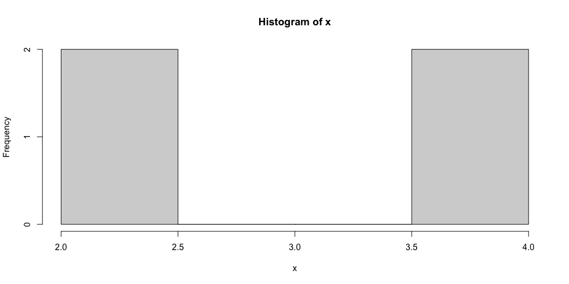
# create a histogram hist(x)

Slide 21
You also may recall the standard deviation, $S$, of a set of values is calculated using:
$$S=\sqrt{\frac{Σ{\left(x−m\right)}^{2}}{n}}$$
EXAMPLE – Standard deviation of a set
Assume we have a small set of data: 2, 2, 4, 4. Using the formula for standard deviation above, where $x$ is the score, $m$ is the mean (sometimes referred to as $\overset{‾}{x}$), and $n$ is the sample size, we get the following:
$$\frac{{\left(2−3\right)}^{2}+{\left(2−3\right)}^{2}+{\left(4−3\right)}^{2}+{\left(4−3\right)}^{2}}{4}=\frac{1+1+1+1}{4}=1$$
Most formulas of this nature are programmed into R/RStudio, but for more advanced modeling, we learn how to input raw data and formula into the software.

Slide 22
Inferential measures
Pelham notes that “the basic idea behind inferential statistical testing is that decisions about what to conclude from a set of research findings need to be made in a logical, unbiased fashoion” (p. 13). However, with a more critical lens on the development of statistics and some of the assumptions made in the mathematical models, we need to consider more concretely about the role of theory and context in making inferences about data.

Slide 23
What should it mean to be critical in the context of statistics?
Notes from Duncan (n.d.) reading.
On Canvas, in the Week 2 folder, there is a document titled “Critical Thinking” by Jennifer Duncan. This document is one example of how we can frame what it could or should mean to be critical in statistics. Please review this document.

Slide 24
Using a higher order of thinking. Duncan emphasizes that critical thinking is a higher order of thinking with different advanced thinking skills, and offers a few suggestions.
We base our thinking on logic and not on feelings.
We should look deeper into inferences for hidden assumptions or values.
Ask complex questions that help build a critical inquiry.

Slide 25
Asking complex questions. Duncan breaks down the process into a few sub-questions.
Who is the implied audience?
What are the strengths and weaknesses of the argument?
What are the underlying assumptions and values?

Slide 26
Using a variety of thinking processes. Duncan defines a process around analyzing, synthesizing, interpreting, and evaluating information that helps with our thinking.

Slide 27
Reflecting on how we answer a question. Duncan ends with a set of questions that help us think about different points of view, if we have clarity, and if more details are needed.

Slide 28
The quantification of information can help us understand and represent important situations. We’ll begin by exploring the concept of a set, and how it is defined in mathematics and used to frame various situations.

Slide 29
DEFINITION: Set
A set is a well-defined collection of elements or items.
A set is characterized by its contents, or what is generally referred to as a set’s elements. If we are given two sets, the sets are considered equal if and only if they have exactly the same elements. The basic relation for sets is that of membership in a particular set.
We write $x∈X$ to indicate that the object $x$ is an element (or member) of the set $X$.

Slide 30
A FEW IMPORTANT NOTES:
Note 1: We tend to label sets using capital letters.
For example, we may label two different sets as $X$ and $Y$ or as $A$ and $B$.
Note 2: We use curly brackets { and } to enclose the elements of a set.
Parentheses ( and ) are often used to indicate a point like $\left(x,f\left(x\right)\right)$ or an open interval
Square brackets [ and ] are often used to separate sets or to indicate a closed interval.
Note 3: We tend to list the elements of a set using lower case letters with subscripts, $x_{i}$.
The $i$ in $x_{i}$ is a subscript that is used as a “position indicator,” with $i=1,2,3,...$
We use subscripts to index the elements of a set: $X=\{x_{1},x_{2},...,x_{n}\}$ and $A=\{a_{1},a_{2},...,a_{n}\}$.

Slide 31
EXAMPLES – Sets as a collection of elements or items
Sets can be defined in many different ways.
Consider a set of electronics $E$ = {laptop, phone, tablet, watch} = $\{e_{1},e_{2},e_{3},e_{4}\}$
Consider a set of friends $F$ = {Akeah, Brandon, Cris, Daveon, Evelyn}
Consider a set of numbers $N=\{1,2,3,...\}$ = $\{n_{1},n_{2},n_{3},...\}$, so $n_{1}=1$, $n_{2}=2$, …
Consider a set of sets $S$ = {{laptop, phone, tablet, watch}, {1, 2, 3, …}, …}

Slide 32
Quantifying elements of a set allows us to perform mathematical operations on those elements.
Together, the elements and operations combine to create equations, functions, and models that help us understand and communicate details about the elements of a set – which is a form of data.
We will need a host of math concepts. The different sets of numbers can be a fun starting point.

Slide 33
Sets and numbers
DEFINITIONS: Sets of numbers
– Natural numbers: $N=\{1,2,3,...\}$
– Whole numbers: $N_{0}=\{0,1,2,3,...\}$
– Integers: $Z=\{...,−3,−2,−1,0,1,2,3,...\}$
– Rational numbers: $Q=\left\{\frac{p}{q},p∈Z,q∈Z,q≠0\right\}$

Slide 34
DEFINITIONS: Sets of numbers, continued…
Irrational numbers
any number that is not a rational number; irrational means not rational (no ratio)
e.g., you may know some irrational numbers such as $π$, $\sqrt{2}$, $\sqrt{3}$, $e$ (Euler’s number)
Real numbers: $R$
The set of numbers on the real number line
This set is constructed by combining the rational and irrational numbers
Imaginary numbers: $I$
a number that has a negative value when it is squared
$i$ is the unit imaginary number, $\sqrt{−1}=i$ by definition
so $i$ is a complex number since $i^{2}=−1$
Complex numbers: $C$
a number in the form $a+bi$ where $a∈R$, $b∈R$, and $i$ is an imaginary number

Slide 35
Part III: Code

Slide 36
Getting started in RStudio
In Lab 0, you downloaded and installed base R and RStudio. In this section, we will learn more about R and RStudio.
Let’s start with a little fun!

Slide 37
First, install the ‘praise’ package.

Slide 38
Next, load the library for the ‘praise’ package.

Slide 39
Now, get some praise!
You can keep inserting the code above to get praise when you need it!

Slide 40
Arithmetic in R
We will learn how to calculate values in R.

Slide 41
[1] 3

Slide 42
[1] -1

Slide 43
[1] 12

Slide 44
[1] 0.8

Slide 45
[1] 5050

Slide 46
Variables in R
We will learn to give a variable (or character) a value.

Slide 47
Use the different assignment operators
[1] 2

Slide 48
Set x equal to two added to three
[1] 5

Slide 49
Set y equal to two minus three
[1] -1

Slide 50
Set z equal to two times three
[1] 6

Slide 51
Overwrite the value of y by setting y equal to x divided by z
[1] 0.8333333

Slide 52
In the next module, we will continue our explorations in R by learning how to load data sets into our data frame, and perform some basic operations using some additional packages. These packages will allow us to consider how we can construct original data sets to develop unique questions for our analysis.

Slide 53
References

