Slide 1


Biweekly Progress
Customer Lifetime Value Prediction
Shashwat Dhayade

Slide 2
Introduction
Data Understanding
Data Preprocessing/Cleaning

Slide 3
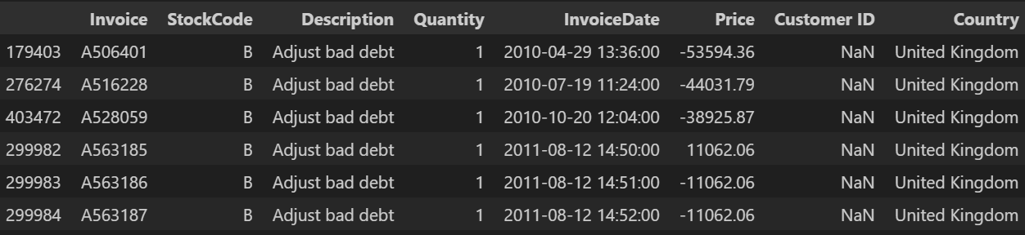

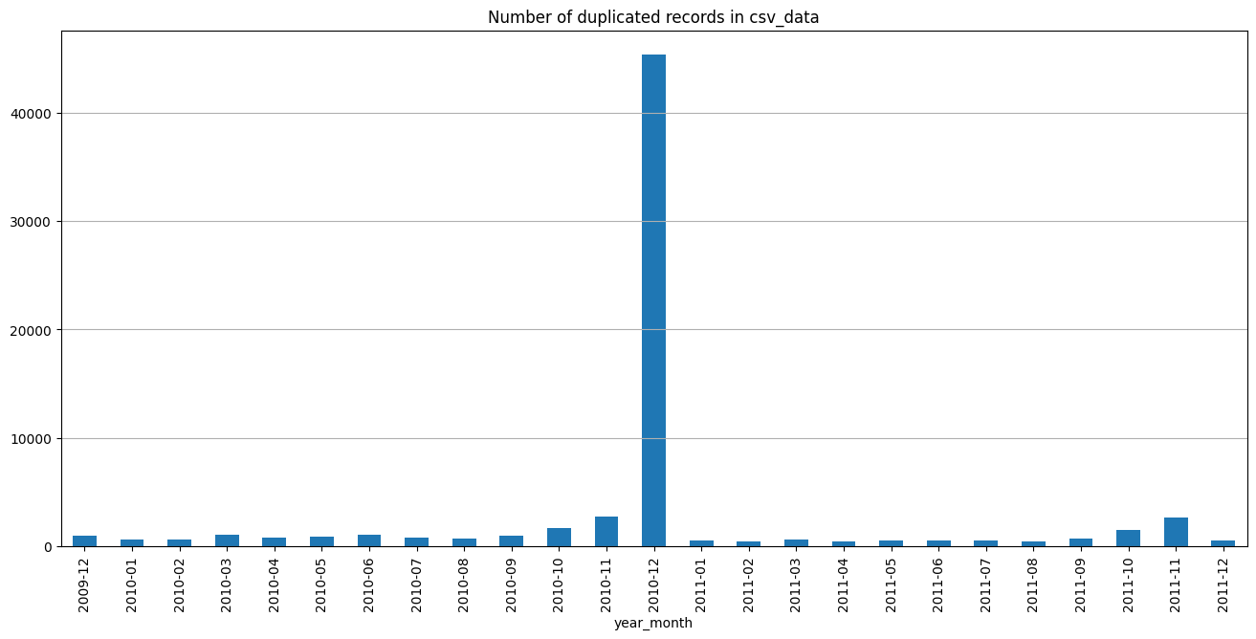
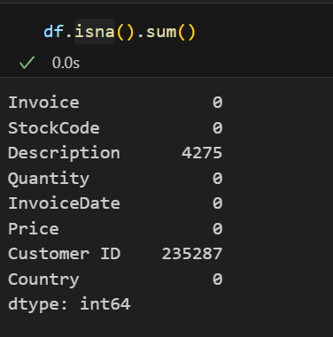
Data Cleaning
Duplicate Data: 34335
Overlap in Data for 2010-12
Total Duplicates after Overlap Removal: 11812
Missing Values:

Slide 4
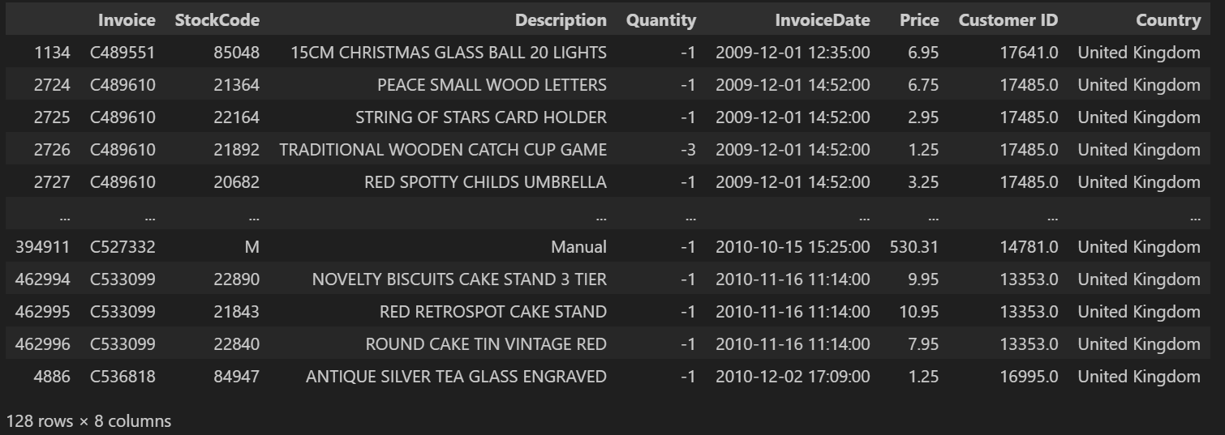
Data Cleaning
Customer with no positive purchase history: 128
After removing all of the above:
Data: 809433 instances
Duplicates: 11676

Slide 5
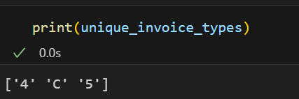
Data Understanding
Invoice: Refunds have different Invoice Number. It depends on date and time.
Quantity: It contains negative values for refunds
InvoiceDate: Contains time of purchase.
Price: Price of each quantity. All of them are positive.
Customer ID: All of them are positive. Unique to each customer.

Slide 6
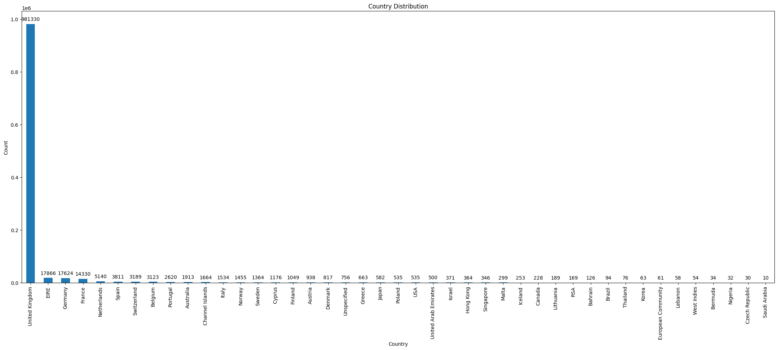
Data Understanding
6. Country: 43 countries. Majority Purchase from UK (981330)

Slide 7
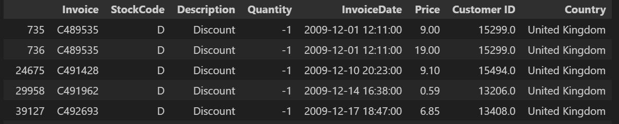
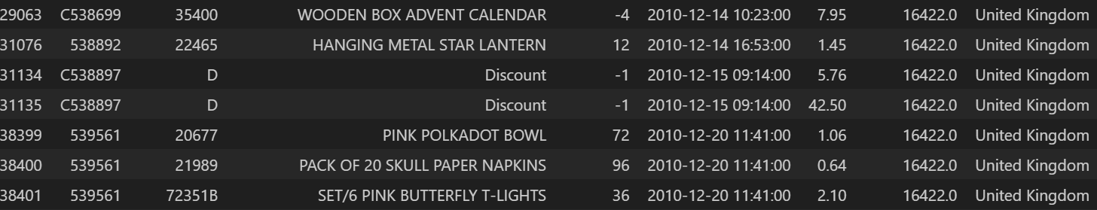
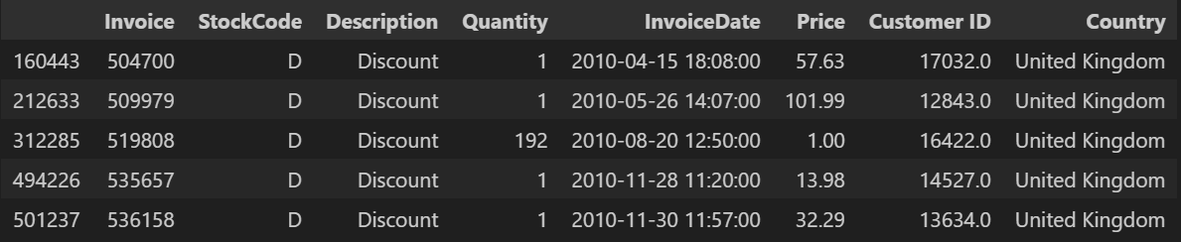
Data Understanding
7. Description: 5296 Unique
Discount: 170
Invoice with positive Quantity: Remove?

Slide 8
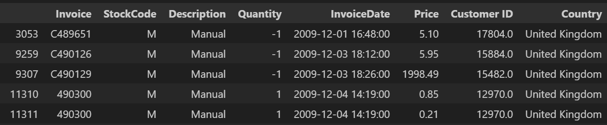
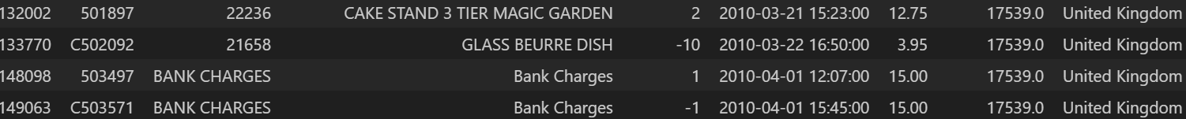
Data Understanding
Manual: 1066 (Removed)
Assumption: They might represent labor work involved in the purchase
Positive Quantity: 698
Negative Quantity: 368
Bank Charge: 35 (Remove?)
Assumption: They might represent the charge on the purchase by the bank
Negative Quantity: 4

Slide 9
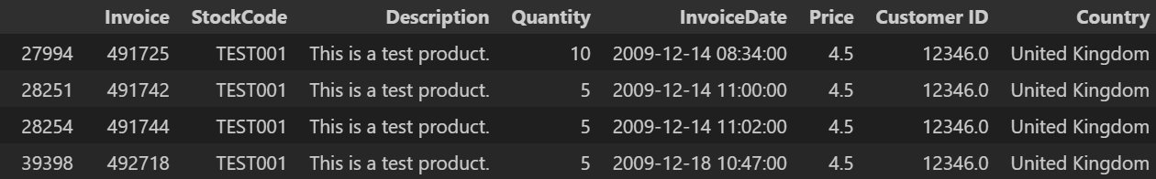
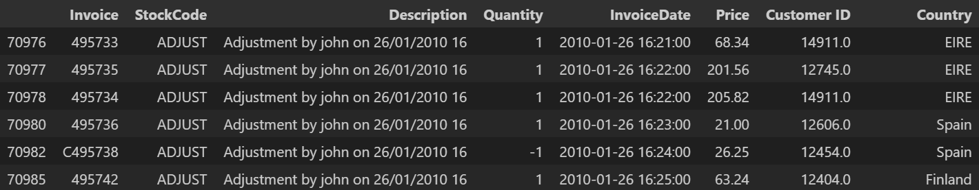
Data Understanding
Test Product: 16 (Removed)
Negative Quantity: 4
Adjustment by john/peter: 55 (Removed)
Assumption: They might represent some instances that might balance out the data

Slide 10
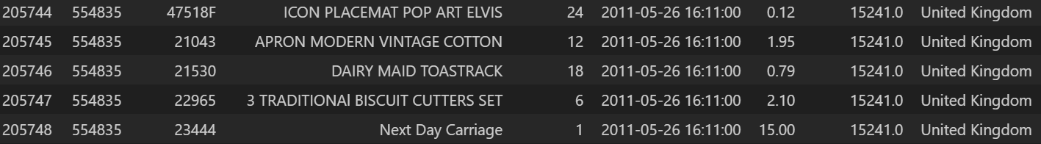
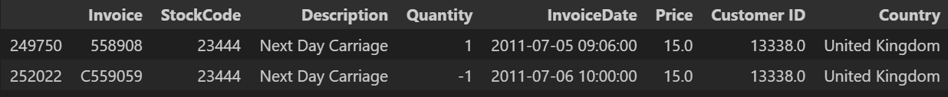
Data Understanding
Next Day Carriage: 80 (Remove?)
Assumption: They might represent immediate delivery fees
Negative Quantity: 1
CRUK (Cancer Research UK) Commission: 16 (Removed)
Assumption: They might represent some fees paid
Only one customer has this history: 14096

Slide 11
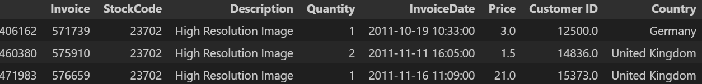
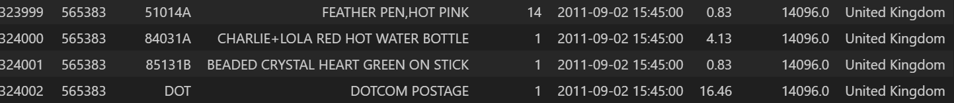
Data Understanding
High Resolution Image: 3
POSTAGE: 1983 (Remove?)
Negative Quantity: 180
DOTCOM POSTAGE: 16 (Remove?)
Assumption: They might represent the delivery fees

Slide 12
Data Understanding
8. StockCode: 4643 Unique
TEST001/002: Test Products
D – Discount
M – Manual
POST – Postage
PADS – Cushion Products
ADJUST – Adjustment by john/peter
DOT – DOTCOM POSTAGE
CRUK – CRUK Commission
BANK CHARGES
SP1002 – Kid’s Chalkboard
SrockCodes having letters (e.g. 12344P): Specific product labeling

Slide 13
Data Understanding
12. C2 (Carriage): 254 (Remove?)
Assumption: Delivery Charges ($50)
Negative Quantity: 6

Slide 14
Challenges
Identification of Description and StockCode variables
The complexities of relationship between different variables (Invoice, StockCode, Quantity, InvoiceDate)

Slide 15
Future Plan
Finish Data Cleaning
Make a Base Model based on RFM Strategy
Feature Engineering

Slide 16
Thank you

