Slide 1
EEG Classification Progress Update 1
Clayton Whitteberry

Slide 2
Overview
Meeting with Dr. Cooper
EEG 10-20 System
Electrode Correlations
Proximity
Lateralized vs. Generalized
ACNS EEG Terminology
Main Terms 1 and 2
Periodic Discharge and Rhythmic Delta Activity Examples
Signal Plots over Short Intervals
Challenges and Next Steps

Slide 3
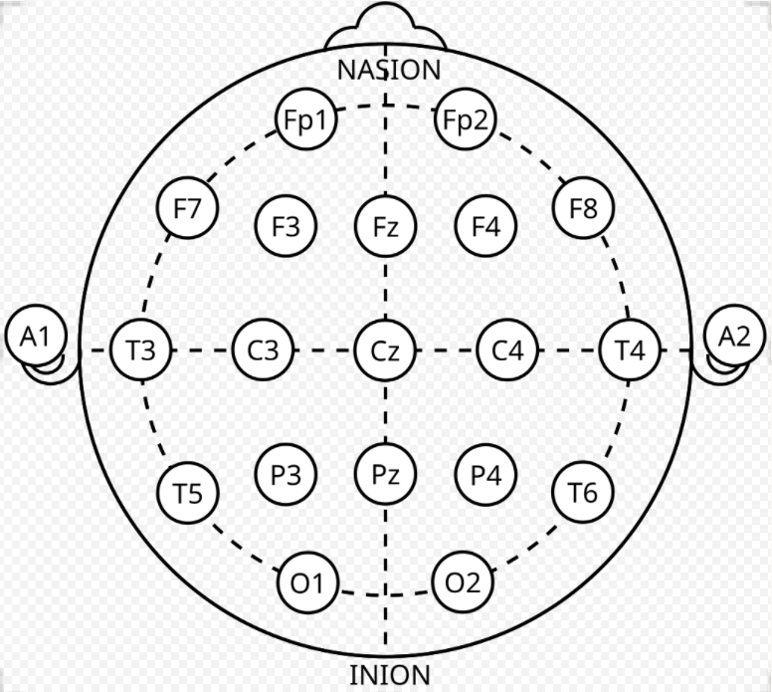
10-20 System Electrode Layout
Brain Regions
Fp – Prefrontal
F – Frontal
C – Central
T – Tempora
P – Parietal
O – Occipital
Even # – Right Hemisphere
Odd # – Left Hemisphere
Z - Middle

Slide 4
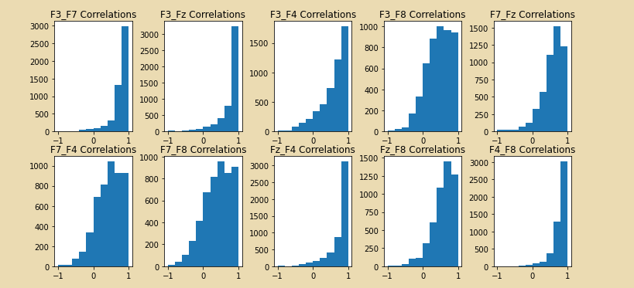
Electrode Correlations: Proximity
Pearson correlation for frontal electrode pairs of 5000 sub EEGs
Stronger correlation for electrode pairs closer together
F3_F7
F4_F8
F3_Fz
Fz_F4

Slide 5
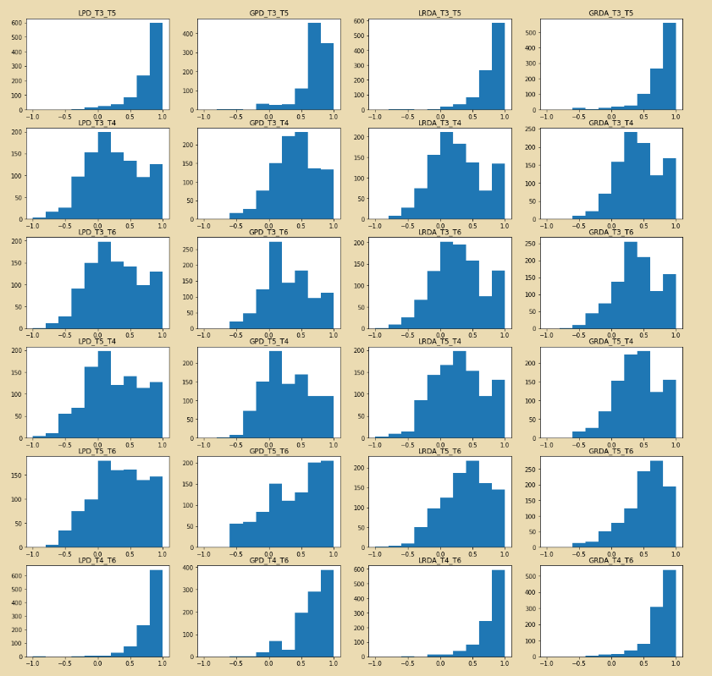
Electrode Correlations: Lateralized vs. Generalized
LPD, GPD, LRDA, GRDA
Temporal Electrode Correlation Histograms
Lateralized correlation of opposite hemisphere electrodes tends to be weaker than generalized activity

Slide 6
ACNS EEG Terminology
Main Term 1: Location
Lateralized (L)
More prominent in one hemisphere
Generalized (G)
More evenly distributed across all hemispheres
Bilateral Independent (BI)
Multifocal (MF)
Main Term 2: Waveform
Periodic Discharge (PD)
Rhythmic Delta Activity (RDA)
Spike-and-Wave/Sharp-and-Wave (SW)
Relevance to My Data
Target Variable: Brain Activity Type (6 Types)
Seizure
Lateralized Periodic Discharge (LPD)
Generalized Periodic Discharge (GPD)
Lateralized Rhythmic Delta Activity (LRDA)
Generalized Rhythmic Delta Activity (GRDA)
Other

Slide 7
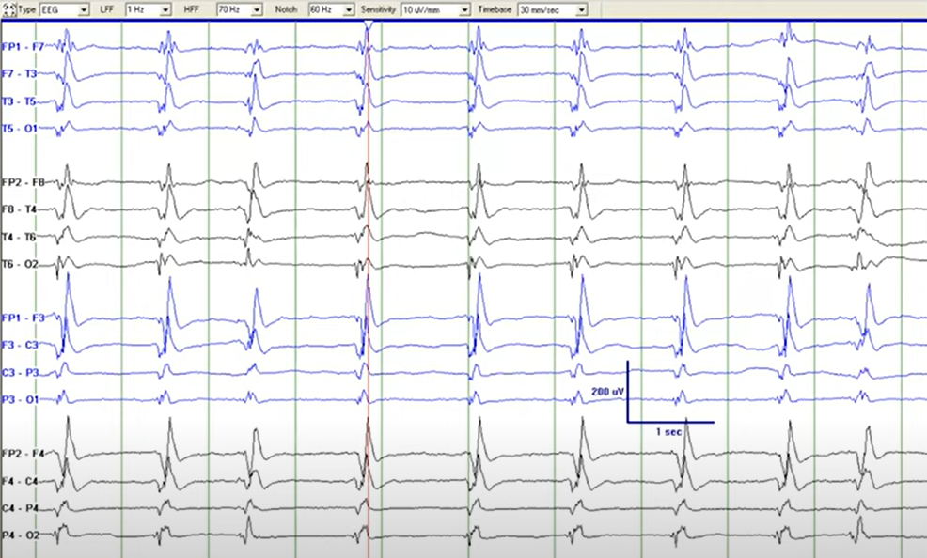
Periodic Discharge Example

Slide 8
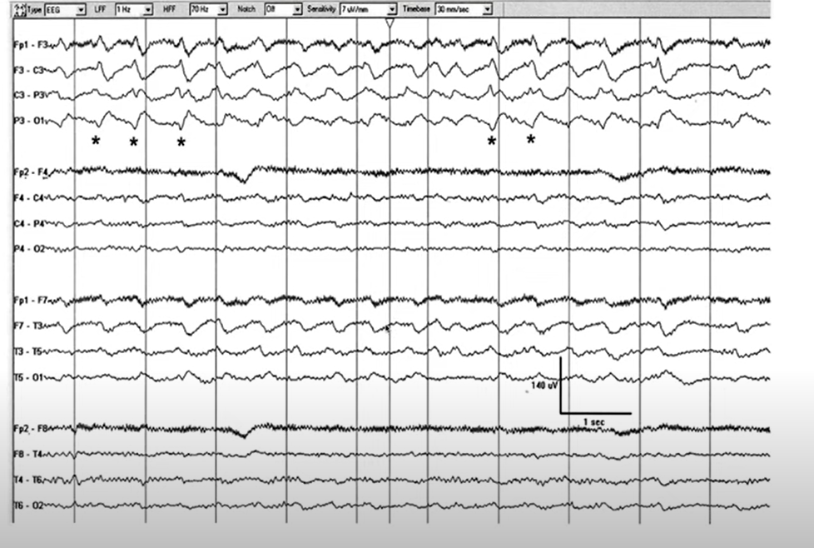
Rhythmic Delta Activity Example
LRDA+S
+S modifier
Sharp waves superimposed on lateralized rhythmic delta activity
Shown by the asterisks
Activity predominantly in the top set of channels which are left hemisphere

Slide 9
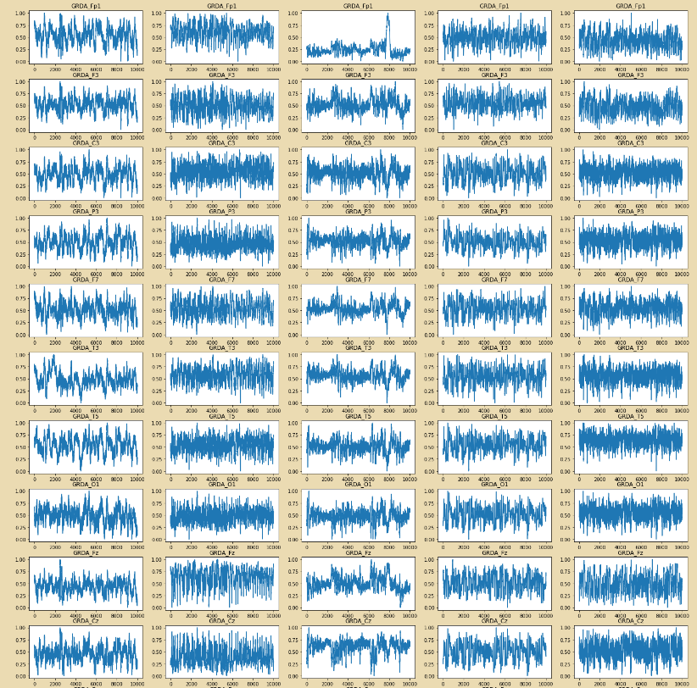
Generalized Rhythmic Delta Activity 50s

Slide 10
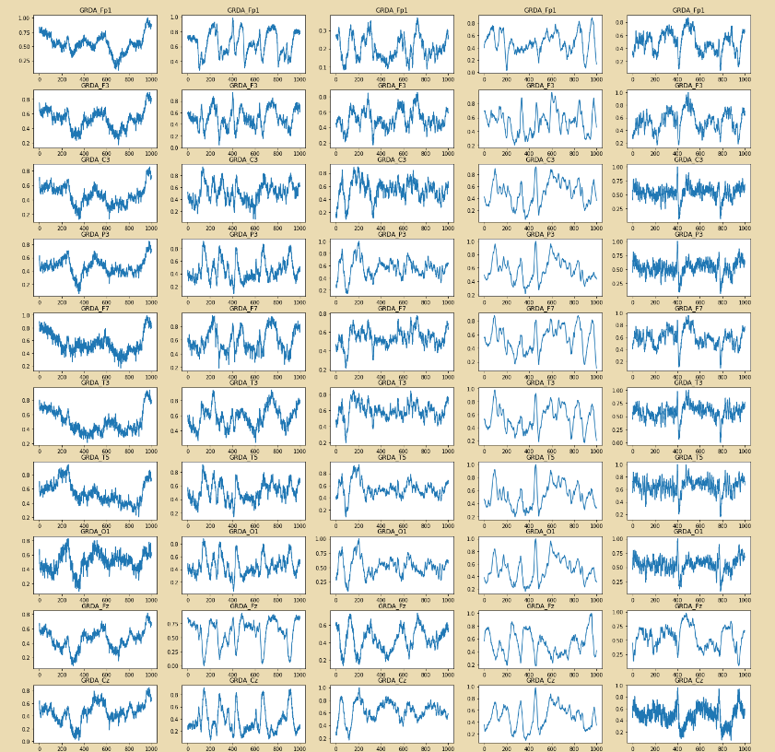
GRDA 5s

Slide 11
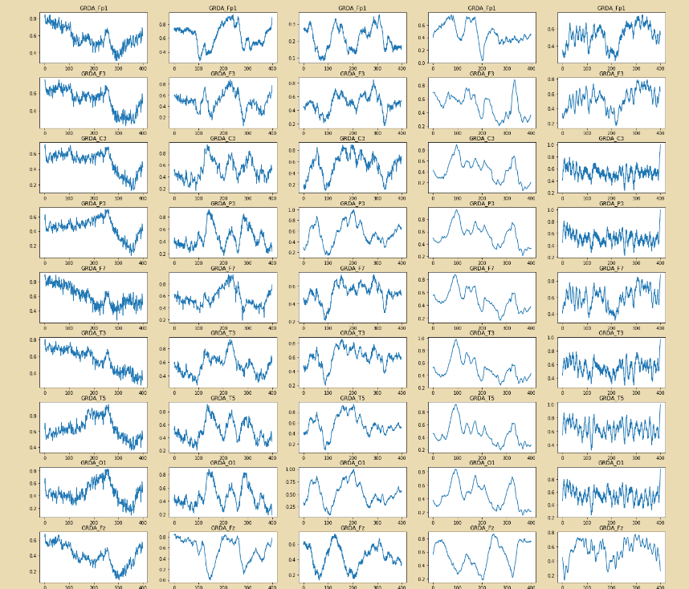
GRDA 2s

Slide 12
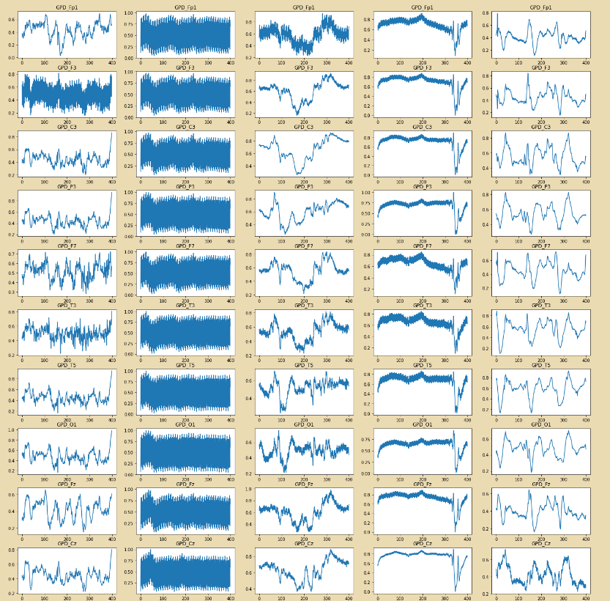
GPD 2s

Slide 13
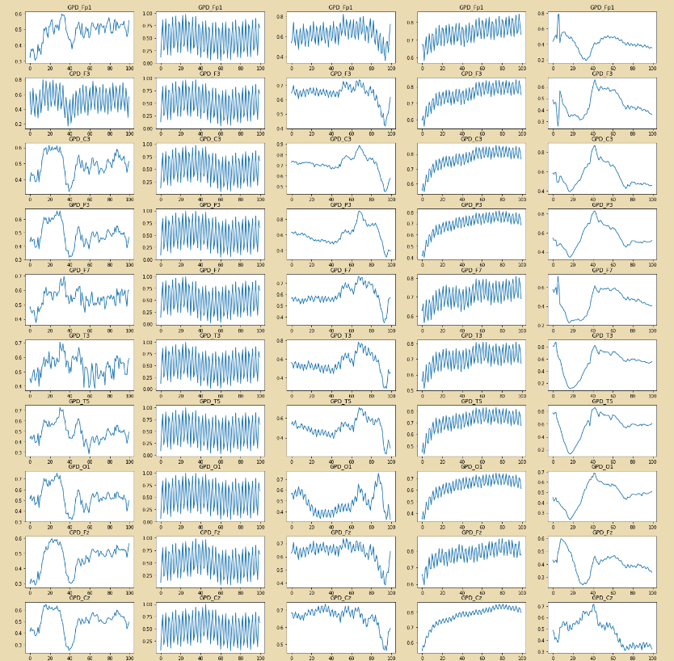
GPD 0.5s

Slide 14
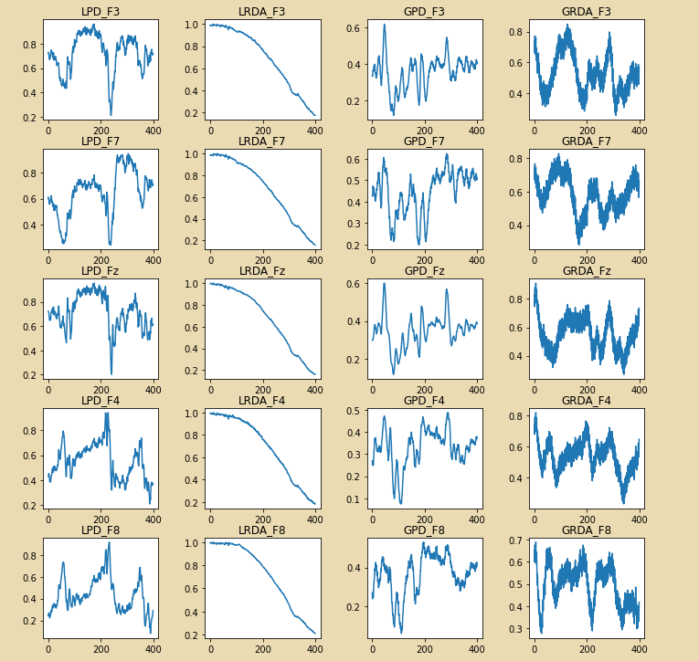
Lateralized vs. Generalized: Frontal Electrodes

Slide 15
Challenges and Next Steps
Preparing for next meeting with Dr. Cooper
Notebook with more detailed project and data overview and some basic signal visualizations
Handling Missing Values
Potential issues with median imputation
Identifying Bad EEGs
Approaches to Dimension Reduction
Row Reduction
Varied approach to column reduction to avoid location information being lost
Attempting PCA and Plotting Transformed Signals

