Slide 1
EEG Classification Progress Update 3
Clayton Whitteberry

Slide 2
Objectives
Noise Removal
ICA-PCA
Dimensionality Reduction
PCA on Time Dimension
Domain Knowledge
EEG Tracings and Montages
Spectrogram Generation
Frequency Analysis Limitations

Slide 3
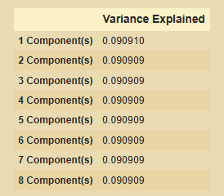
EEG Denoising
Goal was to reduce noise with ICA and then reduce column dimensions with PCA
Pulled 1000 sub EEGs at random and did ICA and PCA on the left hemisphere and right hemisphere scalp electrodes
PCA with 8 components explained about 72% of the variance
Each component explains about 1/11th of the variance for the 11 independent components from ICA

Slide 4
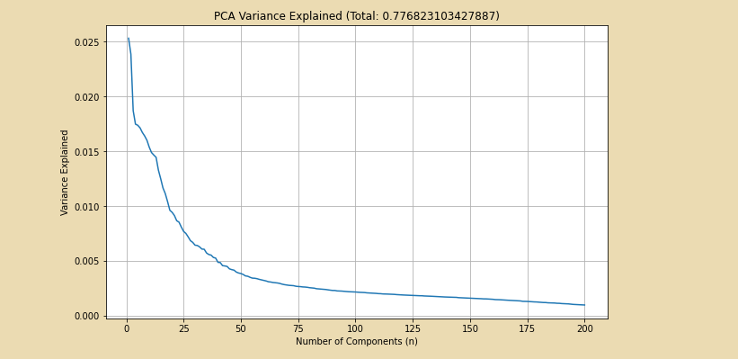
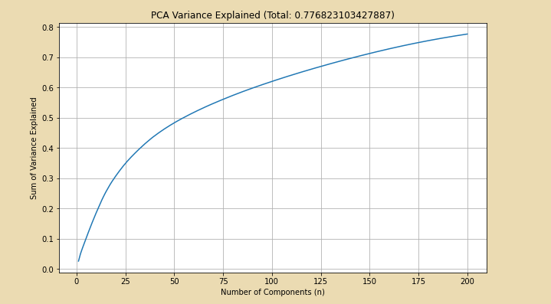
PCA on Time Dimension
Reduced 10k rows to 200 components
About 77.7% variance explained

Slide 5
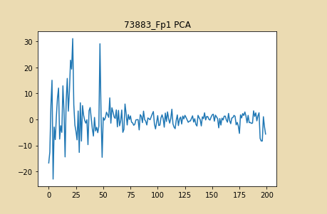
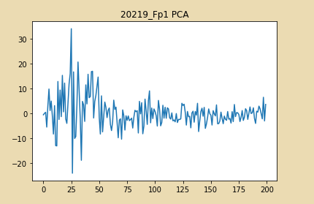
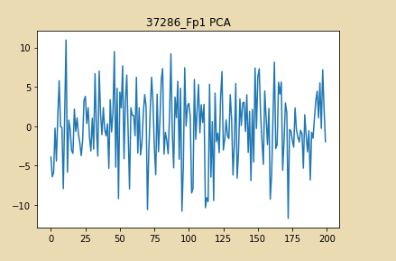
Fp1 Plots After PCA

Slide 6
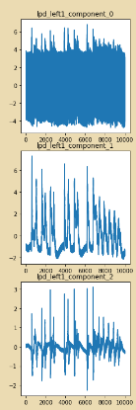
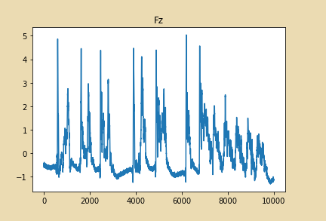
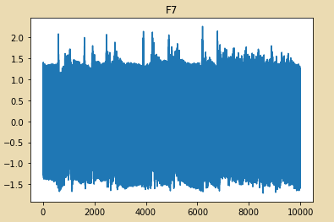
Left Electrodes PCA Example
1st component corresponds with left hemisphere electrodes like F7
2nd and 3rd components correspond most with central electrodes like Fz

Slide 7
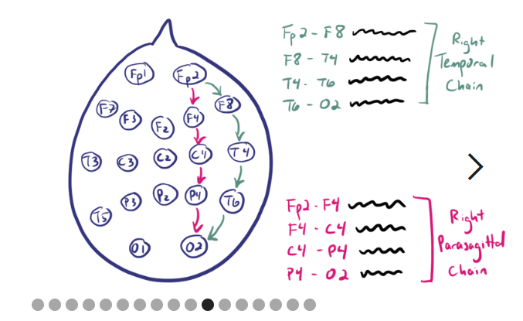
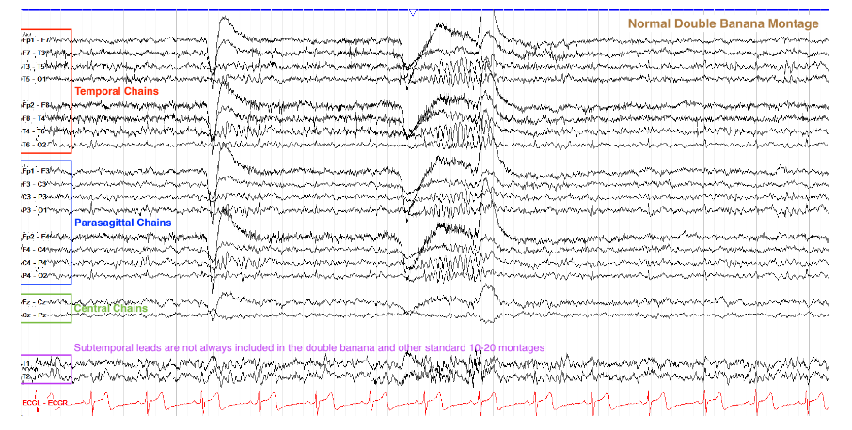
Bipolar Montage
A bipolar montage links electrodes from end to end (Fp1 to O1 and Fp2 to O2)
Within each chain of electrodes, electrodes are paired and the difference of the signals is taken
The result is the set of EEG waves to the right

Slide 8
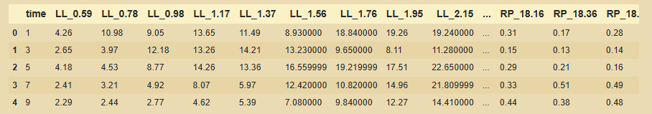
Spectrograms
Columns are electrode chain and frequency in Hz
Regions: Left and Right Lateral and Parasagittal Chains
Lateral chain is temporal chain

Slide 9
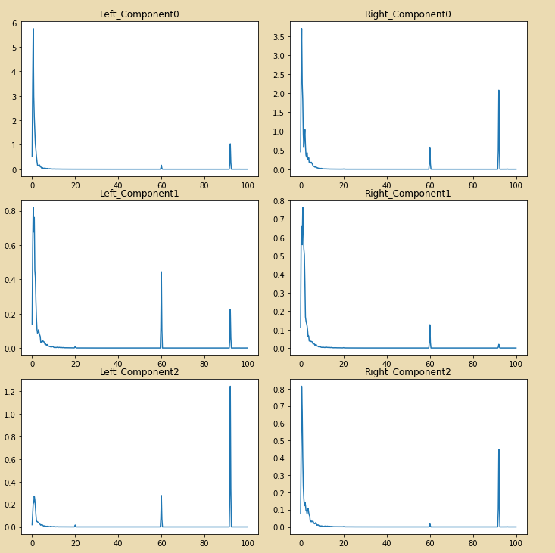
Initial Power Spectrum Plots
Spikes at 60 Hz are common and the result of power line noise
Relevant Frequency Bands
Delta (0-4 Hz)
Theta (4-8 Hz)
Alpha (8-13 Hz)
Beta (13-30 Hz)
Gamma (>30 Hz)
Sampling Frequency Limitation

Slide 10
Next Steps
Trying filtering approaches to denoising
Interpretation of PCA on time dimension results
Beginning to calculate frequency band features to compare denoising and dimensionality reduction methods
More domain study

