Slide 1
EEG Classification Progress Update 2
Clayton Whitteberry

Slide 2
Overview
Project: EEG and Spectrogram Harmful Brain Activity Classification
106.8k sub EEGs and corresponding sub spectrograms
Sub EEG Dimensions: 10k rows, 20 columns
Sub Spectrogram Dimensions: 300 rows, 401 columns
6 Target Variable Classes
Seizure
LPD
GPD
LRDA
GRDA
Other

Slide 3
Where I Left Off Last
ACNS Main Terms 1 and 2
Dimensionality Reduction and Denoising
Missing Values
Outlier Handling

Slide 4
Summary of Work
Created Notebooks for Meeting with Dr. Cooper
Overview
Explanation of Project and Data
Signal Plots
Handling Missing Values
Outlines Missing Value Problem
Displays Difference After Complete Removal of EEGs and Spectrograms with Missing Values
Creates New .CSV with Complete Removal
Handling Outlier EEGs and Spectrograms
Outlines Outlier EEG and Spectrogram Problem
Searches for Outlier Examples
Plots Examples
PCA by Electrode Grouping Notebooks
Explanation of Approach
Standardizes EEG Data
Performs PCA and Plots Resulting Signals

Slide 5

Missing Values
For now, the chosen approach is removal
If imputing
Within patient
Within activity type
Within electrode

Slide 6
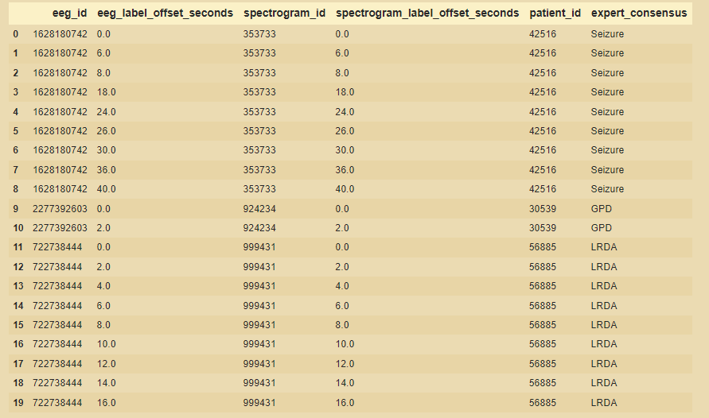
Important Metadata

Slide 7
Outlier EEGs
In the process of building an overview notebook of my project and data, I found a new example of an outlier EEG.
This led me to pull sub EEGs at random from each target class and plot the signal for one electrode (Fp1).
I separated out any with abnormal looking plots over the full 50s and plotted them over different time intervals.

Slide 8
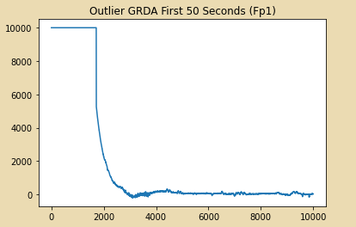
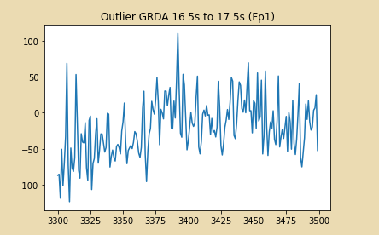
GRDA Outlier Example 1
First approximately 15s very abnormal
Signal after the 15s mark more normal
Every electrode except EKG had 9999.0 as the value for the first approximately 2k rows
EKG had 0.0 as the value for those rows

Slide 9
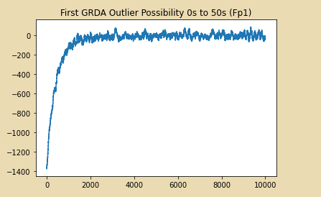
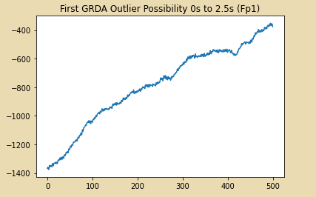
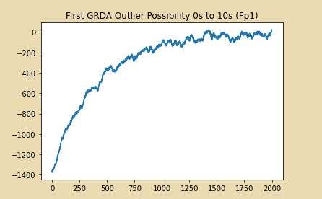
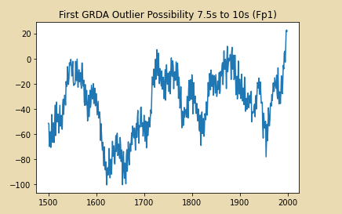
GRDA Outlier Example 2

Slide 10
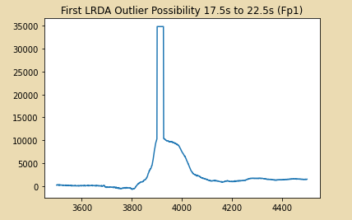
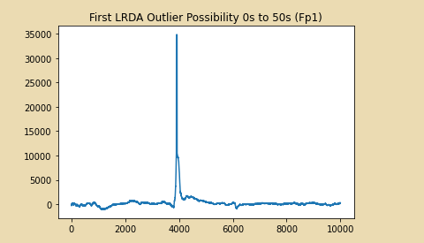
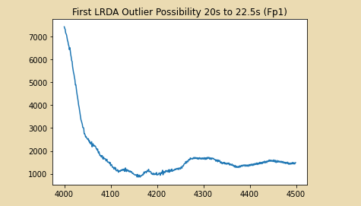
LRDA Outlier Example

Slide 11
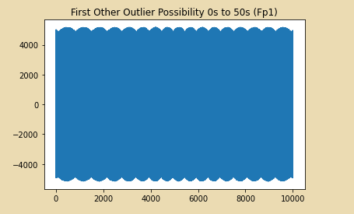
Other Outlier Example

Slide 12
ACNS Main Terms 1 and 2
Main Term 1: Location
Lateralized
LPD
LRDA
Generalized
GPD
GRDA
Main Term 2: Wave Pattern
Periodic Discharge
LPD
GPD
Rhythmic Delta Activity
LRDA
GRDA

Slide 13
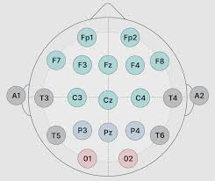
10-20 System EEG Electrode Layout

Slide 14
PCA by Electrode Groupings
Retaining Location Information
Quadrants
Left/Right Hemispheres
Front/Back Hemispheres
Examples: Left/Right
PCA on left hemisphere electrodes and right hemisphere electrodes separately
11 electrodes in each group
PCA reduced 11 electrodes to 3 components explaining about 92% of the variance

Slide 15
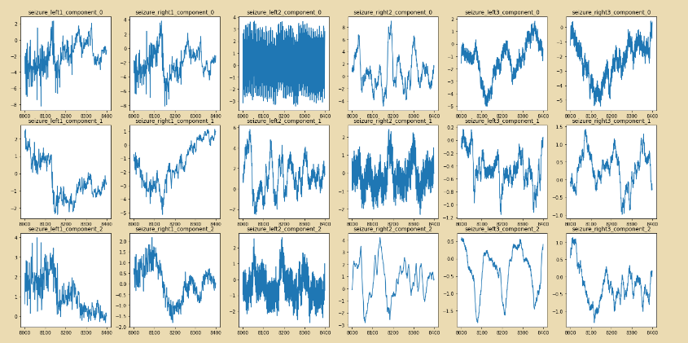
Seizure Left vs. Right Hemisphere PCA

Slide 16
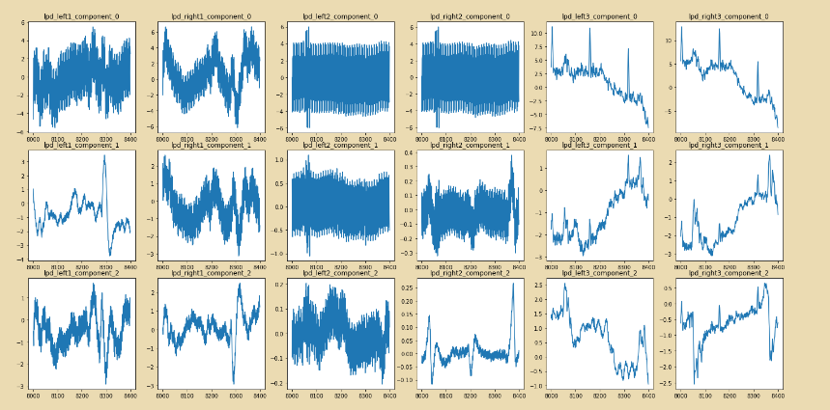
LPD Left vs. Right Hemisphere PCA

Slide 17
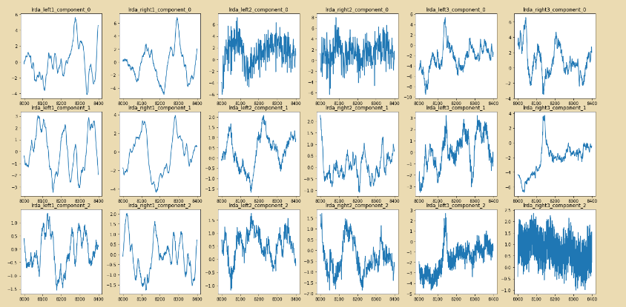
LRDA Left vs. Right Hemisphere PCA

Slide 18
Challenges and Next Steps
Main Challenge: Domain Knowledge
Rhythmic Delta
Preprocessing Methods
Next Steps:
Continue Building Domain Knowledge
Experiment with ICA-PCA Combination Approach
Experiment with Welch Transformation and Frequency Band Analysis
Power Line Noise
Comparing Delta, Theta, Alpha, and Beta Bands Across Activity Type

